Slide 1
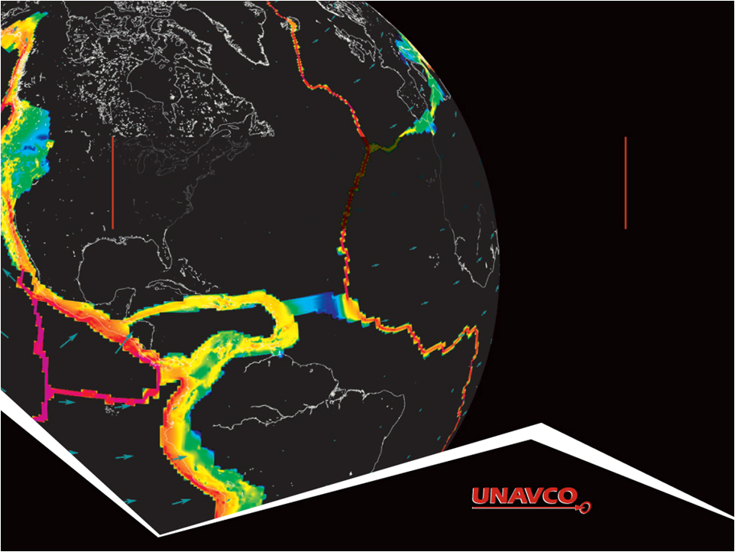
Visualizing Relationships with DATA: Earthquakes, Volcanoes, and Plate Tectonics
Ruth Powers (UNAVCO Master Teaching-in-Residence); Becca Walker and Shelley Olds (UNAVCO)
Notes:
Realized that our challenge is more general than plate tectonics
As you will see we have multiple data types and multiple science applications
And multiple educator and student needs
Which require vis tools to accommodate this

Slide 2
Activity Outcomes
Learners should be able to…
  Describe how the locations of earthquakes, volcanoes, and plate motions from GPS velocity vectors inform us about plate boundary zones
  Describe and draw a velocity vector
  Analyze regional plate motion and crustal deformation based on velocity vector maps
  Describe the difference between a plate boundary and plate boundary zone
Notes:
Explore locations of earthquakes and volcanoes
Compare plate motion between the Pacific Northwest and California
Determineplate boundary zones using multiple lines of evidence: GPS plate velocity vector maps, earthquake and volcano locations

Slide 3
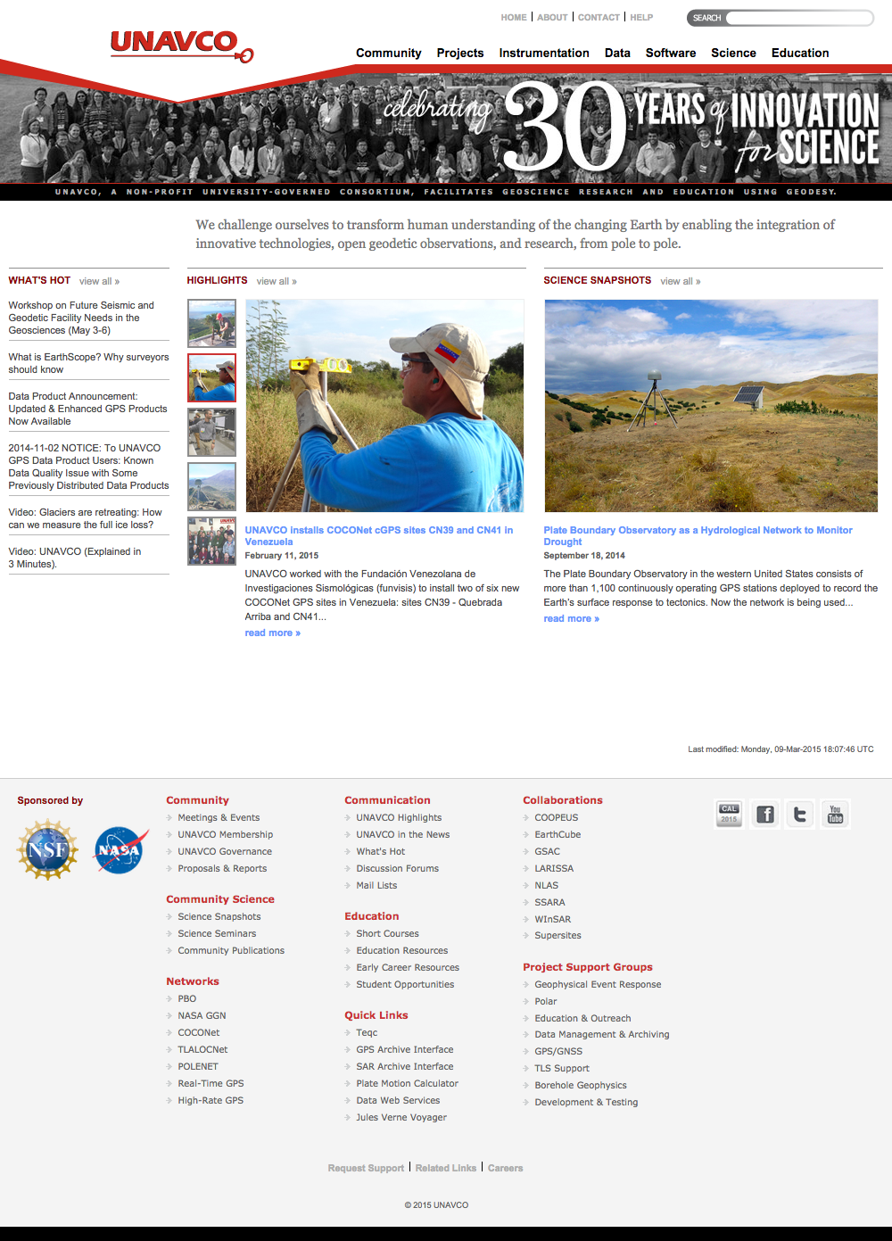
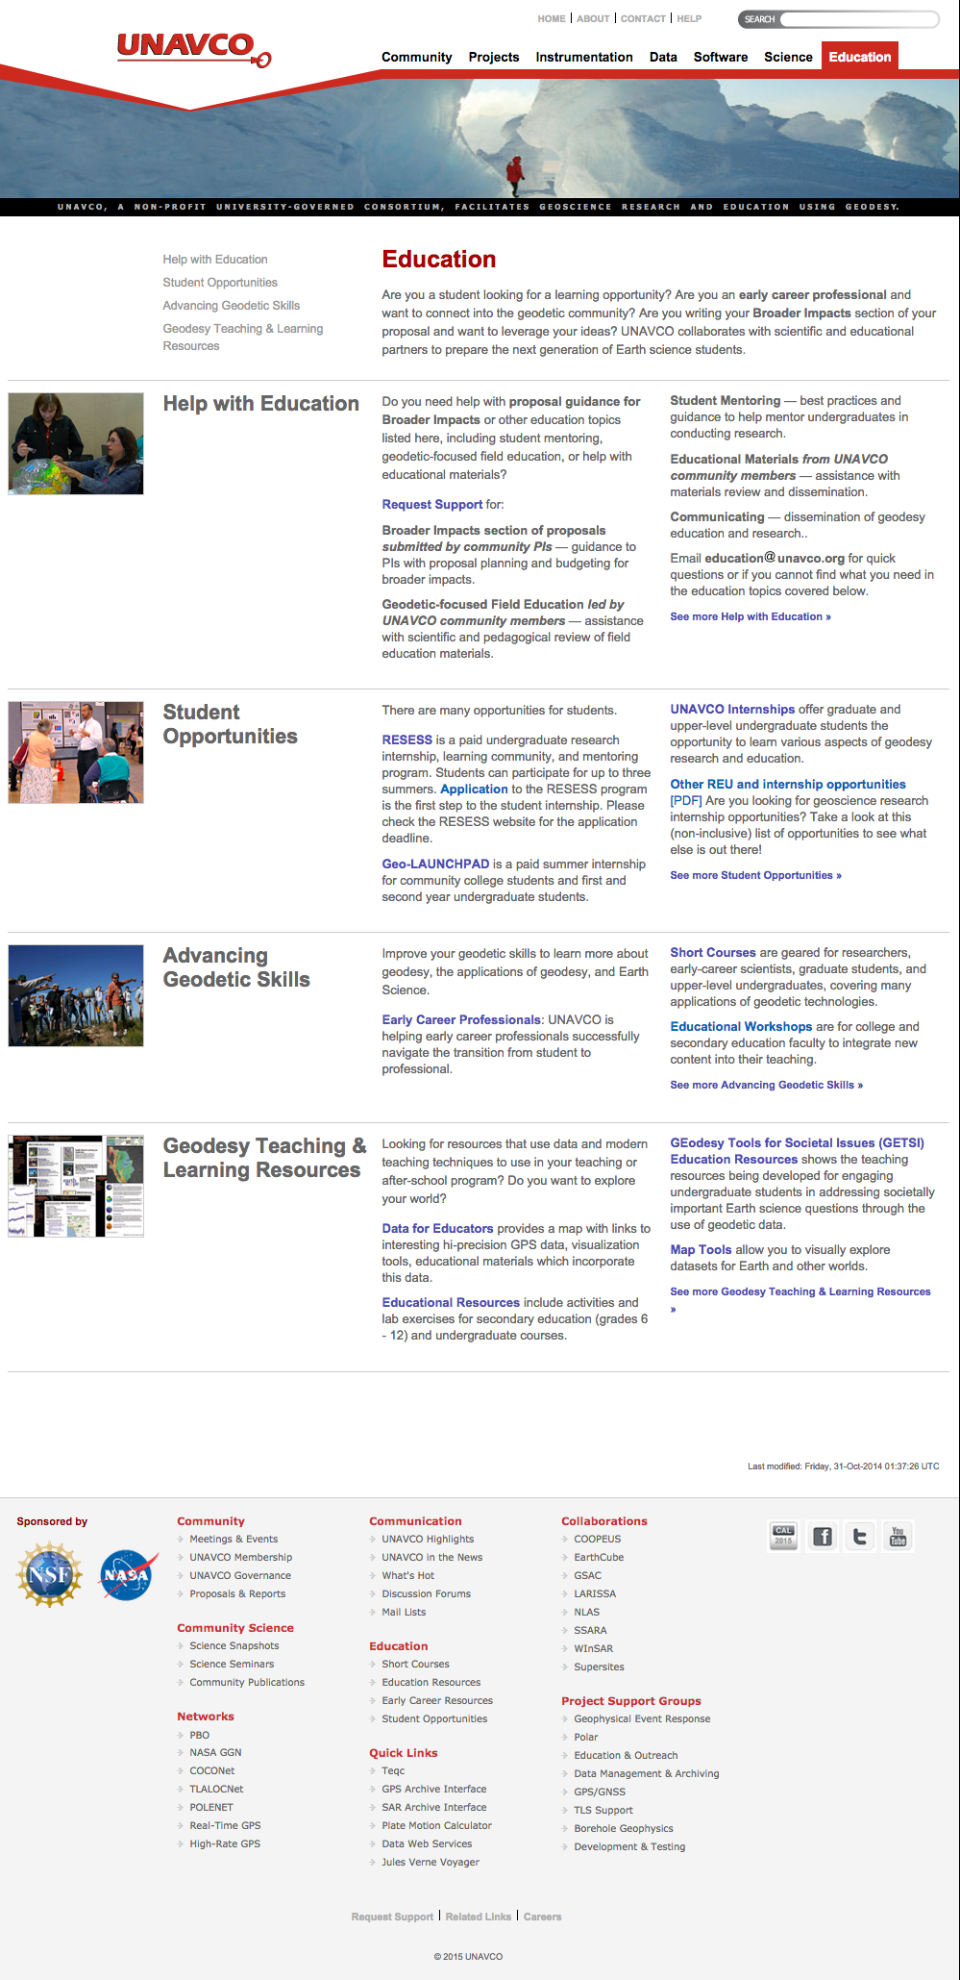
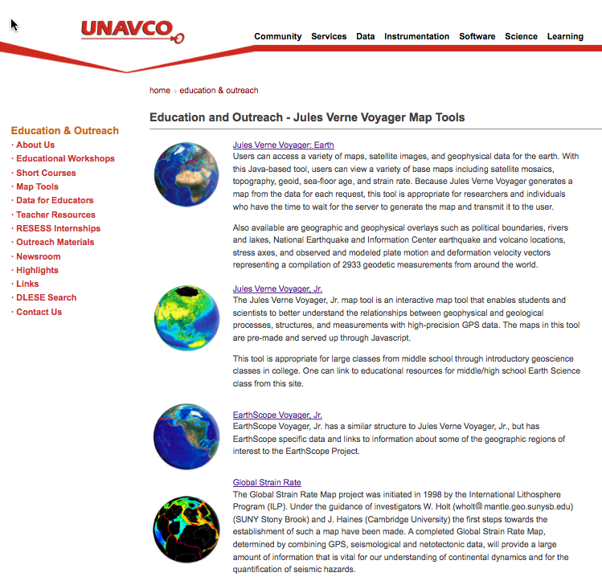
Part 1: Prepare Your Map for Study
Go to: http://www.unavco.org/
Click on Education
then Map Tools, then
EarthScope Voyager Jr.

Slide 4
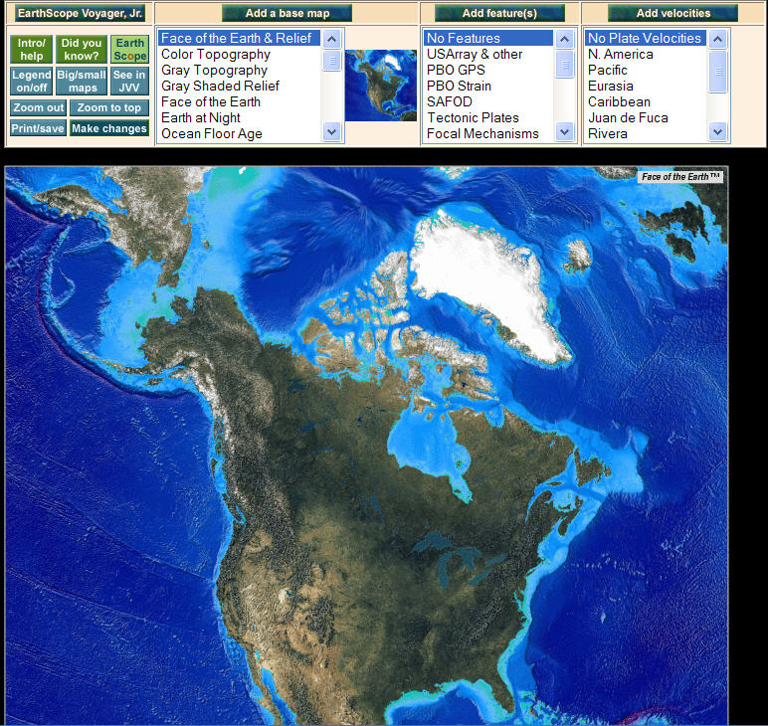

Getting Oriented to the Map

Slide 5
Getting Oriented to the Map

Slide 6
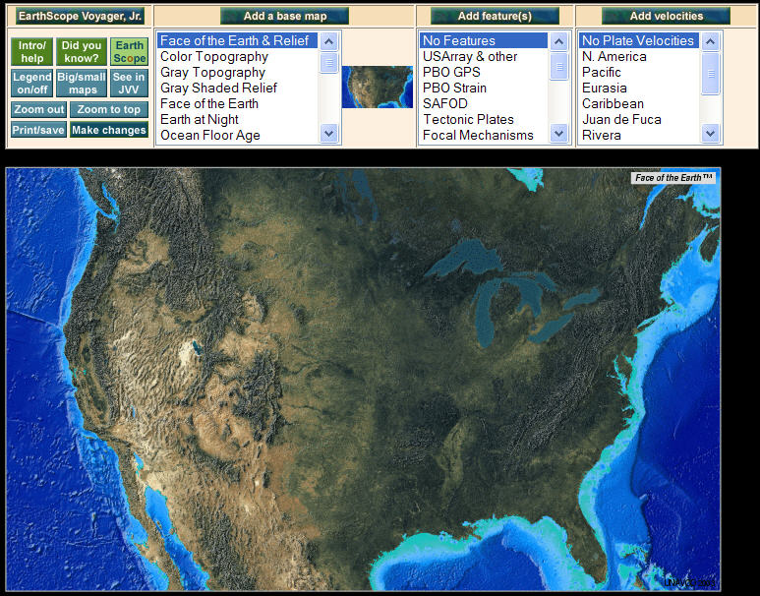
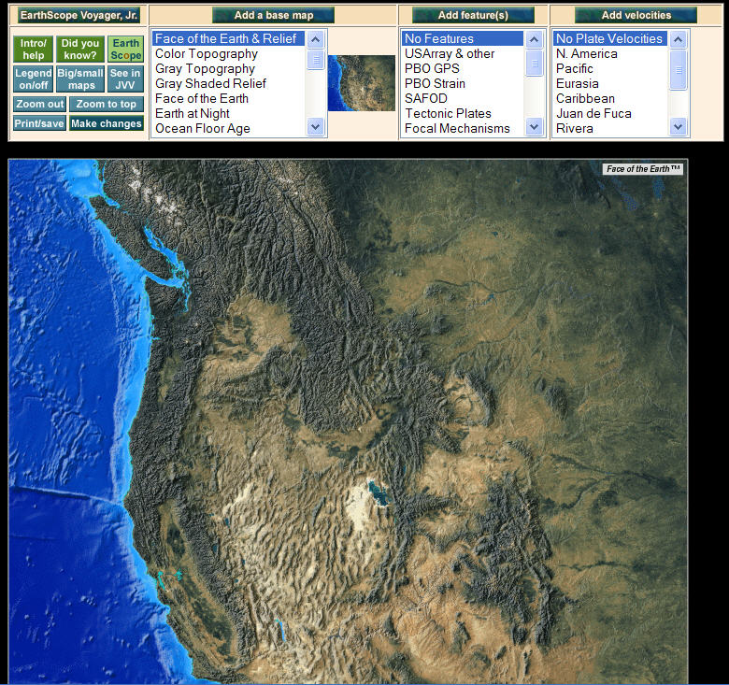
Zoom Into the Western U.S.
Click on map to zoom in
Zoom into the
United States
Zoom into the Western United States

Slide 7
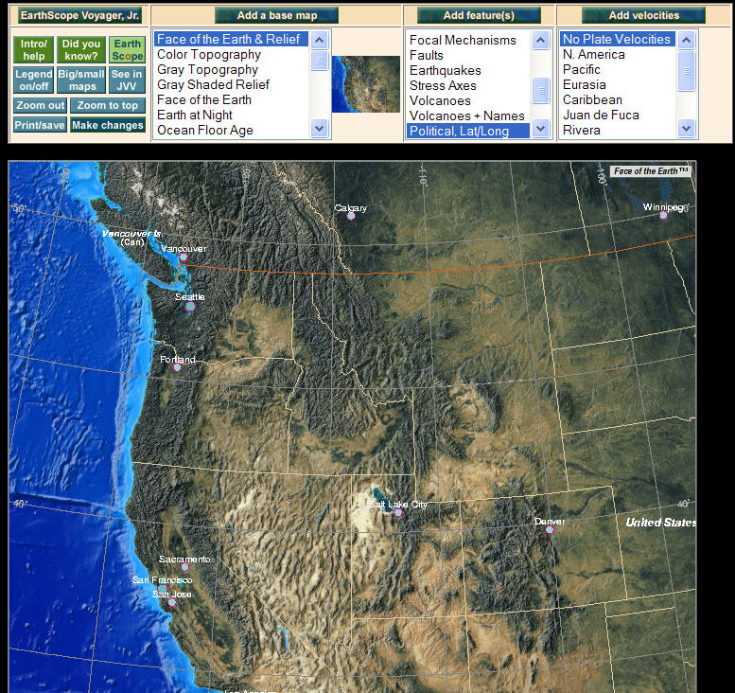
Add Political Lat/Long under Add Features
Add political boundaries and latitude/longitude lines

Slide 8

Part 2: Compare Earthquake and Volcano Locations
Work with a partner
Follow the instructions:
  Add your feature (hold ctrl- or command-key to keep the Political, Lat/Long)
  Study your map
  Answer the questions
  Draw the locations of your feature
  Share your findings
Stop at Part 3

Slide 9
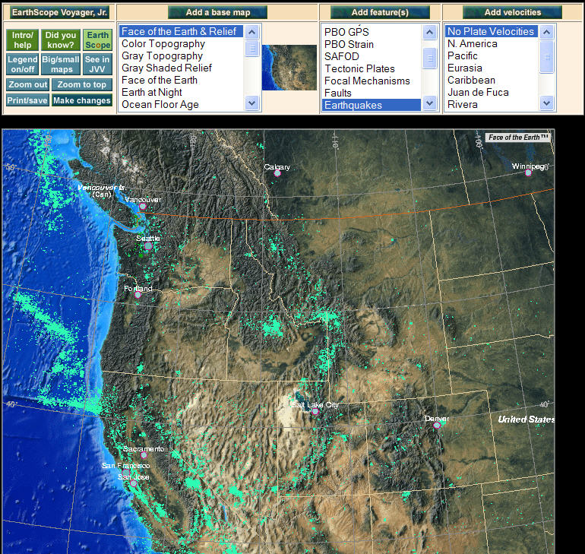
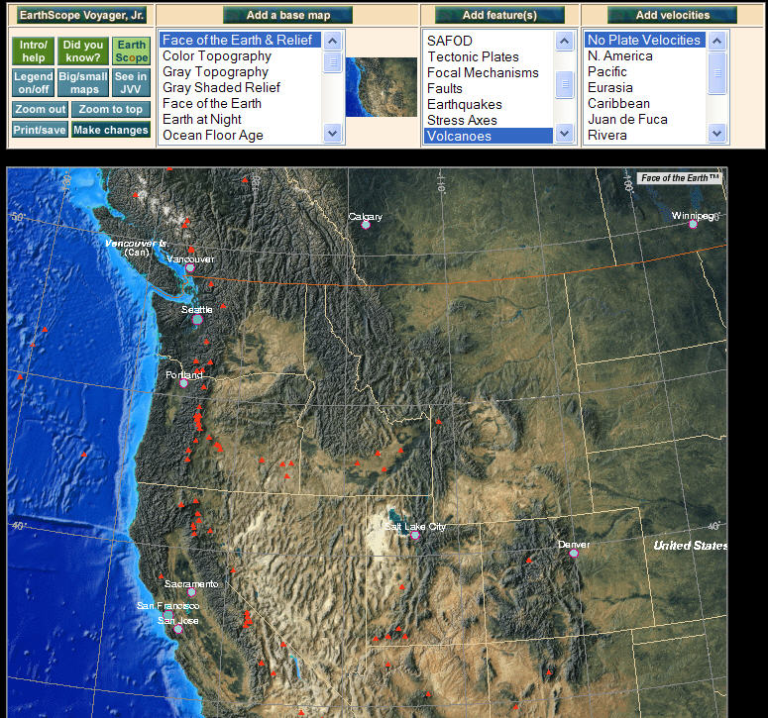
Earthquake and Volcano Distribution

Slide 10
Earthquakes and Volcanoes
Discussion:
  What geographic features (mountains, plains, valleys, etc) are frequently where there are only:
    Earthquakes?
    Volcanoes?
  In which regions do you find earthquakes and volcanoes near each other? What’s there?
  Summarize the relationships you discovered.
  What explanation can you provide for the observed relationships?

Slide 11
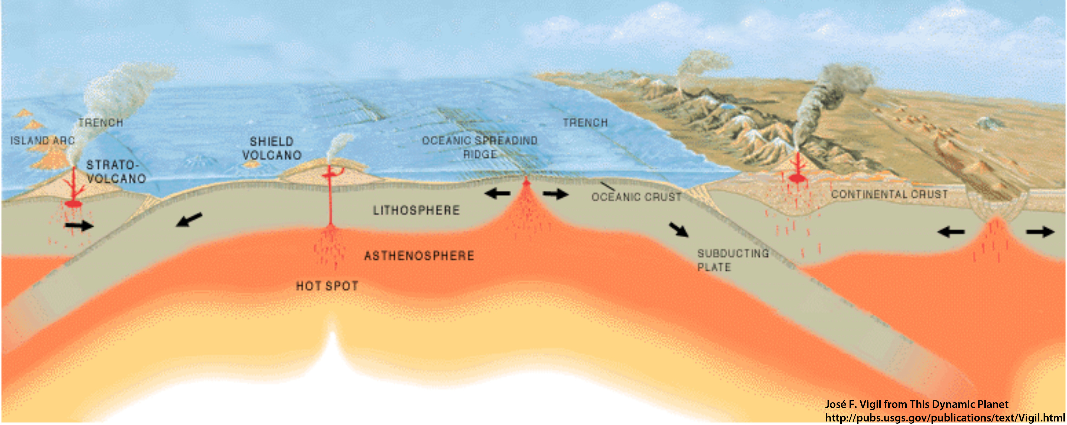
Part 3: Examine GPS Vector Data
GPS station positions change as plates move.
A
B
How will GPS Station B’s position change relative to GPS Station A?
GPS stations are not to scale

Slide 12
Part 3: Examine GPS Vector Data
GPS station positions change as plates move.
A
B
GPS Station B is moving toward A.
GPS stations are not to scale
Notes:
Note that the red arrow is really just an arrow… there is no scale to show the rate of motion.

Slide 13
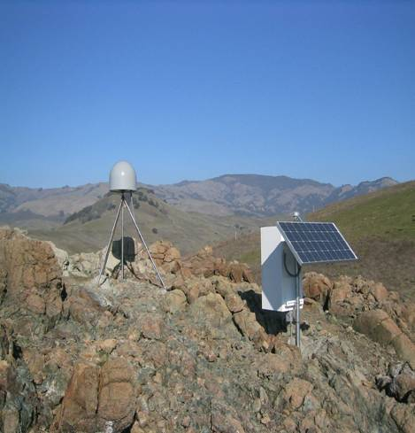
Anatomy of a High-precision
Permanent GPS Station
GPS antenna inside of dome
Monument solidly attached into the ground with braces.
If the ground moves, the station moves.
Solar panel for power
Equipment enclosure
GPS receiver
Power/batteries
Communications/ radio/ modem
Data storage/ memory

Slide 14
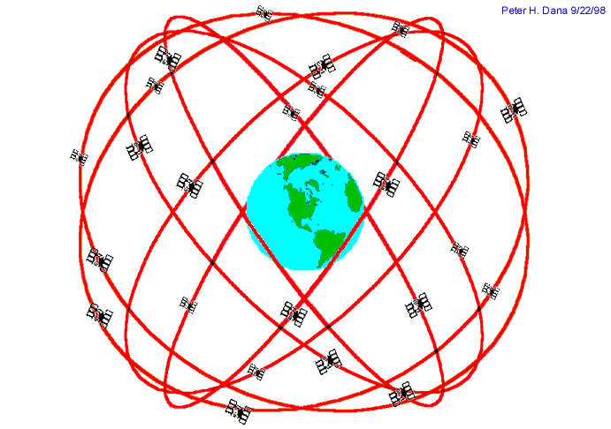

Introduction: GPS Basics
Three satellite signals are needed to locate the receiver in 3D space.
The fourth satellite is used for time accuracy.
Position can be calculated within a sub-centimeter.
Needs ground control and time quality
Notes:
Also note that the GPS stations used for scientific work are more precise for many reasons: the unit uses both of the signals coming from the satellites, two the clocks are atomic rather than crystal, (see slide). These stations can measure the change in position of a location with sub-centimeter accuracy.

Slide 15
Demonstration
Pinpoint Location With GPS
How to demonstrate this:
http://www.youtube.com/watch?feature=player_embedded&v=s_CeiMjO5Pc#!

Slide 16
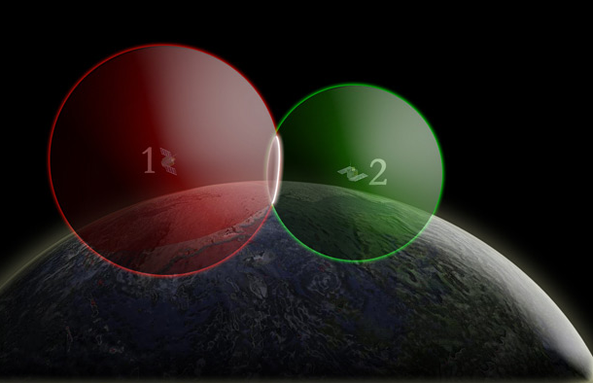
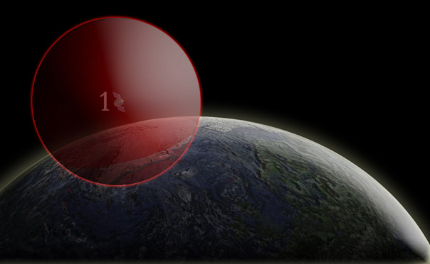
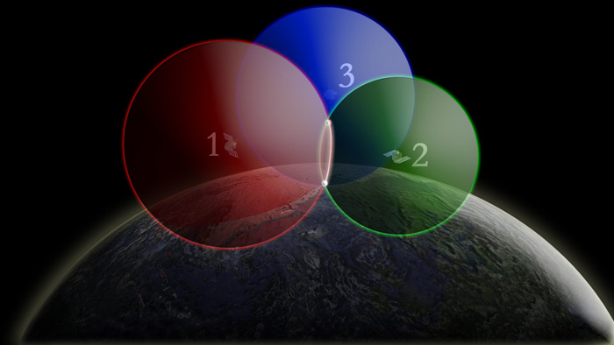
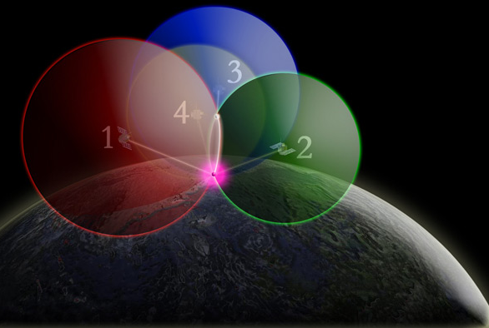
One way to find your location –
4 intersecting spheres
One satellite, the GPS could be anywhere on the edge of the sphere.
Two satellites, GPS could be on the circle where spheres intersect.
3 satellites:
spheres intersect in 2 places.
4 satellites, spheres intersect in one place.

Slide 17
One way to find your location – 4 intersecting spheres
With one GPS satellite, the GPS receiver could be anywhere on the edge of the sphere.
With two GPS satellites, the GPS receiver could be on the circle where spheres intersect.
With four GPS satellites, the spheres intersection in one place.
With three GPS satellites, the GPS receiver could be two places where the spheres intersect.

Slide 18
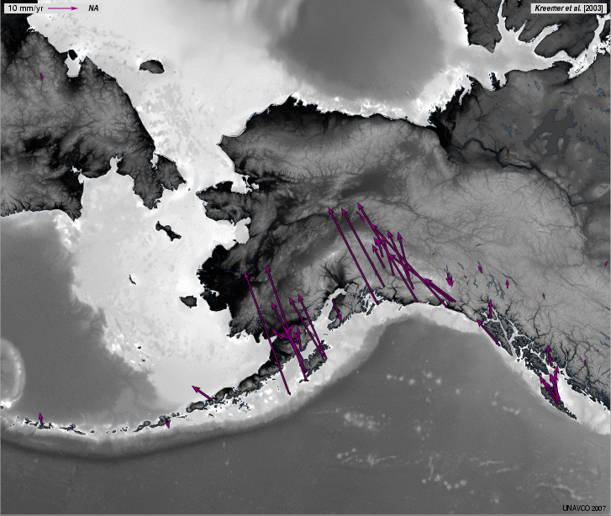
About Velocity Vectors
Length of the vector arrow
= how fast the plate is moving (magnitude).
Direction of the vector arrow
= the direction that the plate is moving at that GPS station
Tail of vector = location of GPS station

Slide 19
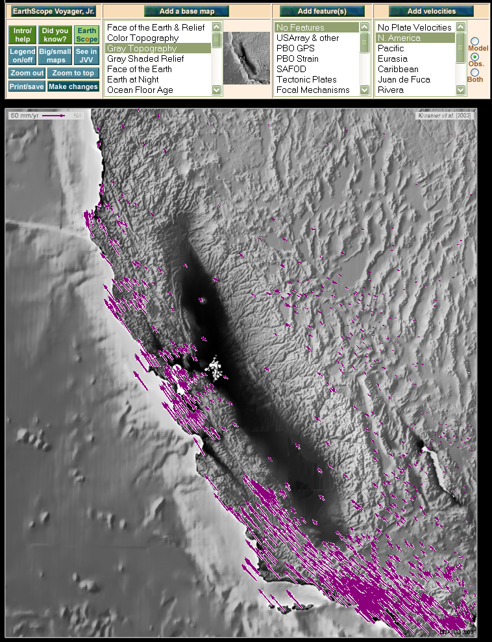
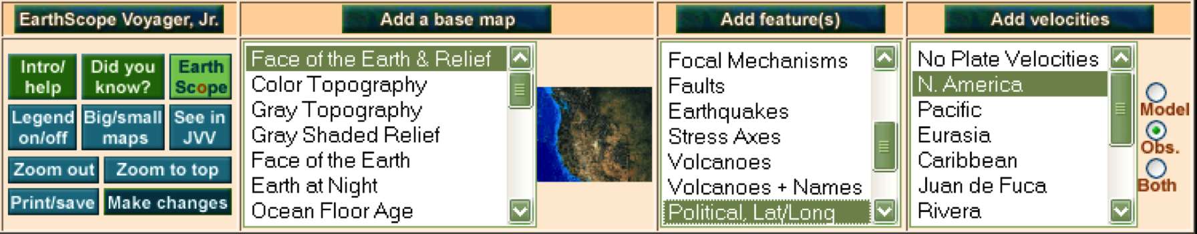
Add Features and Velocity Vectors

Slide 20
Part 3 continued: Sketch and Study the Vectors
Sketch some of the observed velocity vectors on your map of the Western United States
Answer questions on page 8
Discuss with your teammate
Bonus: How would you characterize the width of the plate boundaries on your map?
Based on your data, which plate boundaries should be shown as a thin line or a zone? Why?

Slide 21
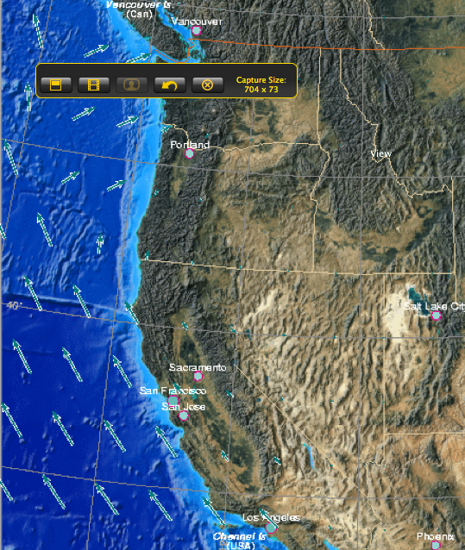
Part 4: Put It All Together
Notes:
Show vectors using JVV Jr or Velocity View of convergent, divergent, transform – or have students do this- use modeled data with JVV Jr.

Slide 22
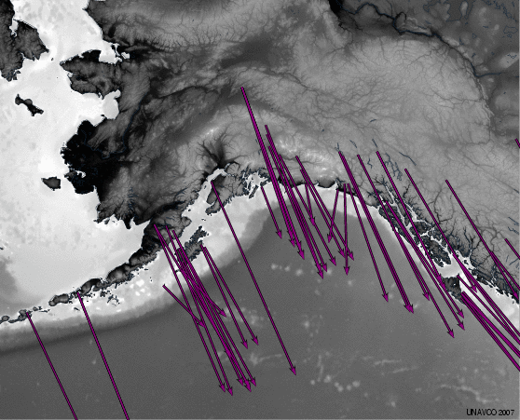
Neighboring Frames of Reference: North America
North America Reference frame
The rest of the world’s plates move, while the North America plate stays fixed.
Pacific plate reference frame
The world moves compared to the Pacific plate
Notes:
Leet’s see how a frame of reference changes your view.
Under Add velocities is a list of the tectonic plates. Typically scientists look at the velocities using a reference frame near where they are looking. In the example above, looking at Alaska, scientists might choose either the Pacific plate or North America reference frames to investigate how the velocities change – sometimes you see surprising subtle features by doing this! For instance, by using the North America reference frame, you can see that the very edge of Alaska is being pushed inland due to the subducting Pacific plate

Slide 23
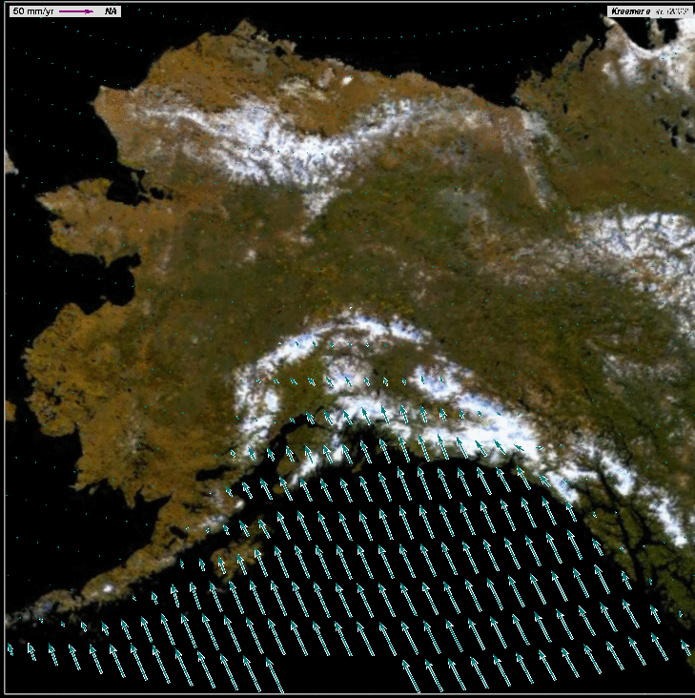
Quick Reference:

Slide 24
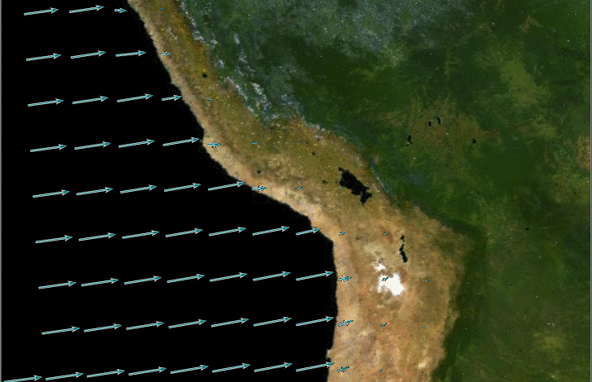
Quick Reference

Slide 25
Quick Reference: Convergent Boundary
Longer vectors running into shorter vectors

Slide 26
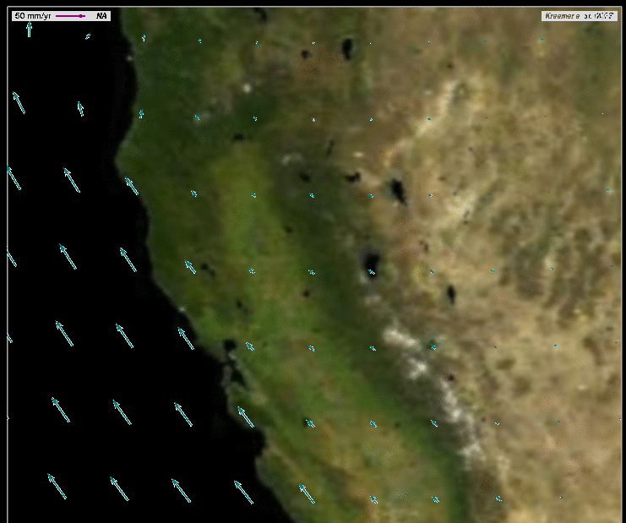
Quick Reference:

Slide 27
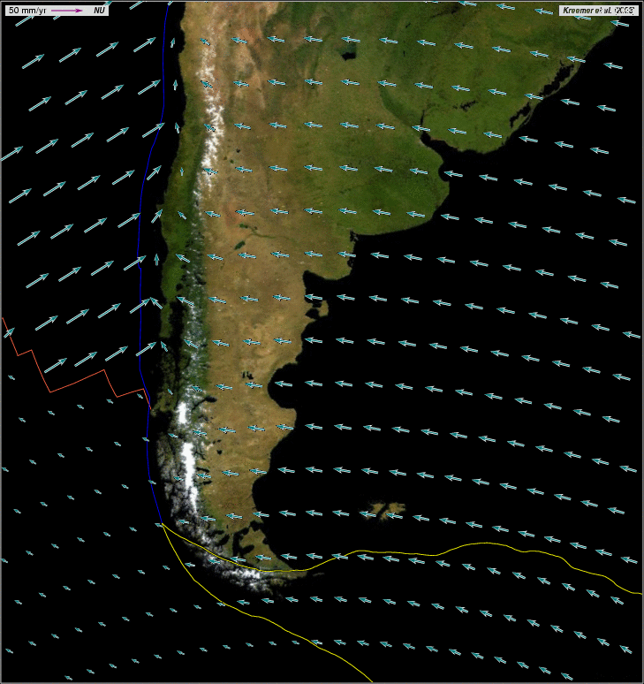
Quick Reference:

Slide 28
Quick Reference:
Transform Boundary
Longer vectors parallel to shorter vectors

Slide 29
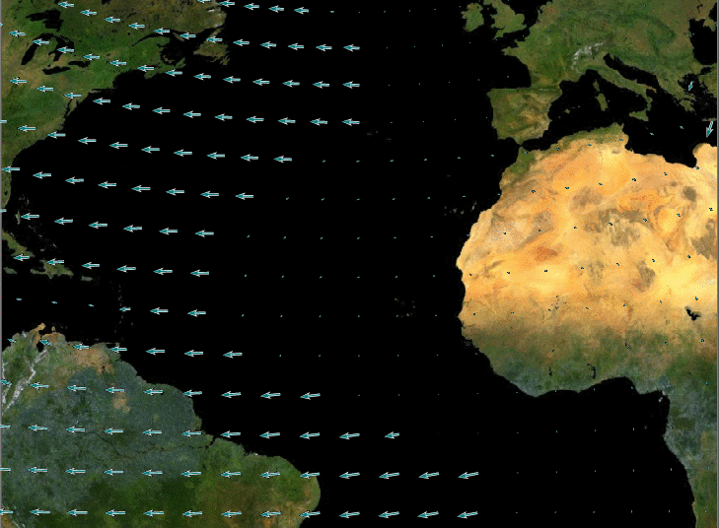
Quick Reference

Slide 30
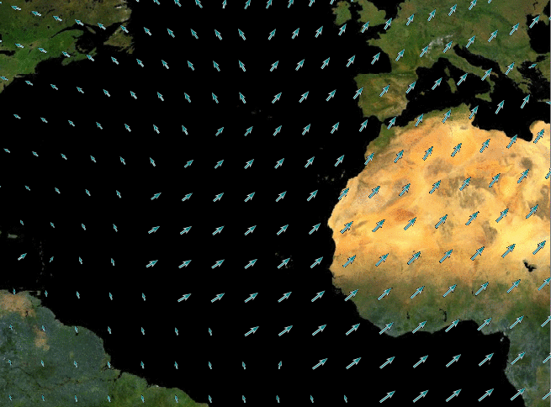
Quick Reference

Slide 31
Quick Reference: Divergent Boundary
Example 1
Example 2
Vectors pointing away from each other

Slide 32
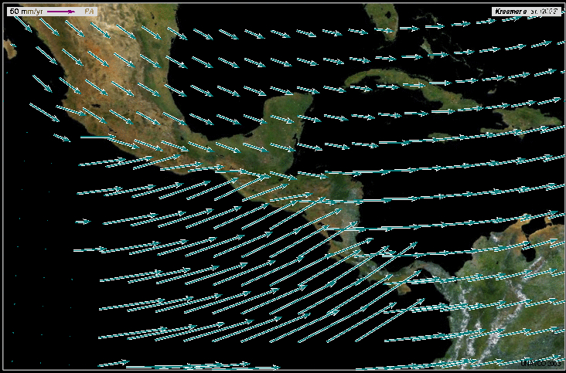
What’s this plate boundary?

Slide 33
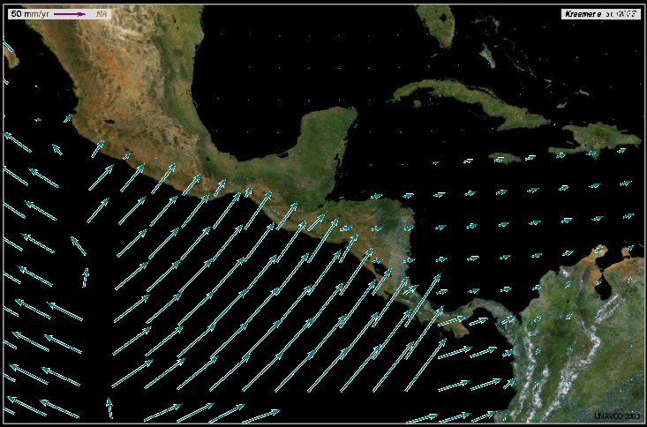
Divergent Boundary

Slide 34
Can you name the boundary types?

Slide 35
Part 4: Sketch and
Study the Modeled Vectors
Sketch vectors where they are very different from each other
Draw where you believe the plate boundaries are located
Compare with plate boundaries in EarthScope Voyager Jr.
Answer questions
Discuss with your teammate

Slide 36
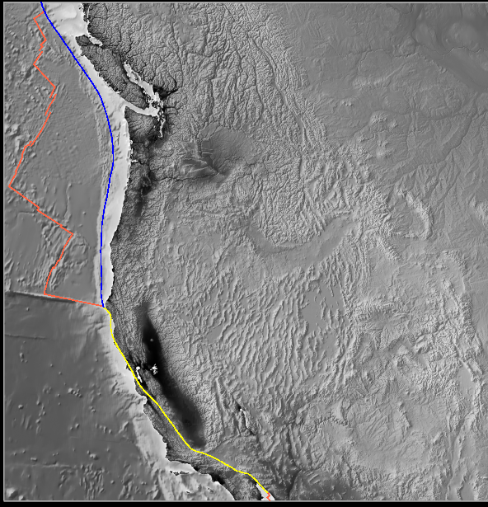
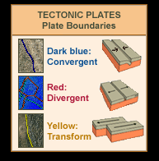
Plate Boundaries Along the West Coast

Slide 37
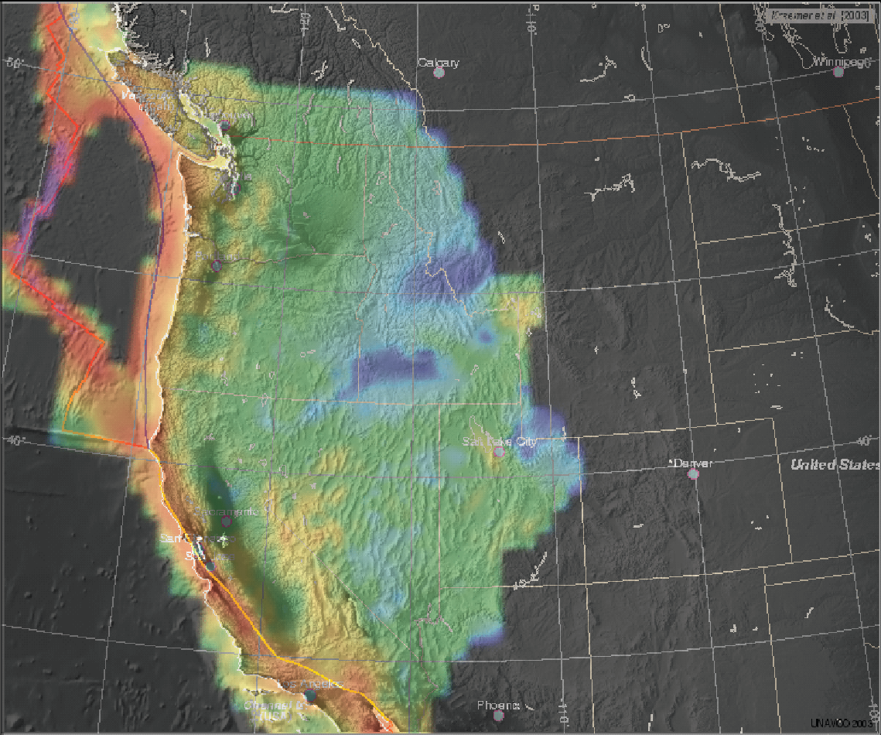
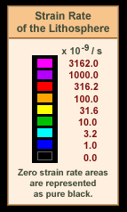
Thinking of Boundaries as Zones

Slide 38
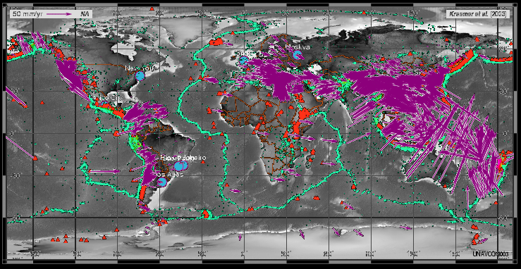
Global Motion

Slide 39
Wrap Up
What we did:
Explored locations of earthquakes and volcanoes
Compared plate motion between the Pacific Northwest and California
Determined plate boundary zones using multiple lines of evidence:
  Ground motion using GPS vector maps
  Locations of
    Earthquakes
    Volcanoes

Slide 40
Other Tools to Explore
UNAVCO GPS, Earthquake, Volcano Viewer
  http://www.unavco.org/software/visualization/GPS-Velocity-Viewer/GPS-Velocity-Viewer.html
  Google search: unavco GPS Velocity Viewer
IRIS Earthquake Browser
  www.iris.edu.ieb

Slide 41
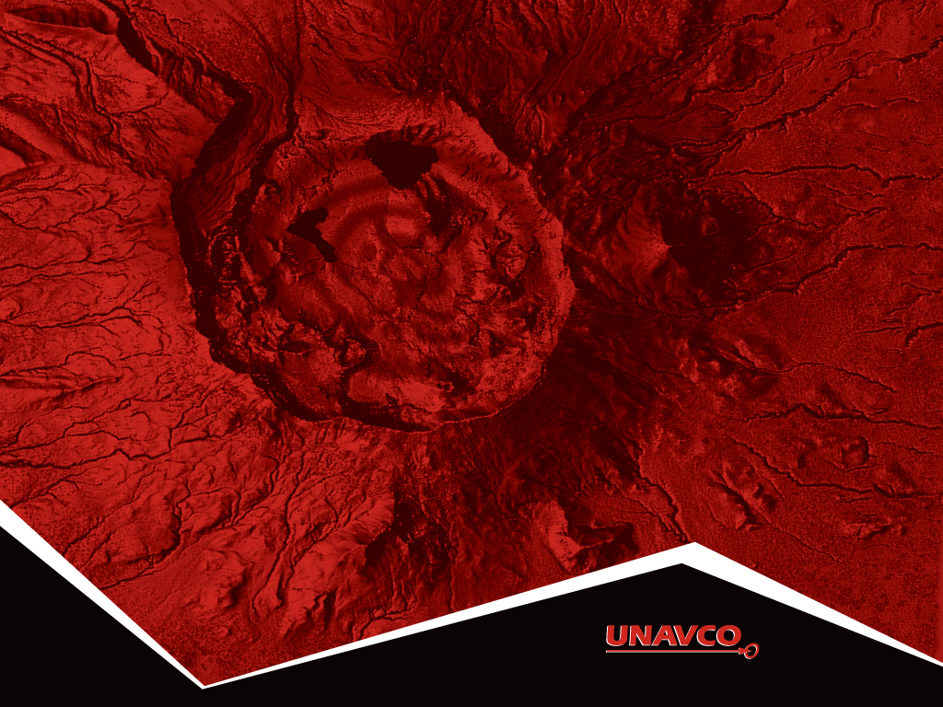

Thank You!
Contact:
education unavco.org
http://www.unavco.org/
Follow UNAVCO on _______ Facebook Twitter

