Slide 1
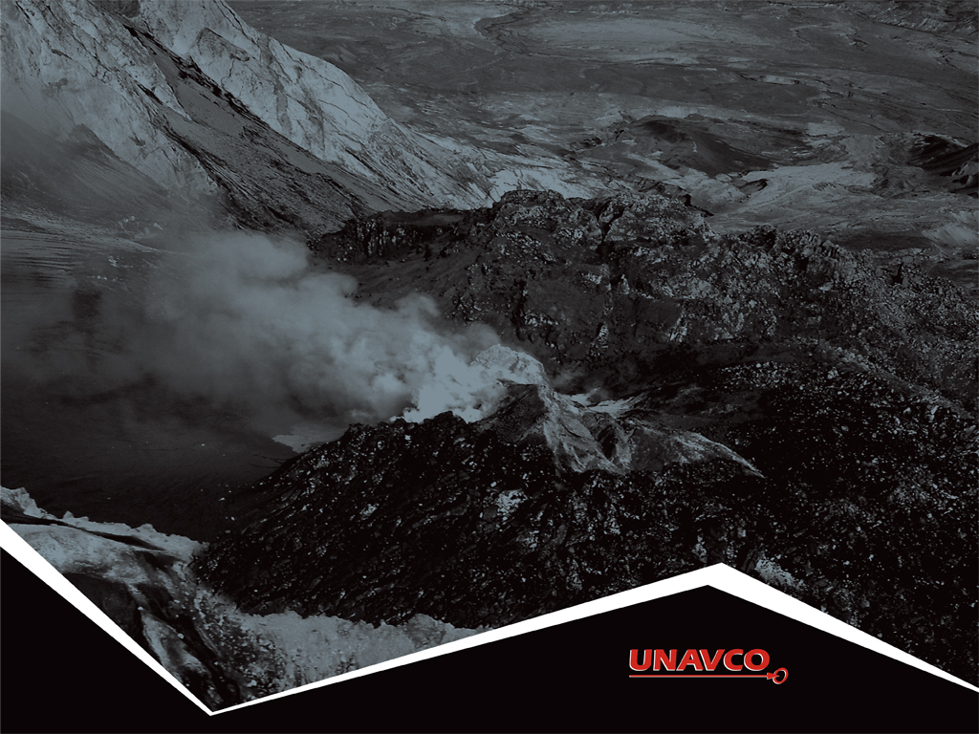
4
Measuring plate motion with GPS:
Introducing GPS to study tectonic plates
as they move, twist, and crumple
Roger Groom and Cate Fox-Lent, UNAVCO Master Teachers-in-Residence, Nancy West and Shelley Olds, UNAVCO

Slide 2
By the end of this activity…
You should be able to:
Describe generally how GPS works;
Interpret graphs in a GPS time series plot;
Determine velocity vectors from GPS time series plots;
Explain relative motions of tectonic plates in Iceland; and
Explore global GPS data.

Slide 3
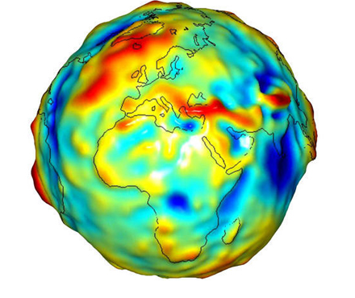
About geodesy
Geodesy is the science of …
measuring Earth’s
size, shape, orientation,
gravitational field, and
variations of these
with time.
3
Notes:
3
3
Traditional geodetic application is the precise positioning of points on the surface of the Earth.
Image from NASA’s Grace satellite, showing gravitational variation around the globe. Jet Propulsion Laboratory, 2007. http://www.jpl.nasa.gov/news/news.php?release=2007-147 Retrieved 10 October, 2013.

Slide 4
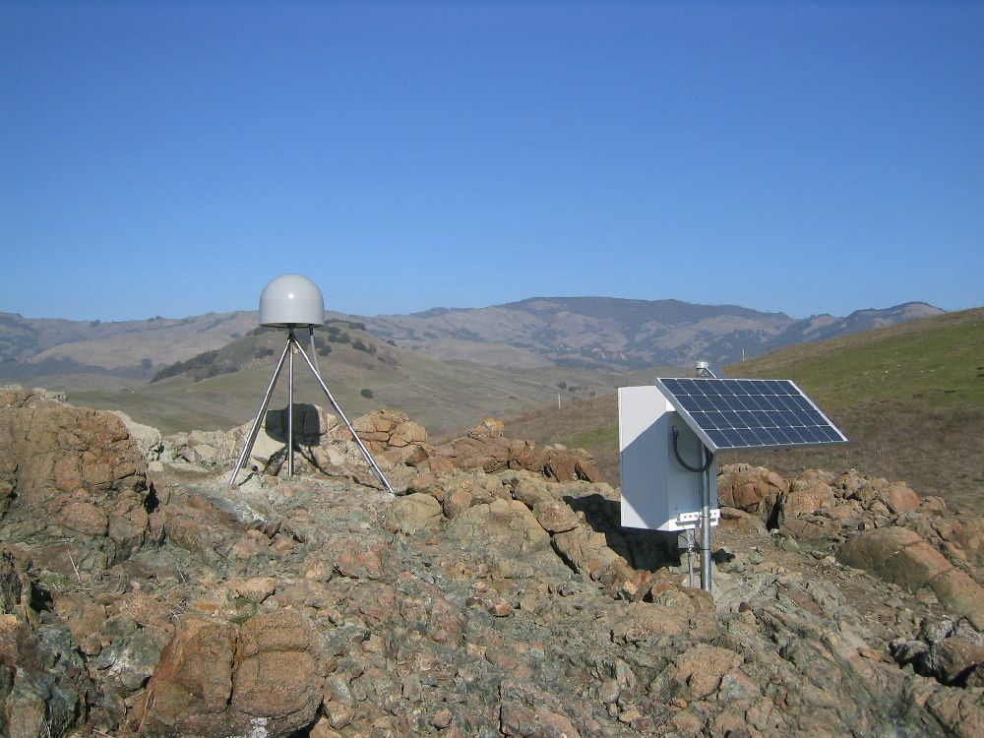
Anatomy of a GPS station
GPS antenna inside the dome is anchored to the ground with braces.
Solar panel for power.
Equipment enclosure includes:
GPS receiver
Power/batteries
Communications
Data storage
Notes:
GPS stations are installed permanently into the ground; as the land moves so do the GPS stations.

Slide 5
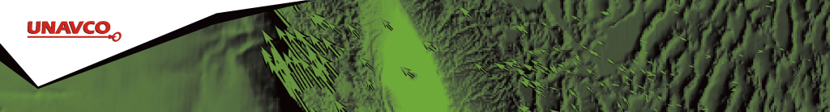
Modeling GPS
Sketch a diagram of the demonstration. Label
the components

Slide 6
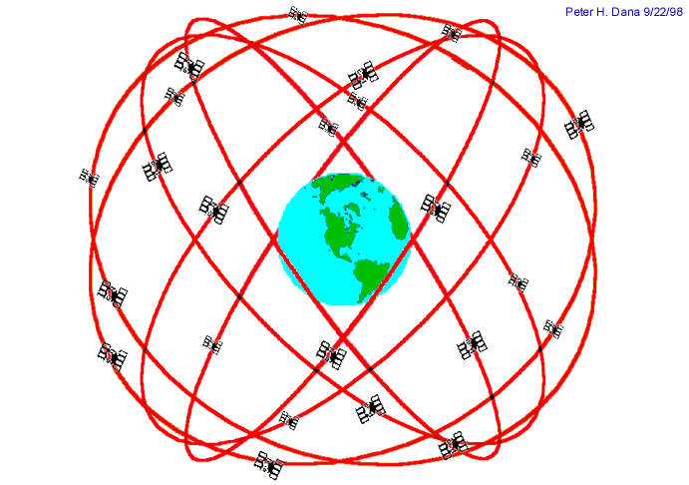
GPS basics
Three satellite signals locate the receiver in 3D space.
The fourth satellite is used for time accuracy.
Position can be located to within less than a centimeter.
Notes:
Also note that the GPS stations used for scientific work are precise for several reasons: The units use both of the signals coming from the satellites and two of the clocks are atomic rather than crystal. These stations can measure the change in position of a location with sub-centimeter accuracy. They can detect motion as little as millimeters over a year.

Slide 7
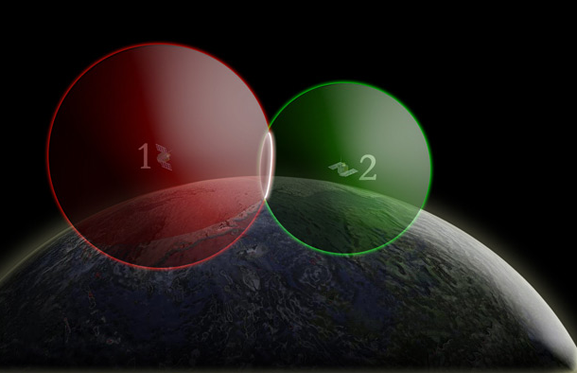
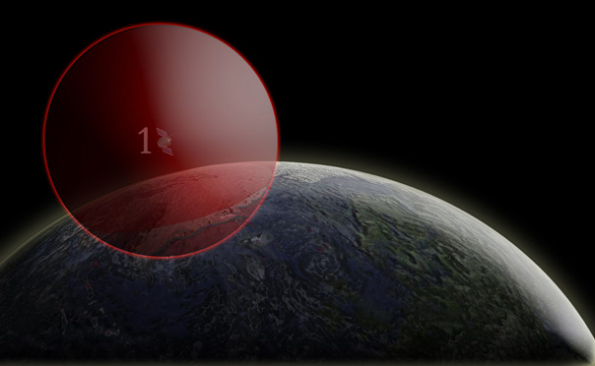
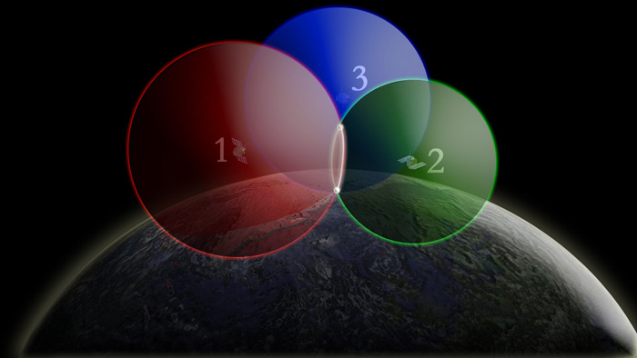
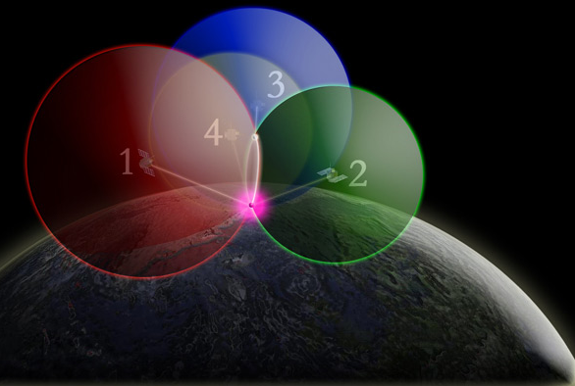
One way to find your location –
4 intersecting spheres
One satellite,
the GPS could be anywhere on the edge of the sphere.
Two satellites, GPS could be on the circle where spheres intersect.
3 satellites:
spheres intersect in 2 places.
4 satellites, spheres intersect in one place.

Slide 8

Instantaneous positioning with GPS
Consumer grade accuracy of
+/- 10 m (30 ft) error (horizontal)
+/- 15 m (45 ft) error (vertical)
Your location is:
37º 23.323’ N
122º 02.162’ W
Notes:
Since each satellite maintains time very accurately (~1 nanosecond = 30 cm), it can tag its signal with the time of transmission. This information, together with the location of the satellite, also transmitted to the receiver, is sufficient to allow the receiver to calculate the range to each satellite provided that the receiver also knows also knows the time. Equipping receivers with atomic clocks would be very expensive, so the receiver tags the signal with the time of its internal clock to create a “pseudorange” (range plus an unknown clock correction). The software in the receiver than uses the pseudoranges from four satellites to solve for the four unknowns: three coordinates and the receiver clock correction.

Slide 9
High-precision GPS
Current accuracies sub-cm.
Use the carrier phase
Dual-frequency receivers
High-precision orbital information
Good monuments
Multiple stations
Sophisticated processing software
Collect lots of data
Notes:
The primary GPS signal is transmitted at a “carrier’ frequency of 1575 MHz (“L-band”), corresponding to a wavelength of 19 cm. As with FM radio, This signal is then modulated at a much lower frequency to each modulated to incorporate information about the time and location of the satellites. The precision of the pseudorange is limited by the modulation frequency to about 10 cm. In high-precision GPS we use the carrier phase itself to obtain a measurement precision of 10 cm

Slide 10
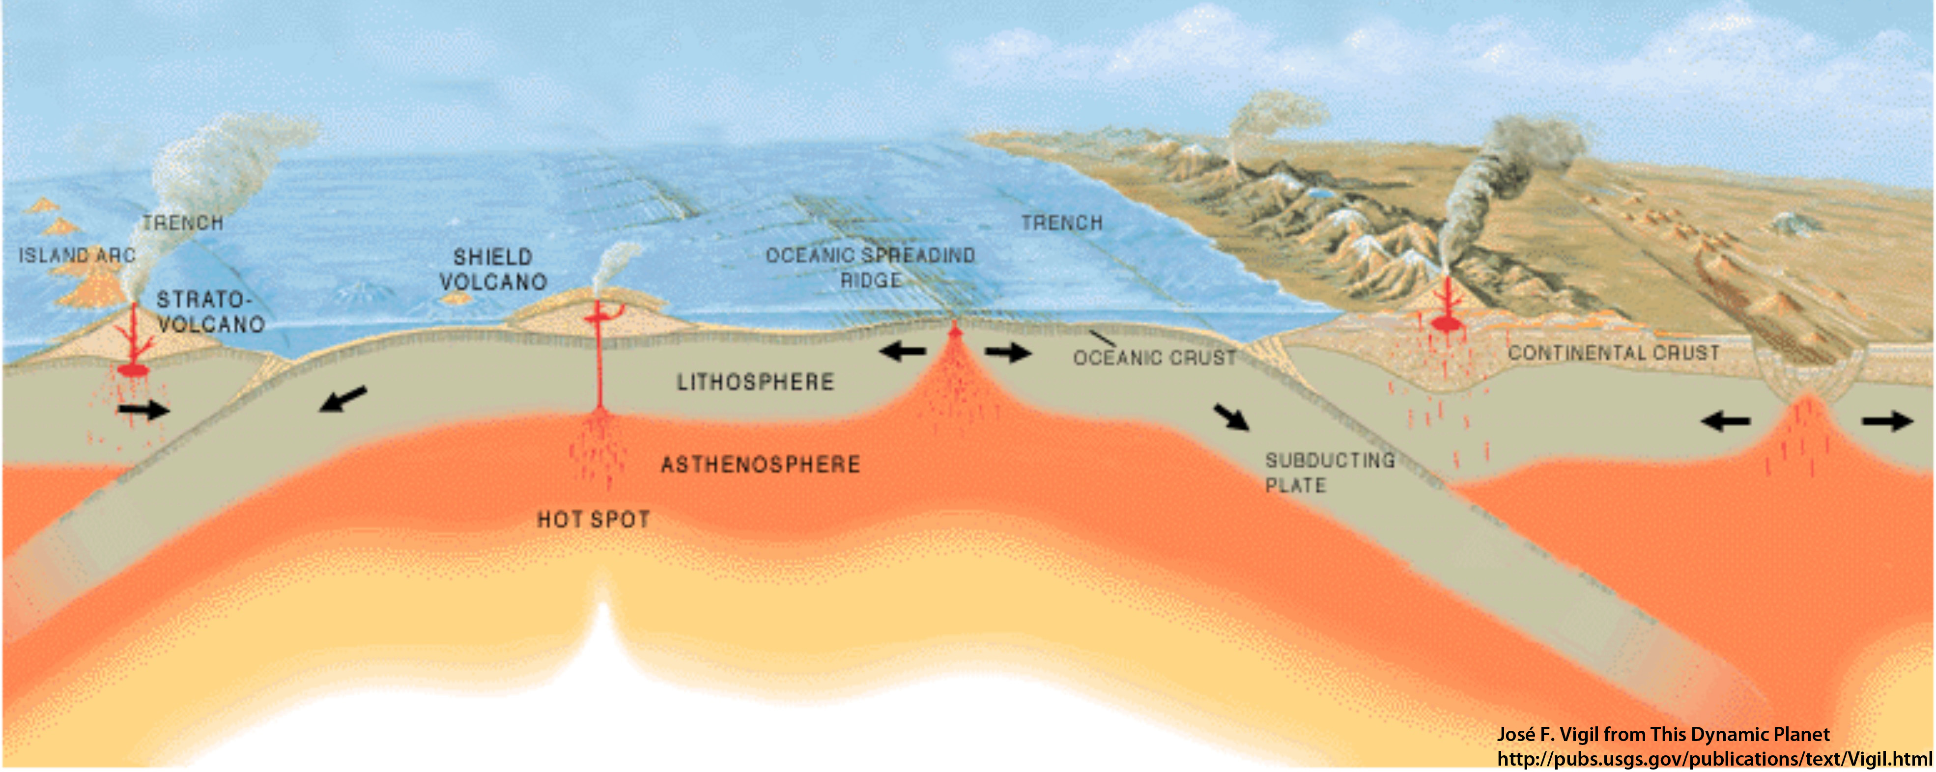
Movement of GPS stations
GPS station positions change as plates move.
A
B
How will Station A move
relative to Station B?

Slide 11
Movement of GPS stations
GPS station positions change as plates move.
A
B
GPS Station A is moving toward B.
Notes:
Note that the red arrow is really just an arrow… there is no scale to show the rate of motion. And GPS stations are obviously not to scale.

Slide 12
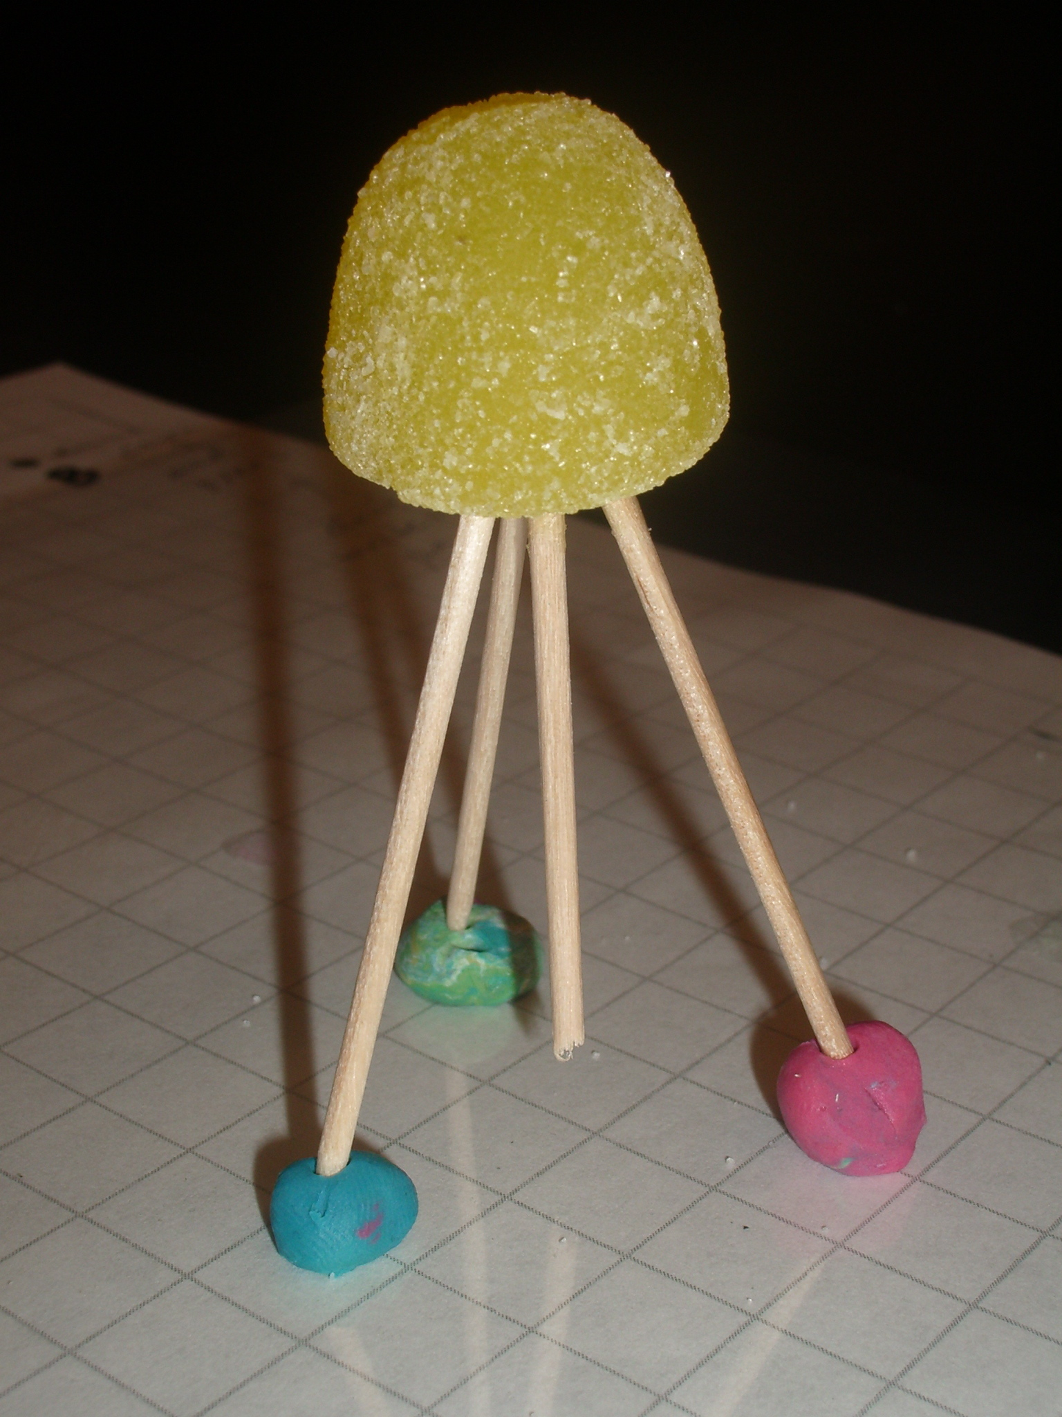

Part 1: Modeling GPS
To build a gumdrop model of a GPS monument:
  Use one gumdrop as the receiver (GPS monument).
  Use toothpicks as three legs and one center post (monument braces).
  Form feet from three small lumps of clay (concrete).
  Place on a small piece of transparent paper (“see-through” crust).
Notes:
Have students write, “This is a tectonic plate” on the transparency.

Slide 13
Questions
Contact:
education @ unavco.org
http://www.unavco.org/
Follow UNAVCO on facebook
Facebook Twitter

Slide 14
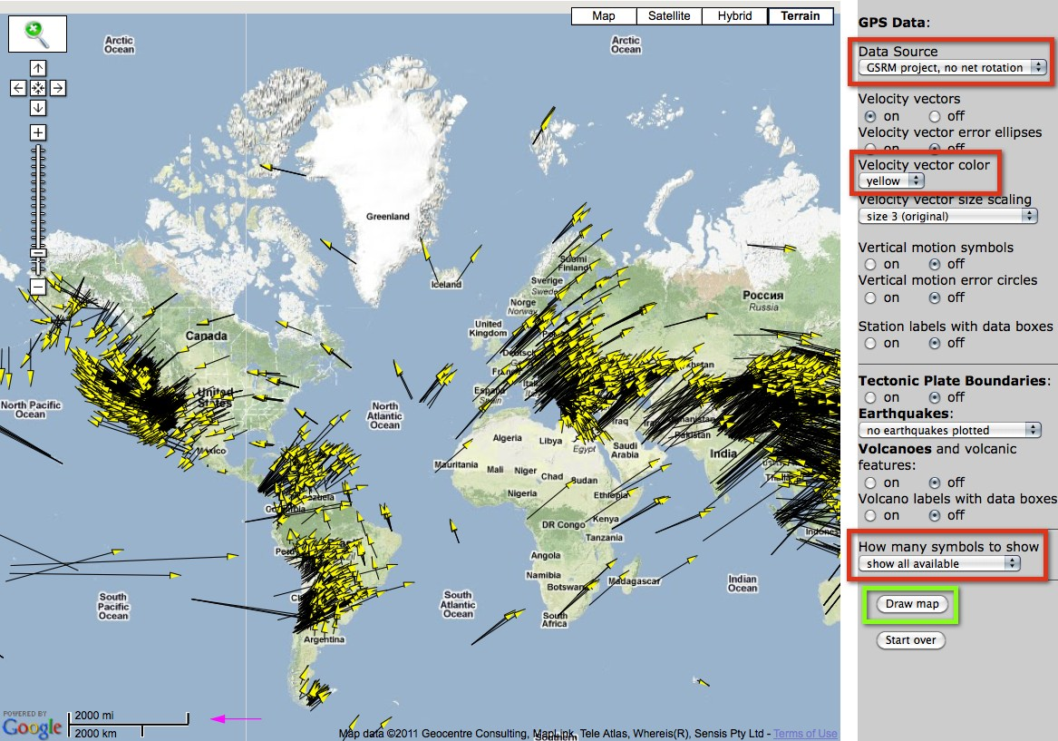
GPS Velocity Viewer
Data source: Global Strain Rate Map Project ; Reference Frame: No Net Rotation
UNAVCO GPS Velocity Viewer:
http://facility.unavco.org/data/maps/GPSVelocityViewer/GPSVelocityViewer.html
Notes:
It is the visual display of GPS, LiDAR, InSAR data, however, that helps make plate tectonics come alive for learners as a process that is happening in the present.
Reference Frame: No Net Rotation – using the velocity viewer

Slide 15
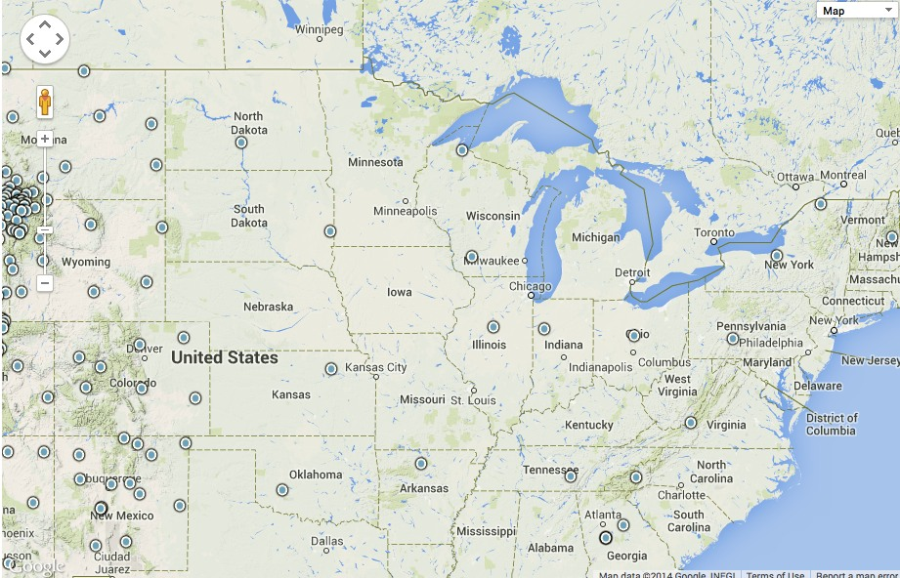
Nearby PBO GPS Stations
http://www.unavco.org/instrumentation/networks/status/pbo

Slide 16
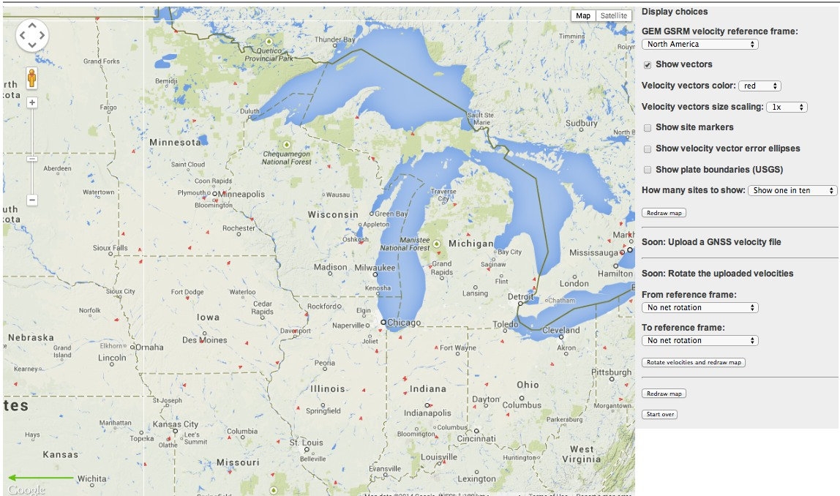
Velocities –
North America reference frame
http://www.unavco.org/software/visualization/GPS-Velocity-Viewer/GPS-Velocity-Viewer.html

Slide 17
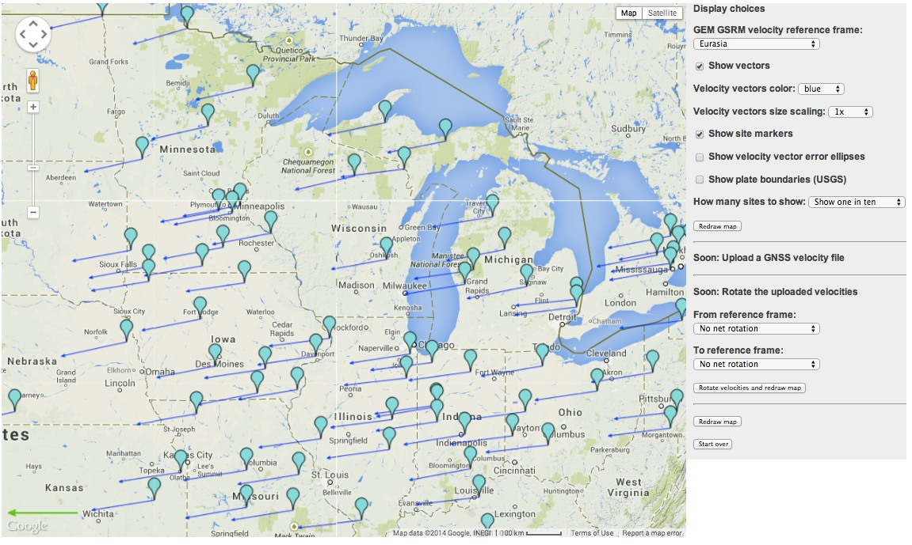
Velocities compared to Eurasia
http://www.unavco.org/software/visualization/GPS-Velocity-Viewer/GPS-Velocity-Viewer.html

Slide 18
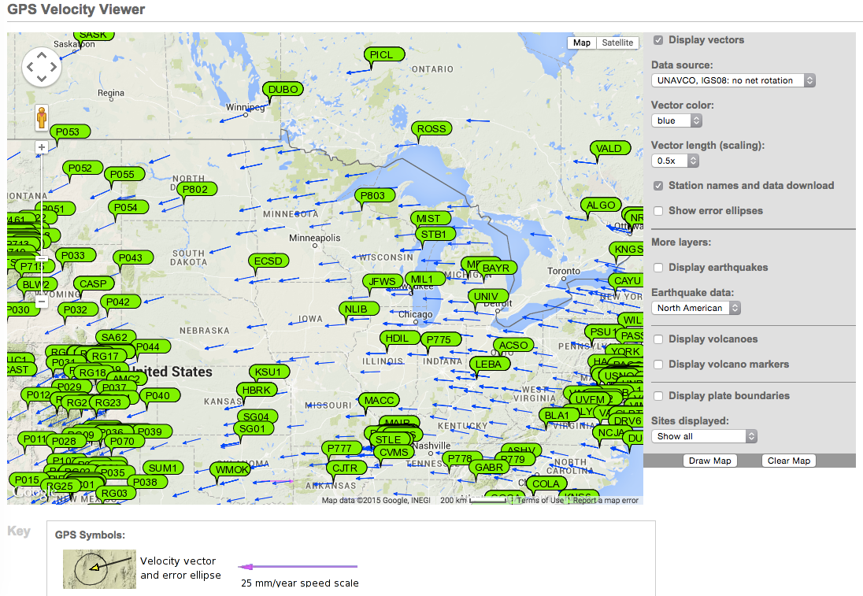
Plate motions from another perspective: world reference frame

Slide 19
Part 2: Measuring movement
SBCC GPS STATION
Located near Mission Viejo, CA
Position data collected every 30 seconds
One position estimate developed for each day:
  North
  East
  Vertical
Date | North (mm) | East (mm) | Vertical (mm)
1/1/2004 | -37.67 | 36.57 | 2.33
1/2/2004 | -38.04 | 35.73 | 5.63
1/3/2004 | -37.16 | 35.83 | 4.69
1/4/2004 | -37.34 | 36.34 | 5.36
1/5/2004 | -37.59 | 36.44 | 9.11
… | … | … | …
1/1/2005 | -9.43 | 9.63 | 2.36
1/1/2006 | 16.48 | -18.09 | 7.35
1/1/2007 | 45.98 | -43.42 | -6.43
Notes:
The data from the GPS stations run by UNAVCO's Plate Boundary Observatory (which is one of the EarthScope projects) is freely available to the public. Each GPS station has a data file which contains the daily change in position.
UNAVCO has provided processed data since Jan 1, 2004. Although some GPS stations were installed earlier, only data after January 1, 2004 is currently available.

Slide 20
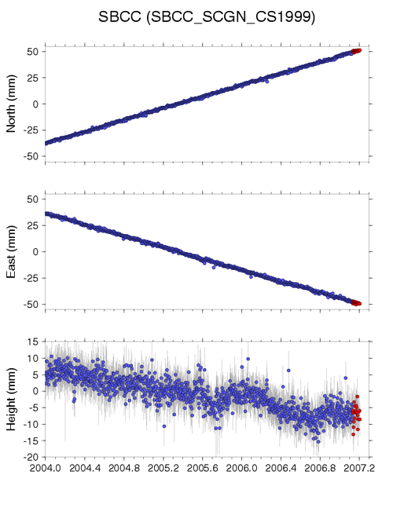
GPS time series plots
3 separate plots on y-axis:
  North
  East
  Height (Vertical)
Notice that scales vary.
Red points:
rapid estimates
X-axis: date of the measurement
Notes:
GPS time series plots show the change of position of the GPS monument over time. After processing, the data is provided in a coordinate system (latitude and longitude) then converted to millimeters of offset. The beginning of the data is not at zero because the offset is measured from a data point in the middle of the dataset. Dates are given as either months or tenths of years.

Slide 21
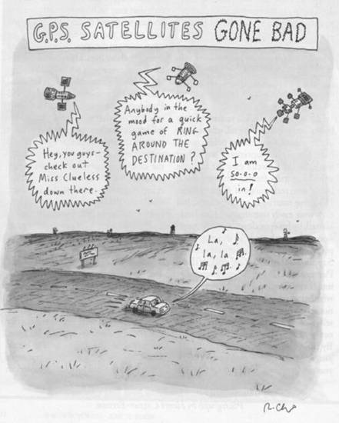
Sources of Error
Some GPS Error Sources
Selective Availability
Satellite orbits
Satellite and receiver clock errors
Atmospheric delays
  Ionosphere
  Troposphere
Multi-path
Human errors
The New Yorker, Roz Chast

Slide 22
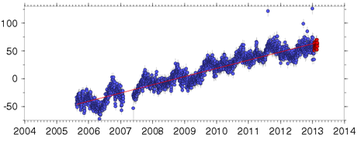
Which way are we going?
Is the GPS station moving
  north or south?
  east or west?
  up or down?
North (mm)
East (mm)
Height (mm)
Time
Notes:
Trend: the average direction of the graph (simplest terms).

Slide 23
Which way are we going?
Positive slope:
  The station is moving north.
  The station is moving east.
  The station is moving up.
North (mm)
East (mm)
Height (mm)
Time
Notes:
Have students sketch these graphs on their worksheet. This station is moving northeast and up over time.

Slide 24
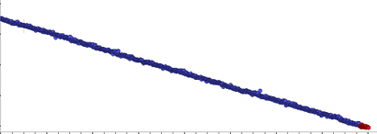
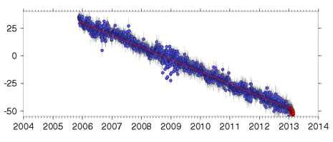
Which way are we going?
Is the GPS station moving
  north or south?
  east or west?
  up or down?
North (mm)
East (mm)
Height (mm)
Time
Notes:
This station is moving southwest and down over time.

Slide 25
Which way are we going?
Negative slope:
  The station is moving south.
  The station is moving west.
  The station is moving down.
North (mm)
East (mm)
Height (mm)
Time
Notes:
Have students sketch these graphs on their worksheet.

Slide 26
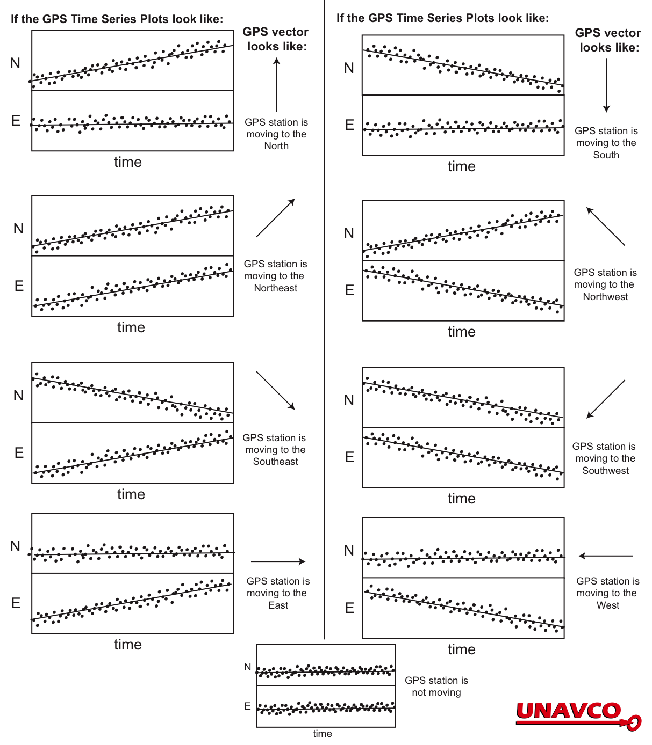
Time series plots

Slide 27
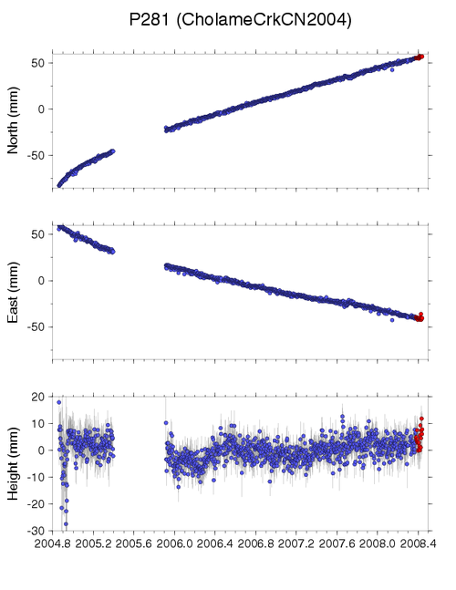
Gaps in data
Causes:
Power outages
Snow coverage
Equipment failure
Vandalism
Wildlife
Etc.

Slide 28
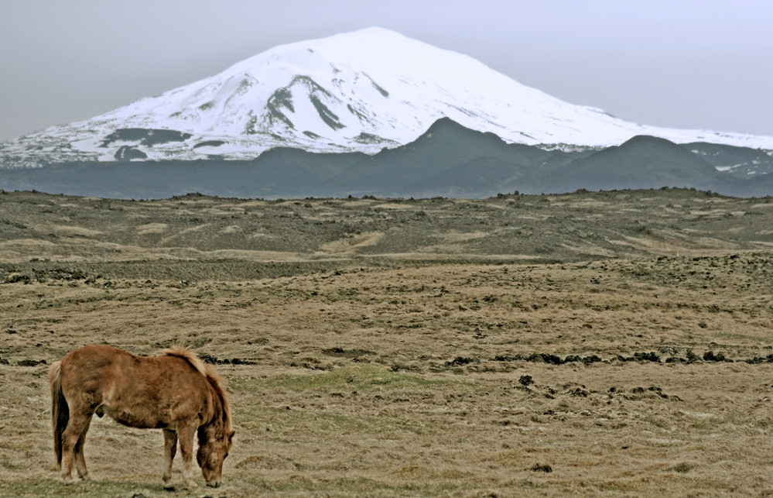
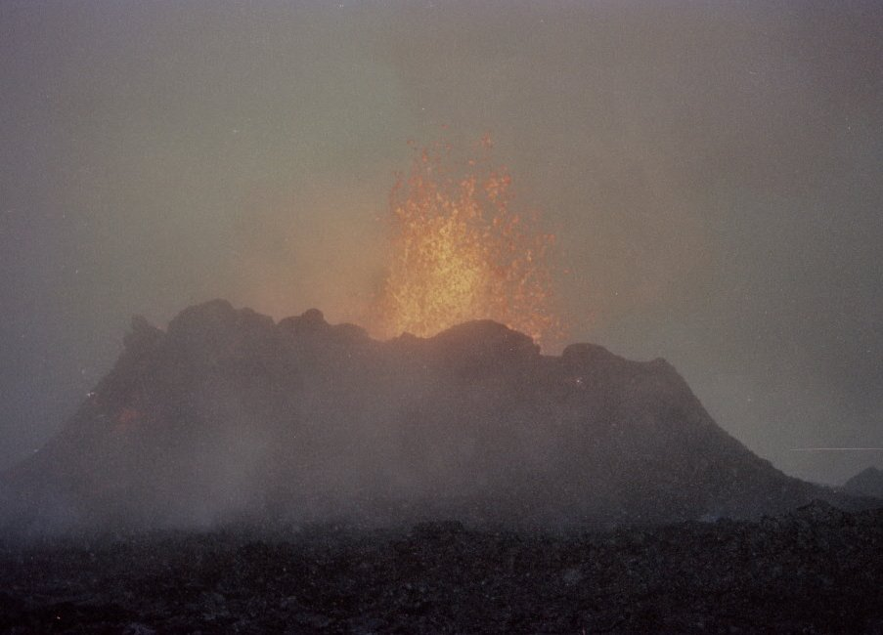
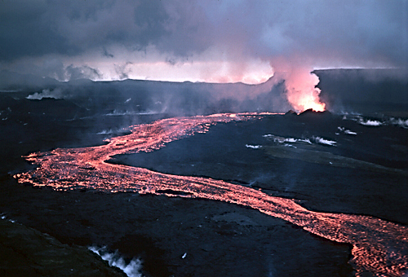
Iceland’s GPS data
Notes:
Large image of the Icelandic pony and Hekla volcano: Skulason, Lydar. 2006. Wikimedia Commons. http://commons.wikimedia.org/wiki/File:Hekla_and_horse.jpg. Retrieved 27 April 2013.
Lava flow at Hekla. Ryan, Michael. U.S. Geological Survey. 1984. Wikimedia Commons. http://commons.wikimedia.org/wiki/File:Lava_flow_at_Krafla,_1984.jpg.
Retrieved 27 April 2013.
Small photo of Krafla eruption. Goodman, Roger. 1984. Wikimedia Commons. http://commons.wikimedia.org/wiki/File:Krafla_eruption,_Sept_1984.jpg.
Retrieved 27 April 2013. Photographer noted: “A small volcano at Krafla, north Iceland, in Sept 1984. There was a snow storm going on at the time, so I was very cold on one side, and very warm on the other. I was entirely too close to this, perhaps a hundred feet away at the most.”

Slide 29
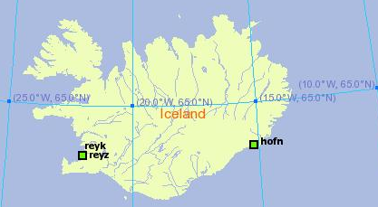
Iceland’s GPS data
HOFN
REYK

Slide 30
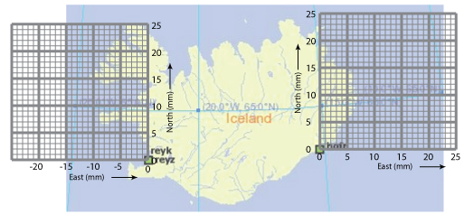
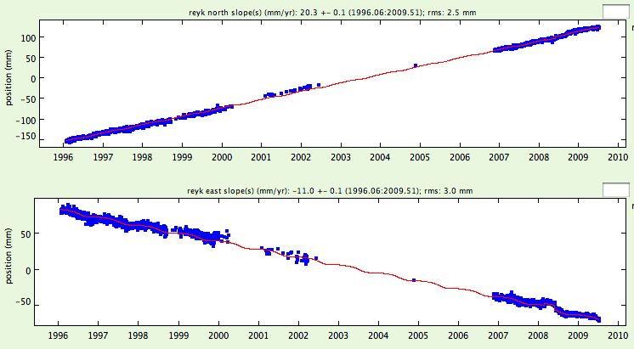
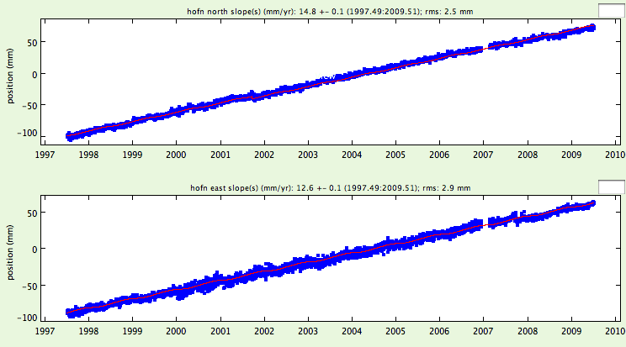
Iceland’s GPS data
REYK
HOFN
North (mm)
North (mm)
East (mm)
East (mm)

Slide 31
Units on time series plots
What are the units of measurement for this data?
North (mm)
East (mm)

Slide 32
GPS monument HOFN: north
How quickly is HOFN moving in the north - south direction?
North (mm)
Let’s look at 1998 and 2008.
Average position on 1/1/2008 = ______ mm
Average position on 1/1/1998 = ______ mm
Notes:
Consider determining the north motion as a class. Have students follow along on their worksheet – drawing the lines across and down seems to help. You can give them the hint of drawing light vertical lines for 1998 and 2008 up to the plot, then a horizontal line from the plot to the y-axis.

Slide 33
GPS monument HOFN: north
North (mm)
Average position on 1/1/2008 = 50 mm
Average position on 1/1/1998 = -98 mm
Change in position = 50 – (-98) = 148 mm
Annual speed of HOFN north = 148 mm/10 years
= 14.8 mm/yr to the north for HOFN

Slide 34
GPS monument HOFN: east
How quickly is HOFN moving in the east - west direction?
Average position on 1/1/2008 = ______ mm
Average position on 1/1/1998 = ______ mm
Speed of HOFN east = ___ mm/10 years
= ____ /yr to the (east or west)

Slide 35
GPS monument HOFN: east
How quickly is HOFN moving in the east - west direction?
East (mm)
Average position on 1/1/2008 = 50 mm
Average position on 1/1/1998 = -80 mm
Speed of HOFN east = 130 mm/10 years
= 13 mm/yr to the east for HOFN

Slide 36
GPS monument HOFN
What direction is Monument HOFN moving?
a) north only b) northwest
c) northeast d) southwest
North (mm)
East (mm)

Slide 37
GPS monument REYK
Think, then discuss with your neighbor: What direction is monument REYK moving? About how fast?
North (mm)
East (mm)
Notes:
Give your students a chance to think about this, then solicit responses.

Slide 38
GPS monument REYK
How quickly is REYK moving in the north - south direction?
North (mm)
Average position on 1/1/2008 = 90 mm
Average position on 1/1/1998 = -115 mm
Speed of REYK north = (90 – -115) mm/10 years
= 205 mm/10 yr
= 20.5 mm/yr to the north for REYK

Slide 39
GPS monument REYK
How quickly are they moving in the east - west direction?
East (mm)
Average position on 1/1/2008 = -50 mm
Average position on 1/1/1998 = 60 mm
Speed of REYK (east) = (-50 - 60) mm/10 years
= -110 mm/10 yrs
= 110 mm/10yr to the west
= -11 mm/yr to the west for REYK
Notes:
Having thought through and shown these worked examples for HOFN and now REYK, now ask your students to use the time series plots for 1997 to 2013 provided on their worksheets to calculate motion for HOFN and REYK again. They could do this in pairs or solo. Their results will be similar to results from this earlier data.

Slide 40
Displaying velocities on a map
There must be an easier way to show this!
North: 20.5 mm/yr
East: -11 mm/yr
North: 15 mm/yr
East: 13 mm/yr
HOFN
REYK
REYK
HOFN
North (mm)
North (mm)
REYK North = 20.5 mm/year
HOFN North = 15.0 mm/year
East (mm)
East (mm)
REYK EAST = ⁻11.0 mm/year
HOFN EAST = 13.0 mm/year
Notes:
Negative east is west

Slide 41
Are REYK and HOFN moving…
…towards each other, away from each other, or in the same direction?
North: 15 mm/yr
East: 13 mm/yr
North: 20.5 mm/yr
East: -11 mm/yr
HOFN
REYK
Mimic these motions with your GPS models.
Notes:
Now think about a map with many GPS stations. And, each one has two numbers for north and east on it … it would get very complicated. There has to be a better way!

Slide 42
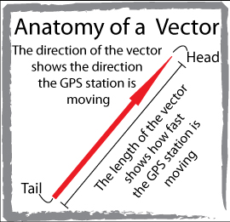
What is a vector?
A vector shows
speed and direction.
Notes:
All vectors have magnitude and direction. With GPS monuments, the magnitude is the speed at which moves. The direction is, obviously, the direction it moves, or its azimuth.
Vector’s tail = starting location of the GPS monument.
Direction the vector points = direction the GPS station is moving.
Length of the vector = how fast the GPS station is moving.

Slide 43
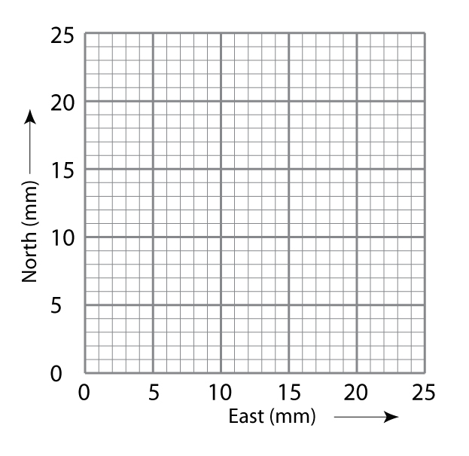
Graph paper as a map
Each axis uses the same scale.
X-axis: east in millimeters
Y-axis: north in millimeters
On your graph paper, each block represents 1 mm.
Where is the origin on this graph paper?
Notes:
Students will draw vectors on grids like this to represent motion of GPS stations. This one will be used for HOFN. It’s mirror image will be used for REYK—along the negative x-axis.
It is very important that both north and east axes use the same scale so that the two vectors can be added together.
Have students work in pairs – check each other’s work.

Slide 44
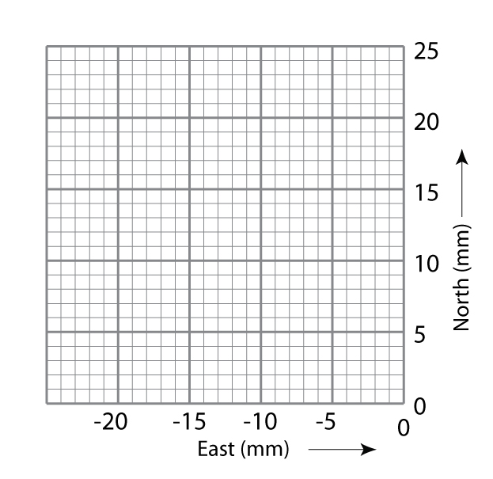
Graph paper as a map
Notes:
On the left will be REYK, and on the right will be HOFN. Your students might recognize these as the first two quadrants of a Cartesian coordinate system that have been pulled apart along the y-axis. REYK’s vector will be mapped in quadrant II; HOFN’s vector in quadrant I.

Slide 45
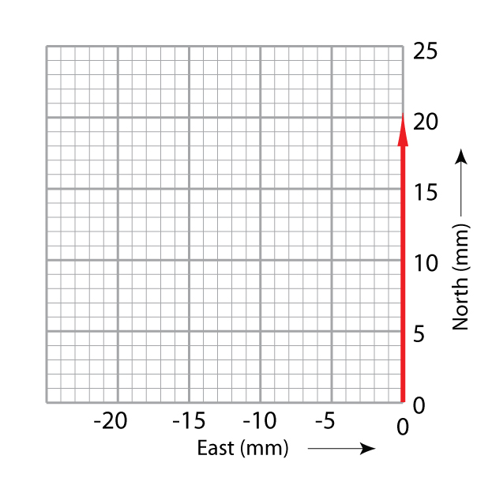
Plotting REYK vectors
Vector: magnitude and direction
  Tail is the GPS monument location.
  Length of arrow is the magnitude.
  Shows direction on a map.
Notes:
Let’s start with the north vector for REYK.

Slide 46
Plotting REYK vectors
Step 1. Draw the first vector along the north axis with the tail at 0.
GPS monument REYK moves 20.5 mm to the north per year
Draw a vector arrow 20.5 blocks along the north axis.

Slide 47
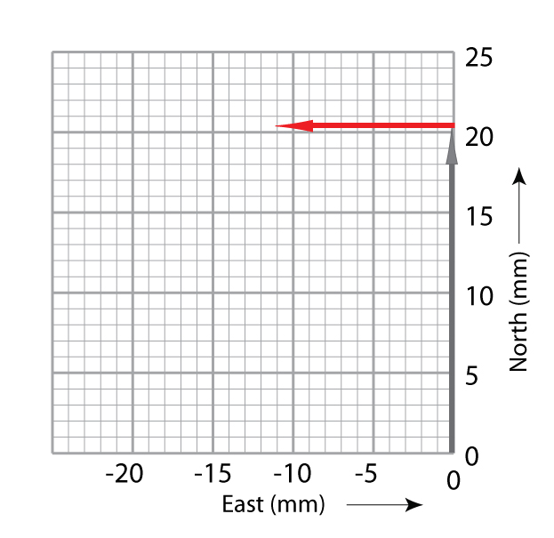
Plotting REYK vectors
Step 2. Place the tail of
the east vector at the
head of the north vector.
Draw the vector -11.0 blocks (mm) beginning
at the head of the north arrow
Notes:
REYK is moving west--or negative east.

Slide 48
Adding REYK vectors
Step 3. Draw the total vector from the tail of the north vector to the arrowhead of the east vector. This new vector is the sum of the north and east vectors.
Notes:
Have students work in pairs – check each other’s work.
Students can move their gum-drop GPS stations along the final vector (in blue) to get the feel of the movement of the GPS.
Reiterate that the GPS is moving because the Earth’stectonic plate is moving.
This analysis is qualitative: Students don’t measure the length of the total vector, although they could. They could mark the length of the total vector on a scrap of paper and measure it against the scale. They could use proportions or ratios to calculate it. Or, as in the next slide, they could use the Pythagorean theorem (typically taught in pre-Algebra). Students could use a protractor, directional compass, or smartphone with a compass app to measure the azimuth of the vector.
Note, however, that this activity does not expect quantitative analysis, only qualitative. Attaching numbers to the vector is optional, an added bonus to build in connections to mathematics.

Slide 49
Adding vectors
Or, use the Pythagorean theorem to add vectors.
GPS monument moves at: √(x² + y²⁾ =
____ mm/yr to the ____
Notes:
For students in pre-Algebra or Algebra 1, this is an opportunity to apply the Pythagorean theorem.
For students who are in Geometry, you can ask them also to find the azimuth using the sine, cosine, or tangent of the angle between the vector and the y-axis. They might have learned “SOH CAH TOA”. For example, SOH means that the sine is the opposite/hypotenuse, or in this case, east vector/total vector. The cosine is adjacent/hypotenuse or north/total. The tangent is opposite/adjacent or east/north.

Slide 50
Mapping vectors
Graph the vectors for HOFN and REYK.
Answer questions in “Thinking through the data and maps.”
Notes:
Students will map the vectors on their worksheets. Circulate and troubleshoot while they do this. Ask them to write responses to questions in the section, “Thinking through the data and maps.”

Slide 51
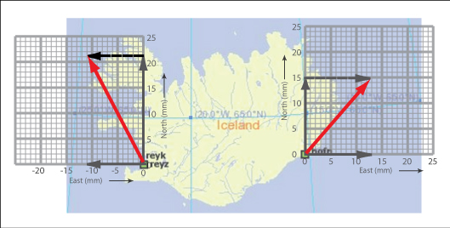
What is happening to Iceland?
Extra credit – How is REYK moving compared to HOFN ? (pretend HOFN is not moving)
Notes:
A placeholder slide for a class or group discussion about the splaying of Iceland.

Slide 52
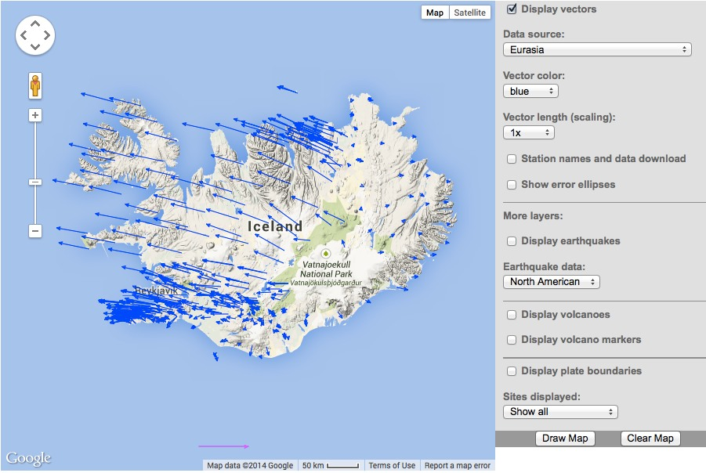
What is happening to Iceland?
Extra credit – How is REYK moving compared to HOFN ? (pretend HOFN is not moving)
Notes:
A placeholder slide for a class or group discussion about the splaying of Iceland.

Slide 53
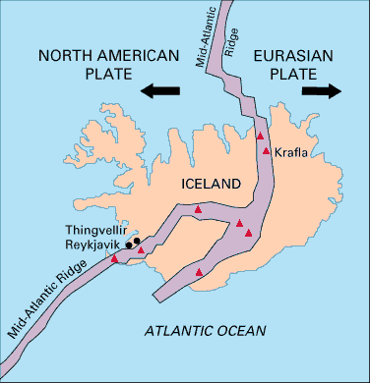

Rifting
Sites of surface eruptions
Notes:
Photo is of the volcano Fimmorduhais, Iceland. Boaworm. 2010. Wikimedia Commons. http://commons.wikimedia.org/wiki/File:Fimmvorduhals_2010_03_27_dawn.jpg Retrieved 26 April 2013.
The map shows the Mid-Atlantic Ridge rifting Iceland. REYK lies to the west of the rift, while HOFN lies to the east. Kious, J. and R. Tilling, U.S. Geological Survey. 1996. “Understanding Plate Motions” in This Dynamic Earth: the story of plate tectonics, online edition. http://pubs.usgs.gov/gip/dynamic/understanding.html. Retrieved 26 April 2013.

Slide 54
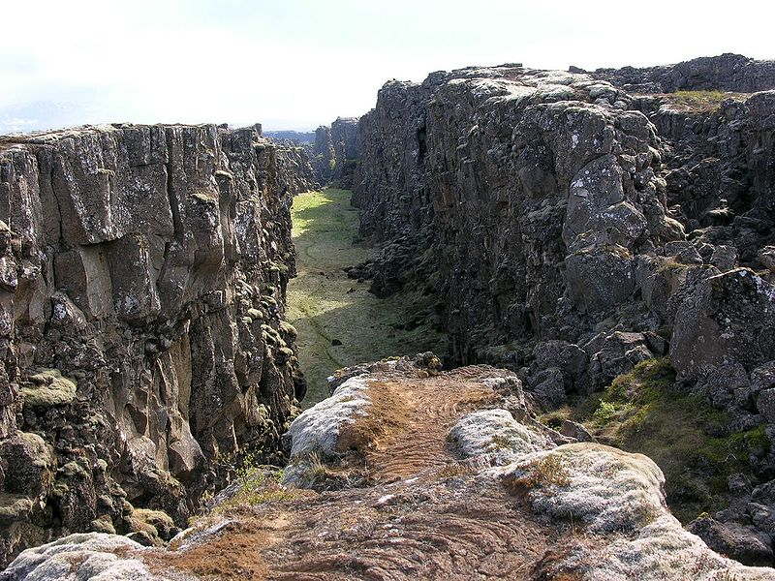
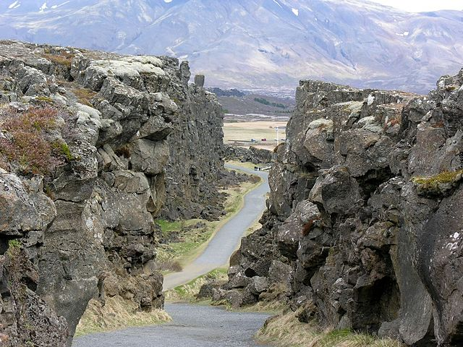
Fissures opening
Notes:
This fissure near Þingvellir, Iceland is where the Mid-Atlantic Ridge is slowly spreading the island apart.
Photo on right: Krapf, Hansueli. 2006. Wikimedia Commons. http://upload.wikimedia.org/wikipedia/commons/9/9a/%C3%9Eingvellir_Iceland_011.JPG. Retrieved 26 April 2013.
Photo on left: Krapf, Hansuili. 2006. Wikimedia Commons. http://upload.wikimedia.org/wikipedia/commons/thumb/7/79/%C3%9Eingvellir_Iceland_037.JPG/640px-%C3%9Eingvellir_Iceland_037.JPG. Retrieved 26 April 2013.

Slide 55
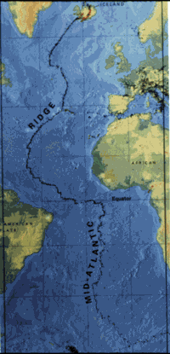
Mid-Atlantic Ridge
Iceland
Mid-Atlantic
Ridge
Notes:
Iceland is a high spot on the Mid-Atlantic Ridge—volcanically and seismically active, rifting, and above sea level.
Map from the U.S. Geological Survey. Kious, J. and R. Tilling, U.S. Geological Survey. 1996. “Understanding Plate Motions” in This Dynamic Earth: the story of plate tectonics, online edition. http://pubs.usgs.gov/gip/dynamic/understanding.html. Retrieved 26 April 2013.

Slide 56
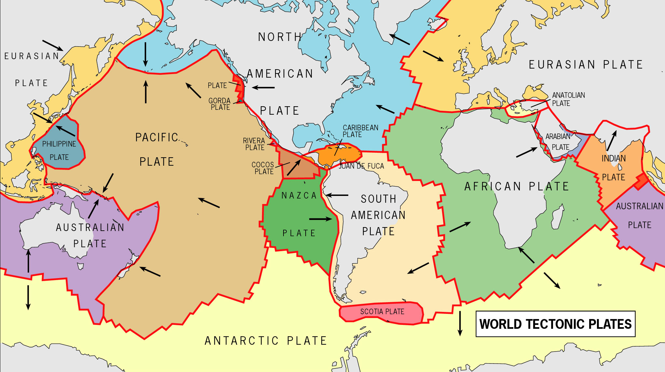
East Africa Mystery - worldview
Notes:
Image: Map of tectonic plates. USGS. URL?

Slide 57
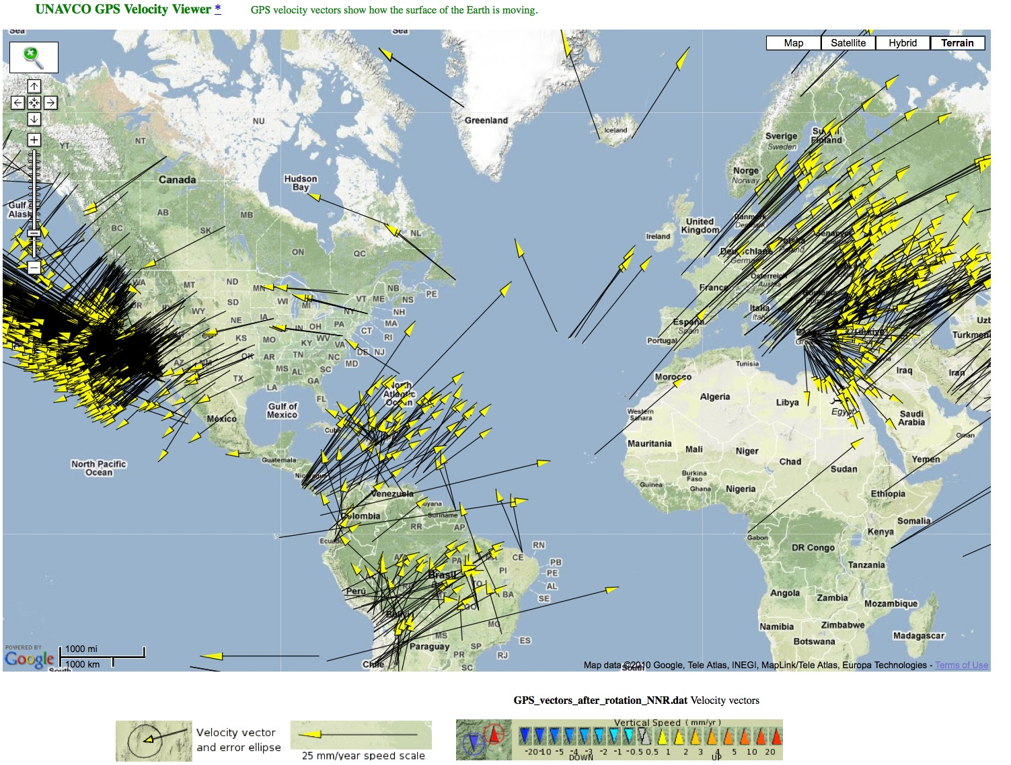
Mapping plate movement
Notes:
We can use vectors to show motion. Each arrow on this map represents the velocity of a single GPS station. These GPS stations, affixed to the ground, also show the motion of tectonic plates.

Slide 58
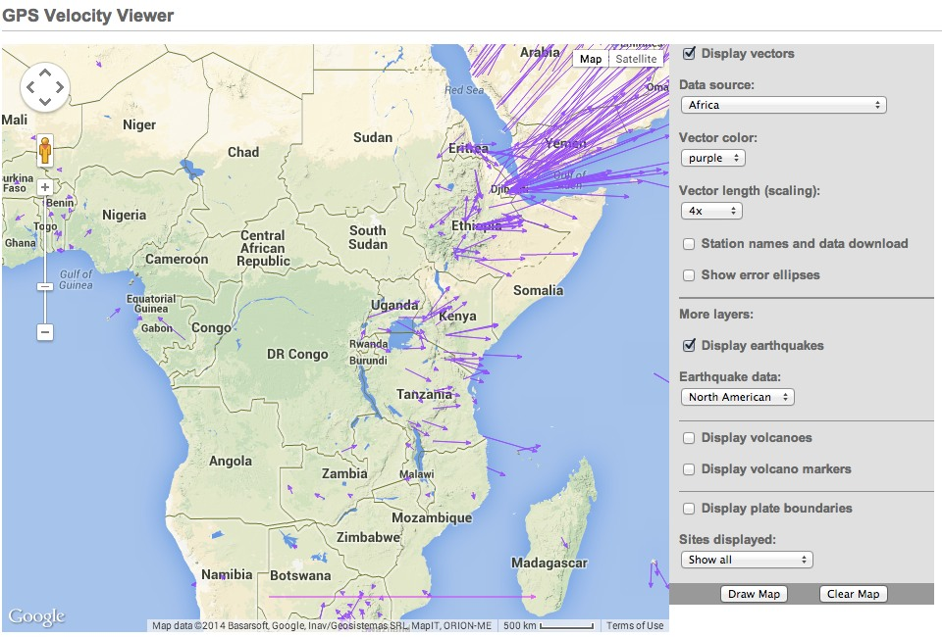
East Africa Mystery - revisited
Notes:
Image: Map of tectonic plates. USGS. URL?

Slide 59
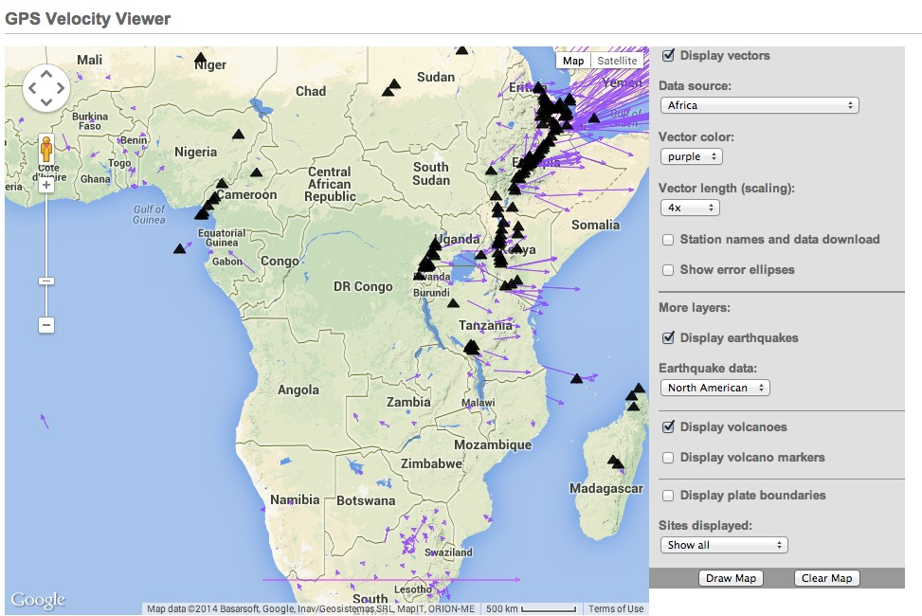
East Africa Mystery - revisited
Notes:
Image: Map of tectonic plates. USGS. URL?

Slide 60
East Africa Mystery - revisited
Notes:
Image: Map of tectonic plates. USGS. URL?

Slide 61







Part 3: Applying knowledge
A
North
B
E
C
D

Slide 62
Match cars and graphs
i)
What
direction?
________
Which car?
________
North
East
North (miles)
East (miles)
Time (Hours)
Time (Hours)
A
North
B
E
C
D

Slide 63
Match cars and graphs
i)
What
direction?
North-Northeast
Which car?
Car A
North
East
North (miles)
East (miles)
Time (Hours)
Time (Hours)
A
North
B
E
C
D

Slide 64
Match cars and graphs
ii)
What
direction?
________
Which car?
________
North
East
North (miles)
East (miles)
Time (Hours)
Time (Hours)
A
North
B
E
C
D

Slide 65
Match cars and graphs
ii)
What
direction?
South
Which car?
Car C
North
East
North (miles)
East (miles)
Time (Hours)
Time (Hours)
A
North
B
E
C
D

Slide 66
What direction is car D moving?
v)
What direction is
Car D moving?
_____________
Draw the north and east graphs
North
East
North (miles)
East (miles)
Time (Hours)
Time (Hours)
A
North
B
E
C
D

Slide 67
What direction is car D moving?
v)
What direction is
Car D moving?
Southeast
Draw the north and east graphs
North
East
North (miles)
East (miles)
Time (Hours)
Time (Hours)
A
North
B
E
C
D

Slide 68
GPS Velocity Viewer
Data source: Global Strain Rate Map Project ; Reference Frame: No Net Rotation
UNAVCO GPS Velocity Viewer:
http://facility.unavco.org/data/maps/GPSVelocityViewer/GPSVelocityViewer.html
Notes:
It is the visual display of GPS, LiDAR, InSAR data, however, that helps make plate tectonics come alive for learners as a process that is happening in the present.
Reference Frame: No Net Rotation – using the velocity viewer

Slide 69
Let’s explore
Data for Educators
  http://www.unavco.org/edu_outreach/data/data.html
UNAVCO Velocity Viewer
  http://facility.unavco.org/data/maps/GPSVelocityViewer/GPSVelocityViewer.html
Notes:
Encourage your students to explore the motion of Earth’s tectonic plates. The first website connects to data sets created for school use. The second takes users to velocity vectors around the world.

Slide 70
Summary
You should now be able to:
Describe how GPS works;
Interpret graphs in a GPS time series plot;
Determine velocity vectors from GPS time series plots;
Explain relative plate motions in Iceland; and
Explore global GPS data.

Slide 71
Questions
Contact:
education @ unavco.org
http://www.unavco.org/
Follow UNAVCO on facebook
Facebook Twitter

Slide 72
Other tools to explore
UNAVCO GPS, Earthquake, Volcano Viewer
  http://geon.unavco.org/unavco/GEV.php
IRIS Earthquake Browser
  http://www.iris.washington.edu/servlet/eventserver/map.do

Slide 73
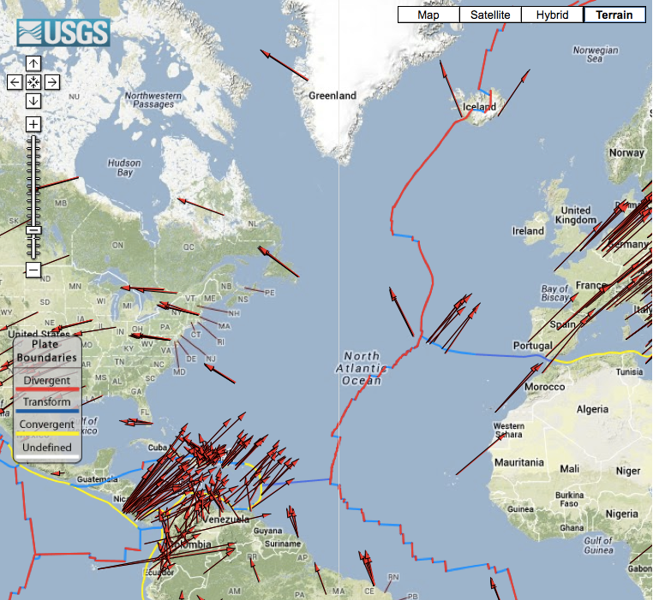
Comparing Plate Movement
GSRM Project GPS Data

Slide 74
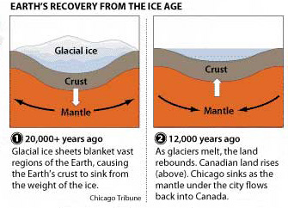
Measuring the Crust and Mantle Move
Sources
Ice
Ice-age melting
Present-day melting
Water
Ocean tides
Wind-driven surges
Reservoir depletion
Air
Water Vapor
Weather systems as noise and signal (information)
Sella and others, 2007

Slide 75
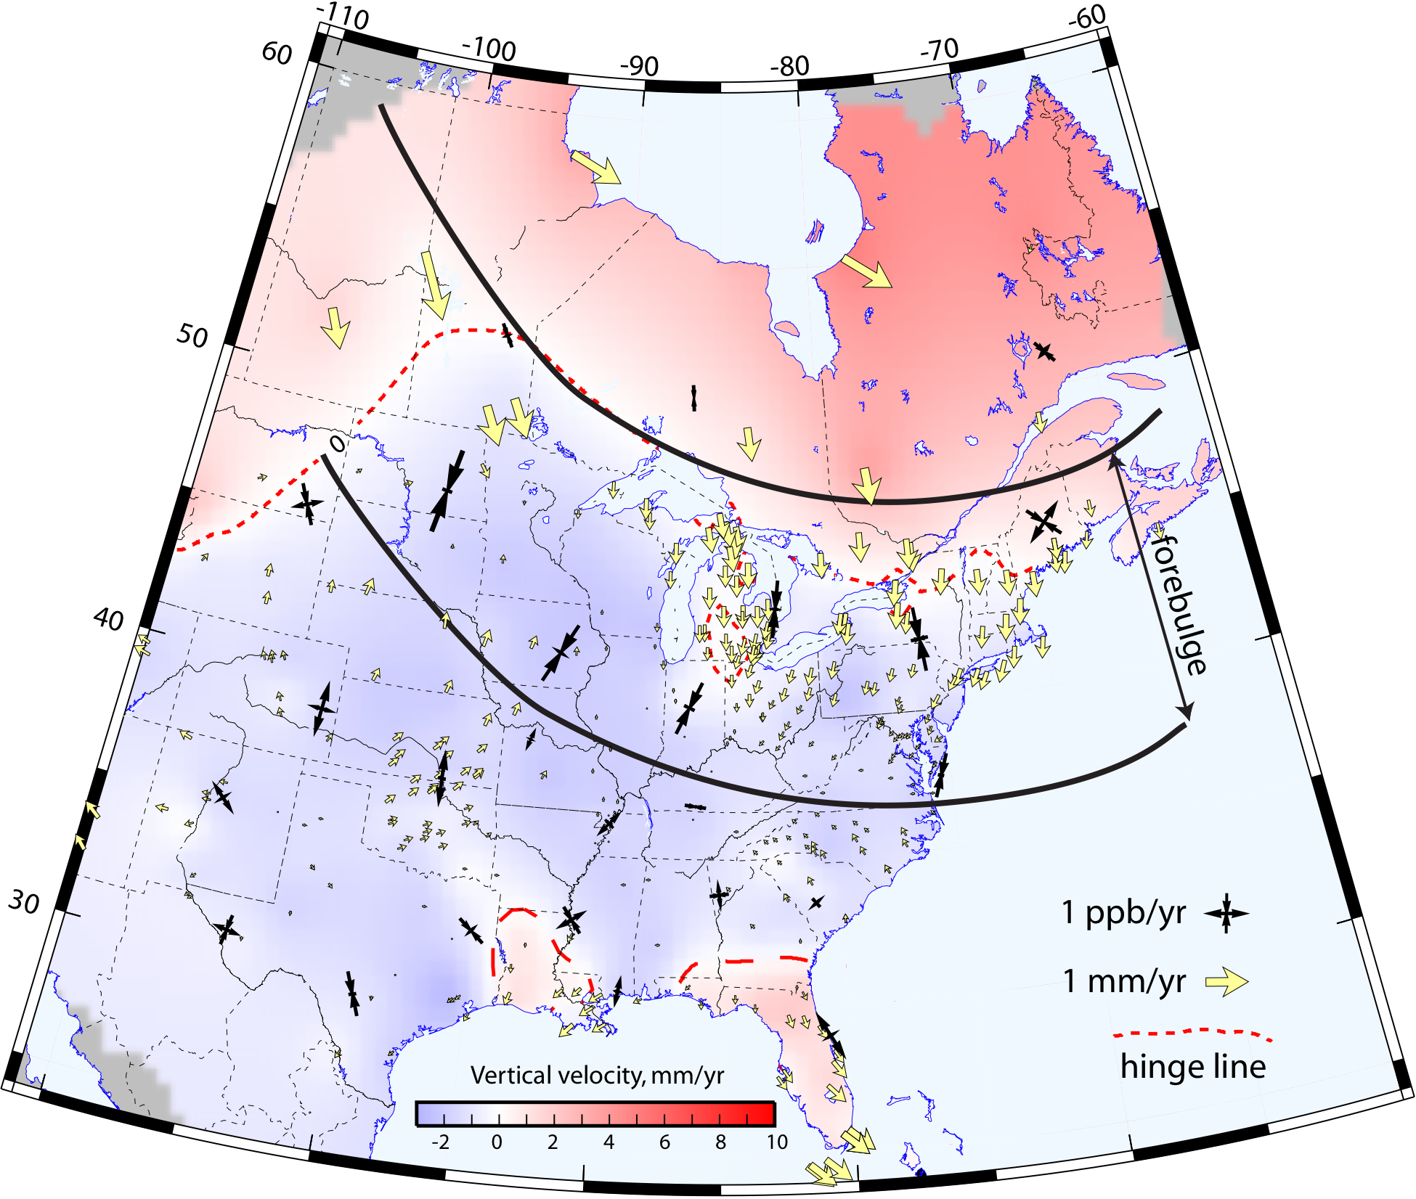
Measuring the Land Rebound (or Sink)
Glacial Isostatic Adjustment
Calais et al., GU 2009

Slide 76
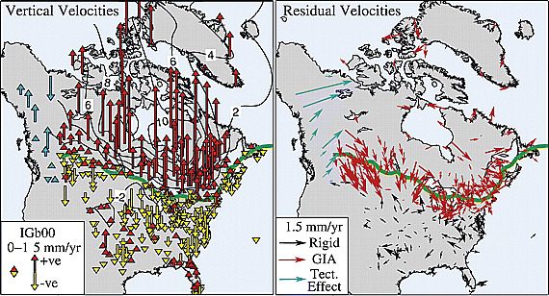
Sella, G. F., S. Stein, T. H. Dixon, M. Craymer, T. S. James, S. Mazzotti, and R. K. Dokka (2007), Observation of glacial isostatic adjustment in “stable” North America with GPS, Geophys. Res. Lett., 34, L02306, doi:10.1029/2006GL027081.
Green line shows 0 mmyr vertical “hinge line” separating uplift from subsidence.
(left) Vertical GPS site motions
(right) Horizontal motion Red vectors represent sites primarily affected by GIA.
Purple vectors represent sites that include effects of tectonics.
Notes:
with respect to IGb00. Note large uplift rates around Hudson Bay, and subsidence to the south.
site residuals after subtracting best fit rigid plate rotation model defined by sites shown with black arrows.

Slide 77
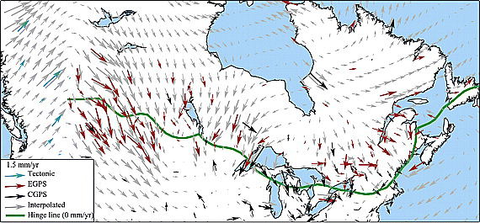
Sella, G. F., S. Stein, T. H. Dixon, M. Craymer, T. S. James, S. Mazzotti, and R. K. Dokka (2007), Observation of glacial isostatic adjustment in “stable” North America with GPS, Geophys. Res. Lett., 34, L02306, doi:10.1029/2006GL027081.
GPS horizontal velocities with motion of rigid North America removed. Interpolated velocity field based on these data derived using GMT
Notes:
software [Smith and Wessel, 1990; Wessel and Smith, 1998] are shown in light grey.

Slide 78

Horizontal GPS Motions
Geoffrey Blewitt, Corné Kreemer, William C. Hammond, Jay M. Goldfarb, Terrestrial reference frame NA12 for crustal deformation studies in North America, Journal of Geodynamics, Volume 72, 2013, 11–24. http://dx.doi.org/10.1016/j.jog.2013.08.004
Fig. 5. Assessment of core station selection. Velocities of core stations (with yellow circles) are shown together with other frame stations, indicating the effects of plate boundary deformation in the west, and post-glacial rebound in the northeast. To compar...

Slide 79
GPS

Slide 80
Add load
GPS

Slide 81
Displacements caused by adding a load
GPS receiver moves downward and towards the load
Add load
GPS

Slide 82
Displacements caused by removing a load
GPS receiver moves upward and away from the load
remove load
GPS

Slide 83


Websites shown during demonstration
Learn more about how GPS works and the science learned through research
GPS Spotlight: http://xenon.colorado.edu/spotlight/index.php
PBO H2O: http://xenon.colorado.edu/portal/index.php

Slide 84


Websites shown during demonstration
See the ground and forests with LiDAR
Many places to get LiDAR!
Open Topography: http://www.opentopography.org/
New York: http://gis.ny.gov/elevation/lidar-coverage.htm
Maine: http://www.maine.gov/megis/projects/lidar.shtml
Vermont: http://vcgi.vermont.gov/warehouse/products/ALL-LDR_MIX_LIDAR_STATE_ALL
New Hampshire: http://www.granit.unh.edu/resourcelibrary/specialtopics/lidar/

Slide 85

About GRACE
http://earthobservatory.nasa.gov/Features/GRACE/page3.php

Slide 86

Measuring the Plates Move
UNAVCO Plate Boundary Observatory Data

