Slide 1
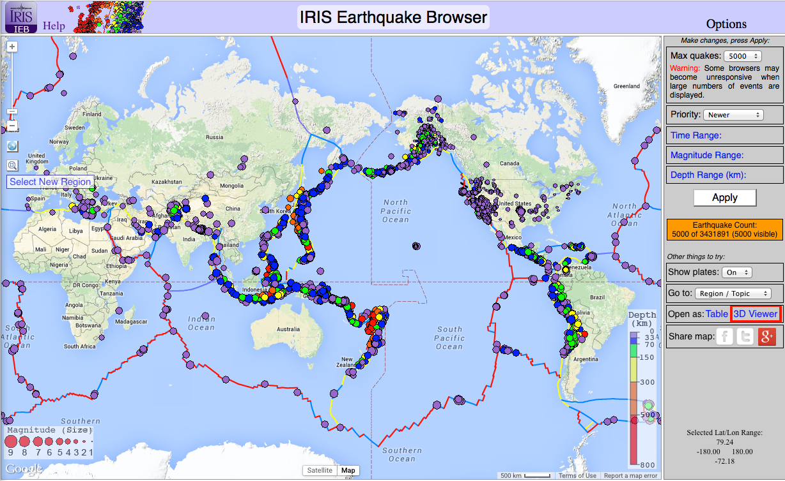
Earthquakes and Plate Tectonics
www.iris.edu/ieb
Exercise: http://www.iris.edu/hq/resource/african_mystery

Slide 2
How do earthquakes provide evidence of plate tectonics?
With a partner, choose a type of plate boundary:
  Divergent
  Convergent
  Transform
Using the “Show plates” option, select 1-2 boundaries of that type
  Explore the earthquakes in map and 3D view
  What features of the earthquake distribution provide evidence for your plate boundary type?
Find someone who examined a different type of plate boundary and compare what you each found

