Slide 1
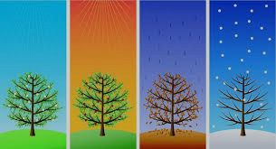
Phenology Across Minnesota
Sharing phenological events from my place to yours. Native science and phenology across Minnesota.

Slide 2
Our Essential Question
How can our students use place based data collection, observation, and story sharing to interpret natural events from the perspectives of both Indigenous and Western Science?

Slide 3
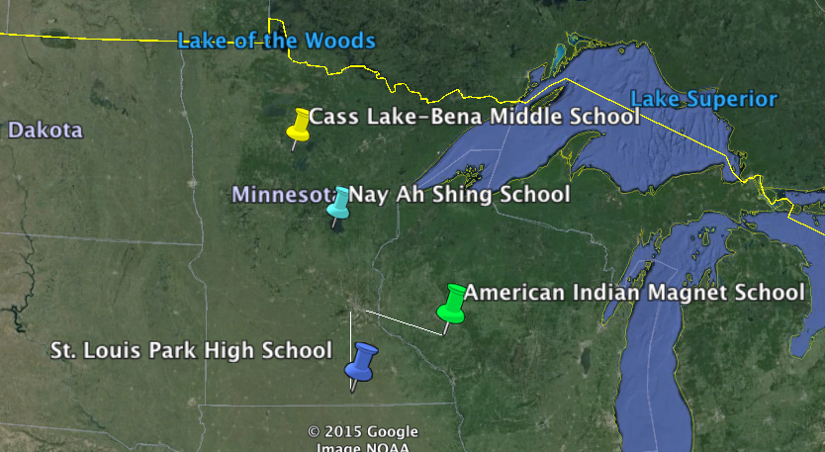
Our Places

Slide 4
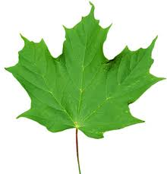
Potential Shared Events:
Ice in on local lake
Ice out on local lake
Sugar maple: bud to full leaf, including sap
Wild rice gathering and processing
Blueberry picking
Mississippi River

Slide 5
Data Sharing
Nature’s Notebook - MN Phenology Network
Project Bud Burst
Google Earth using Landsat data
Skype

Slide 6
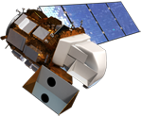
What is Landsat
https://www.youtube.com/watch?v=BPbHDKgBBxA

Slide 7
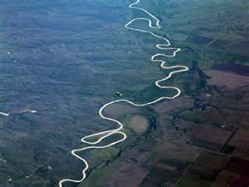
Our communities are tied together by the Mississippi River (Misiziibing). The river is a common “place” (danakamigizi) that all of the students have their own unique understanding of.
Students will use Google Earth Pro and Landsat data to define and share their Place with their research partners around Minnesota.

Slide 8
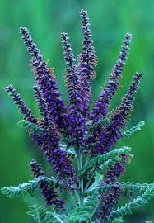
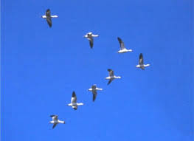
Phenology Defined
The relation between climate and
periodic biological phenomena.
For example: Birds migrating or flowers blooming
In Ojibwemowin: azhigwa (at this time)

Slide 9
Seasons
Months of the year are often named by many Indigenous tribes for the activities that took place during that time. In a sense, this is a type of verbal phenology in the oral traditions. For the Ojibwe of Minnesota the changes in the natural world that take place with the changes of the seasons where closely observed and signified the time to move or take action.
Students of all cultures are encouraged to share the seasonal traditions and words associated with their own cultural teachings as they pertain to the environment and personal observations.

Slide 10
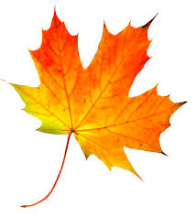
Fall - Dagwaagin
September - Waatebaagaa-giizis
(Leaves Turning Color Moon)
October - Binaakwe-giizis
(Leaves Falling Moon)
November - Gashkadino-giizis
(Freezing Over Moon)

Slide 11
In each season, the research partners will compare specific events in their own area and share their observations with the students in the other parts of the state.
This will provide a framework for presenting Western Science and Native Science in ways that are most effective for our students.
http://www.youtube.com/watch?v=2B5nP21eq-k?hd=1&autoplay=1
https://www.youtube.com/watch?v=rlKKPQH8vj4

Slide 12
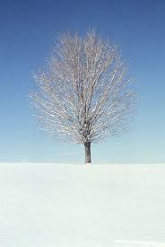
Winter - Biboon
December - Manidoo-giizisoons
(Little Spirit Moon)
January - Gichi-manidoo-giizis
(Great Spirit Moon)
February - Namebini-giizis
(Sucker Fish Moon)

Slide 13
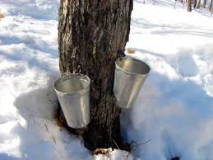
Spring - Ziigwan
March - Onaabani-giizis (Crust on Snow Moon)
April - Iskigamizige-giizis (Sap Boiling Moon)
May - Zaagibaa-giizis (Budding Moon)

Slide 14
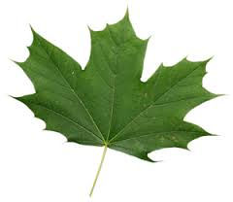
Summer - Niibin
June - Ode’mini-giizis
(Strawberry Moon)
July - Miini-giizis
(Blueberry Moon)
August - Manoominike-giizis
(Ricing Moon)

Slide 15
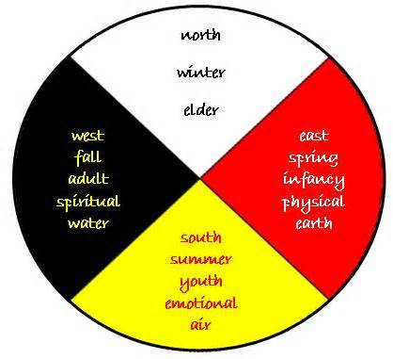

Slide 16
Minnesota State Standards
5.1.3.2.1 Describe how science and engineering are influenced by local traditions and beliefs.
5.1.3.4.2 Create and analyze different kinds of maps of the students’ communities and of Minnesota.
9.1.1.1.2 Science is a way of knowing about the natural world and is characterized by emperical criteria, logical argument and skeptical review.
9.1.3.2.1 2. Men and women throughout the history of all cultures, including Minnesota American Indian tribes and communities, have been involved in engineering design and scientific inquiry.
9.4.4.1.3 1. Human activity has consequences on living organisms and ecosystems.

Slide 17
Additional Resources
G-WOW
http://www.g-wow.org/en-us/default.aspx
Jeffer's Foundation
http://www.jeffersfoundation.org

