Slide 1
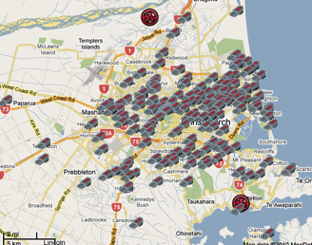
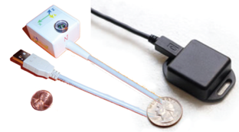
The Quake Catcher Network
Danielle F. Sumy
IRIS

Slide 2
OUTLINE
Basics of Earthquake Science: Rupture Simulations
Quake-Catcher Network: Increase the Density of Observations
QCN Research: In California and Worldwide
How do you fit in? The QCN-EPIcenter Network

Slide 3
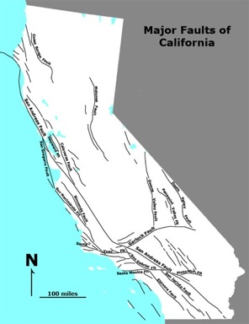
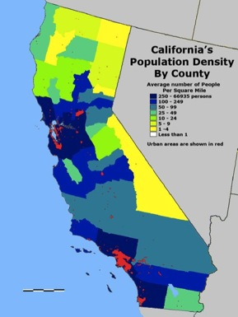
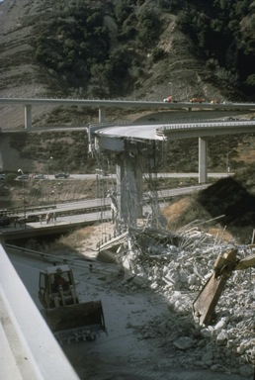
Seismic Risk
Vulnerability of a population to earthquake-related hazards depends on:
  Proximity to earthquake-prone faults
  Population density
  Building construction standards
Notes:
One of the goals of the network is to better understand seismic hazard and the associated seismic risk. This is especially important to determine where there are vulnerable populations which would benefit from improved earthquake monitoring.
The three main considerations when determining seismic risk:
Proximity to faults.
Population density
Construction standards
Let us consider each of these briefly

Slide 4
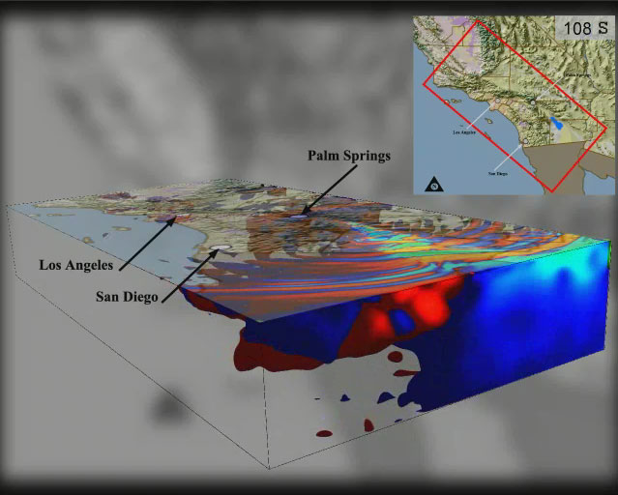
Earthquake Simulations
TeraShake Simulation (SCEC/CME)
M 7.7 Southern San Andreas Animation (SCEC/CME)
Notes:
To better understand seismic risk, we much have a clear picture of the earthquake rupture, the propagation of seismic waves through various materials, and the response of structures to seismic shaking.
I will give a brief overview of recent advances that seismologists and earthquake engineers have made in understanding each of these phenomena. Many of the advances are due in large part to the recent explosion in computing capabilities that has taken place in recent years.

Slide 5
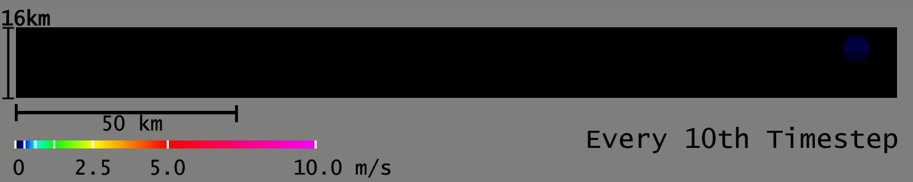
How does a fault break?
We must understand the rupture velocity
and the distribution of slip along a fault
M 7.7 Southern San Andreas Animation (SCEC/CME)
Notes:
First, we must understand the earthquake rupture itself. This shows an animation developed through a collaborative effort between seismologists and computer scientists from the Southern California Earthquake Center and Community Modeling Environment. What you see here is an image of a fault plane, so we are looking into the earth to see what is happening on the fault plane. This animation shows a simulation of M7.7 rupture along the southern San Andreas in California. The colors represent slip velocity with red/pink indicating high slip velocities. From this simulation, you can see the complexity of the earthquake rupture. Currently we do not have the density of observations necessary to know how complex slip is especially away from the surface of the earth. In addition, we do not have a good understanding of why the slip might be so complex, it could be due to change in geologic material along the fault, different stress conditions along the fault, or other unknown effects.

Slide 6
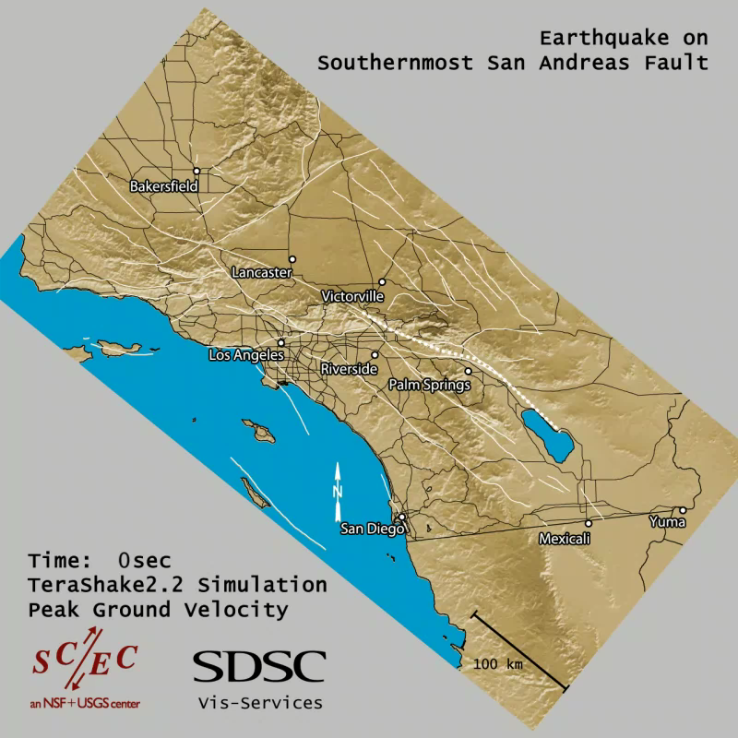
How do seismic waves travel away from a fault?
Notes:
Then, we need to understand how seismic waves propagate out away from the rupture. Depending on the type of geologic material, shape of sedimentary basins, and other conditions the amplitude of shaking varies significantly on small spatial scales. We need to understand in detail how seismic wave properties change while they propagate.
This animations shows the propagation of waves throughout southern California during and after a rupture on the southern San Andreas. This is the same rupture we just saw, but taking that earthquake rupture and propagating waves away from the rupture.

Slide 7
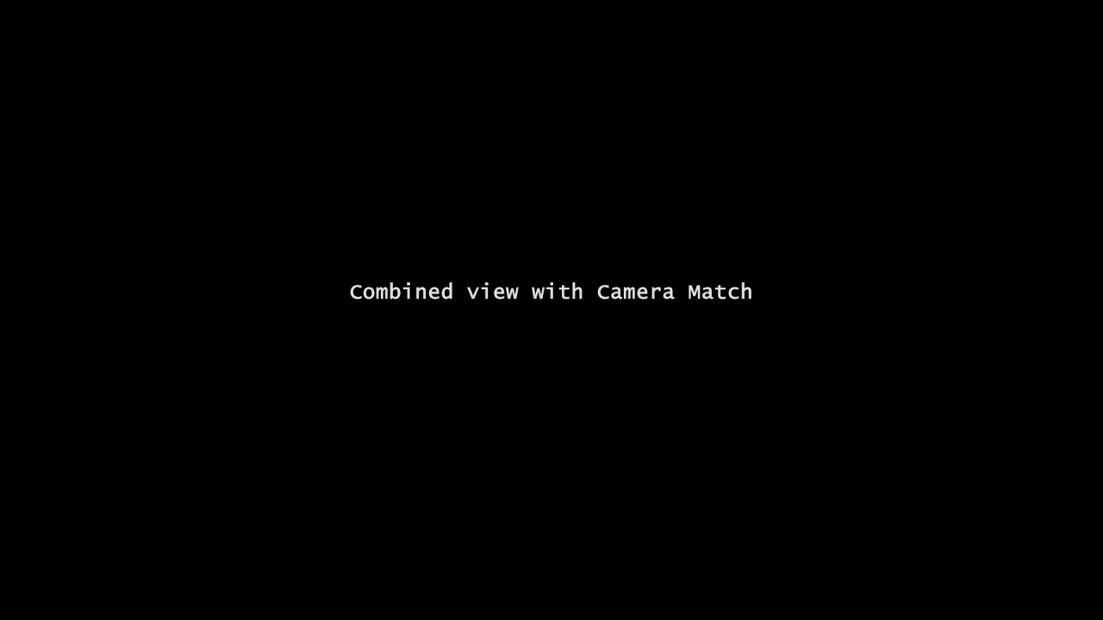
Building Response
SDSC Visualization Services
Notes:
UC San Diego School of Engineering shook a full-size, 275-ton building erected on a shake table, duplicating ground motion from the January 14, 1994 Northridge earthquake in Los Angeles
Building was fitted with 600 sensors and filmed as it was shaken
Building motions were then recreated by the San Diego Supercomputer Center
However, very little data has been collected in buildings and it would be impractical to run shake table tests of many different types of buildings and very large buildings (e.g. skyscrapers).
With the recent incredible advances in modeling fault rupture, wave propagation, and building response, we are in a position where we are lacking the observations at the same resolution as the models. So, we need some way to greatly increase the number of seismic stations around the world. However, very few countries can afford large numbers of traditional seismic stations. At a cost of $10,000 per station, it would require millions of dollars to increase the number of stations in the Los Angeles region by 1000 stations. So, especially in the current economic climate it is difficult to get the funding for such a network even in relatively wealthy countries.
But, with new low-costs MEMS sensor technologies that have become ubiquitous it may be possible to have thousands of sensors in a city at relatively low cost.

Slide 8
To further our understanding of
earthquakes and rupture processes,
we need spatially dense instrumentation
Introducing the Quake-Catcher Network!

Slide 9
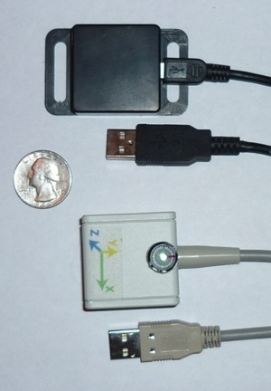
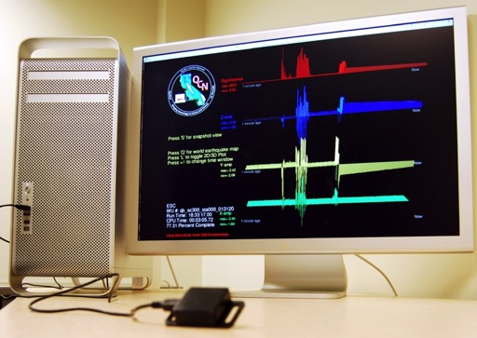
Quake-Catcher Network
Better understand earthquakes and mitigate seismic risk by increasing the density of seismic observations using:
  New sensor technology
  Distributed sensing techniques
  Community participation
Notes:
We began this project a couple of years ago in an effort to increase the the density of seismic stations. A higher density of observations would allow us to conduct high resolution studies of how an earthquake ruptures and hopefully allow us to answer some of the many outstanding questions in seismology.
In order to do this we would need much lower cost instrumentation. Traditional seismic instrumentation costs several thousands to tens of thousands of dollars with additional, large infrastructure costs to install and maintain the instrumentation. In California, we have a very reliable, high-quality seismic network, but the stations are widely spaced, limiting our ability to resolve details of the earthquake source and wave propagation features.
Recent advances in MEMS sensor technologies allow us to have much lower cost instrumentation, for strong motion studies (studies of moderate to large local earthquakes) and distributed computing can dramatically reduce the infrastructure cost.
An added benefit of this is the ability to install instrumentation in peoples homes, offices, and local schools to increase awareness of seismic risk.
Here, I will discuss some of the recent advances in seismology and how increased instrumentation can dramatically advance the field.

Slide 10

QCN: How it Works

Slide 11
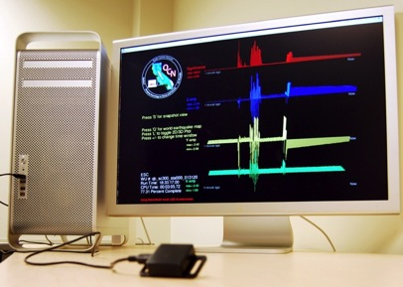
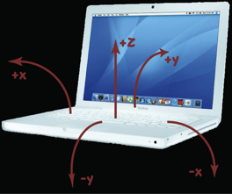
Building the Quake-Catcher Network
Laptops: Many have internal sensors (FREE!)
Desktop computers: MEMS accelerometer attached via USB
  Cost per station: $30 - $100 (depending on noise level)
Challenges: Location, Timing, Noise
Notes:
QCN uses MEMS sensors internal to laptops and external to desktops to record moderate to large earthquakes. The sensors are in most late model laptops as a way to protect the harddrive in case the computer is dropped. In addition, these sensors are in many smart phones and gaming systems. These other industry uses have driven down the cost of sensor technologies while improving the sensitivity, making them an ideal low-cost strong motion sensor.
These stations are not of the same outstanding quality as traditional sensor installations, so we have some challenges to overcome:
We need fairly accurate station locations, so this is done initially through IP-lookup tables and then Google map input by the user
Time is very important in seismology to determine how quickly seismic waves travel through different material, and accurate earthquake origin times
We need some way to distinguish earthquakes from noise. However, we can use a large number of stations to distinguish ‘local’ noise from a regional event that causes multiple sensors in the same area to trigger at about the same time.

Slide 12
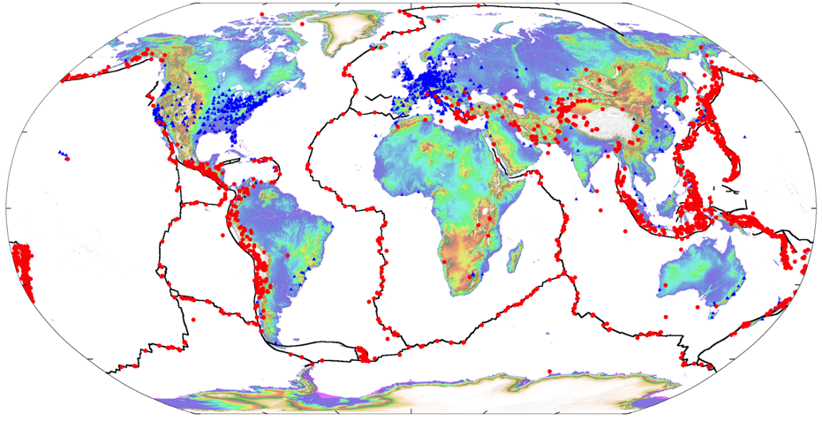
Current Network
Participants
Earthquake Locations
Cochran et al., IEEE, 2009
2500 Seismic stations globally in 67 countries
Recorded earthquakes between M 2.6 (New Zealand) – M 8.8 (Chile)
Statistics

Slide 13
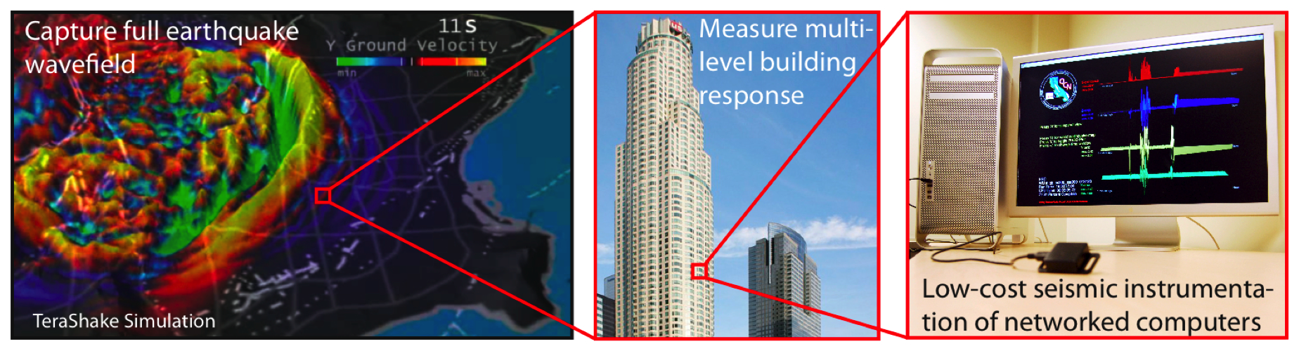
Project Goals
  Rapid earthquake detection and characterization
  Detailed ground motion
  Building Response
Project website: qcn.stanford.edu
Notes:
We want to involve the community in seismic data collection that will be very valuable for advancing the fields of seismology and earthquake engineering. The key here is to get sensors into homes, offices, and schools to understand what the ground shaking is for the places where people are located.

Slide 14

Project Goal: Rapid Earthquake Detection

Slide 15
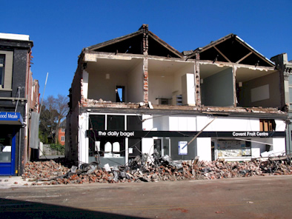
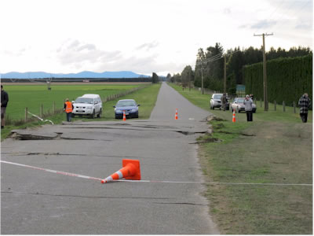
M7.1 Darfield New Zealand Earthquake
3 September 2010

Slide 16
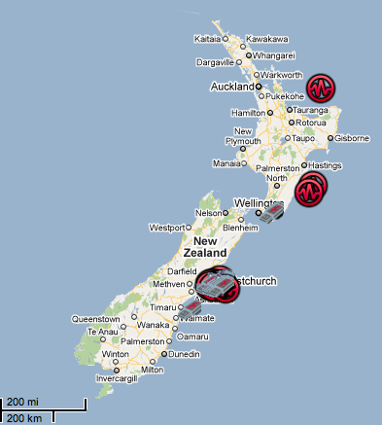
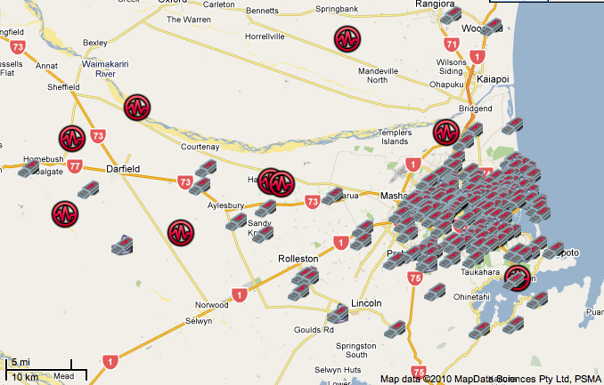
M7.1 Darfield New Zealand RAMP
Installed over 180 sensors in New Zealand in the week following the 3 Sept 2010 M7.2 earthquake
Collaboration between GNS Science and QCN

Slide 17
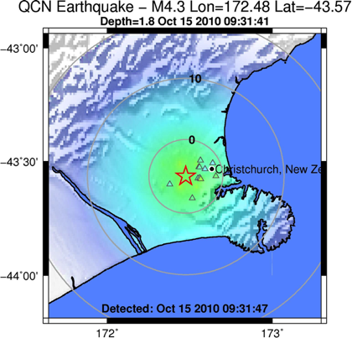
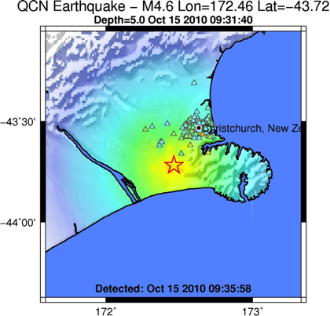
Example: M4.6 Earthquake
Initial event characterization:
5 seconds after the origin time
11 triggers
Final event characterization:
194 total triggers from 104 stations

Slide 18
Detection Time
Most detections occur within 8-12 seconds after the earthquake
Depends on:
  Station-earthquake distance
  Station-server transfer
  Trigger correlation
  Event characterization
Updated with additional information throughout time

Slide 19
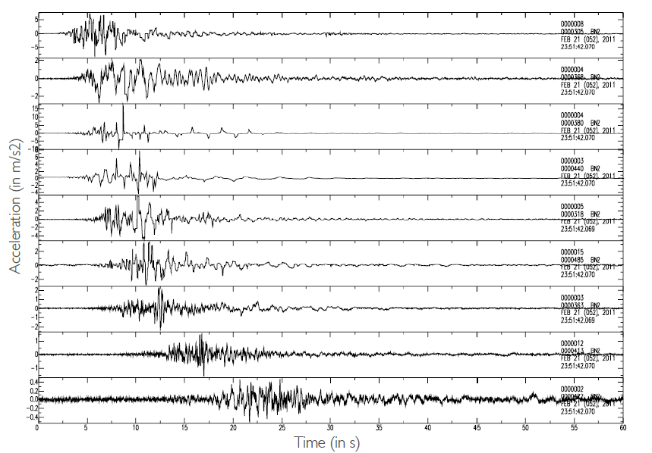
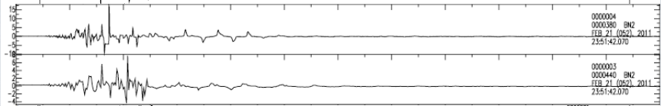
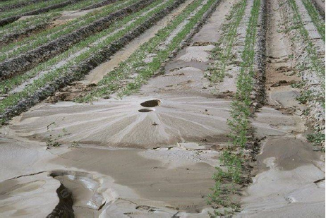

Slide 20
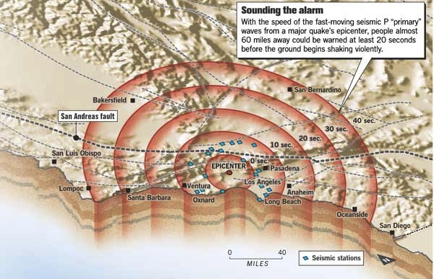
Earthquake Early Warning Systems?
From San Francisco Chronicle
Notes:
Finally, there is the potential to provide information that is useful for earthquake early warning.
EEW use fact that seismic waves travel slower than information over the internet or through telephone lines. So, once an earthquake starts, if you can rapidly detect the earthquake and figure out the location and magnitude you can use this information to warn people who are at greater distances from the earthquake hypocenter.

Slide 21
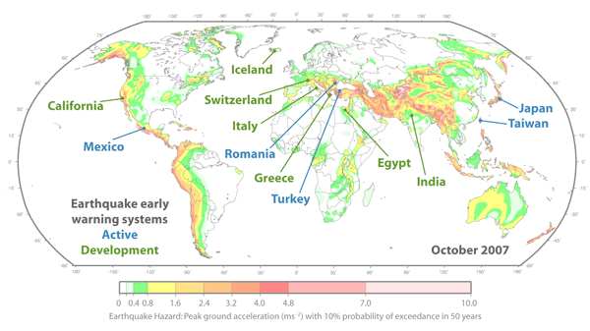
Future: Earthquake Early Warning Systems
From Richard Allen, ElarmS.org
Notes:
Currently there are several EEW systems that are either active or under development throughout the world. The premier system is the one in Japan which sends warning out to slow bullet trains, possibly shut off gas to certain areas, and give warning to the general public.
These systems are able to get warning out sooner with more instrumentation which allows you to detect and characterize the earthquake much sooner to be able to warn more people

Slide 22
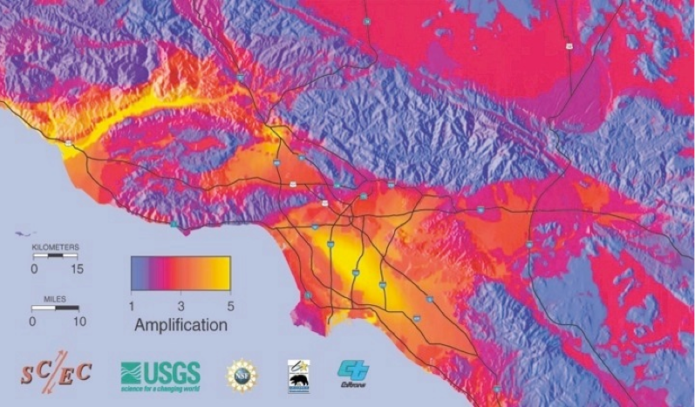
Project Goal: Ground Motion

Slide 23
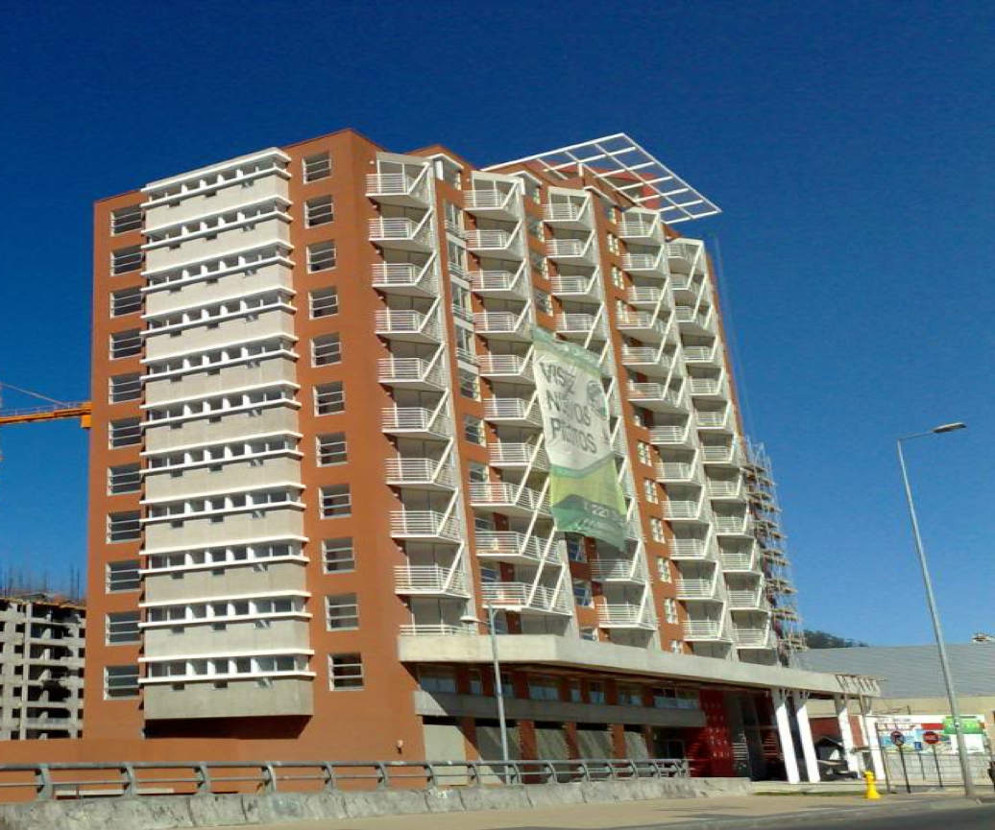
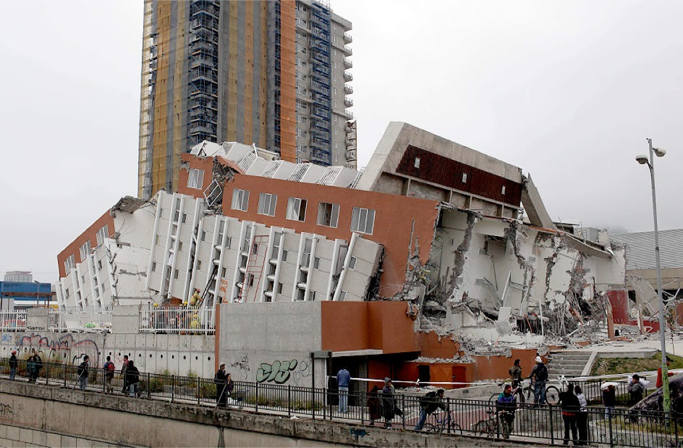
Project Goal: Building Response

Slide 24

Where do you come in?
We need you to
join our network!

Slide 25
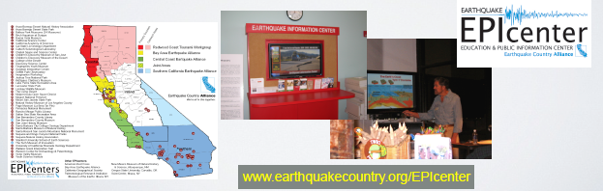
Earthquake Education and Public Information (EPIcenter) Network
EPIcenters include a variety of public venues, like museums, science centers, libraries, schools and universities
Demonstration and encourage earthquake and tsunami preparedness
Help coordinate ShakeOut

Slide 26
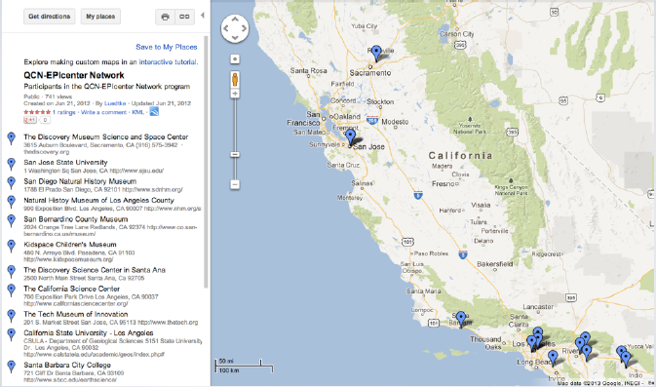
The QCN-EPIcenter Network:
A Network within a Network

Slide 27
QCN in the Classroom
Incorporate sensors into lessons:
  Basics of a seismometer – how they work and identify squiggles
  Plate tectonics – why earthquakes occur where they do
  Physics concepts – displacement, velocity, acceleration

Slide 28
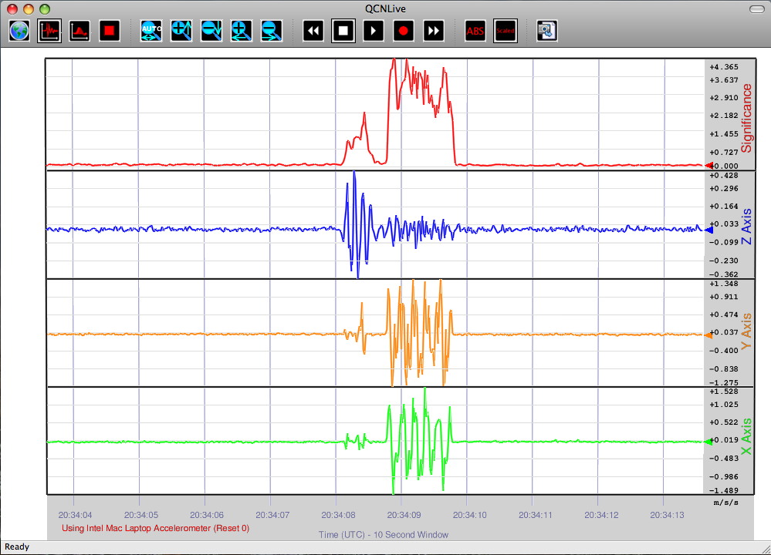
Demo – QCNLive

