Slide 1
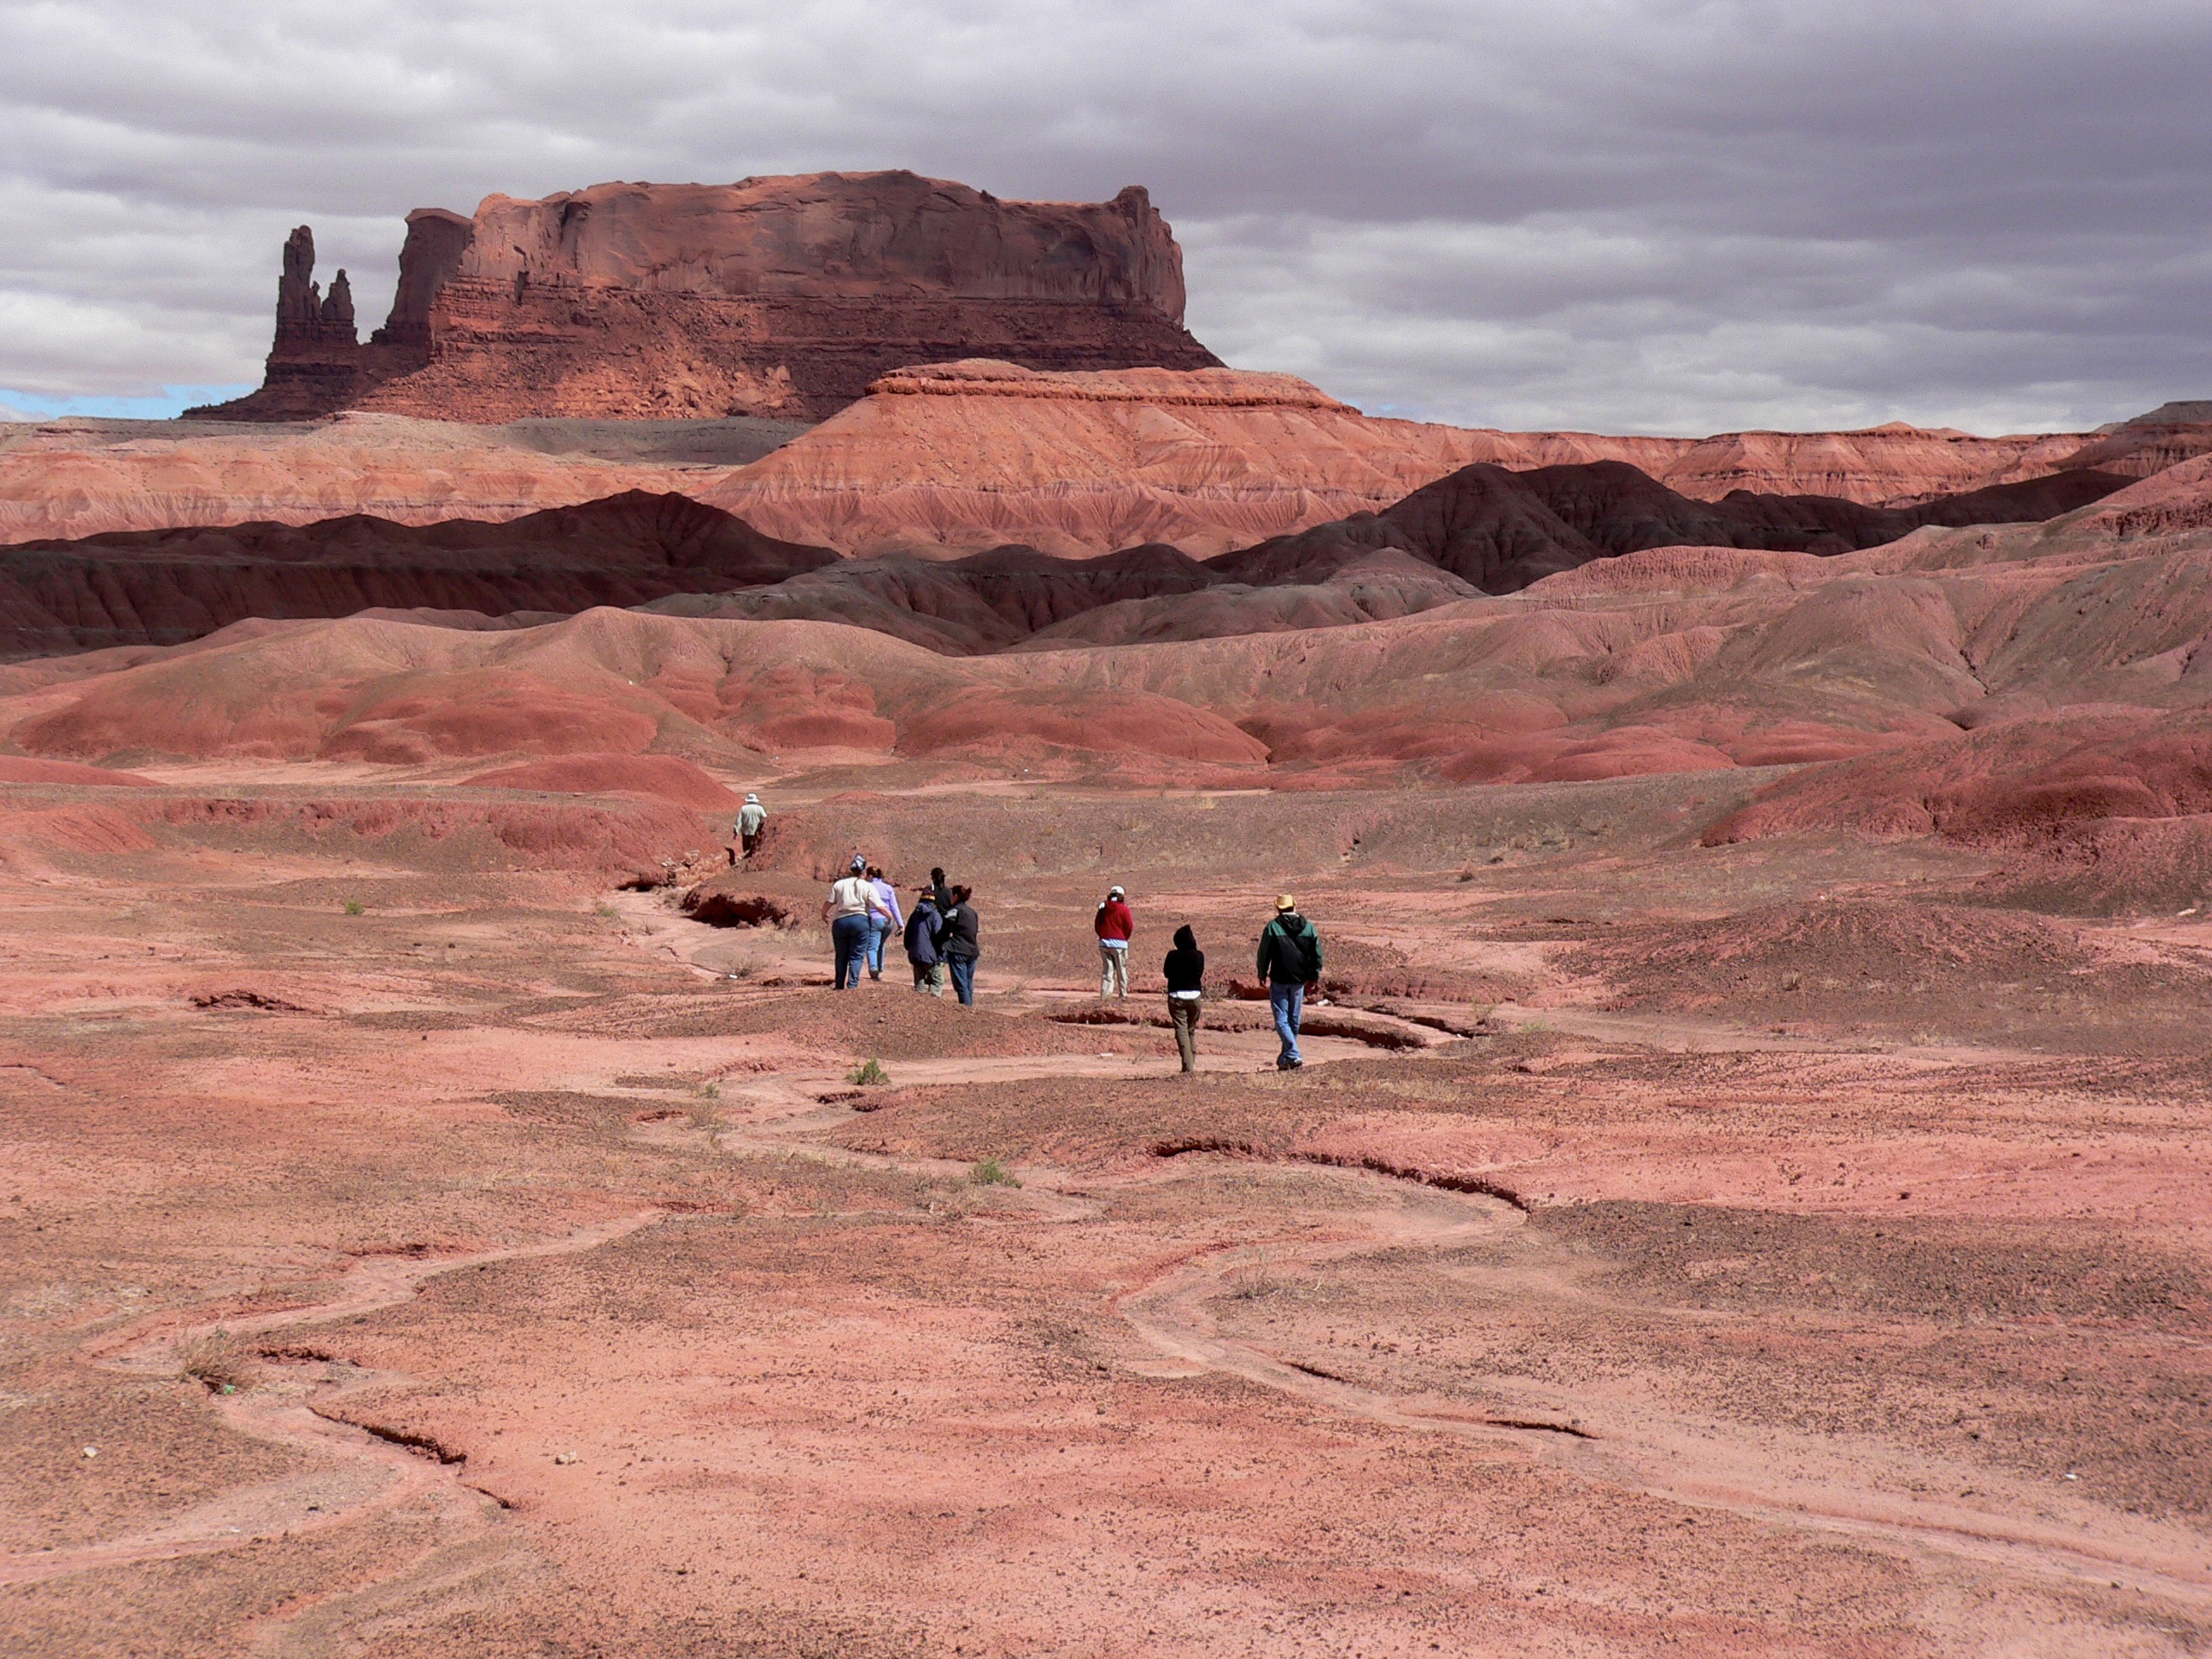
Leverage Sense of Place in Teaching
Southwest Geoscience
Steve Semken, ASU SESE • ESNO

Slide 2
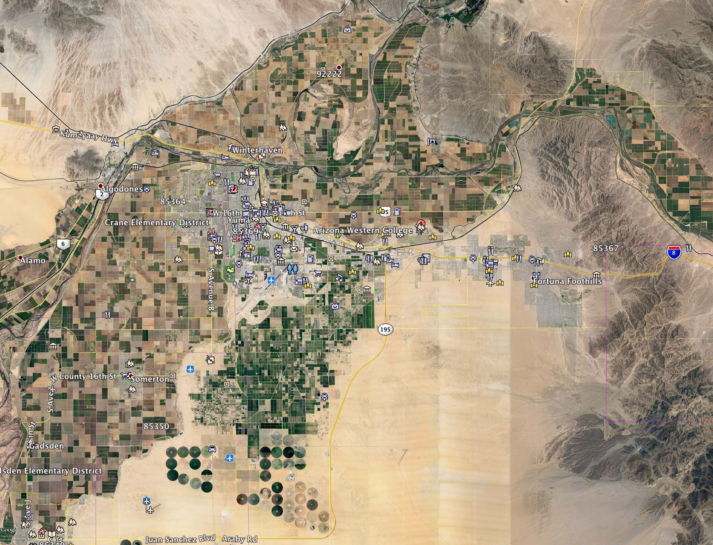
A place is any locality, real or imagined, that accrues meaning by means of human experience.
Place-making is an inherent human behavior.
What begins as undifferentiated space becomes place as we get to know it better and endow it with value. Yi-Fu Tuan, geographer, in Space and Place (1977)
Google Earth

Slide 3
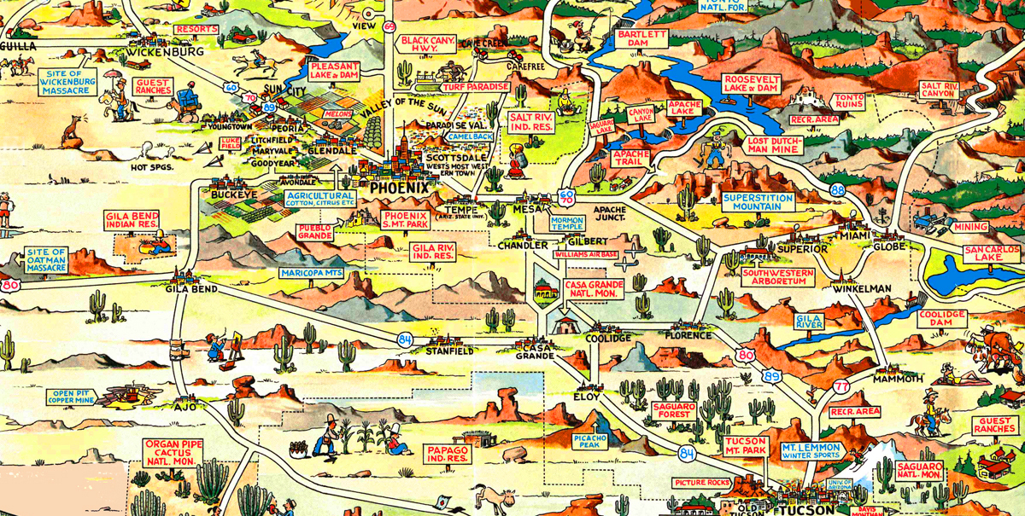
Places populate the cultural landscape just as landforms, water, and biota comprise the physical landscape.
[Landscape] may be defined as an area made up of a distinct association of forms, both physical and cultural. Carl Sauer, geographer, The Morphology of Landscape (1925)
Cartoon tourist map of central Arizona (Bloodgood, 1950)

Slide 4
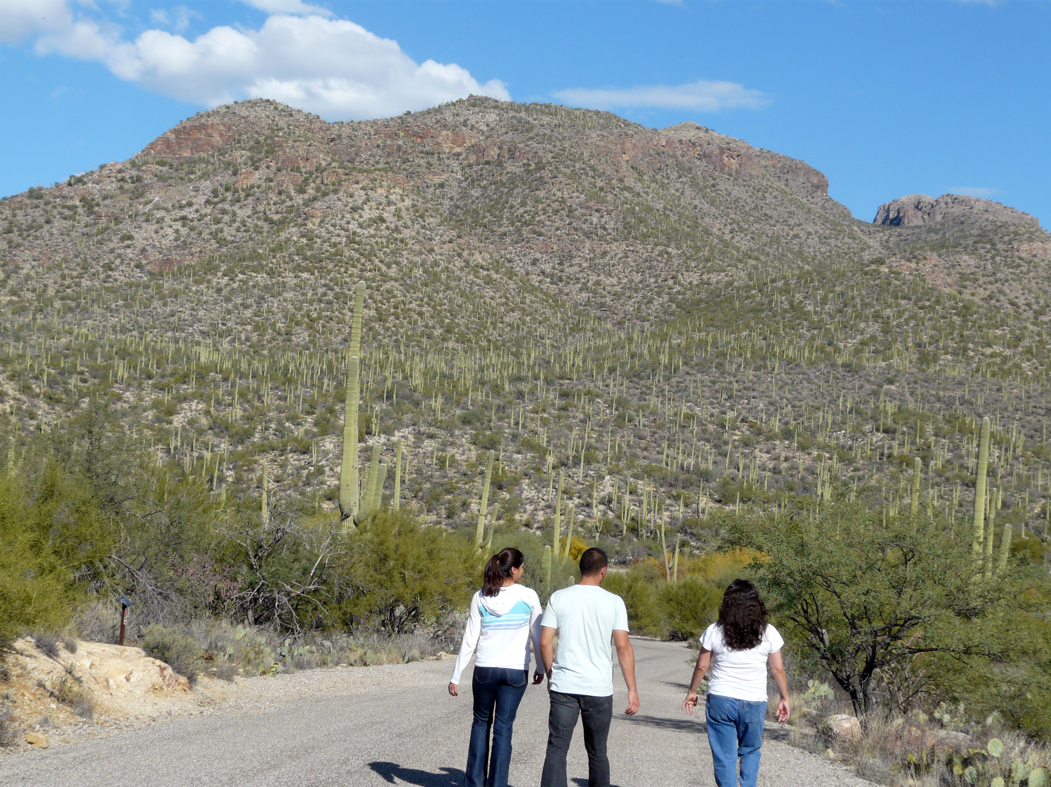
The sense of place encompasses meanings and attachments, hence encapsulating the human connection to place (and Earth).
People imbue places
with diverse
place meanings
People form
place attachments
to meaningful places
Sense of place is the set of all meanings and attachments
held by an individual or a group for any given place.
(e.g., Brandenburg & Carroll, 1995; Shamai, 1991; Young, 1999; Williams & Vaske, 2003; Williams & Semken, 2011)
Sabino Canyon, Arizona

Slide 5
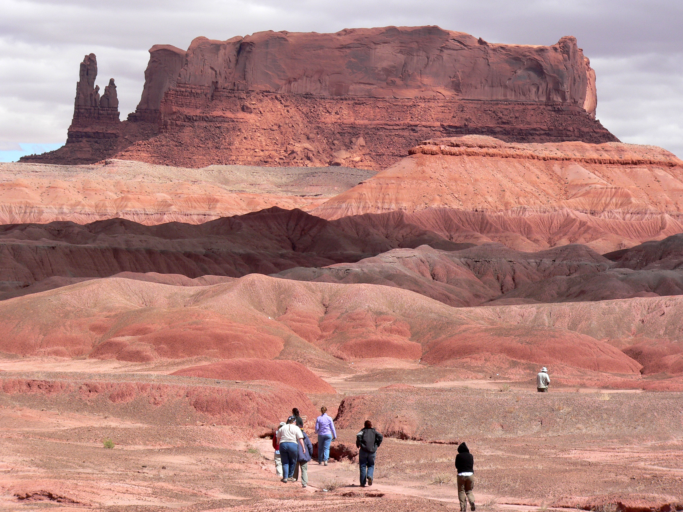
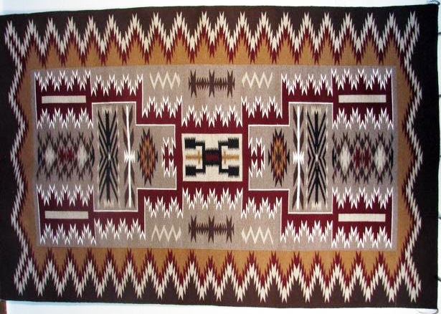
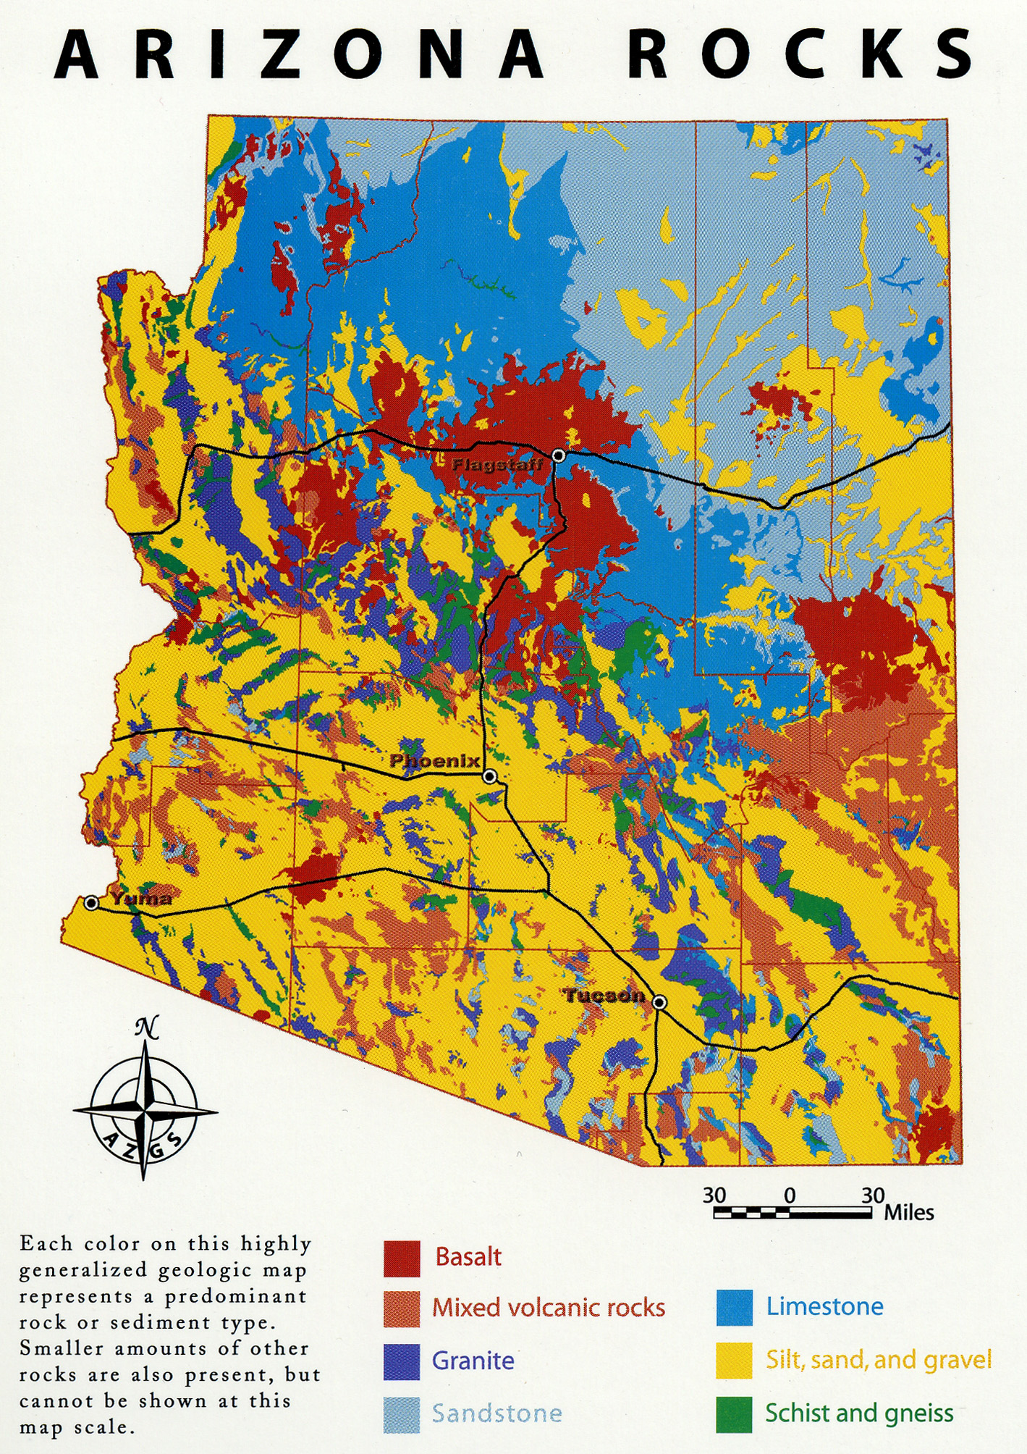
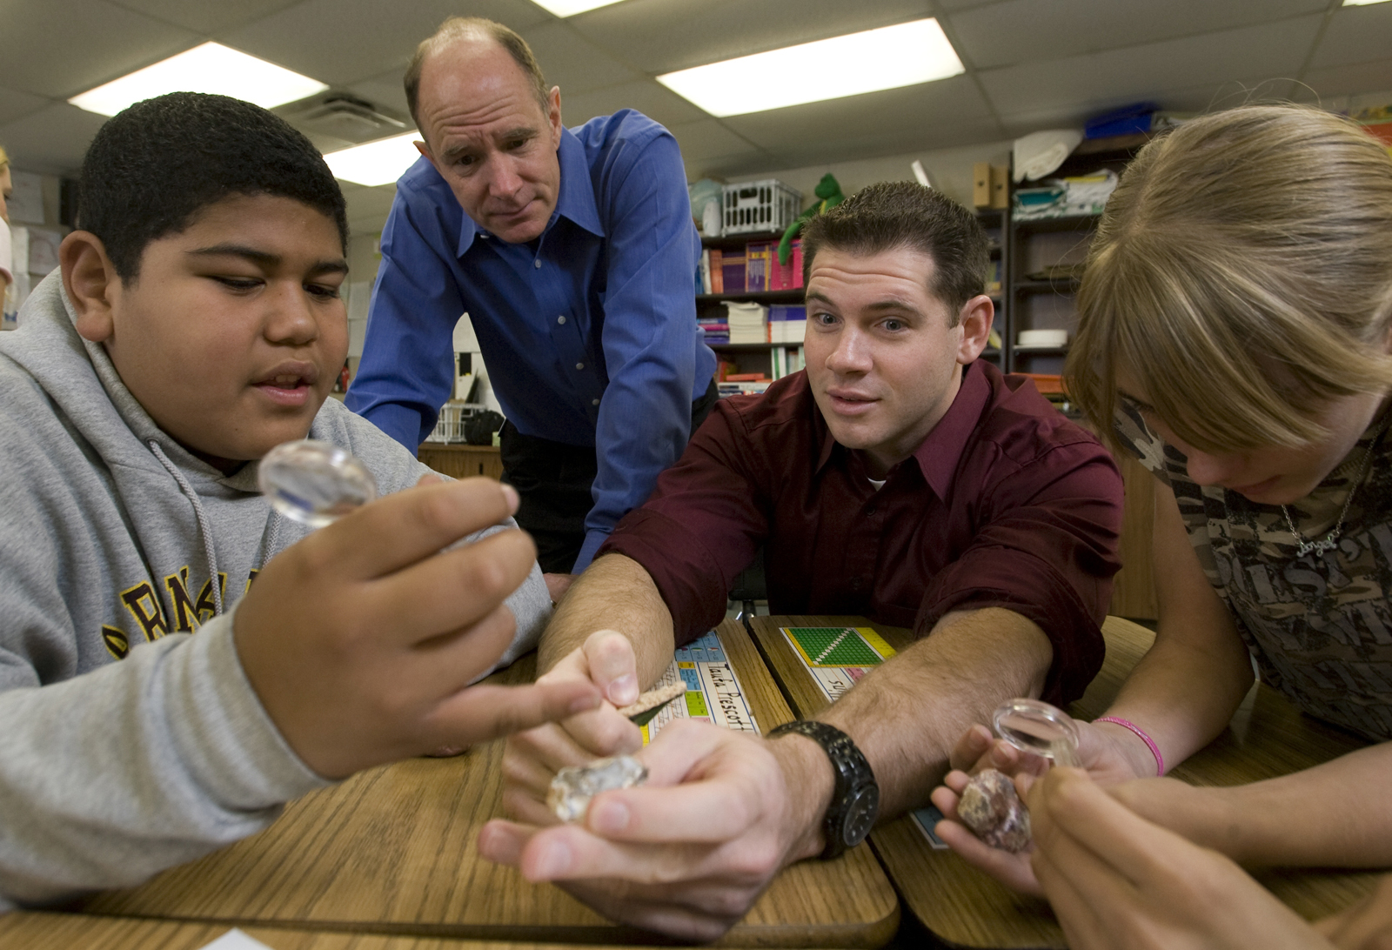
Place-based education is learning fully situated in place.
Typical characteristics of the approach include:
Experiential learning in the field, environment, neighborhood (or virtual setting?).
Use of local examples and cases: focus on Earth-system features and processes that occur or occurred locally or regionally.
Integration of artistic, humanistic, cross-cultural, and cross-lingual place knowledge as relevant context for scientific inquiry and interpretation
Engagement with relevant environmental and cultural issues and case studies of local or regional significance.
Service-learning or creative projects that offer return to the community.
Teaching to promote environmental and cultural sustainability of the places studied.
Leveraging and enhancing sense of place to motivate learners and instructor alike.

