Slide 1
Beyond the slinky: Sequencing activities, earthquake visualizations, and demonstrations to enhance student learning of seismic waves
John Taber and Michael Hubenthal
IRIS Consortium

Slide 2
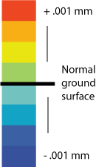
Let’s Compare

Slide 6
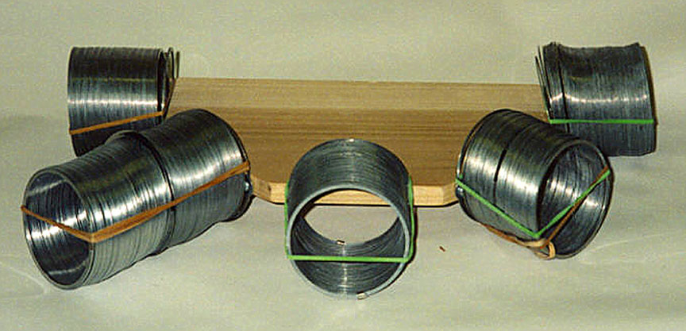
Wave fronts to ray paths – following packets of energy

Slide 7
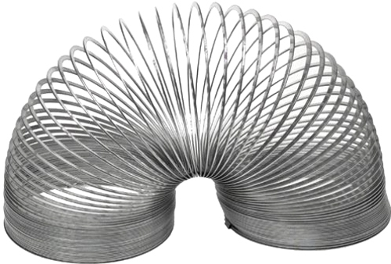
Slinky
Notes:
Why do seismic waves propagate?
What is being transferred by seismic waves?
Why no s-waves in outer core?

Slide 8
If you need an elastic spring for waves to travel in a material, where is the spring in the Earth?
Notes:
Why do seismic waves propagate?
What is being transferred by seismic waves?
Why no s-waves in outer core?

Slide 10
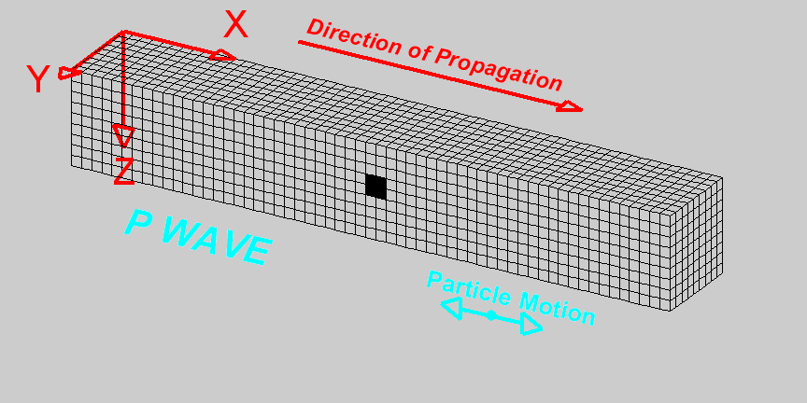
Compressional Wave (P-Wave)

Slide 11
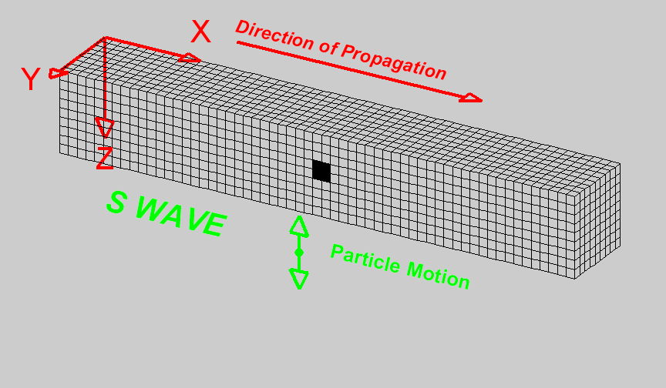
Shear Wave (S-Wave)

Slide 12
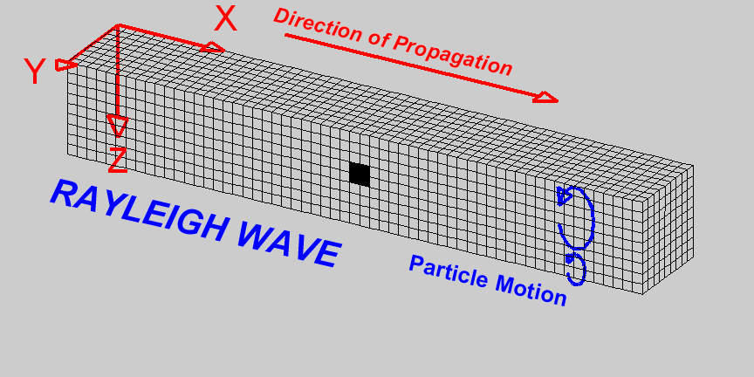
Rayleigh Wave

Slide 13
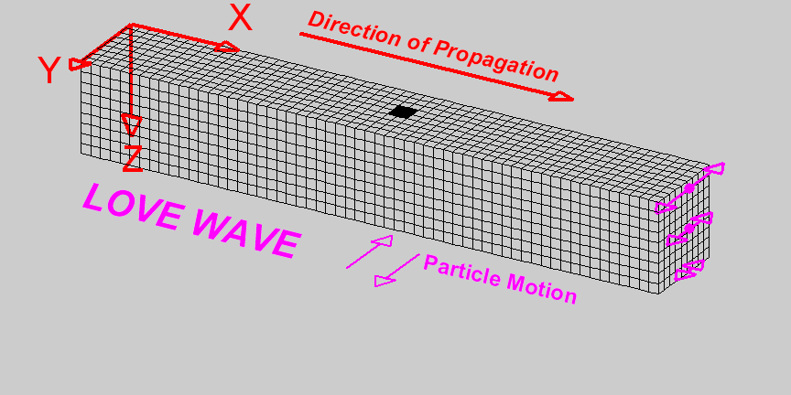
Love Wave

Slide 14
Human Wave

Slide 15
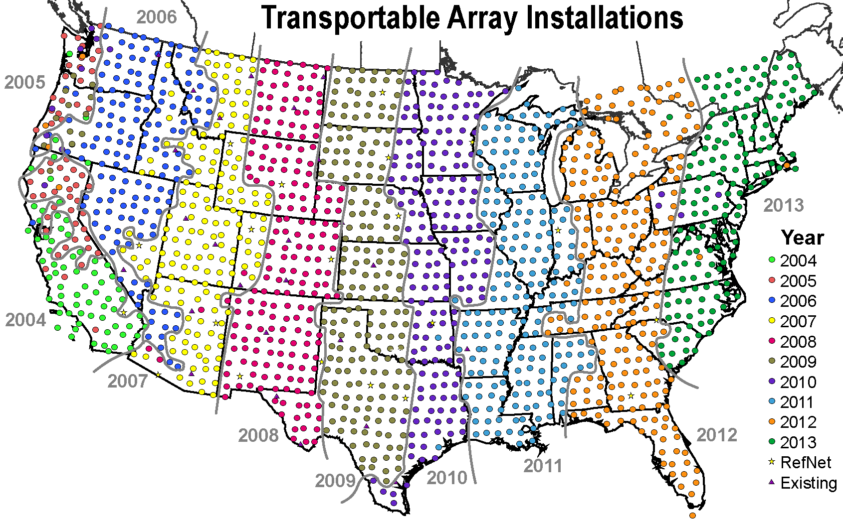
UArray

Slide 18
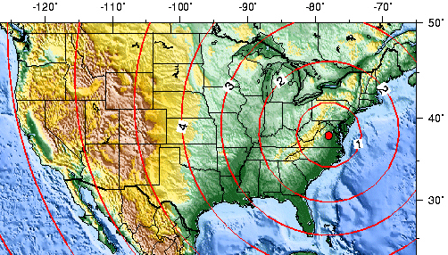
Magnitude 5.8 VIRGINIA Tuesday, August 23, 2011 at 17:51:04 UTC
Courtesy USGS
The above map shows the predicted (theoretical) travel times, in minutes, of the first compressional (P) wave from the earthquake across the United States.
Movie showing seismic waves crossing the US recorded by the USArray.

Slide 21
Sequence summary
Earthquakes: Like ripples on water?
How same?
How different?
Wave fronts to ray paths – 5 slinky model
Slinky
P, S waves
Energy transfer
Elastic medium
Bendable rock
Other Earth materials
Silly putty <-> mantle
Layers – metal/plastic slinky
Human wave
USArray visualizations
Intro versions
Choose a recent earthquake
Using data to improve Earth models

