Slide 1
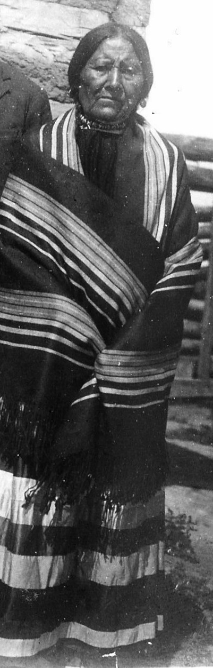

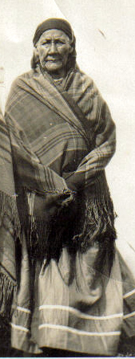
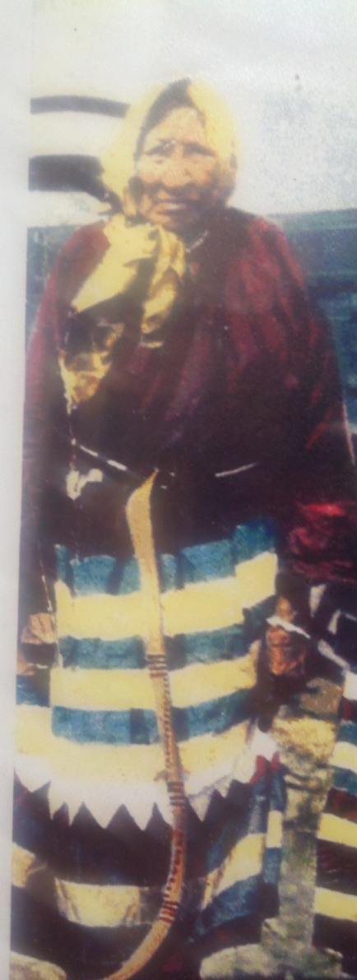
Presented by
Lisa Lone Fight
Soil Scientist
Ice Scientist
Climatologist
Hydrologist
Under the Watch of Elders: Indigenous Earth Science

Slide 2
Cultural-based Approaches to Science Education
The idea of cultural-based approaches to science education is a new development in a long history of Indigenous education and reflects an evolution of thought related to self-determination, community-based education and the preservation of cultural identity. (Cajete, 1999)

Slide 3

Indigenous Earth Science
MAAA UD ITZ A WEE- Hidatsa Indigenous Knowledge System Indigenous Earth Science is Tribally Specific
•Tribal Worldview: An Indigenous Earth Science Framework incorporates a tribal worldview while remaining flexible
•Community: Indigenous Earth Science uses methods that fit our community’s needs and conditions
Ownership: In defining Indigenous Earth Science , we take ownership
Sovereignty: Indigenous Earth Science respects and serves tribal self-determination and sovereignty
Learning: Indigenous Earth Science is about learning and using information

Slide 4
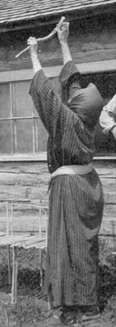
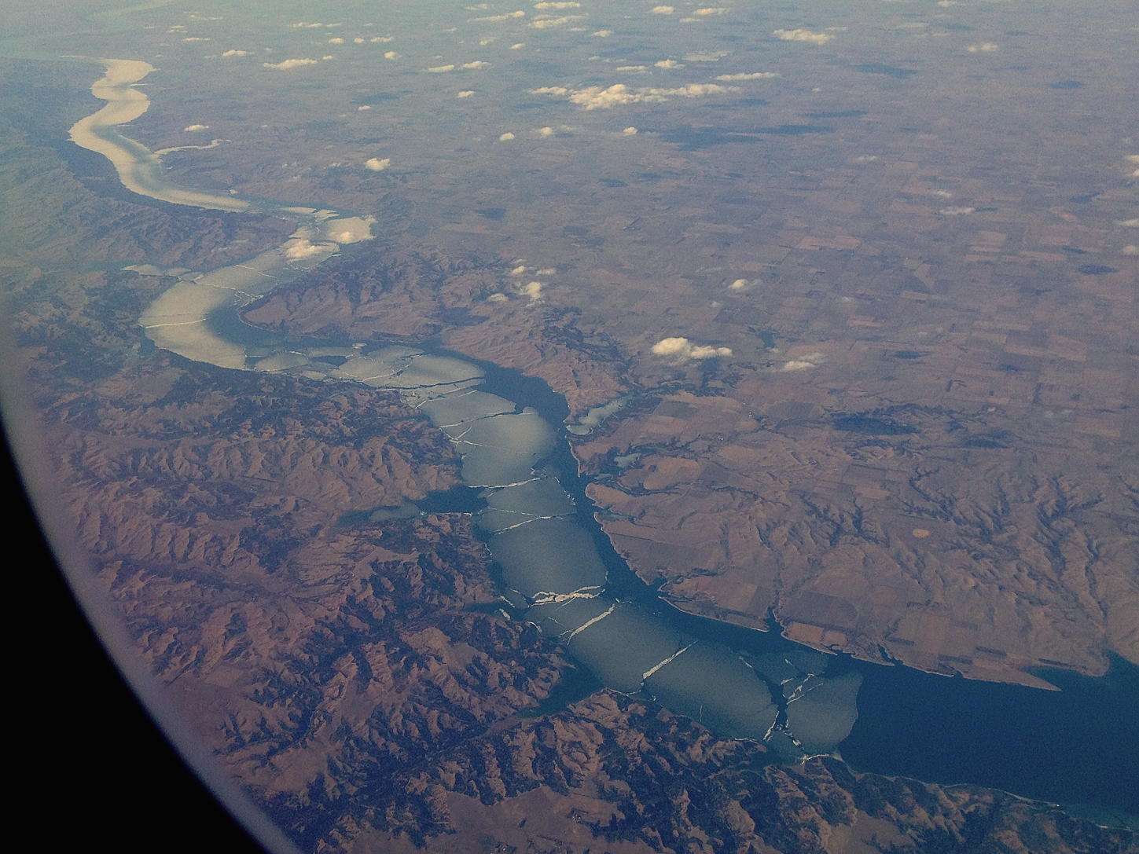
Earth Science in our languages: Remote Sensing
Uh wah tee-Muddy Water-Missouri River

Slide 5
Indigenous Earth Science. is generational
Involves the active use of elders
Involves the active participation of youth
Is based in community knowledge
Is focused on transmitting and retaining cultural knowledge

Slide 6
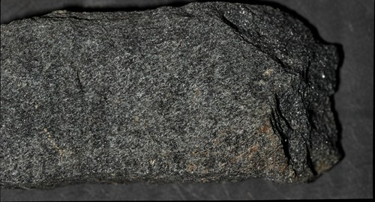
Earth Science in our languages: how to Age Rock --Schist
Wind River Schist from Wind River Canyon Wyoming

Slide 7
Indigenous Climate Knowledge
Indigenous science allowed our communities through accumulated knowledge to understand:
  Patterns of weather
  How and when local natural disasters occur
  When they were likely to recur
  How to plan to cope with their impacts on the natural environment, livelihoods, and lives

Slide 8
Indigenous Earth Science takes a complex view of traditional knowledge
Experiential
Native Language
Received
Experimental
Observed

Slide 9

Indigenous Earth Science :Geography

Slide 10
Indigenous Earth Science is Wholistic/Connected
Tells a Story
Seeks out connections
Is nonlinear
Is process oriented

Slide 11
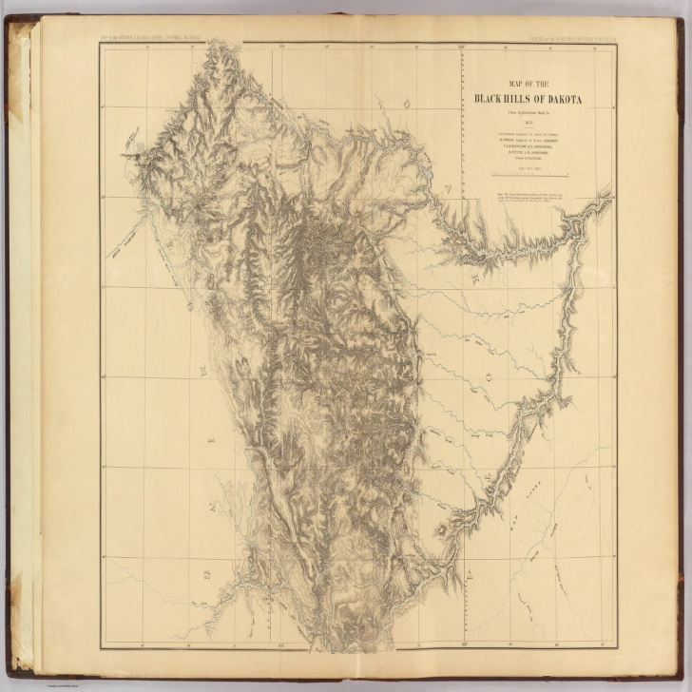
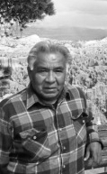
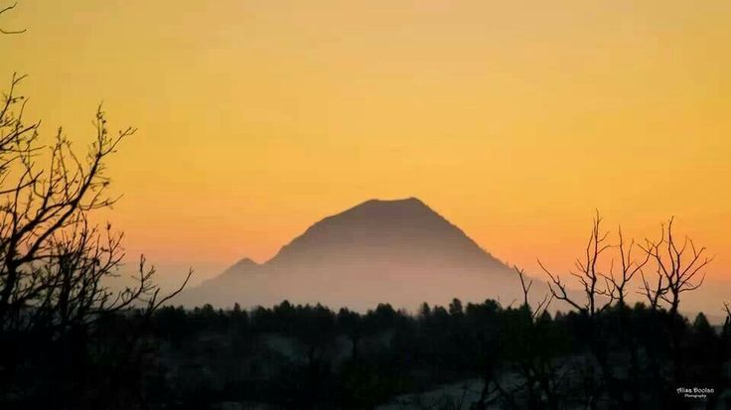

Indigenous Earth Science :GIS and Mapmaking and the Black Hills

Slide 12
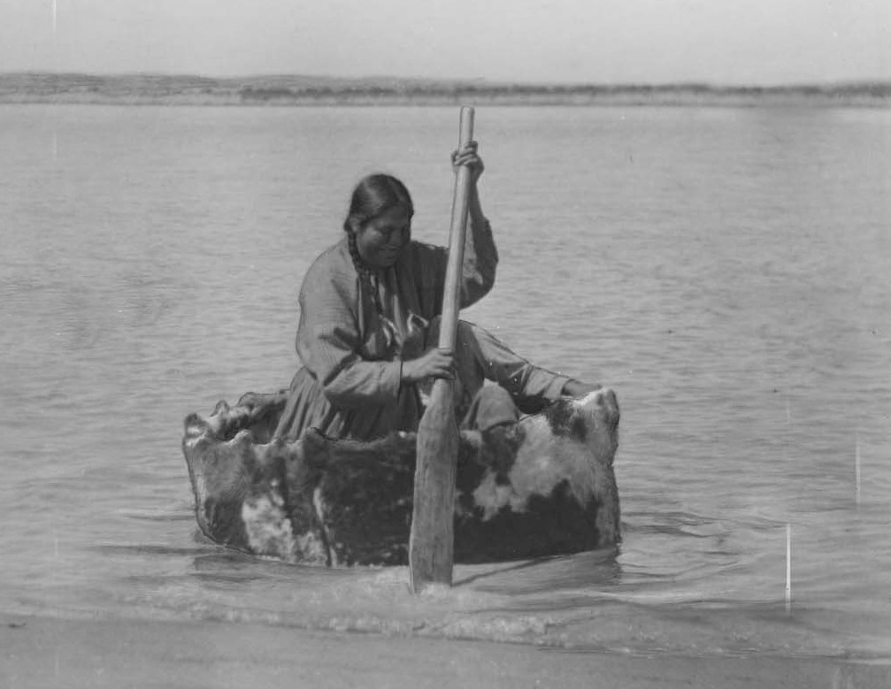
Indigenous Earth Science :Fresh Water science or Limnology
Yellow Cloud in Bullboat Understanding Currents

Slide 13
Indigenous Earth Science is Practical/relevant
Has Contemporary Value
Strengthens Identity
Teaches Skills

Slide 14
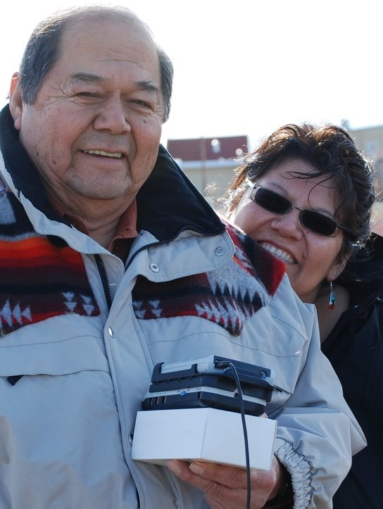
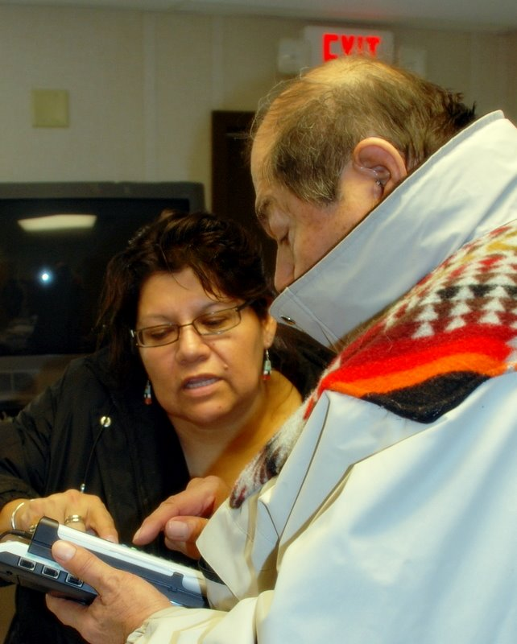
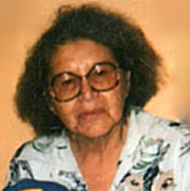
Indigenous Earth Science Researchers

Slide 15
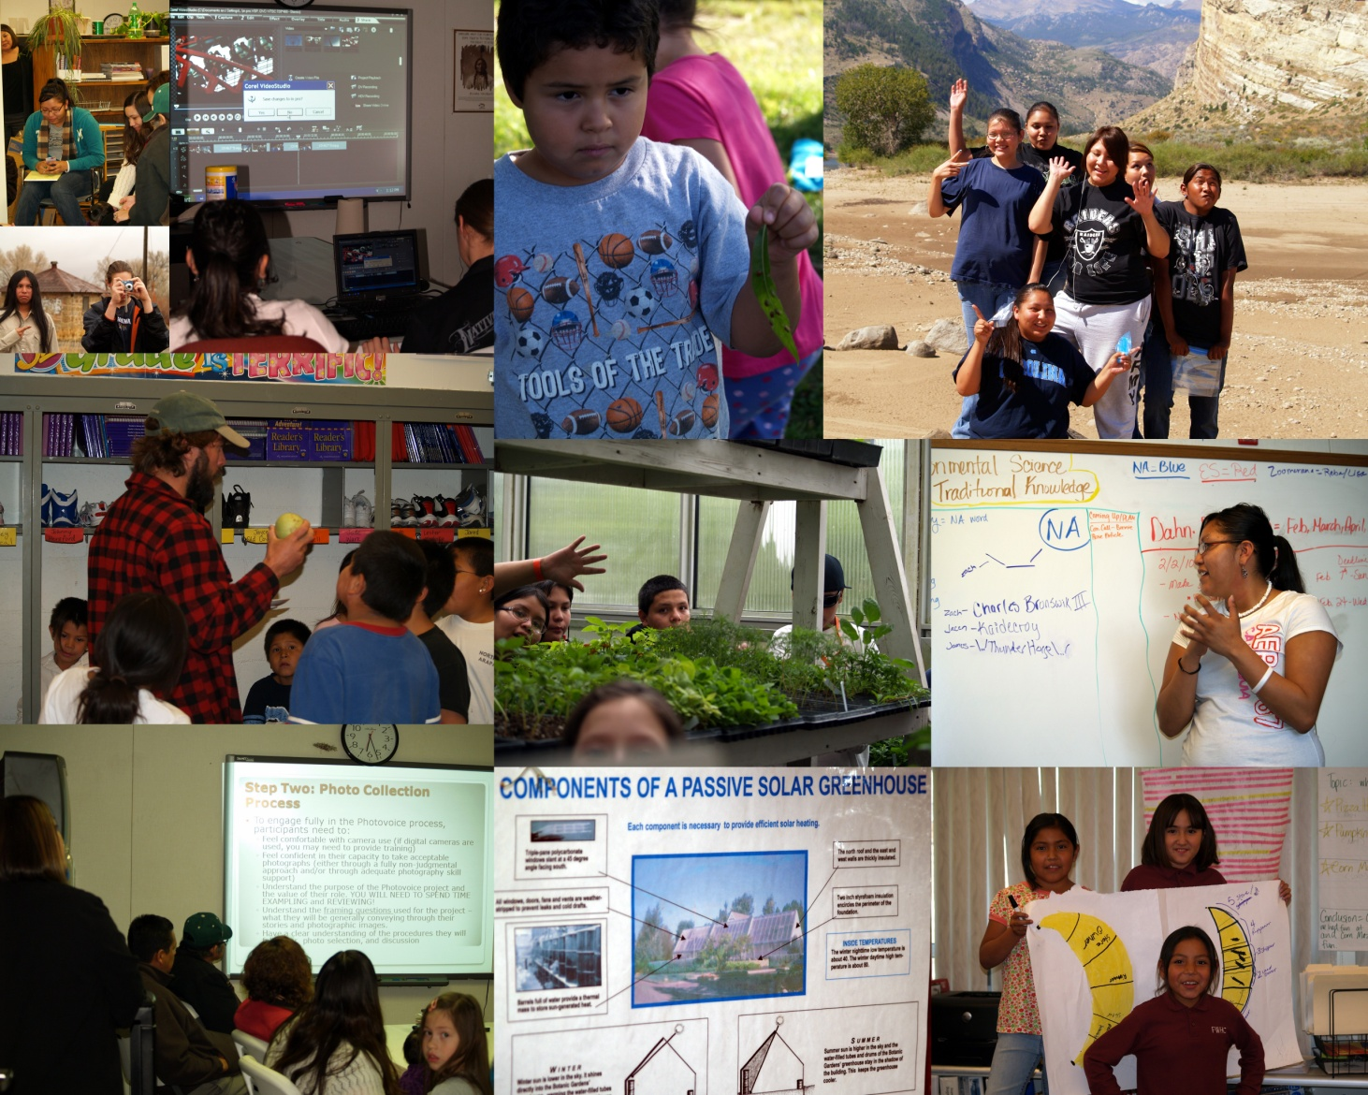
Indigenous Earth Science Case Study: The Wind River Native Science Field Center
Director of the WRNSFC an NSF funded project to promote informal science learning on the Wind River Reservation in Wyoming

Slide 16
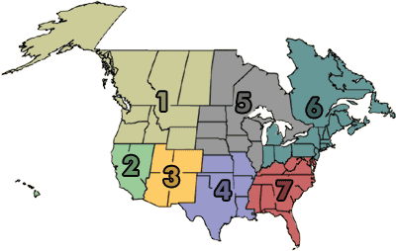
Indigenous Earth Science : American Indian Science and Engineering society
AISES chapters are divided into seven regions across the United States and Canada.
Region 1 – Northwest: Alaska, Canada (British Columbia, Alberta, Yukon Territory, and Northwest Saskatchewan), Idaho, Montana, Oregon, Washington and Wyoming.
Region 2 – West: California, Hawaii and Nevada
Region 3 – Southwest: Arizona, Colorado, New Mexico and Utah
Region 4 – South-Central: Arkansas, Kansas, Louisiana, Missouri, Oklahoma and Texas
Region 5 – Upper Midwest: Canada (Manitoba and Ontario), Iowa, Illinois, Michigan – Upper Peninsula, Minnesota, Nebraska, South Dakota and Wisconsin
Region 6 – Northeast: Canada (Quebec, Newfoundland, New Brunswick, Nova Scotia, and Prince Edwards Island), Connecticut, Indiana, Massachusetts, Maine, Michigan – Lower Peninsula, New Hampshire, New Jersey, New York, Ohio, Pennsylvania, Rhode Island and Vermont
Region 7 – Southeast: Alabama, Delaware, District Of Columbia, Georgia, Kentucky, Maryland, North Carolina, South Carolina, Tennessee, Virginia, and West Virginia

Slide 17
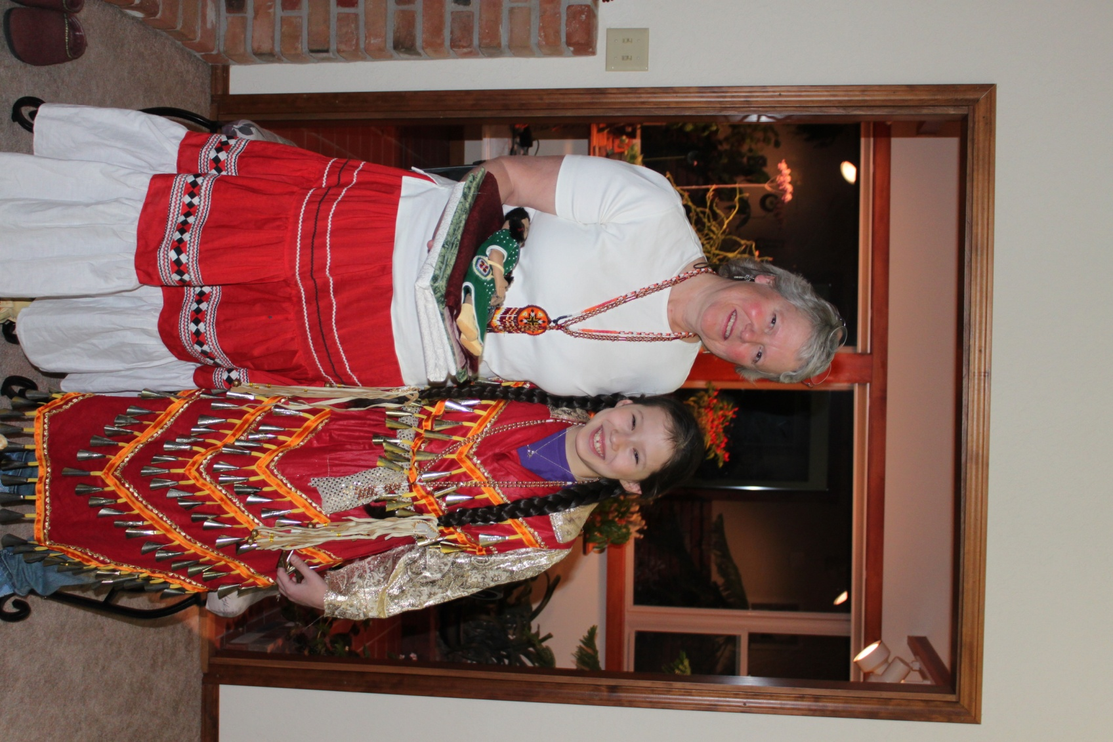
Summary of indigenous Earth Science
Science that celebrates success
Science that speaks from the community
Science resources for Native communities
Participatory & collaborative approaches
Seek to understand
Science that creates a pathway (roadmap),
Science that is Intergenerational
Science that is continuous
Science that is reciprocal

