Slide 1
IRIS Education and Public Outreach: K-16 Resources
We advance awareness and understanding of seismology and geophysics, while inspiring careers in Earth sciences
John Taber, taber@iris.edu
Director of Education and Public Outreach
www.iris.edu

Slide 2
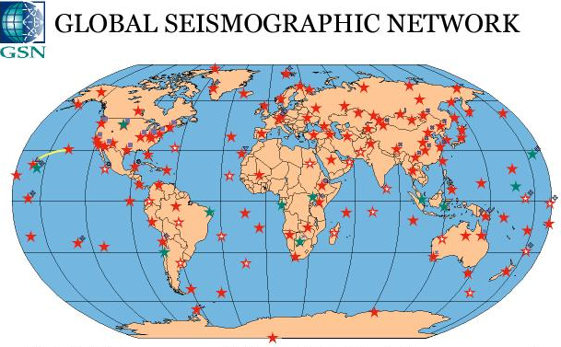
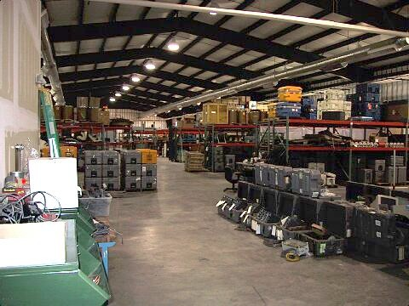
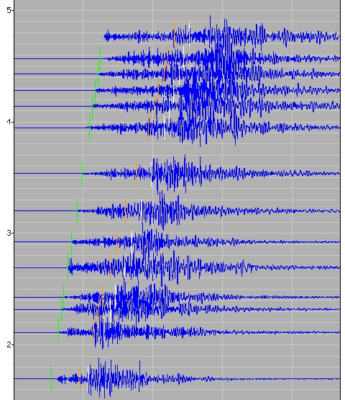
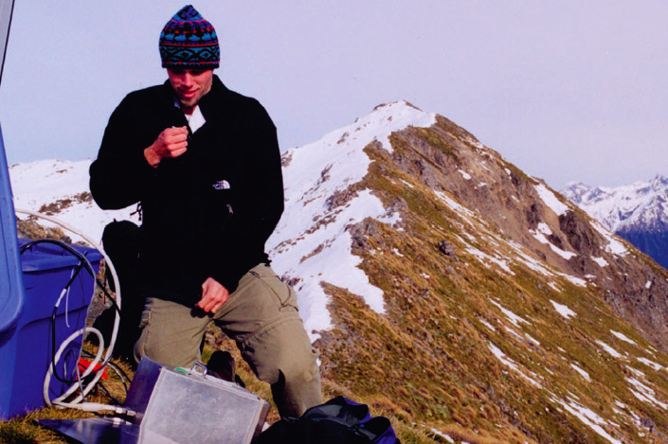
What is IRIS?
Consortium of 140 US colleges and universities
Global Seismic Network
Equipment pool of thousands of portable seismographs for worldwide field studies
Free and open access to all data and data products
USArray
Education and Public Outreach

Slide 3
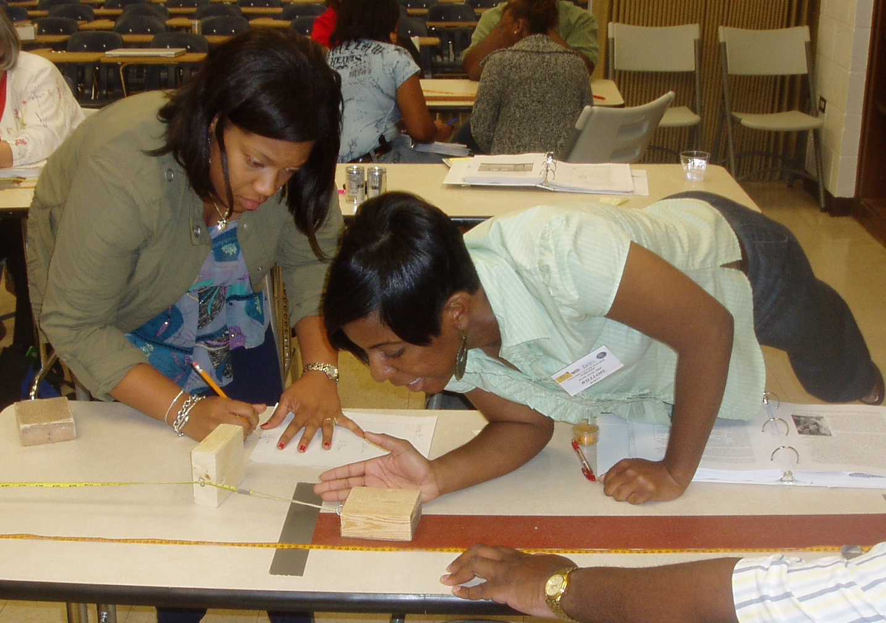
Education and Public Outreach Program
Seismology in the science classroom
K-12, undergraduate, graduate
Public awareness of earthquakes and Earth science

Slide 4
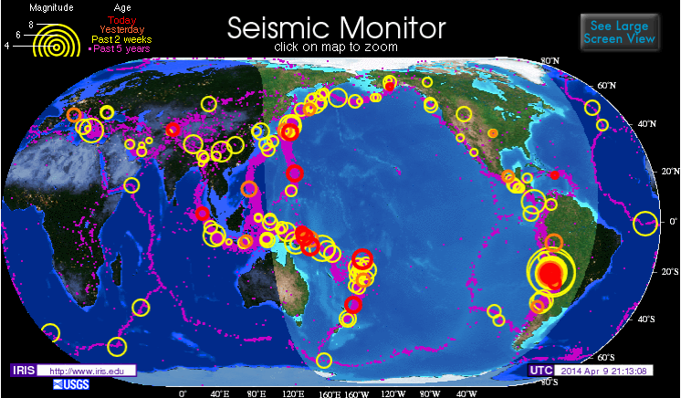
Viewing and exploring earthquake locations
Seismic Monitor
Quick look at last 2 weeks
Earthquake Browser
Explore recent and the past 50 years of earthquake locations worldwide
Map view and 3D
Notes:
Salaries from SAGE, participant support via REU award

Slide 5
Teachable Moment slide sets
Newsworthy earthquakes motivate students
Slide sets produced within 1 day for M7+ earthquakes
Tell a story about the earthquake
Jointly produced with Univ. of Portland, collaborative content from USGS, UNAVCO, ESNO and others
In English and Spanish

Slide 6
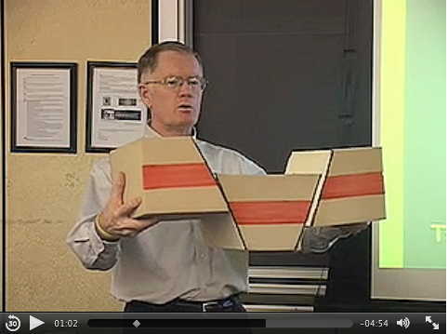
Animations, videos, social media
Over 100 animations, visualizations and videos for use in teaching
Via website and Youtube
Designed to simplify and demonstrate concepts
Follow us on Facebook and Twitter

Slide 7
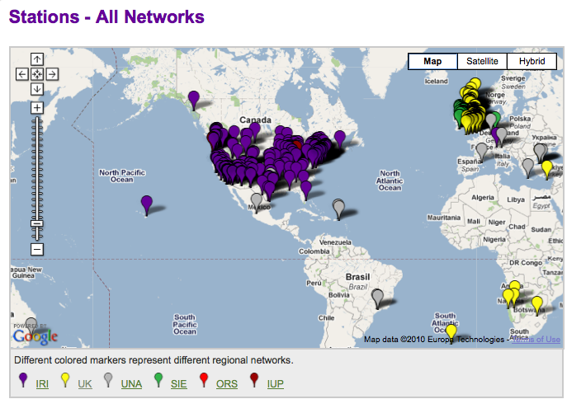
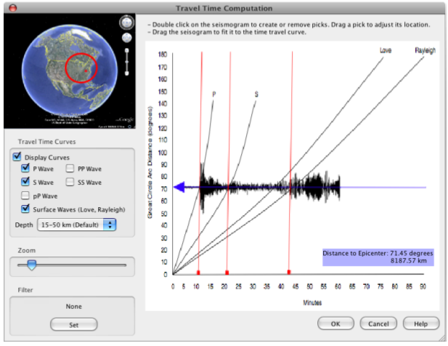
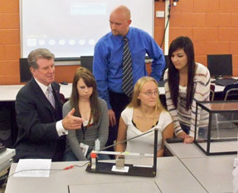
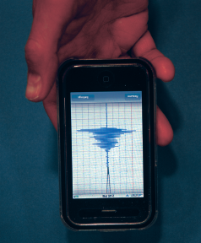
Seismographs in Schools
Teacher training and specialized software
Software will also display nearly-live data from Mars!
Web environment to improve connections between schools
Over 150 US schools
250 international schools
USB accelerometers and smart phones for engagement

Slide 8
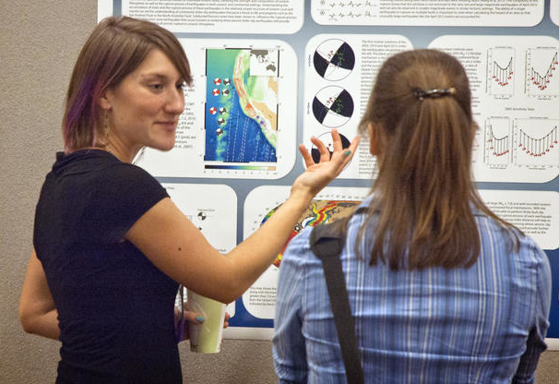
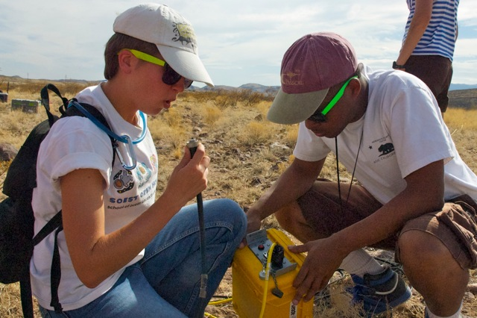
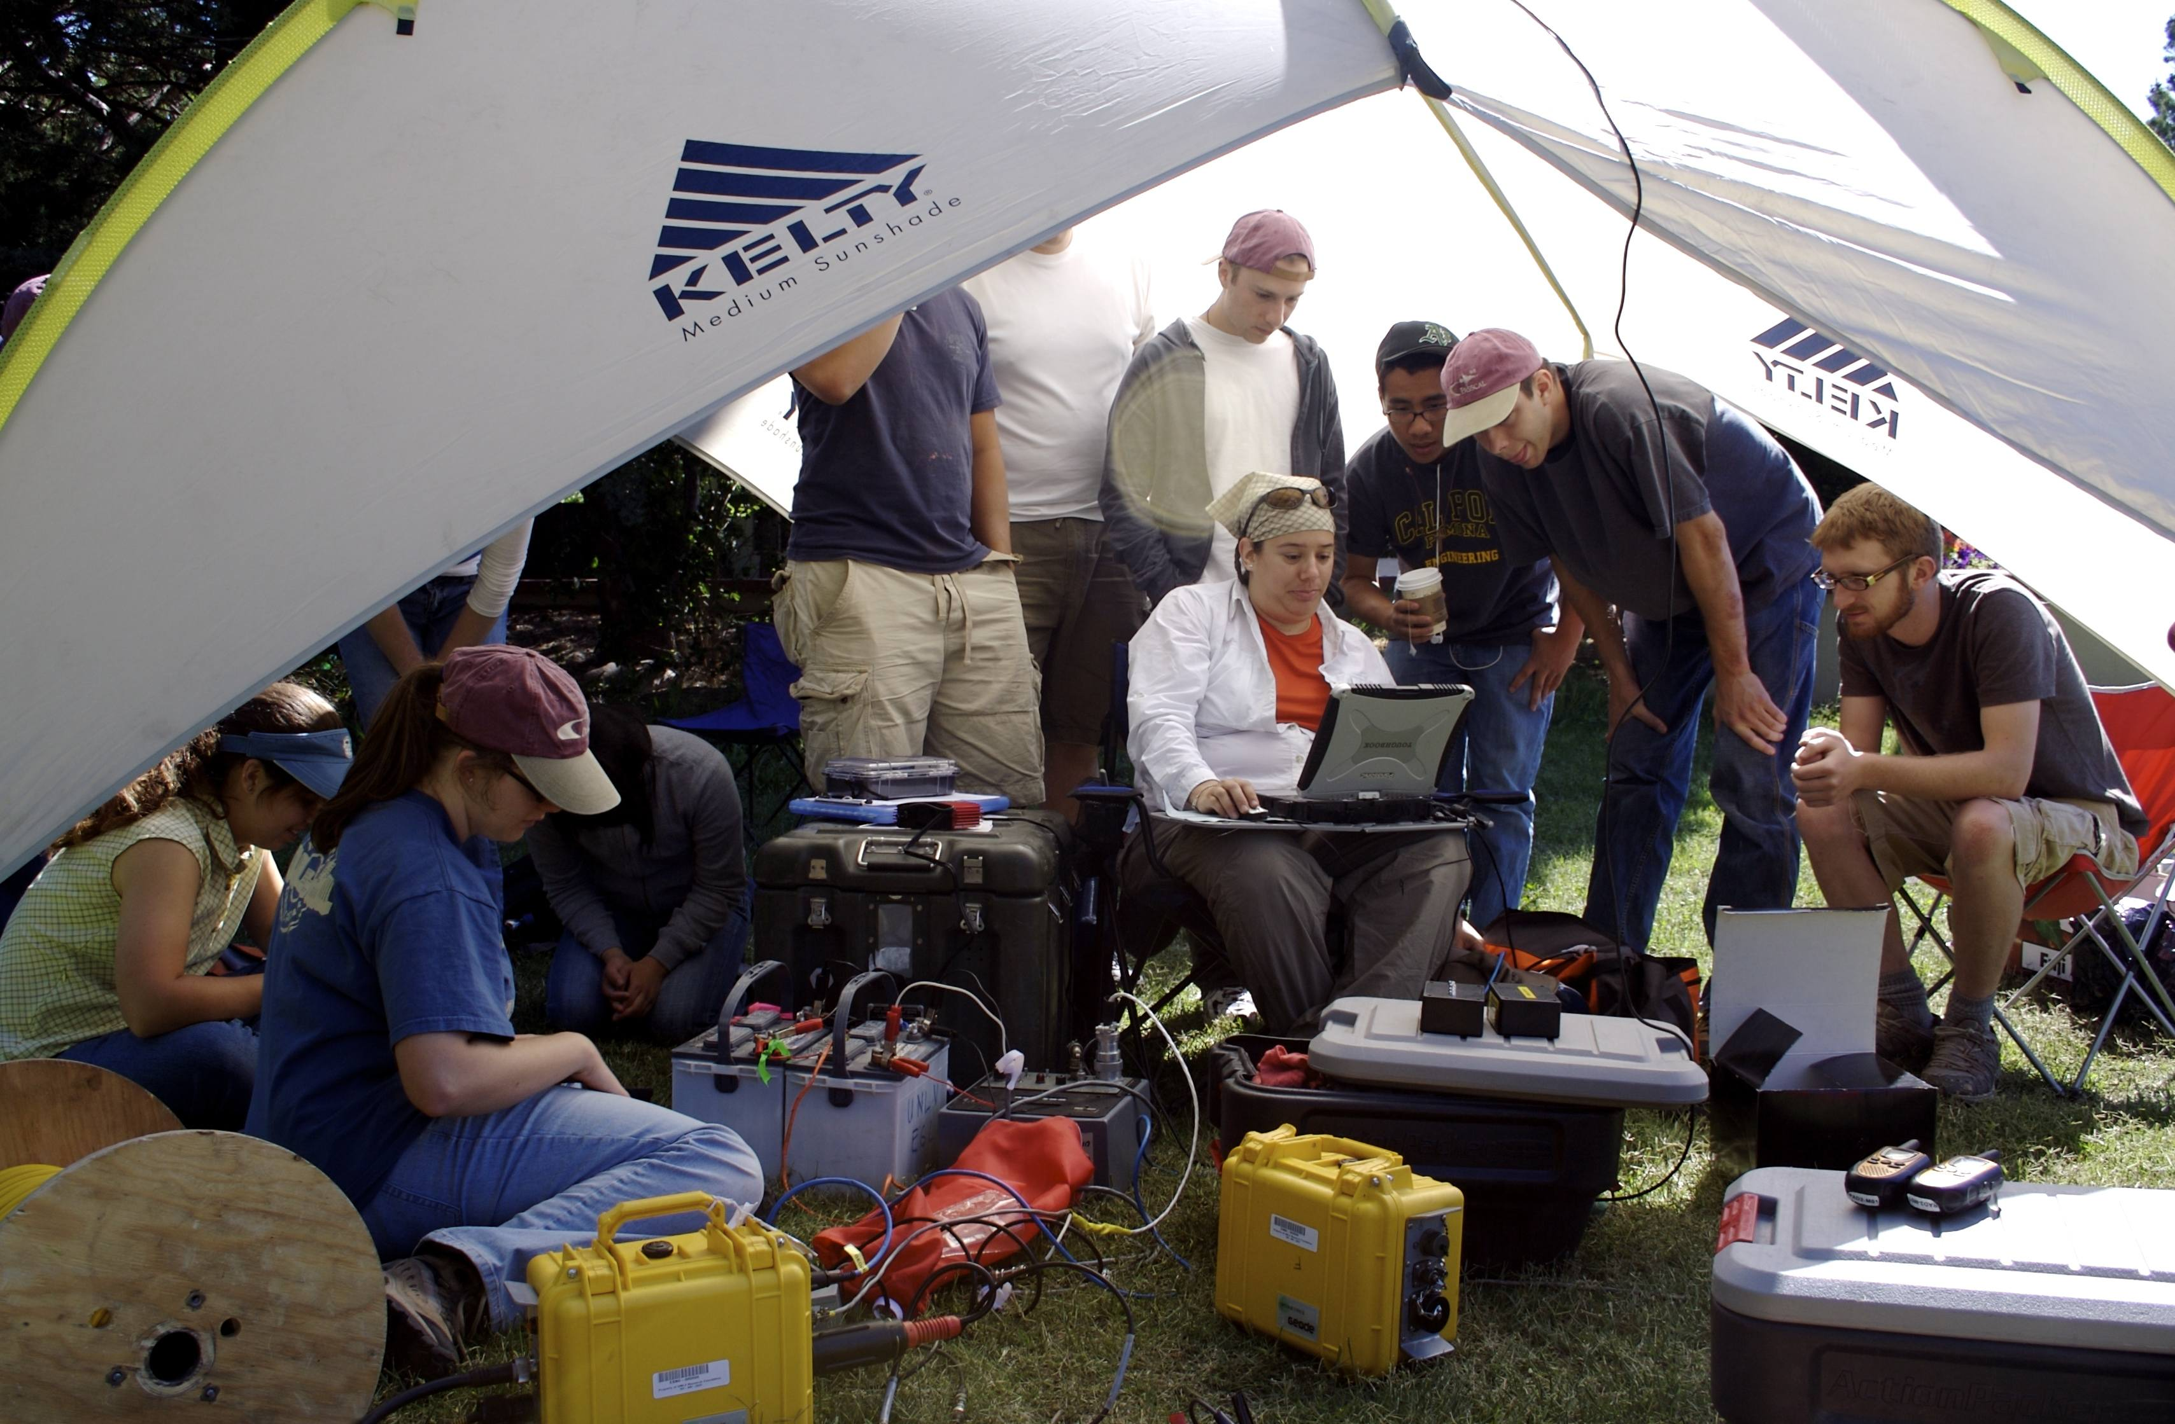
Summer Internships
Provide an introduction to research or seismic instrumentation for undergraduates
Present a paper afterward at a national meeting

Slide 9
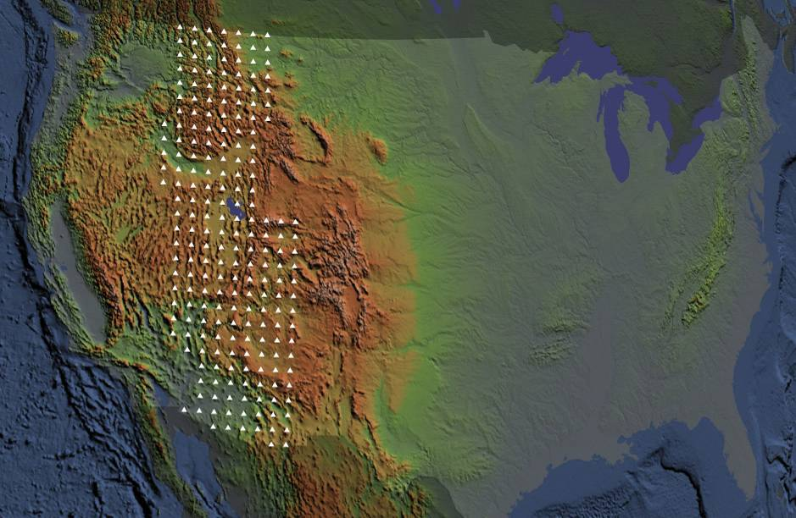
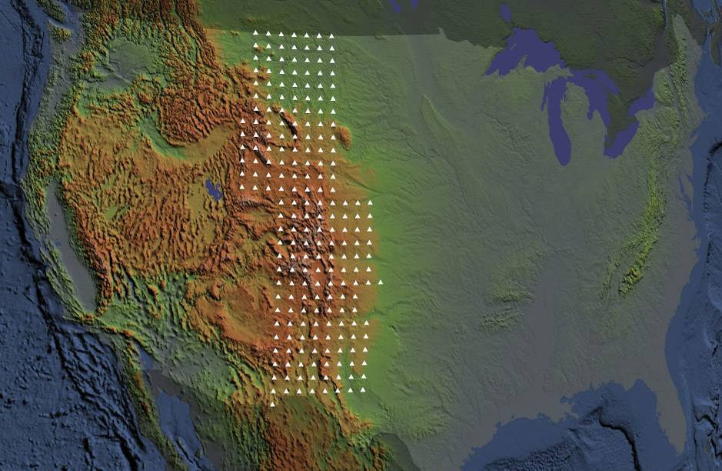
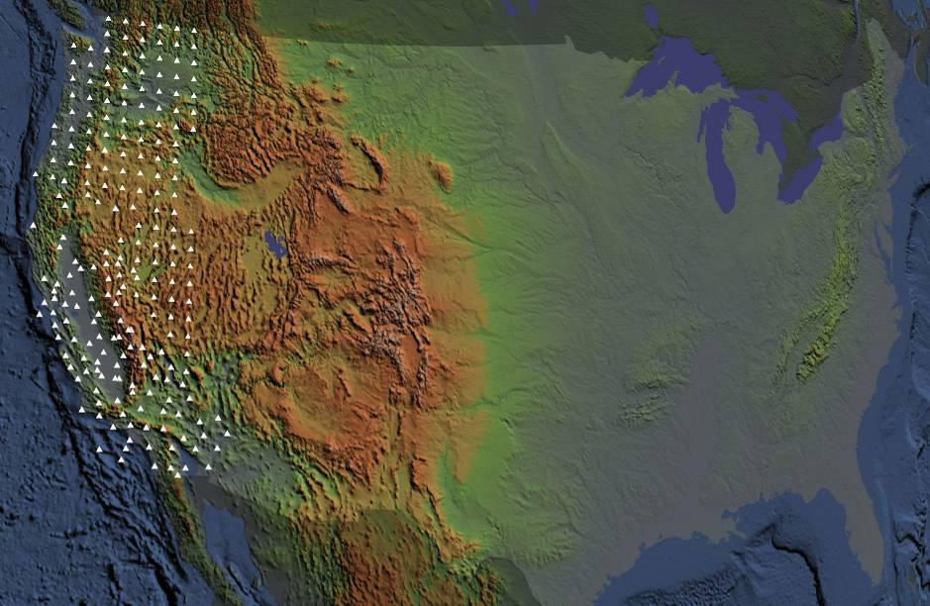
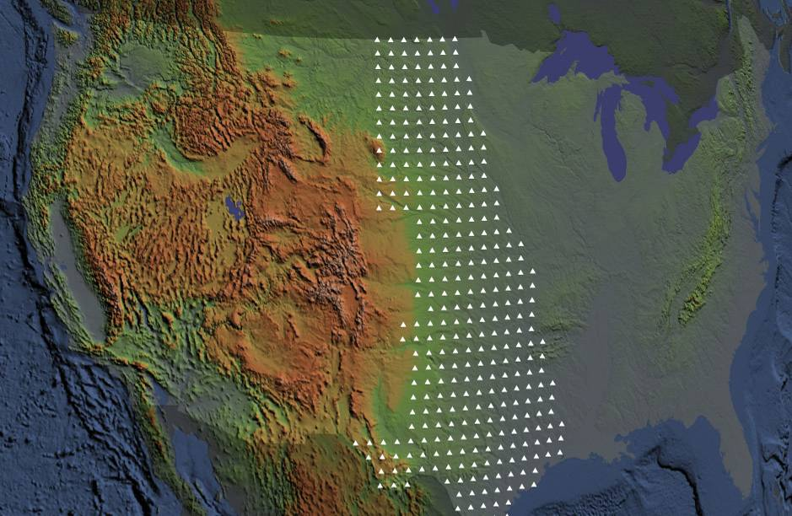
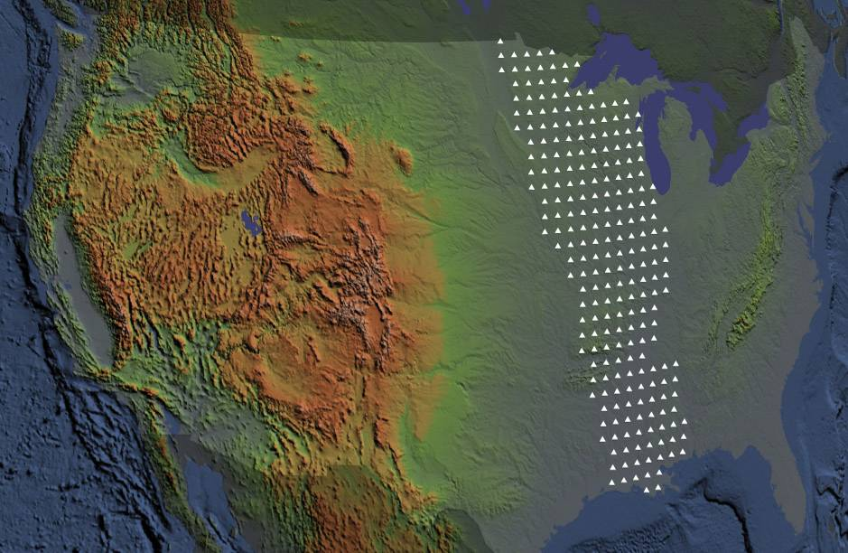
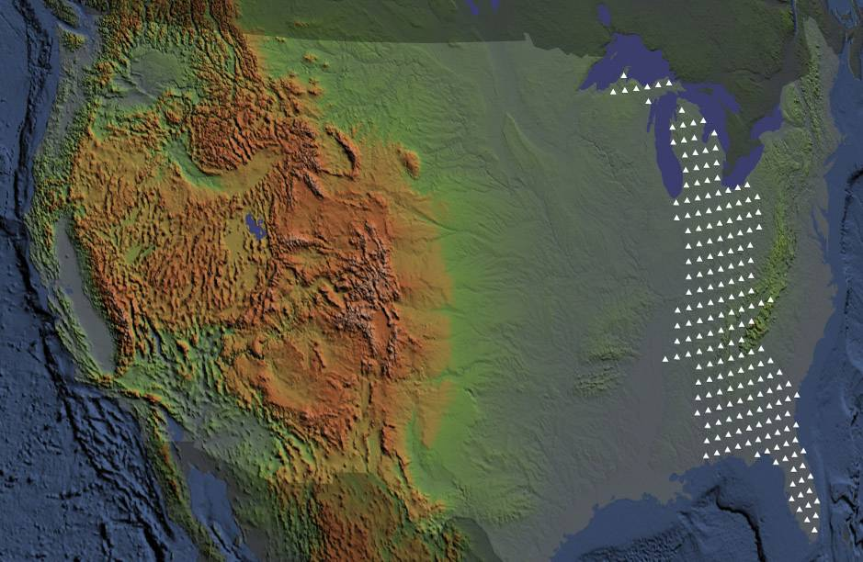
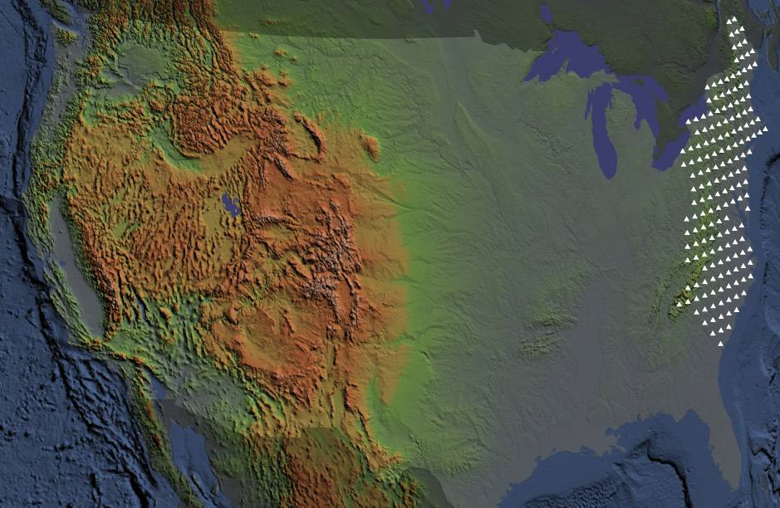
USArray (400 Transportable Seismometers)
Notes:
Presentation notes:
1. The positions shown for the Transportable Array are approximate
2. The time span is 10 years
3. Afterwards, the TA will go to Alaska; no Hawaii deployments are planned at this time

Slide 10
USArray Ground Motion Visualizations

Slide 11
Teachable Moment slide sets
Newsworthy earthquakes motivate students
Slide sets produced within 1 day for M7+ earthquakes
Tell a story about the earthquake
Jointly produced with Univ. of Portland, collaborative content from USGS, UNAVCO, ESNO and others
In English and Spanish

Slide 12
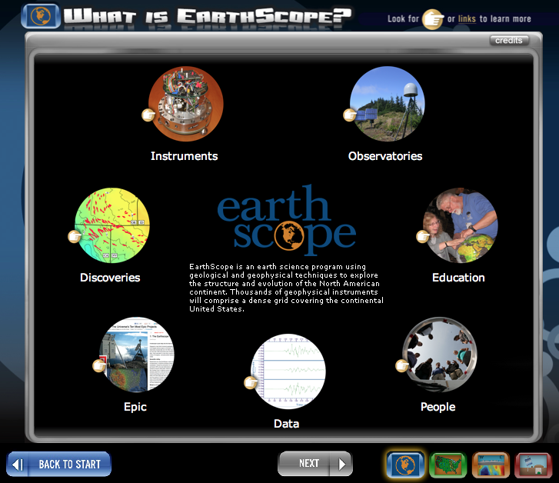
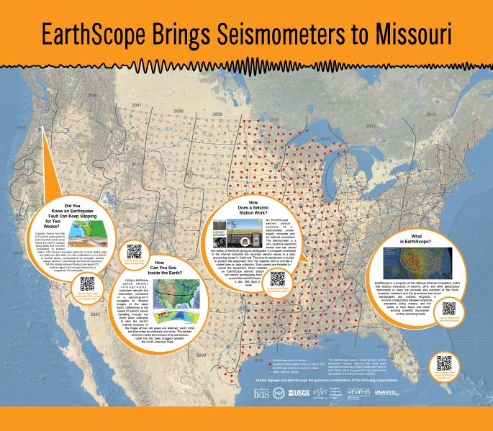
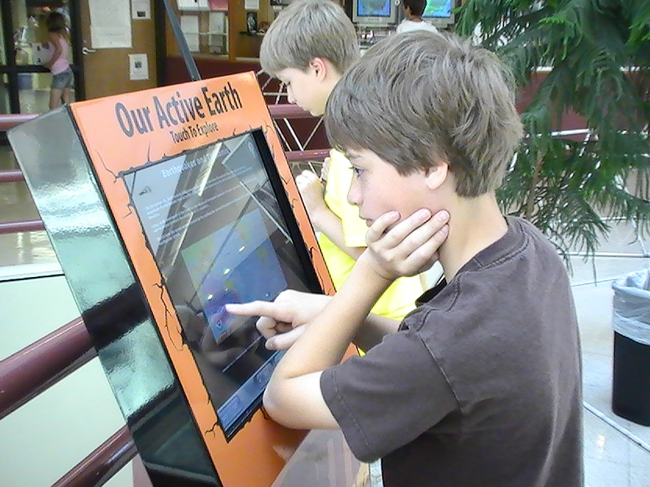
Active Earth Display
Simple real-time display designed for schools, visitor centers, small museums, universities
Use as a display or a computer lab activity
Includes real-time seismic data
Choose from 1 or more content sets
EarthScope, New Madrid, Cascadia, Basin and Range
Content development with UNAVCO, ESNO, SCEC and others

Slide 13
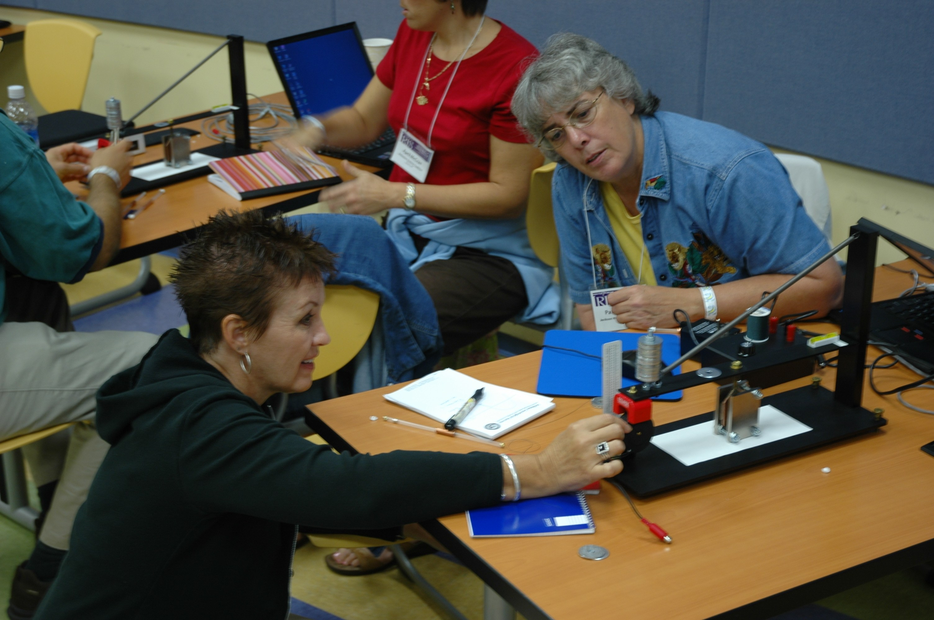
IRIS Educational Resources
Tools for students to explore seismic data
Classroom activities, educational seismographs
Teachable Moment slide sets
Simple real-time displays for schools, visitor centers, small museums, universities
Animations
Notes:
Salaries from SAGE, participant support via REU award

Slide 14
All available via IRIS webpage
www.iris.edu
Notes:
Salaries from SAGE, participant support via REU award

