Slide 1
IRIS Resources
Danielle Sumy, PhD
Native American Teacher Workshop
March 14-16, 2015

Slide 2
Incorporated Research Institutions for Seismology
Community-Based Facilities (3 directorates)
Education and Public Outreach (EPO)
University Research Consortium
  Monitor the Earth
  Explore its Interior
122 Member Universities in the US
114 Foreign Affiliates
22 Educational Affiliates

Slide 3
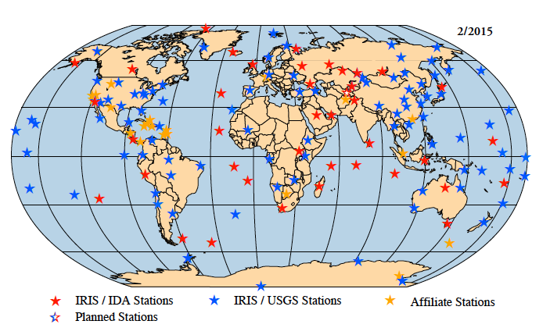
Global Seismographic Network

Slide 4
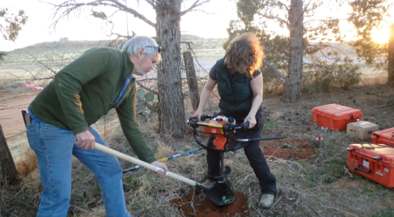
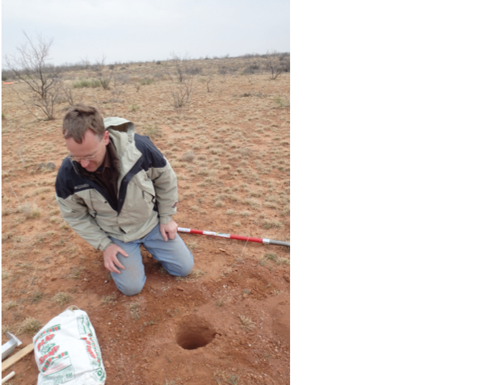
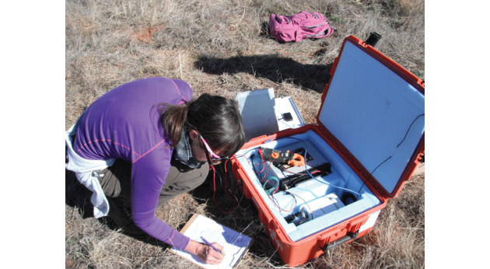
PASSCAL (Program for Array Seismic Studies of the Continental Lithosphere)
Notes:
Portable Instruments for Worldwide deployments, usually short and temporary in nature
Newly designed augered holes make for easy and fast deployments

Slide 5
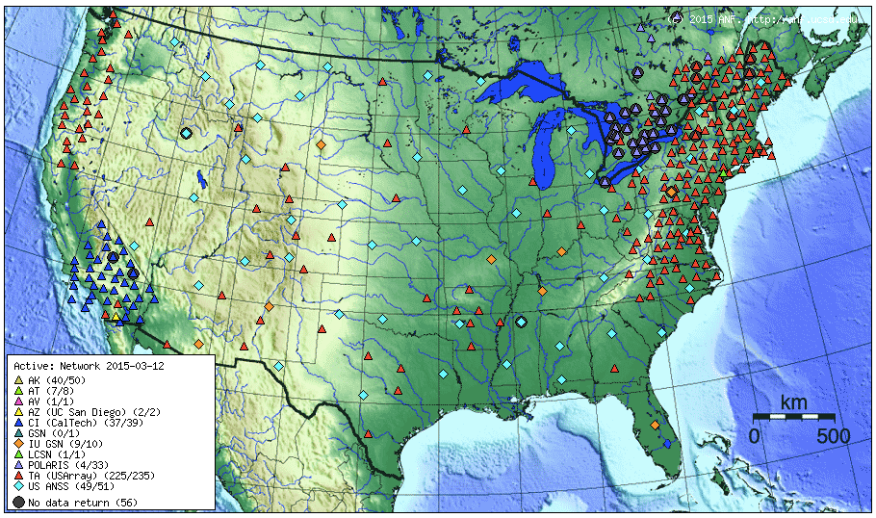
USArray

Slide 6
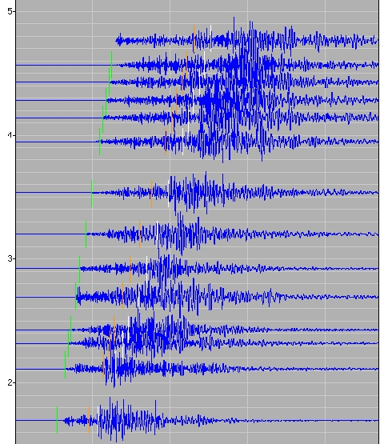
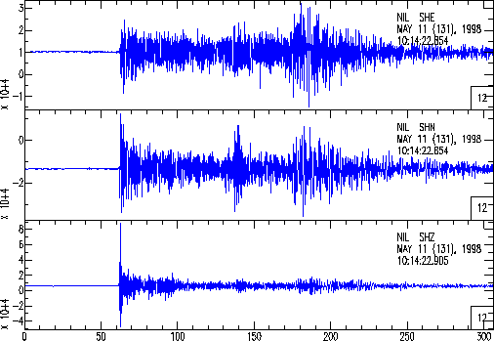
Data Management Center
www.iris.edu
Notes:
Free and open access data for everyone, regardless of whether you are a member or not
Simply go to our website for more information

Slide 7
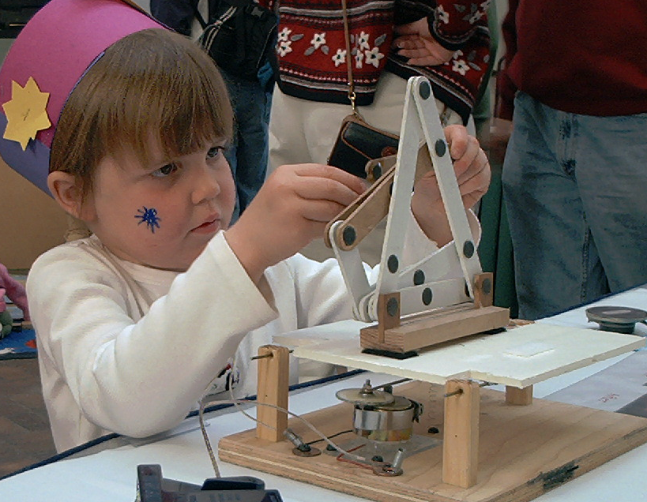
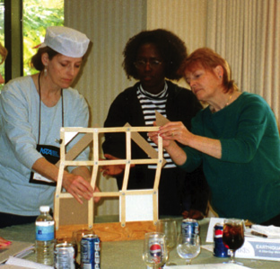
Education and Public Outreach
Seismology in the Science Classroom
Public Awareness of Earthquakes and Earth Science

Slide 8
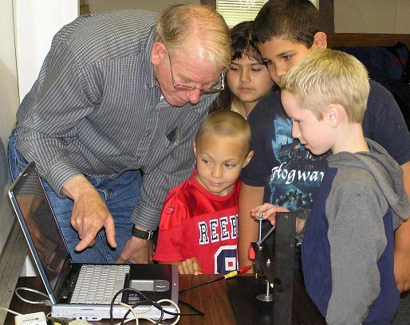
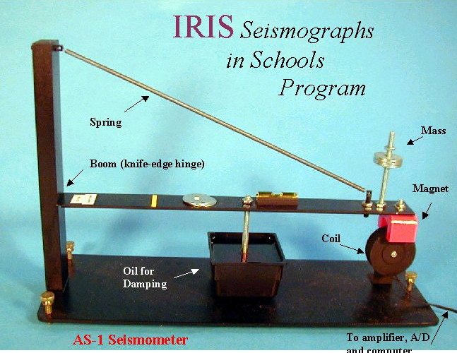
Notes:
Over 140 AS1s (Amateur Seismologist) seismographs have been distributed throughout public schools

Slide 9
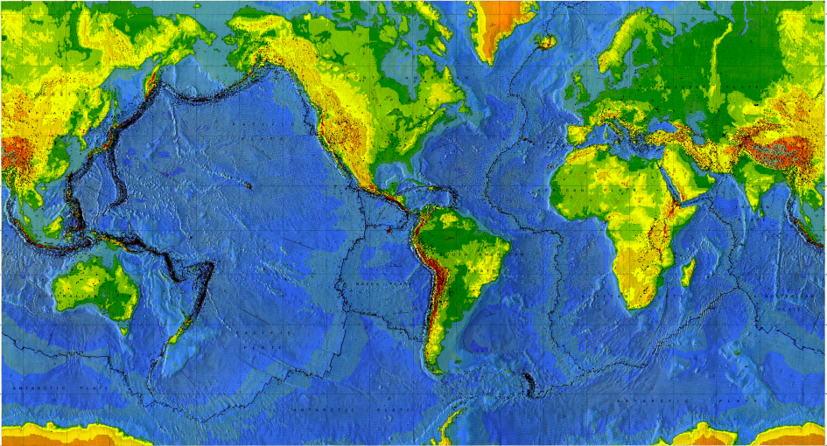
Plate Puzzle
Notes:
My trusty assistant Bob and I will pass around puzzle pieces to each of you. You are trying to put the puzzle pieces together to compose a world map, like you see here. The trick is, you have to put together the puzzle silently. You can point to try and help each other, but no talking.

Slide 10
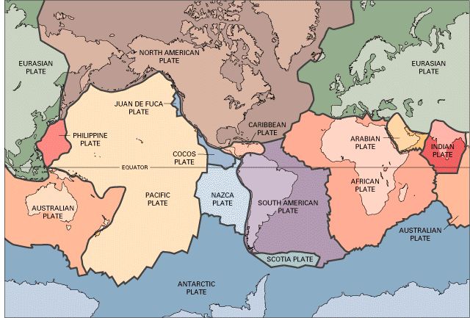
Notes:
Your puzzle should have come together to look something like this. What do you notice about plates themselves? (A: some are large some are small) What do you notice at plate boundaries? (A: earthquakes, volcanoes, mountains)
What do you notice specifically about Australia? (A: few earthquakes, volcanoes, etc., because no active tectonic boundaries in that area)
How does that compare to South America? (A: lots of mountains, volcanoes, and earthquakes)

Slide 11
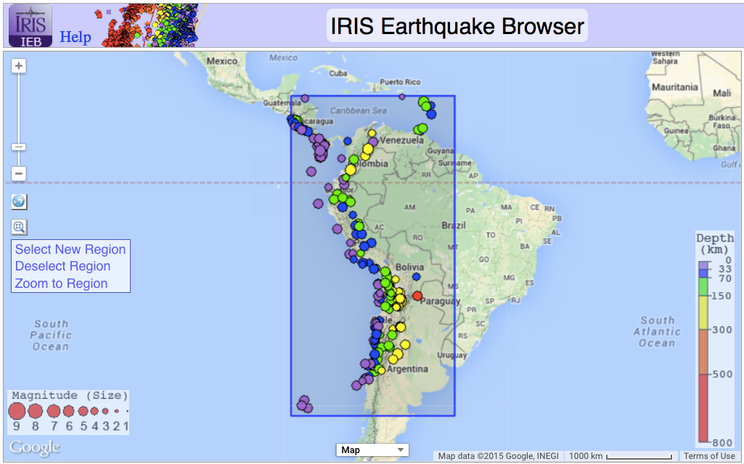
IRIS Earthquake Browser (IEB)
Notes:
ds.iris.edu/ieb (At this point, take the participants to the website.)
We can use the IRIS Earthquake Browser (IEB) and really begin to see what’s going on. We can even use it in 3D to visualize the earthquakes with depth.

Slide 12

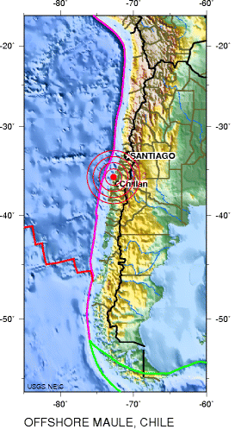
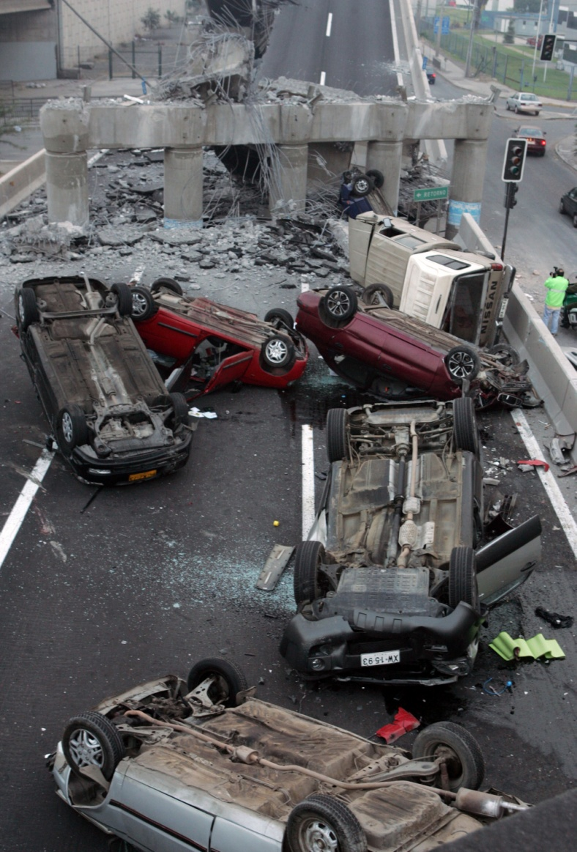
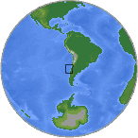
Magnitude 8.8 OFFSHORE MAULE, CHILE
Saturday, February 27, 2010 at 06:34:17 UTC
A great 8.8-magnitude struck central Chile early Saturday. The quake hit 200 miles (325 kilometers) southwest of the capital Santiago. The epicenter was just 70 miles (115 kilometers) from Concepcion, Chile's second-largest city.
USGS
Vehicles that were driving along a highway that collapsed during the earthquake near Santiago are seen overturned on the asphalt Saturday Feb. 27, 2010 after an 8.8-magnitude earthquake struck central Chile early Saturday.
USGS
Images courtesy of the U.S. Geological Survey
AP Photo/David Lillo
Notes:
IRIS also puts out Recent Earthquake Teachable Moments, which are PPT slides, Ground Motion Visualizations (GMVs), etc. about recent M>7.0 earthquakes. These teachable moments are put forth in a day or so following these earthquakes, and can be found on our website.

Slide 13
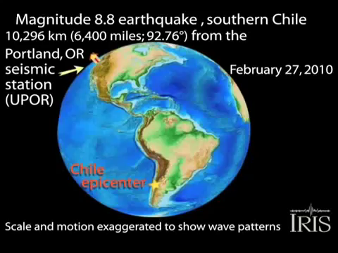

Slide 14
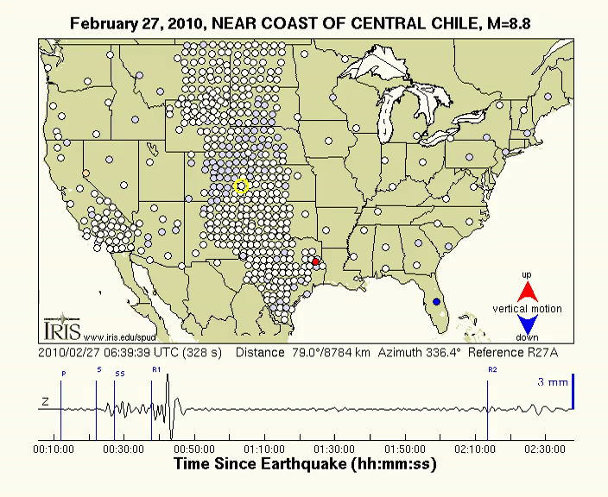
Notes:
http://ds.iris.edu/spud/gmv/2400

Slide 15
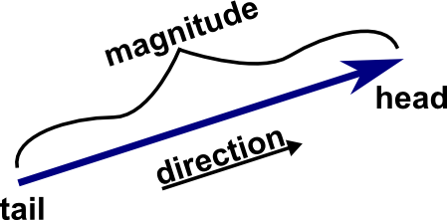
Plate Motion: Vectors
Notes:
As Shelley mentioned with respect to GPS, we can look at the vectors (or magnitude and direction) of which plates travel. On the map, there are also vectors that show the direction and speed of plate motions. What do you notice about the magnitude and direction of plate motions? Are they all the same? Are they different? How fast do the plates travel?

Slide 16
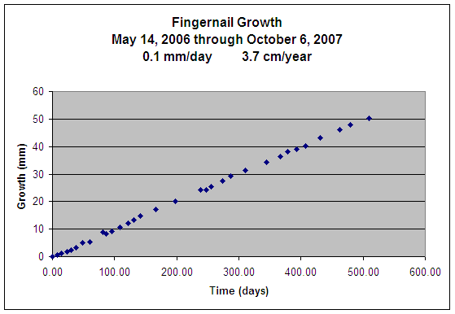
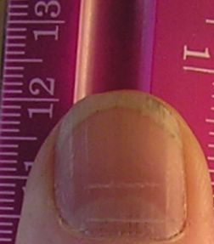
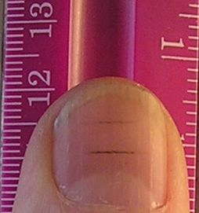
Day 0
Day 60
www.jclahr.com/science/earth_science/thumbnail
Notes:
On average, plates travel at the speed of fingernail growth

Slide 17
What is plate motion driven by?

Slide 18
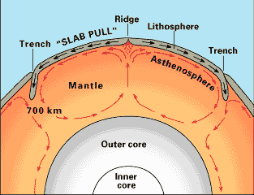
Notes:
A: Heat within the Earth’s interior. Thus, you could also use this puzzle to talk with your students about the interior of the Earth.
Earth’s rigid lithosphere, composed of the Earth’s crust and the upper most mantle, is broken into many large pieces called tectonic plates. Over long periods of time, these plates are moved (only very small amounts annually) around the surface of the planet. This motion is driven by density differences in Earth’s less rigid mantle. As the plates move about they are constantly interacting with one another in a variety of ways. Depending on the type of interaction and the density of the crust, these interactions can result in the formation of large-scale features, such as mountains and deep ocean trenches or they can cause more abrupt and catastrophic effects, such as earthquakes and volcanism.

Slide 19
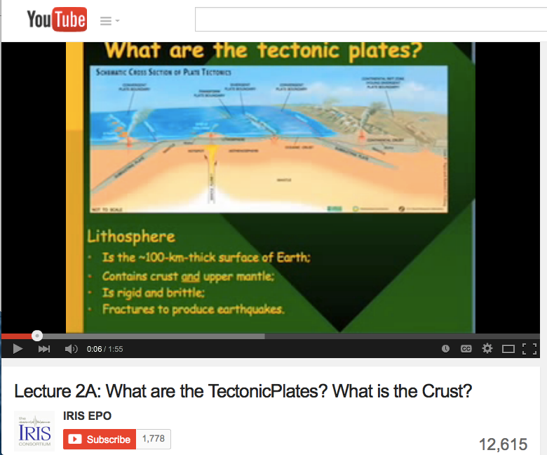

Slide 20
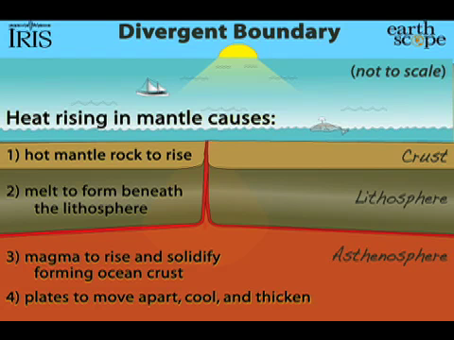
Notes:
Here is another cross-sectional view of just the crust and upper mantle. Note that the plates diverge or spread at mid-ocean ridges. Can you find the mid-ocean ridges on the map? Can you find slow mid-ocean ridges? Can you find fast mid-ocean ridges? Notable mid-ocean ridges are the Mid-Atlantic Ridge and the East Pacific Rise. Specifically point out Iceland, if no one does.

Slide 21
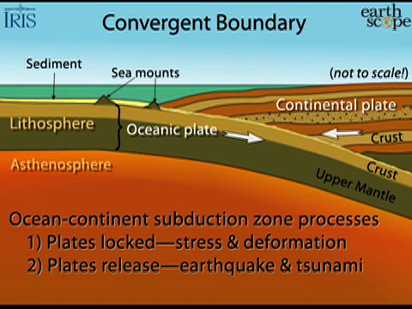
Notes:
Plates converge at subduction zones, where oceanic crust descends beneath continental crust. When the oceanic crust is squeezed beneath the continental crust, you have the presence of heat and fluids. What is a distinctive marker at subduction zones? (A: volcanoes) Can you find subduction zones on this map? (A: Juan de Fuca, etc.)
This is an example of oceanic meets continental plate, but what about where continental meets continental plate? (A: Mountains) Where are some examples of mountainous areas in the world? (A: Himalayas, among others)
Why does oceanic crust sink to form subduction zones, and continental crust form mountains? (A: density contrasts, oceanic crust is more dense than continental crust) In that case, which one is more likely to subduct, old oceanic crust or new oceanic crust? (A: old oceanic crust, because it’s old, cold, and more dense)

Slide 22
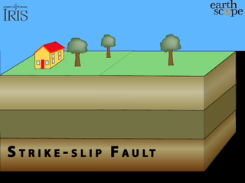
Notes:
The last plate boundary is transform plate boundaries like the San Andreas fault in California, or along mid-ocean ridges, where two plates slide past one another, neither creating or destroying crust in the process.

Slide 23
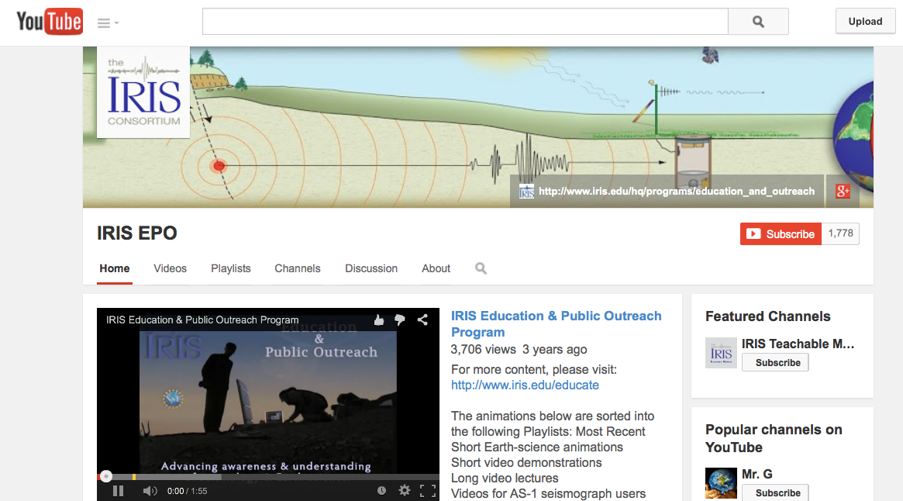
www.youtube.com/user/IRISEnO

Slide 24
Can you find complex systems that are combinations of these?

Slide 25
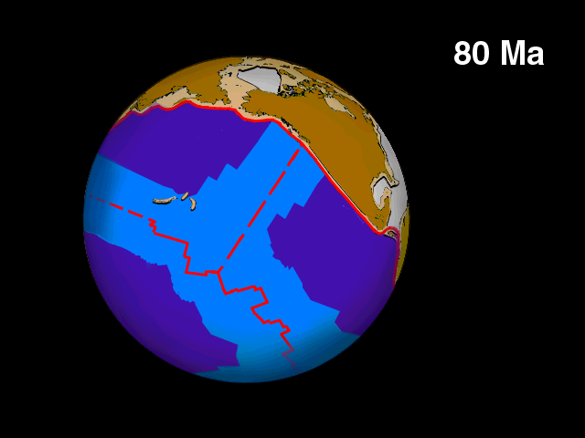
Tanya Atwater
Notes:
You can see here the Kula, Farallon, and Pacific plates. Did any of you have a Kula plate? (A: No!) Did any of you have a Farallon plate? (A: No!) The word ‘Kula’ actually means ‘all gone’ from the Tlingit language (indigenous people of the Pacific NW).

Slide 26
What does the Gulf of California look like now?
Notes:
Have the group make some observations about what the GoC looks like now. What are the velocity vectors? Where are the two plates going? How the GoC sync up? (A: San Andreas Fault)

Slide 27
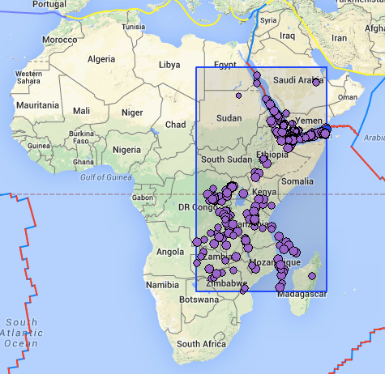
East Africa Mystery
Notes:
Let’s take a look at Africa. How common are earthquakes in Africa compared with other regions of the world. Does Africa have more or less earthquakes than Chile? Does Africa have more or less earthquakes than Australia?
Let’s take a look again at the IEB. Which countries are the most seismically active? Do earthquakes here tend to be deep or shallow? Of the patterns we talked about earlier, which one seems to best explain East Africa?

Slide 28
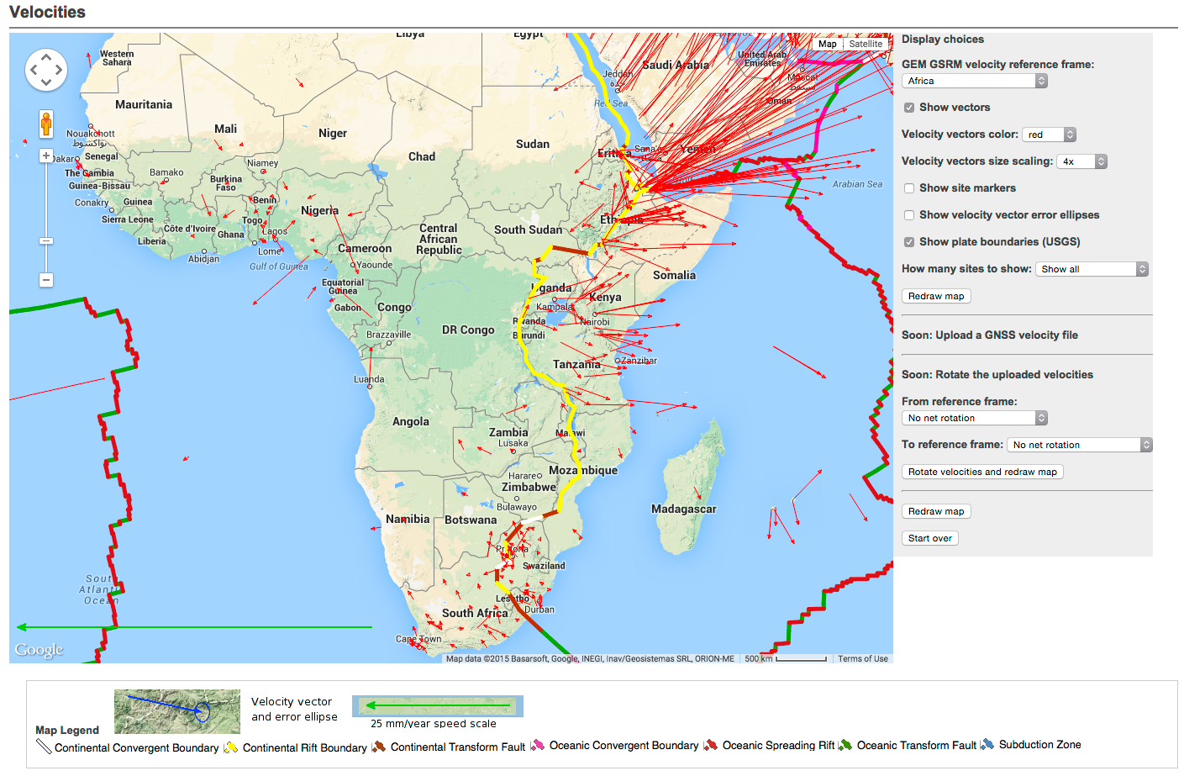
East Africa Mystery
Notes:
Africa is held fixed, and East Africa is moving away.

Slide 29
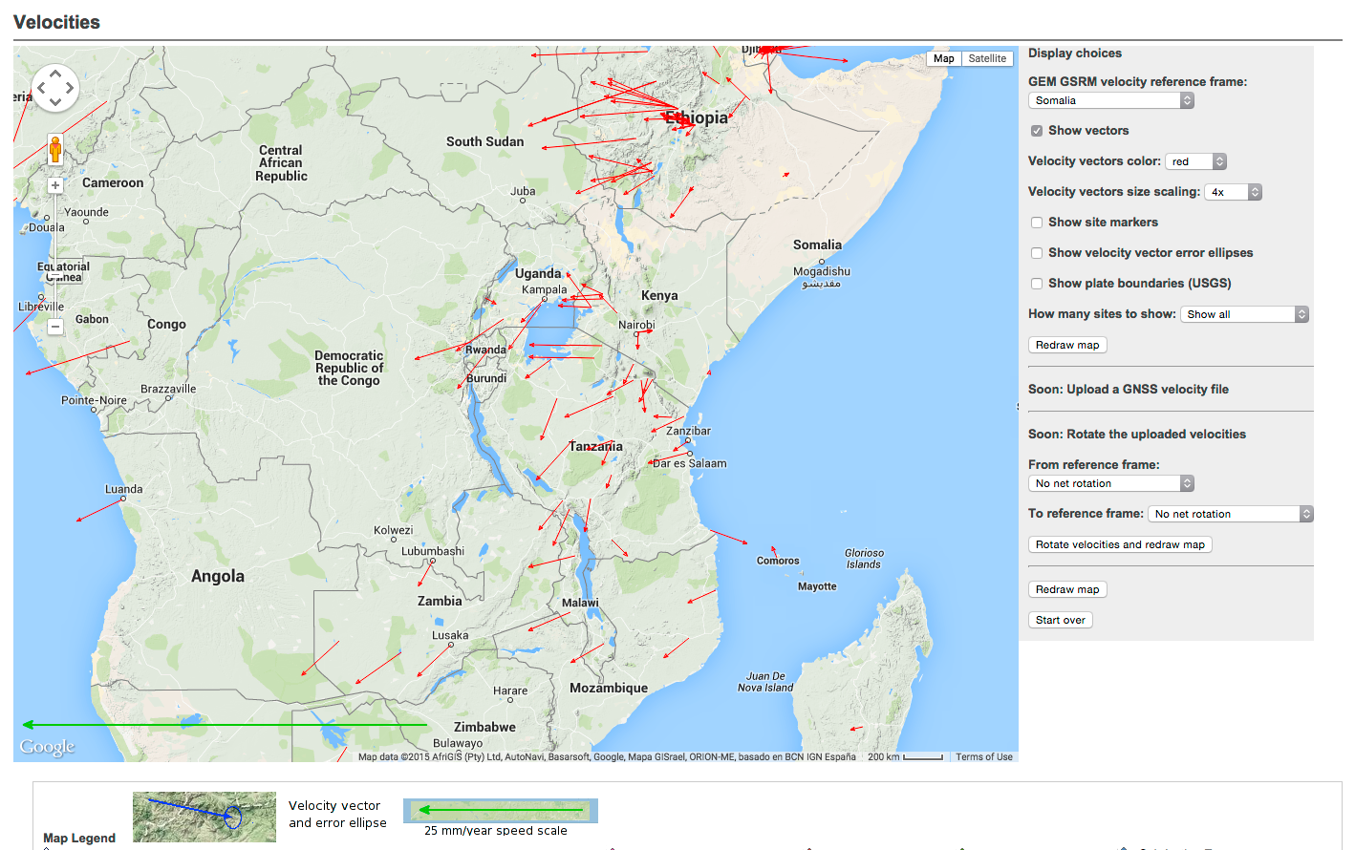
East Africa Mystery
Notes:
In this snapshot, Somalia is held fixed, and Africa is moving away as well as the middle ‘arm’ of the rift.

Slide 30
What about Hawaii?
Notes:
The Hawaiian Seamount chain. What do you see at Hawaii? Although the islands are not near a plate boundary, they are seismically and volcanically very active. Can you see the seamounts, or submerged volcanoes? This is called the Emperor Seamount chain. What do you think caused this volcanic and seamount chain? At the “bend” in the seamount chains that connects the Emperor and Hawaiian chains, the volcanic rocks are about 42 million years old.
At Kauai, the volcanic rocks are about 5 million years old. The Big Island (Hawaii) is less than 1 million years old and eruptions are occurring today. What direction has the plate been moving (with respect to the mantle hotspot)? Where will the future volcanic chain of islands and seamounts be? How fast is the plate moving at Hawaii? Does the velocity measurement (near the arrow) agree with the velocity estimated from the volcanic ages (divide the distance in km from Hawaii to the “bend” by 42 million years, then convert to mm/yr or cm/yr)?

Slide 31
Add’l IRIS Resources
East African Mystery:
  http://www.iris.edu/hq/resource/african_mystery
Public Displays:
  http://www.iris.edu/hq/programs/education_and_outreach/museum_displays
  Among Others!

