Slide 1
A Modeling Activity
Place based teaching-finding a sense of place…
Allison Barta, Sally Bruesewitz, Dan Rogers

Slide 2
Native Science Natural Laws of Interdependence
Gregory Cajete
Native Science stems from a deeply held philosophy of proper relationship with the natural world that is transferred through direct experience with a landscape, and through social and ceremonial situations that help members of the tribe learn the key relationships though participation and their “ella” as the Yupiaq would say. Methodological elements and tools of Native science that have traditionally facilitated such learning included:

Slide 3
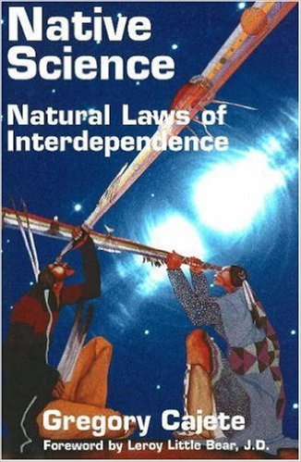
Observation
Experiment
Meaning
Understanding
Objectivity
Unity
Modeling
Causality

Slide 4
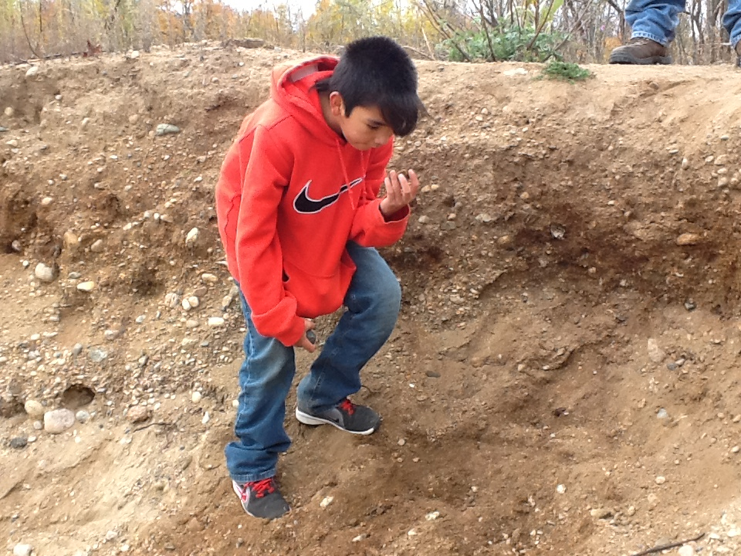
Appropriate technology
Spirit
Interpretation
Explanation
Authority
Place
Initiation
Cosmology
Representations

Slide 5
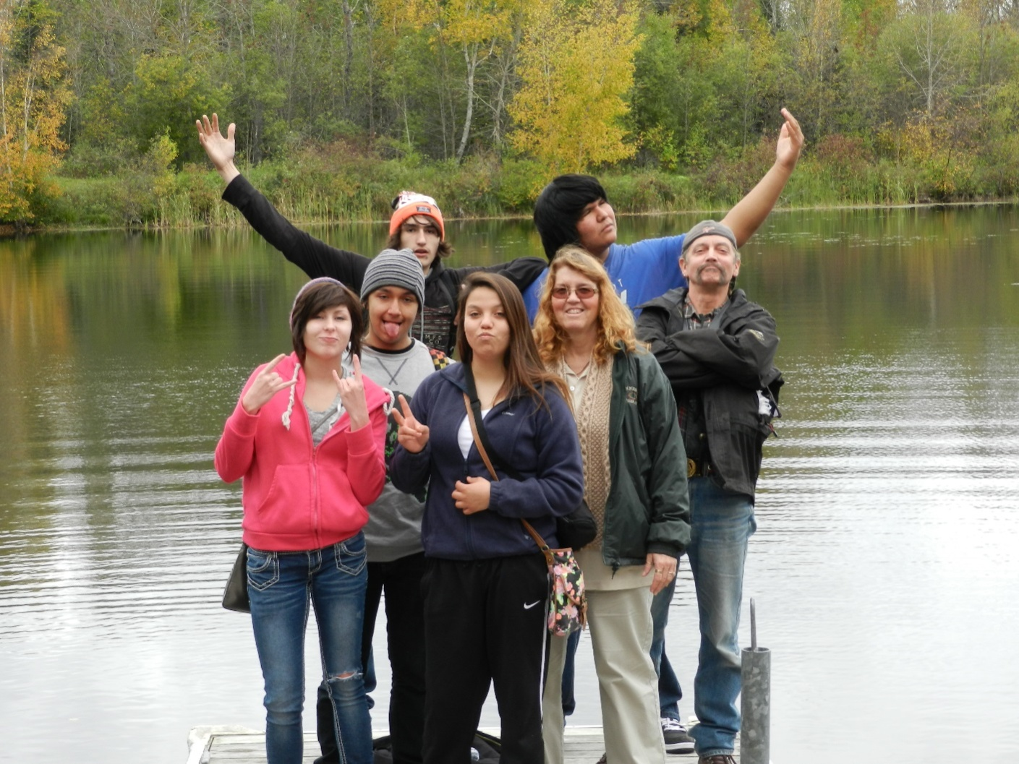
Humans
Ceremony
Elders
Life
Energy
Dreams
Visions
Paths

Slide 6
A Modeling Activity
create
3-d
relief
map
place personal use points
place historical use points
compare your map with other students, and other more technically advanced maps

Slide 7
Task One
As an instructor the options for using this lesson could be introductory or later within a mapping unit. Teams of students
We will embark on a short hike near our school and when we return to class your team will make a 3 dimensional map(raised relief map) of the area.
During the hike catalog as many observations as you can about the area that we are hiking over.
Before we leave the classroom get together with your team and create a list of possible items you may want to look for to help you in your map creation.

Slide 8
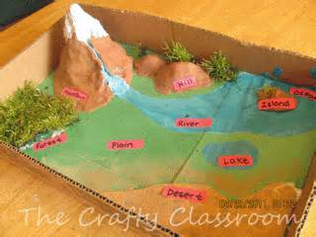
Task Two
When we get back to class your team needs to create a 3-dimensional model of the area we hiked. Use the observations you recorded to help in making your model.

Slide 9
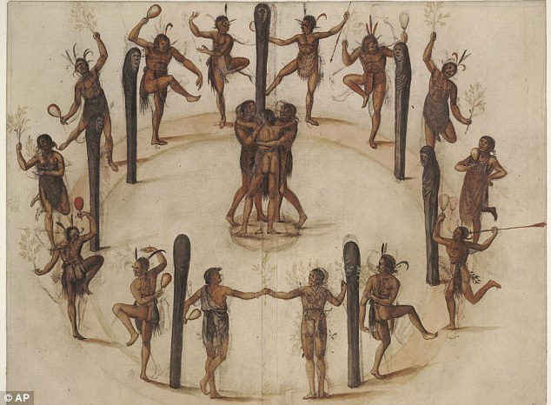
Task Three
As a team, make a list of how this land has been used in recent history.
Now imagine we go back 400 years ago. Repeat.

Slide 10
Reflection
Exchange your map/model with another group
How are they similar? How do they differ?
What might you add to your model/map if you did this again?
What were challenges in doing this activity?

Slide 11
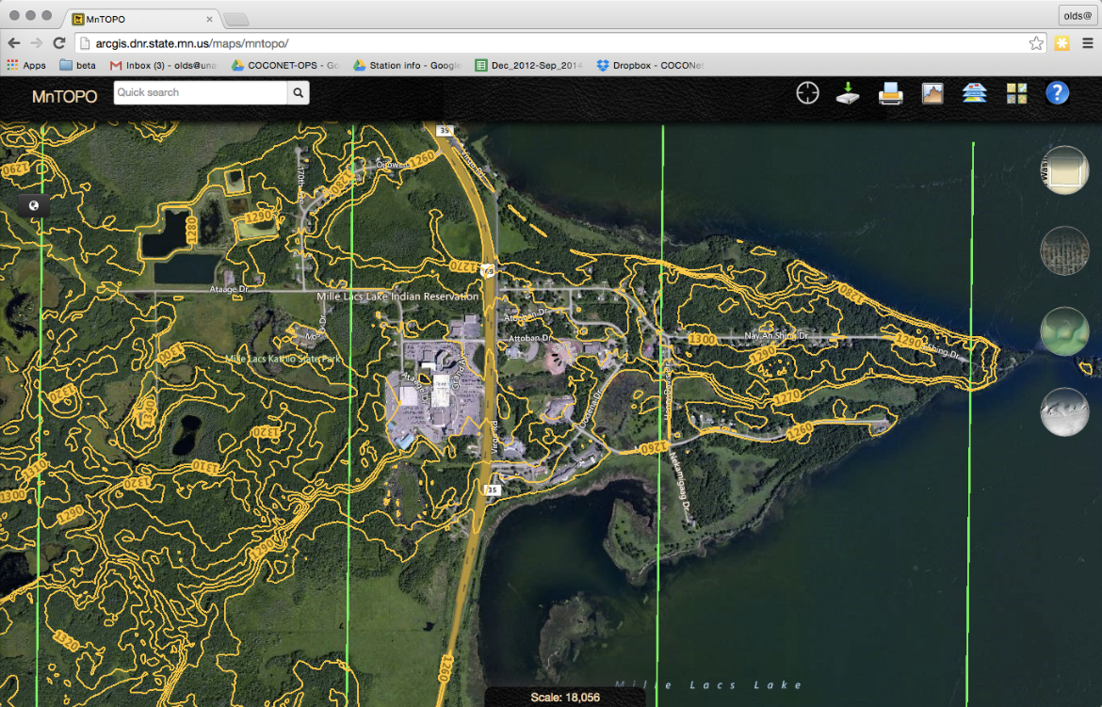
Mille Lacs Lake, MN

Slide 12
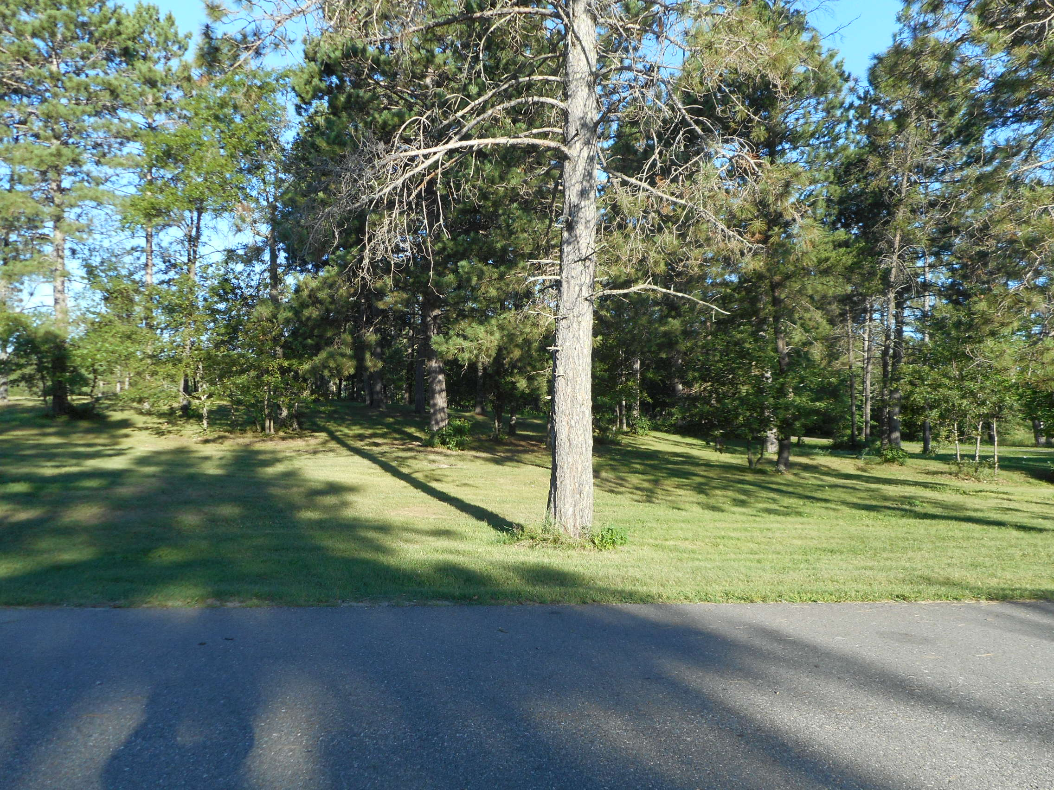

Slide 13
CCSS ELA – Literacy RST.6-8.7
Integrate quantitative or technical information expressed in words in a text with a version of that information expressed visually (e.g. flowchart, diagram, model graph or table)

Slide 14
MN State Science Standards
8th Grade Earth & Space
Strand 1. The Nature of Science and Engineering
Substrand 1. The Practice of Science
Standard 2. Scientific inquiry uses multiple interrelated processes to investigate questions, and propose explanations about the natural world
Code: 8.1.1.2.1 Use logical reasoning and imagination to develop descriptions, explanations, predictions, and models based on evidence
Substrand 3. Interaction among science and technology, engineering, mathematics, and society
Standard 4. Current and emerging technologies have enabled humans to develop and use models to understand and communicate how natural and designed systems work and interact.
Code: 8.1.3.4.1 Use maps, satellite images, and other data sets to describe patterns and make predictions about local and global systems in Earth science contexts.
Strand 3 Earth and Space Sciences
Substrand 1. Earth Structure and Processes
Standard 2. Landforms are the result of the combination of constructive and destructive processes
Code: 8.3.1.2.2 Explain the role of weathering, erosion, and glacial activity in shaping Minnesota’s current landscape.

Slide 15
Learning Outcomes
Benchmarks from MN Standards, 2009
Determine and use appropriate safety procedures, tools, measurements, graphs and mathematical analyses to describe and investigate natural and designed systems in Earth and physical science contexts.
Use logical reasoning and imagination to develop descriptions, explanations, predictions and models based on evidence.
Understand that scientific knowledge is always changing as new technologies and information enhance observations and analysis of data. For example: Analyze how new telescopes have provided new information about the universe.

