Slide 1
Ms. Ness: Cass Lake-Bena
Mrs. Collis: AIMS
Mrs. LaVine: Red Lake
Learning Objective: Students will describe How MN lakes formed and some uses by Native Americans

Slide 3
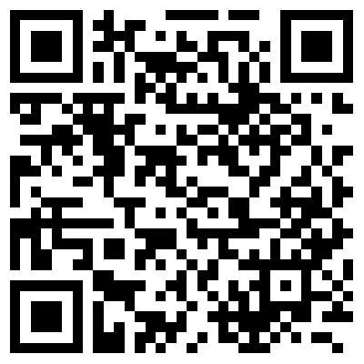
Critical Response Protocol
Please answer these questions with your elbow buddy
as you move through the website:
What do you notice?
What does it remind you of?
What emotions do you feel?
What questions does it raise for you?
What meaning or understanding is intended
or conveyed in this work?
You will have 3 minutes.
http://mrbdc.mnsu.edu/minnesota-river-basin-glaciation

Slide 4
Group discussion
What are some things that you and your elbow buddy discussed?
Using NorthStar Mapper discuss as a group the topography of MN and how this may have helped form lakes as the glaciers retreated.
Why do we care?

Slide 5
Native American Uses
Students will bring in photos or describe the lake by field study and share some uses of the lake.
(Share history of Native American uses of the lake. This may vary depending on location in MN)
(potential to invite elders, go wild ricing or help with processing, sugar bush…)

Slide 6
Assessment
Please use your phone or computer and log in to
Socrative.com
Use room code #8AA6E292
Describe how the lake was formed and some Native American uses of the lake.

Slide 7
Resource Link List
Glacial Advance and Retreat Simulation
https://ees.as.uky.edu/sites/default/files/elearning/module13swf.swf
Ice Cream Model – How Glaciers Formed the Minnesota Landscape
http://serc.carleton.edu/sp/mnstep/activities/26539.html
What is a Glacier
http://www.onegeology.org/extra/kids/earthprocesses/glaciers.html
Crumpled Paper Watershed
http://fergusonfoundation.org/teacher_resources/crumpled_paper.pdf

Slide 8
References
Minnesota River Basin Data Center Minnesota’s Glacial Story
http://mrbdc.mnsu.edu/minnesota-river-basin-glaciation https://www.youtube.com/watch?v=bKhG7maftJA
NorthStar Mapper
http://www.mngeo.state.mn.us/chouse/northstarmapper.html
Minnesota Map Collection
http://geology.com/state-map/minnesota.shtml
The Ojibwe People’s Dictionary
http://ojibwe.lib.umn.edu/english/search/fish?x=0
Minnesota Humanities Center Ojibwe Dictionary
http://www.minnesotahumanities.org/resources/aaniin
Dakota Dictionary Online
https://filemaker.cla.umn.edu/dakota/
The Nature Conservancy – Morphology and Ecology of Lakes in Minnesota
www.nature.org/ourinitiatives/regions/northamerica/unitedstates/minnesota/fac
esofconservation/mn-lakes-portfolio-2008-final.pdf

