Slide 1
Seafloor Spreading
Presented by:
Clarissa Dobson
Cheryl Houde
Joe Kaliszewski
Alana Gross

Slide 2
Learning Target/Objective
Students will be able to relate different plate boundaries to the mid-continental rift and its importance to the area.
  Understand different plate boundaries
  Understand and describe different land formations connected with rifting and how they were developed over time.
Question of the day:
    What is the relationship between the mid-Atlantic ridge and the mid-continental rift in Minnesota?

Slide 3
Download
KMZ file needed to run program:
  oceanleadership.org/files/seafloor_spreading.kmz
An Expedition to the Seafloor-Student guide:
  http://joidesresolution.org/sites/default/files/12-SeafloorSpreading_student_hires.pdf
  Student worksheet may need adjustments per file used
    Background information
    Start at Step 6-7, and 9-10
    Adjust Answer page to make questions related to Mid-Continental ridge

Slide 4
Native Science Relationships
Compare and contrast the Seafloor Spreading exercise to the fault area in Duluth, Minnesota
Jay Cook State Park is a great place to visit with students.
  This is in our area and we can see basalt flows, gabbro and granite from the mid continental rift
    Uses of these types of rocks
    Important resources
  Vocabulary of different plate boundaries:
    divergent = pull apart or separate=naazhaga
    convergent =coming together or meeting=wiidookodaadiwin
    transform = to mold=asiniiwikaa

Slide 5
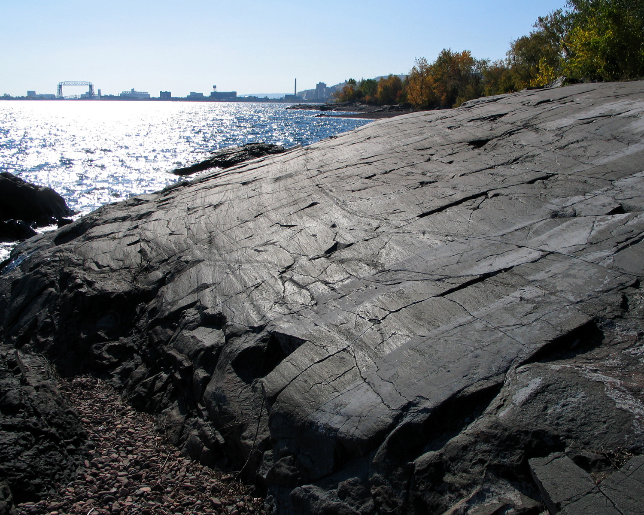
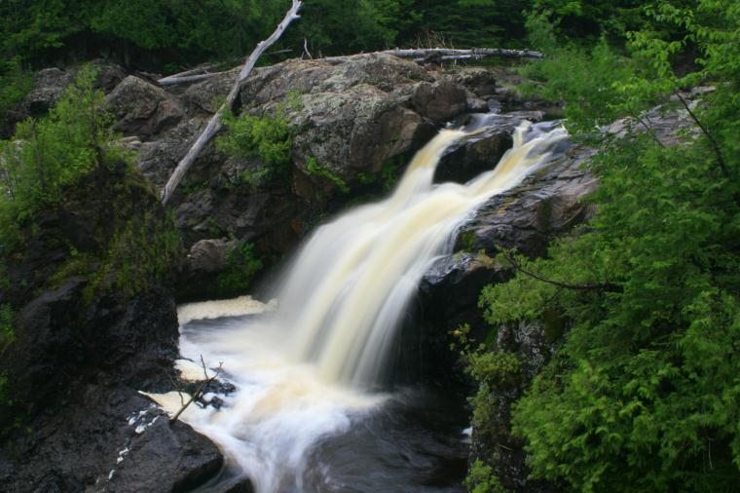
Basalt and Gabbro on the North Shore of Lake Superior
Looking at the fault area in Duluth
  This is in our area and we can see basalt, gabbro and granite uplifts from the mid continental rift

Slide 6
Earthscope Relationships
EarthScope explores the entire North American continent, as well as Earth, to better understand earthquakes, tectonic plates, and active volcanoes.
Youtube video link:
  https://www.youtube.com/watch?v=Wu9AM_T9wyw
For our exercise today, please open:
  http://www.earthscope.org/information/publications/newsletters/the-spree-project

Slide 7
Class Relationships
Covers a number of Minnesota State standards:
Mn Benchmarks 8.1.3.4.1satellite and data sets to describe/predict global systems
8.2.3.1.1expalin seismic waves and energy transfers through geologic layers
8.3.1.1.2correlate ocean trenches/ridges to volcanic /seismic activity
8.3.1.1.3Major geologic events result from moving tectonic plates
Can easily be done within one class period
Interactive, critical thinking, math, graphing, etc.
Helps students visually see how plates have been moving apart for millions of years.

