Slide 1
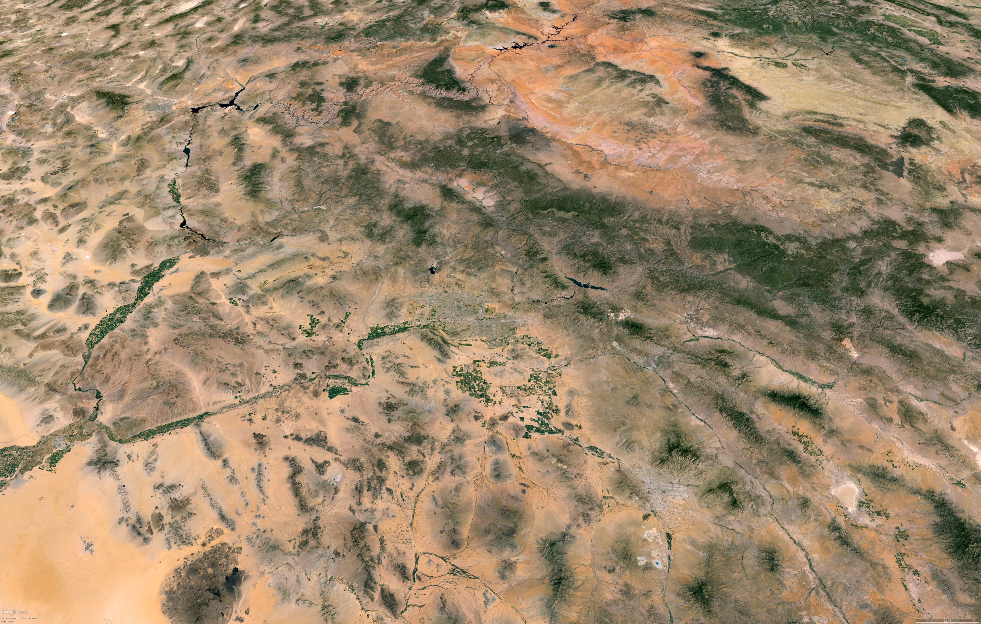


The geology of the Southwest
Steve Semken
Google Earth

Slide 2
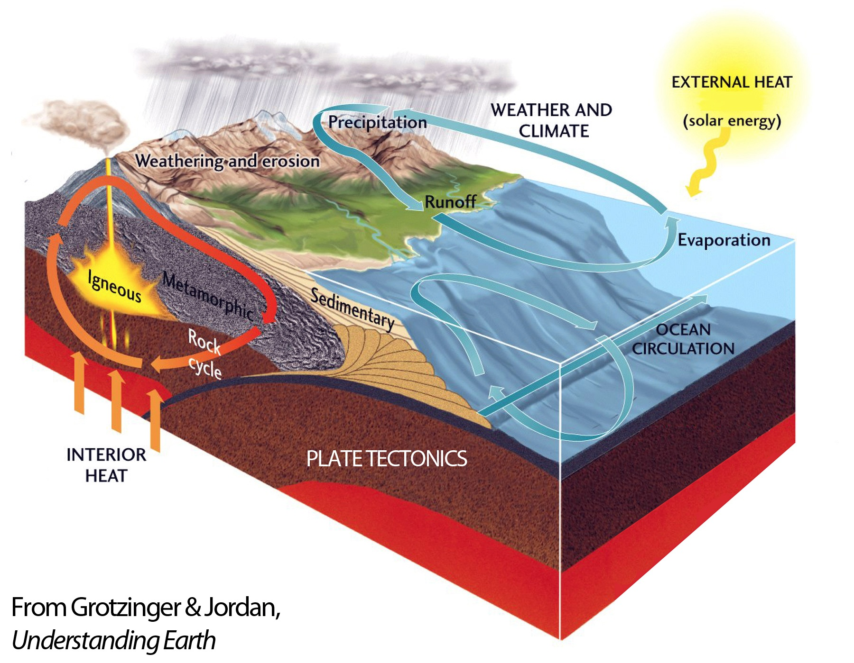
The Earth is a dynamic system, constantly in flux inside and out.
Geomorphic processes
Geodynamic
processes

Slide 3
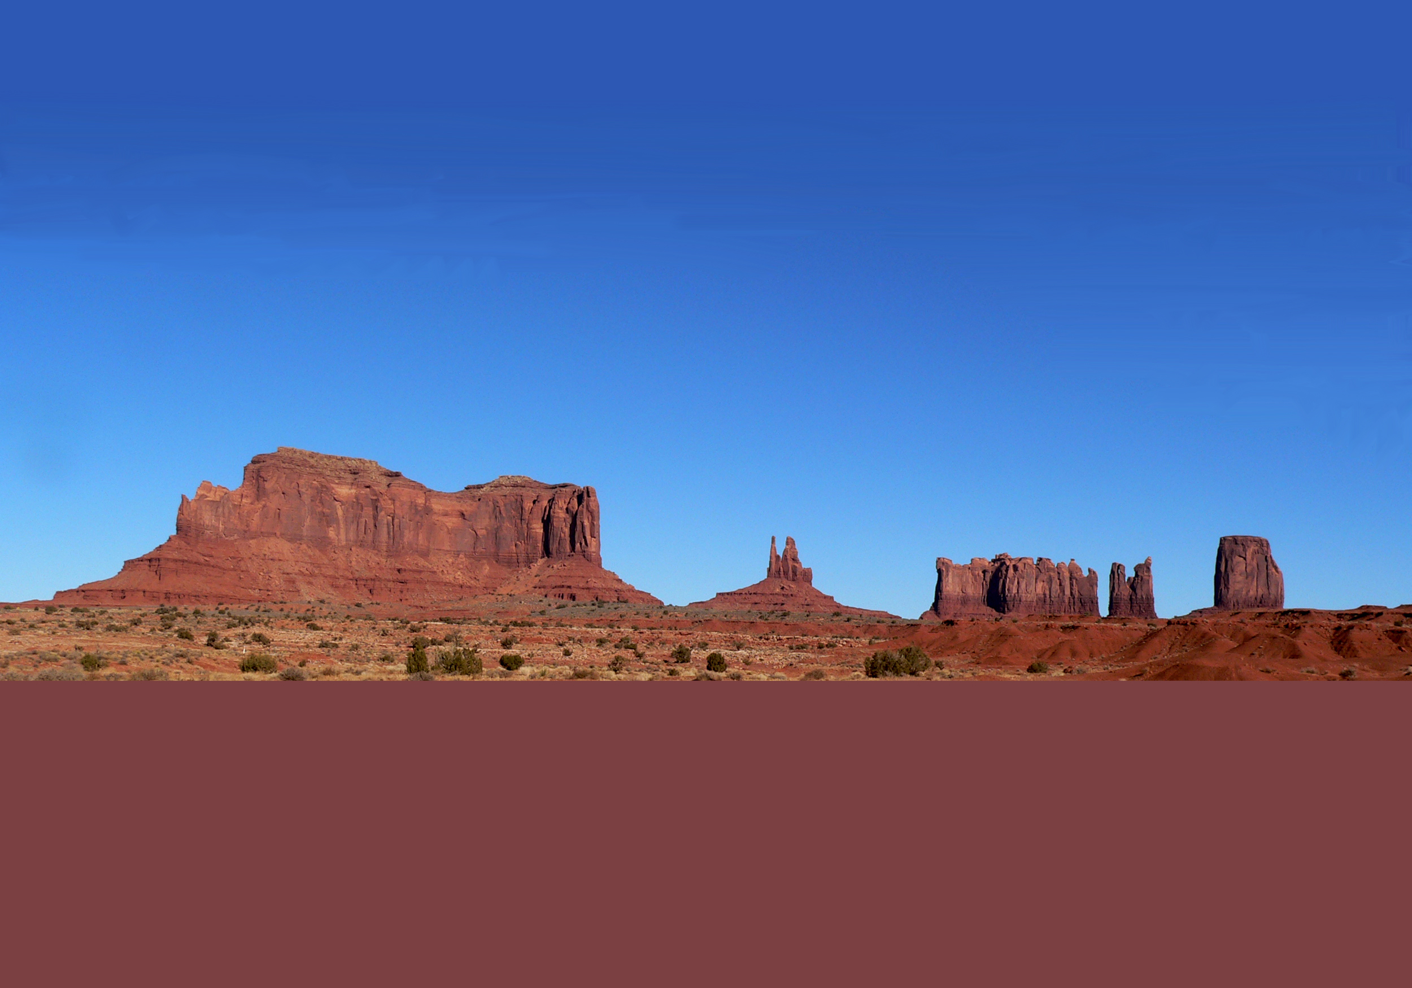
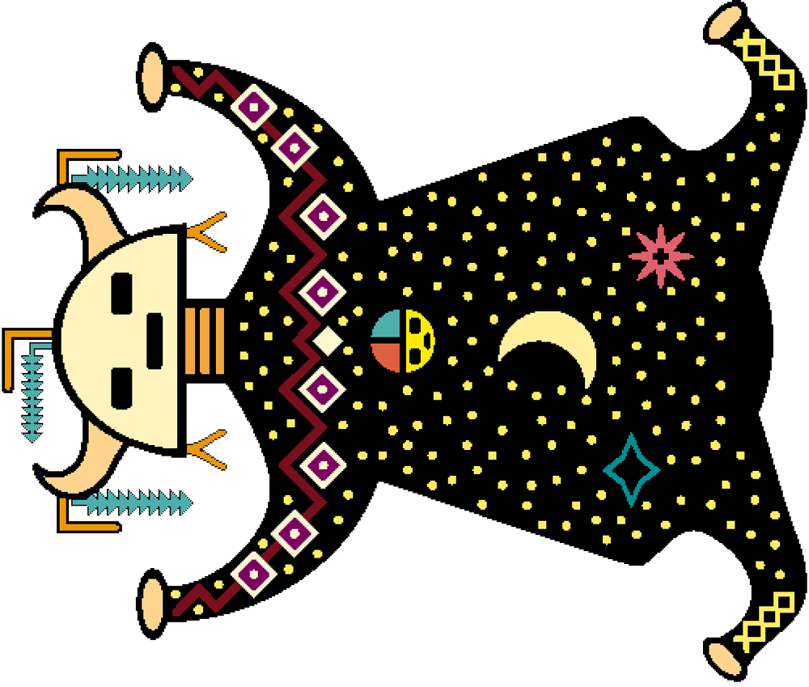
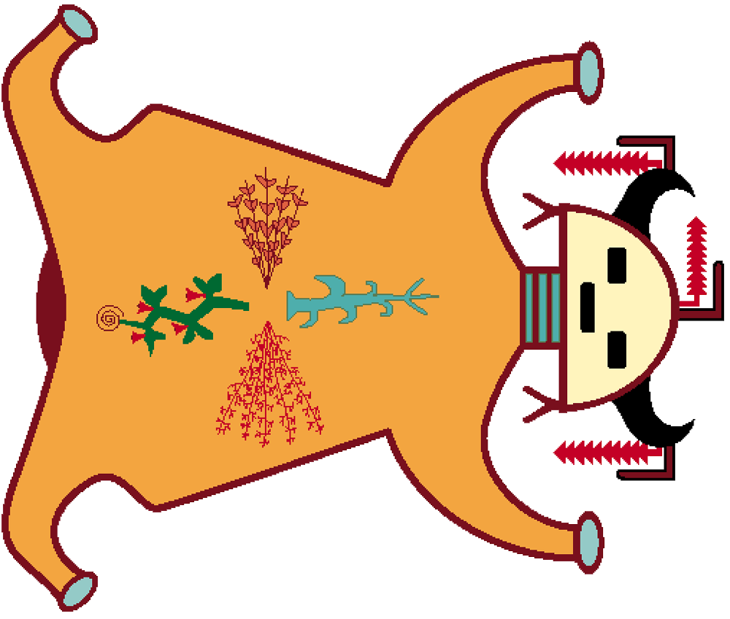
Native peoples of the Southwest have long understood that Earth is a system.
For example: a comparison of traditional Diné (Navajo) ideas of Earth as a system with the global Earth system science model reveals many similarities.
Yádilhil : Sky
Solar energy and gravity
Geomorphic
processes of change
Semken &
Morgan,
J. Geosci. Ed.
(1997)
Yák’ashbaah
Processes of change
Nihookáá’
Processes of change
Near-surface environment: critical zone
Ník’ashbaah
Geodynamic
processes of change
Nohosdzáán: Earth
Radiogenic heat and gravity
Notes:
2 min max
EXPLAIN (2 min).
SOURCES
Semken, S. C., & Morgan, F. (1997). Navajo pedagogy and Earth systems. Journal of Geoscience Education, 45, 109-112.
S. Semken, personal communication.

Slide 4
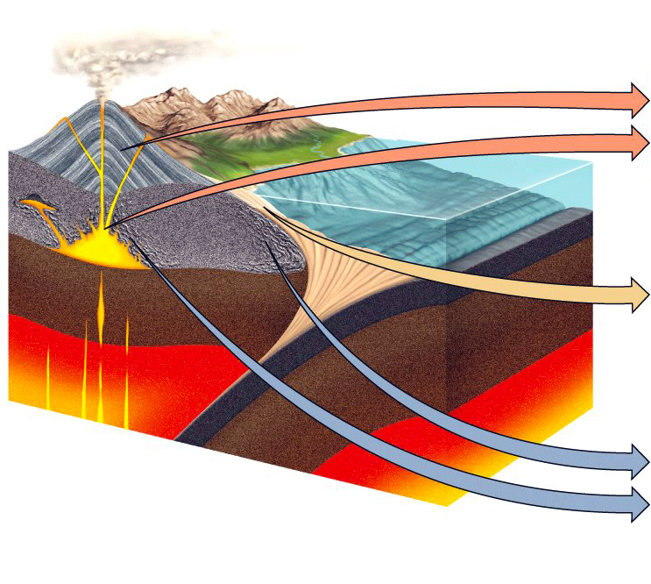
Rocks record the history of Earth.
Clan of rock
and its source
Rock-forming
process
IGNEOUS
ROCKS
Melting of rocks in
hot, deep crust
and upper mantle
MAGMA
(or LAVA)
cools and
solidifies
(crystallizes)
SEDIMENTARY
ROCKS
Weathering and
erosion of rocks
exposed at surface
SEDIMENTS
are transported,
deposited,
buried, and
lithified
METAMORPHIC
ROCKS
High temperatures
and pressures on
rocks in deep crust
and upper mantle
PROTOLITHS
recrystallize
in the solid
state
Grotzinger & Jordan (2014),
Understanding Earth
Each of the three clans of rocks records the history of a different part of the Earth.
Notes:
2 min max
EXPLAIN (2 min).
Distribute trays of rock specimens (if not done earlier).
SOURCE
Grotzinger, J., & Jordan, T. (2014). Understanding Earth (7th ed.). New York: W. H. Freeman & Company.

Slide 5
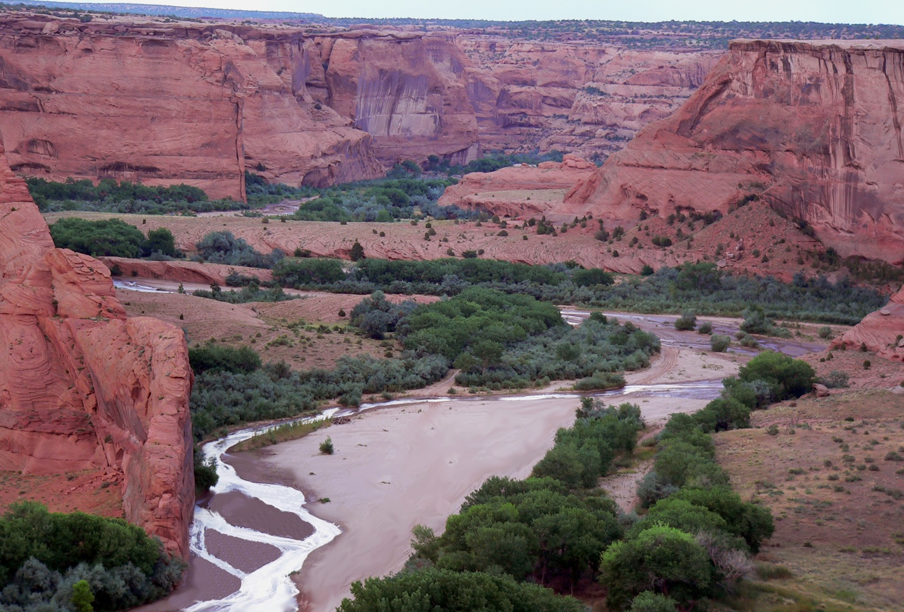
Landscapes also record Earth history, at a different scale.
The landscape consists of all features of a land surface
that can be seen in a single view.
Cliffs of sandstone formed from ancient desert dunes
Entrenched meanders
formed in a recent
interval of regional uplift
Long-term variations in streamflow
reflect climatic changes
Tséyi’ (Diné: ‘Rock, Within It’): Canyon de Chelly National Monument, Navajo Nation, Arizona
(S. Semken photo)
Notes:
2 min max
EXPLAIN (2 min).
SOURCE
S. Semken, personal communication.

Slide 6
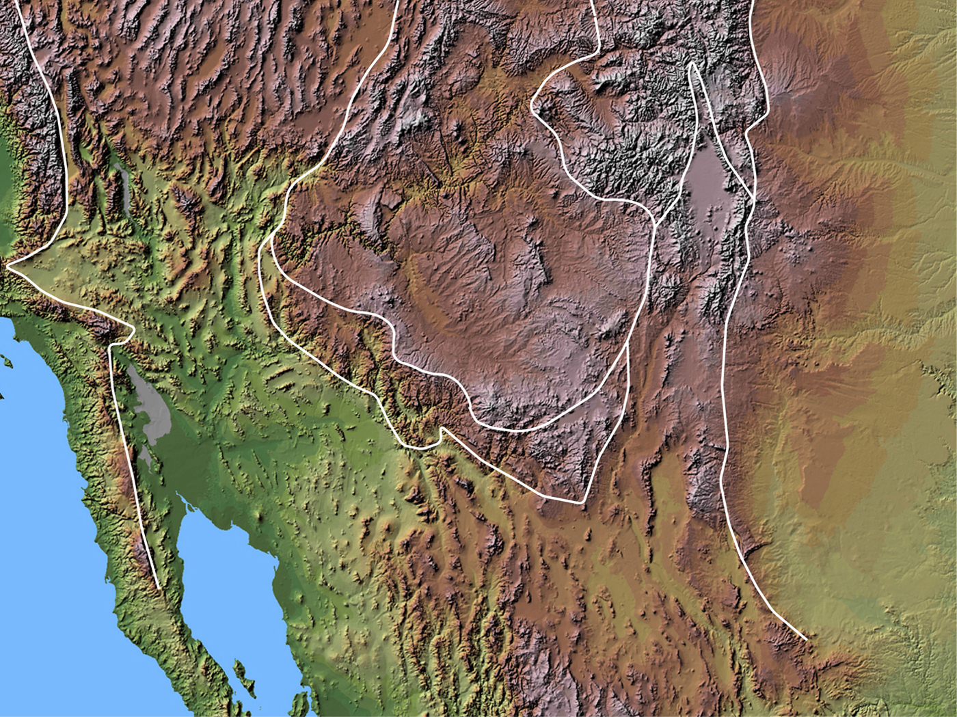
The complex topography (diverse landscapes) of the Southwest offers evidence of a long and tortuous geologic history.
Northern Basin and Range
Southern
Rocky
Mountains
Colorado
Plateau
(Río Grande Rift)
Great
Plains
Transition Zone
Basin
and
Range
Boundaries
are approximate.
USGS (2010)
Notes:
2 min max
EXPLAIN (< 2 min).
EXPLORE Then prompt students to continue making and noting observations from the next set of slides (exploration of the physiographic provinces of the Southwest).
SOURCE
U.S. Geological Survey (2010). National elevation data set shaded relief of the United States [JPEG]. Retrieved 25 October 2011 from http://eros.usgs.gov/imagegallery/collection.php?type=ned_states#45.

Slide 7
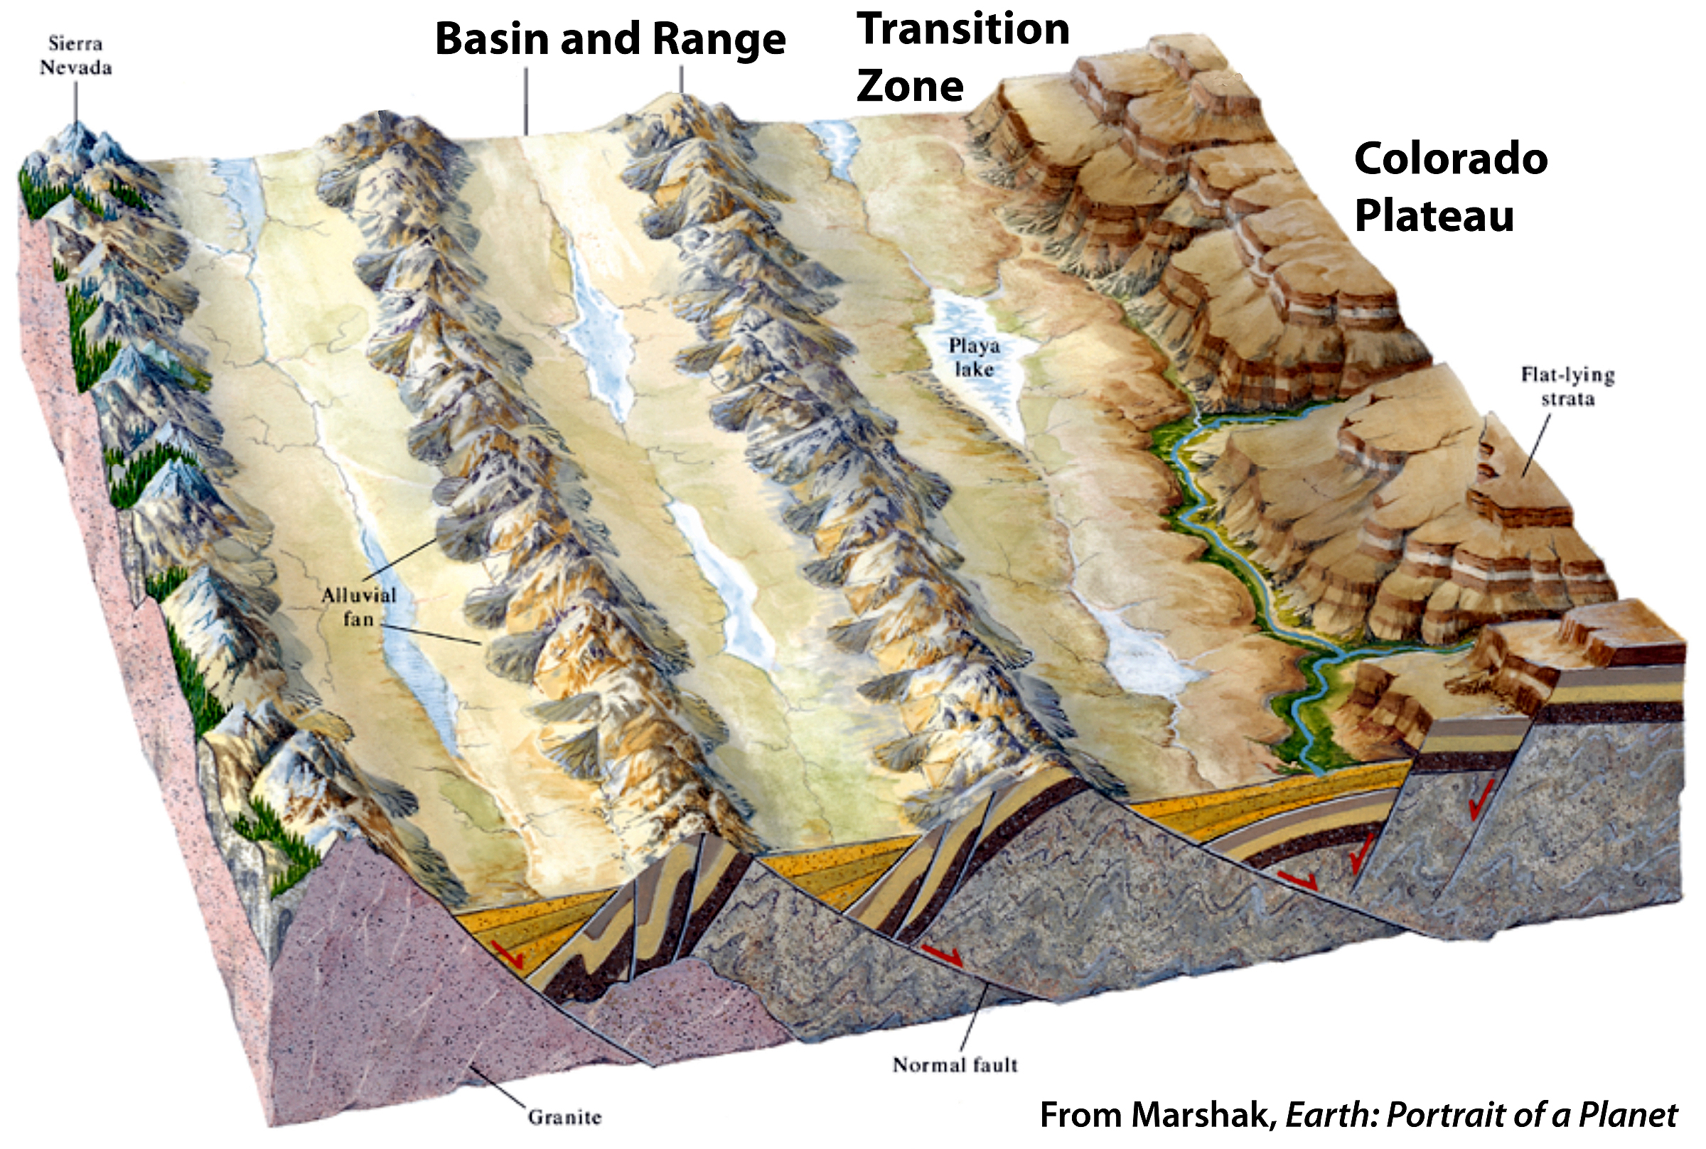
This is the topography of Arizona shown schematically in cross-section.

Slide 8
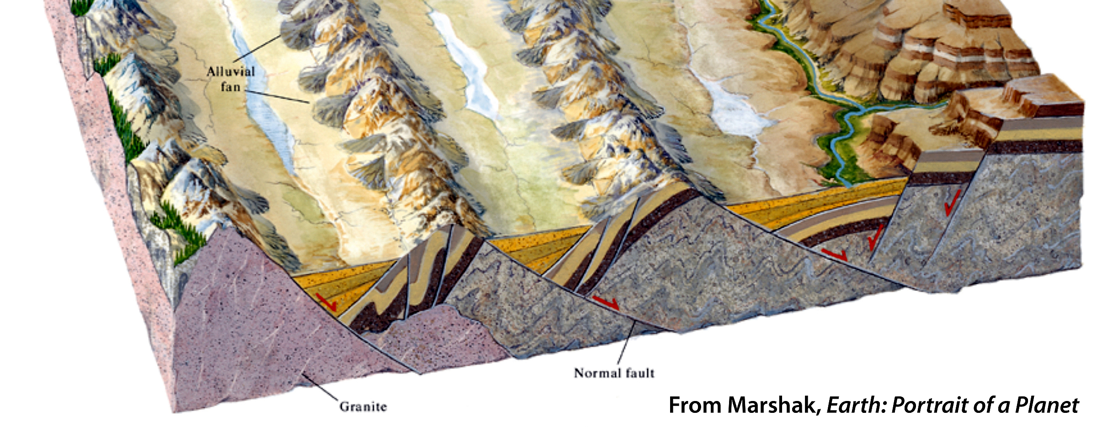
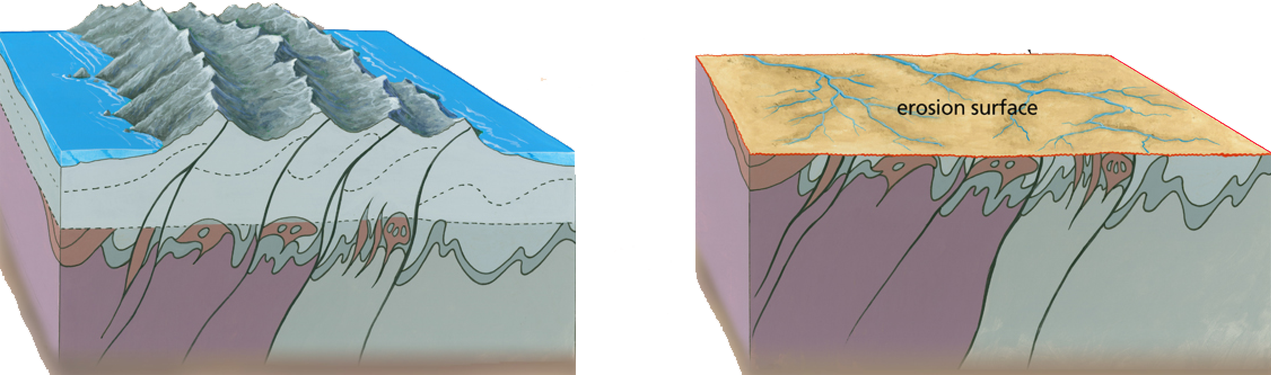
The modern landscapes of the Southwest overly deeply buried basement rocks: between 2 billion and 1 billion years old.
Vishnu Mountains
Trail of Time Project (2010)

Slide 9
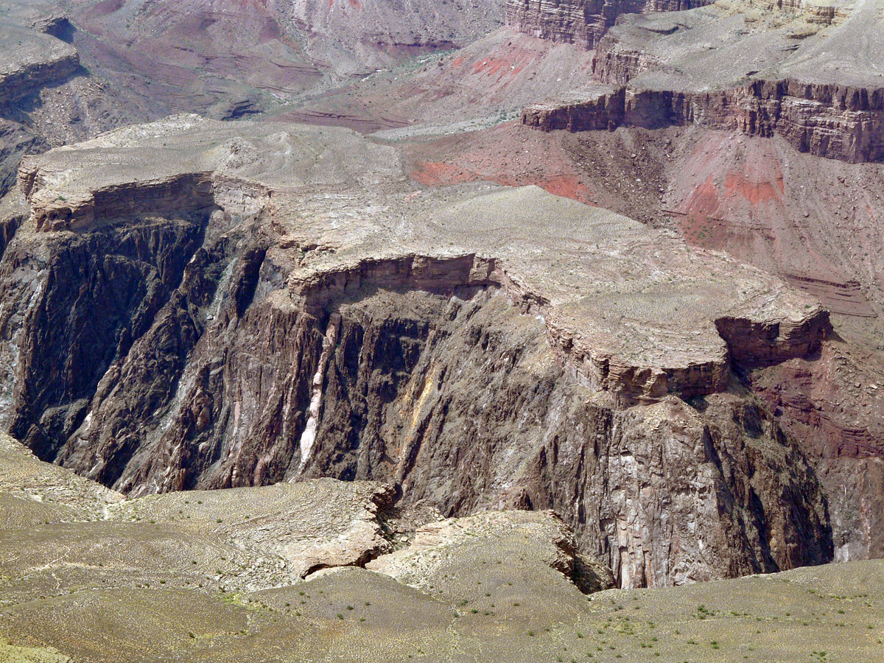
The modern landscapes of the Southwest overly deeply buried basement rocks: between 2 billion and 1 billion years old.
The Great Unconformity in Grand Canyon

Slide 10
Northern Basin and Range
Southern
Rocky
Mountains
Colorado
Plateau
(Río Grande Rift)
Great
Plains
Transition Zone
Basin
and
Range
Boundaries
are approximate.
USGS (2010)
Notes:
2 min max
EXPLAIN (< 2 min).
EXPLORE Then prompt students to continue making and noting observations from the next set of slides (exploration of the physiographic provinces of the Southwest).
SOURCE
U.S. Geological Survey (2010). National elevation data set shaded relief of the United States [JPEG]. Retrieved 25 October 2011 from http://eros.usgs.gov/imagegallery/collection.php?type=ned_states#45.

Slide 11
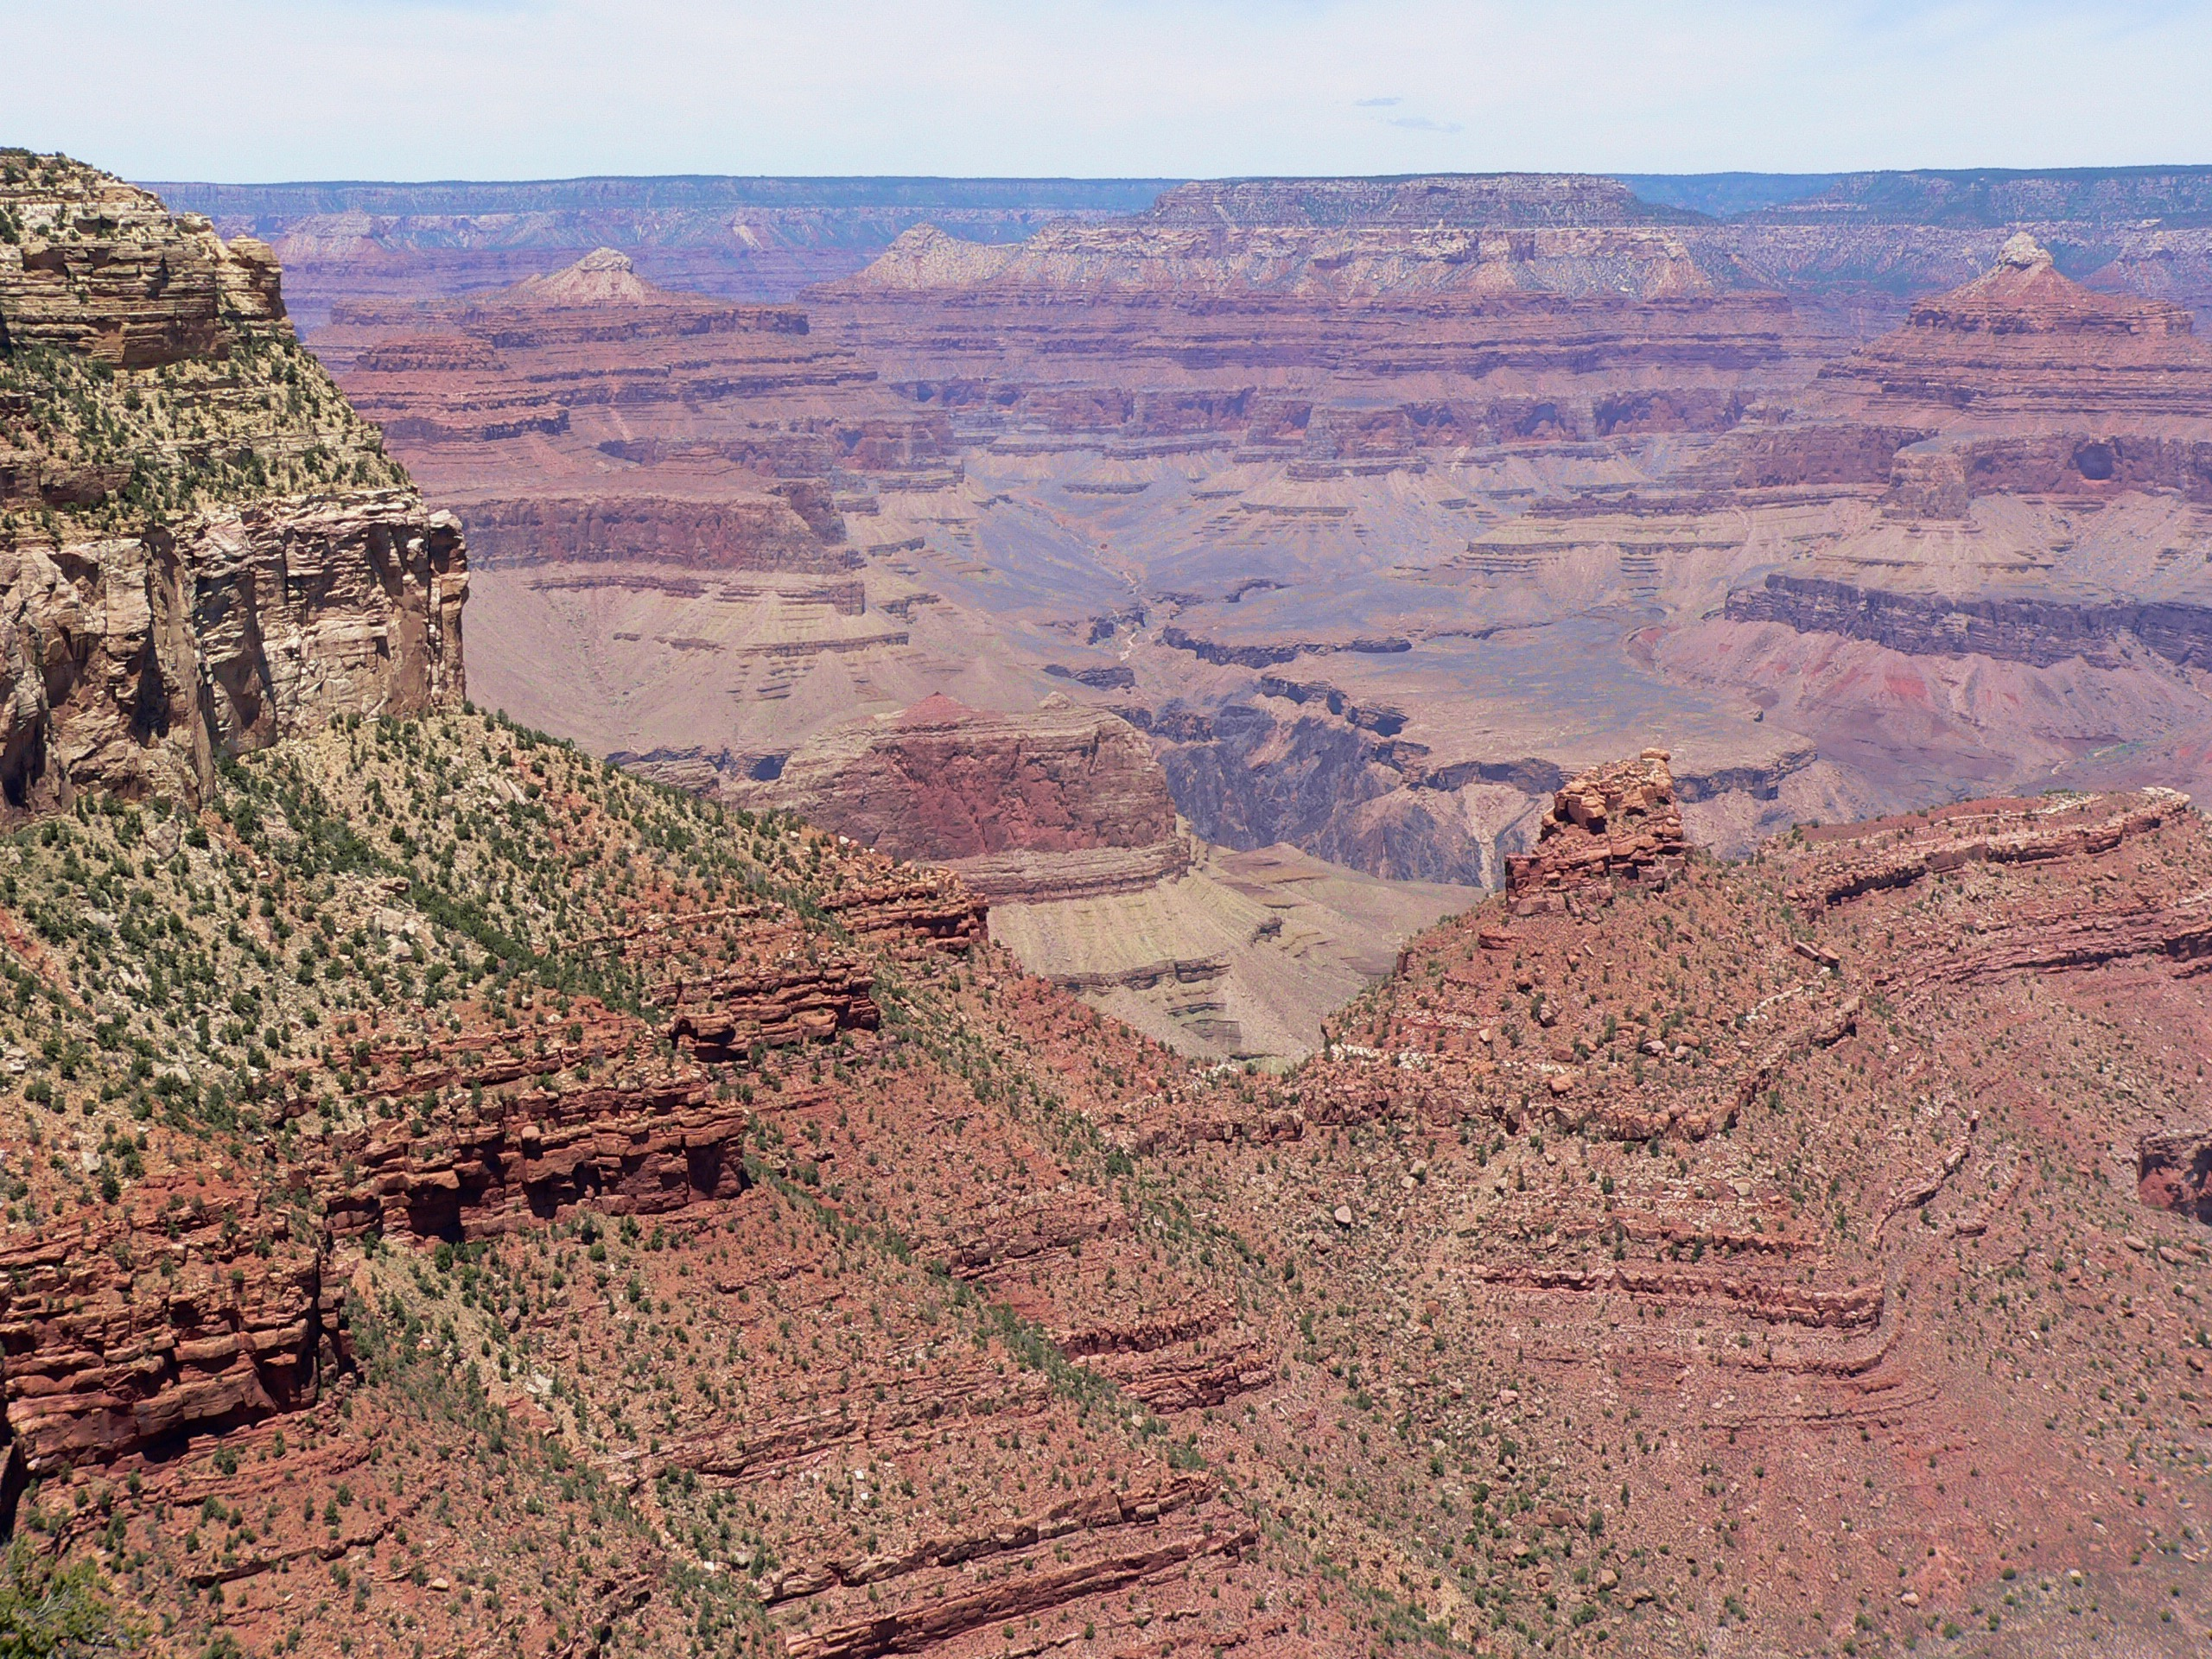
The Colorado Plateau is built on a thick stack of layered rocks.
Grand Canyon
Notes:
2 min max
EXPLAIN (< 2 min).
SOURCE
S. Semken, personal communication.

Slide 12
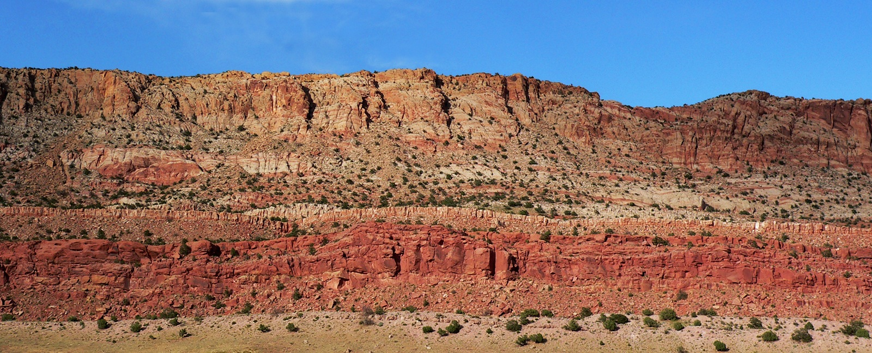
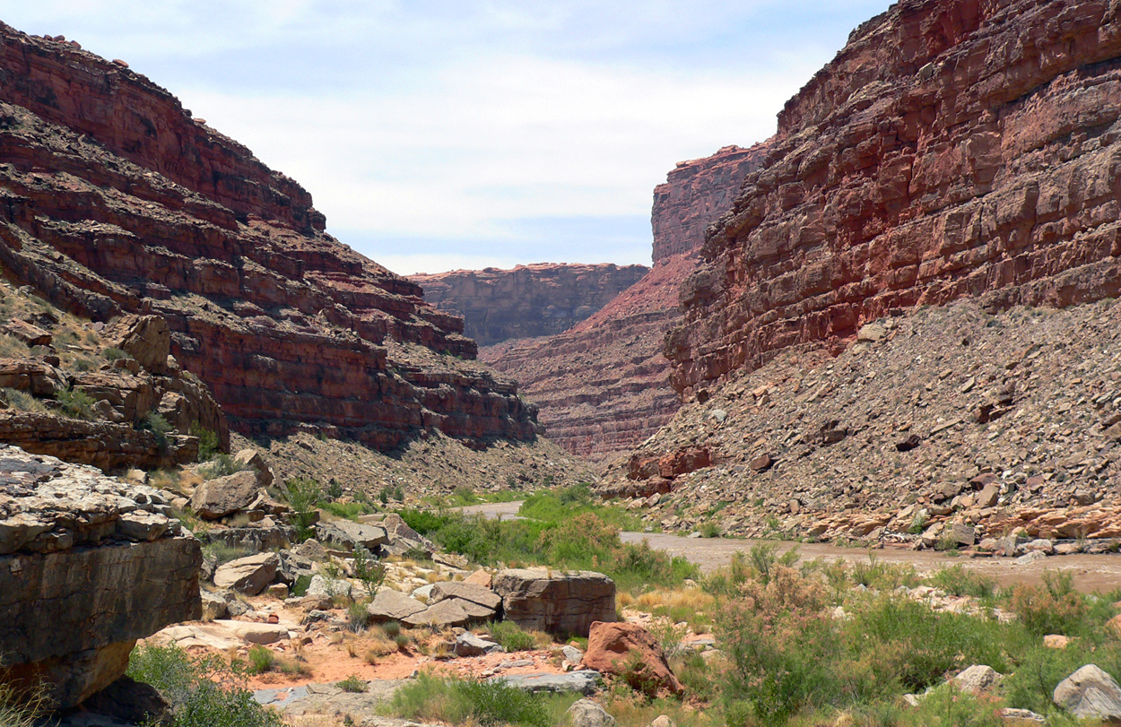
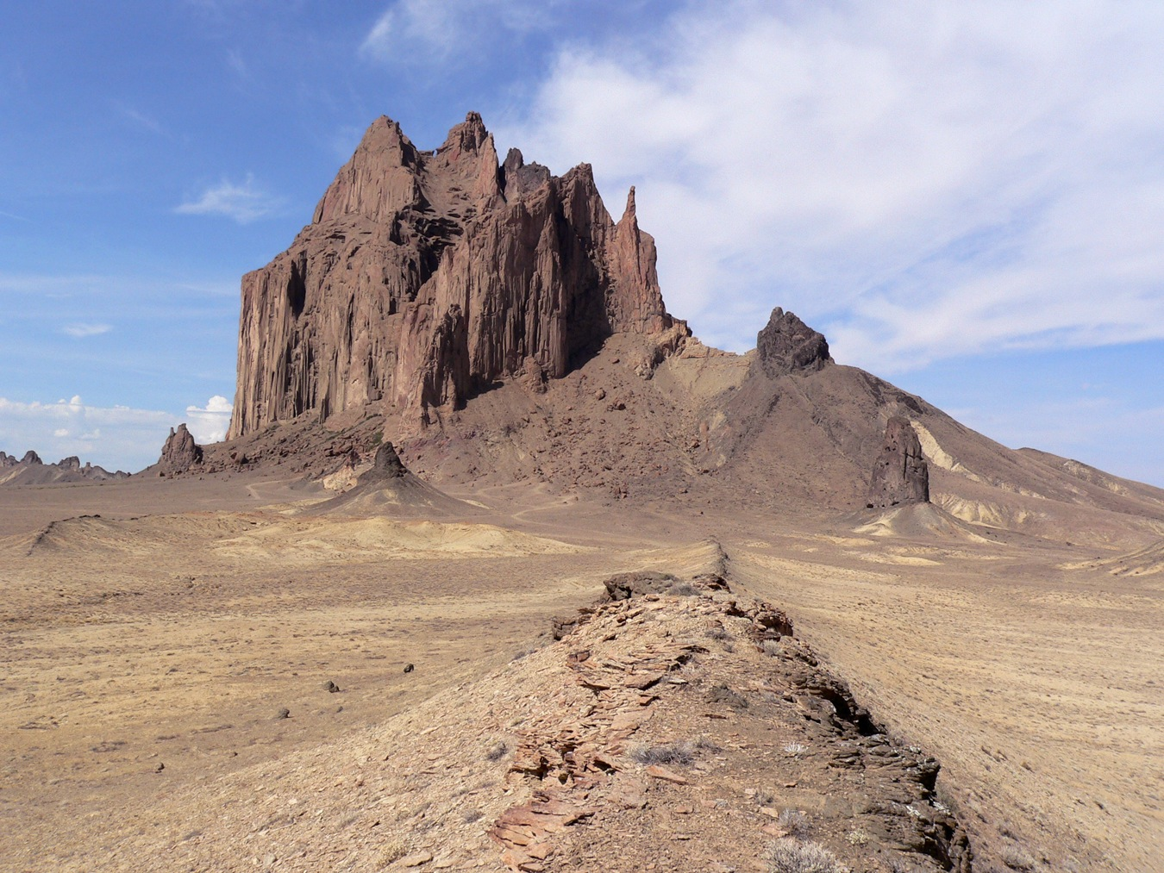
The Colorado Plateau is built on a thick stack of layered rocks.
The Plateau has high elevation but low relief.
Landscapes form on thickly layered rocks, in places deeply incised.
Echo Cliffs, Colorado Plateau, Navajo Nation, Arizona
San Juan River Canyon,
Colorado Plateau, Utah
Tsé bit’á’í, (Diné, “rock with wings”): a.k.a. Ship Rock,
Colorado Plateau,
Navajo Nation,
New Mexico
Eroded remnants of volcanoes dot the landscape.
Through-going rivers
have cut deep canyons.
(All photos by S. Semken)
Notes:
2 min max
EXPLAIN (< 2 min).
SOURCE
S. Semken, personal communication.

Slide 13
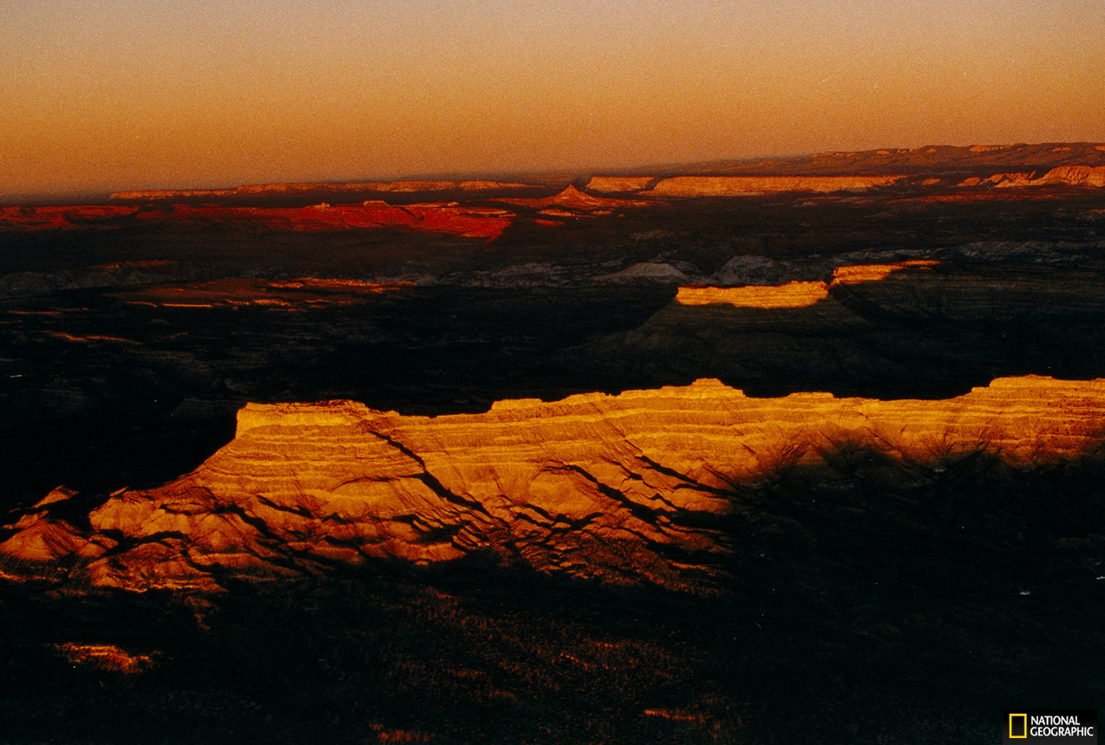
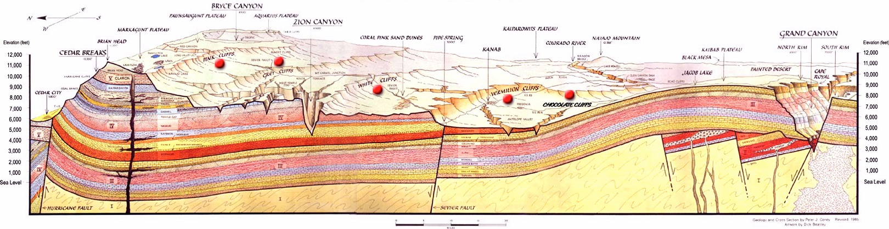
The Colorado Plateau is built on a thick stack of layered rocks.
L. Jenshel (1997)
Utah Arizona
Bryce Canyon
Vermilion Cliffs
Zion Canyon
Grand Canyon
“Stairsteps” cut into thickly layered rocks:
more than 4 km (2.5 mi) thick in some places
National Park Service (2005)
Notes:
2 min max
EXPLAIN (< 2 min).
SOURCES
Jenshel, L. (1997). Twilight, Grand Staircase [JPEG]. Retrieved 15 September 2011 from National Geographic website, http://photography.nationalgeographic.com/staticfiles/NGS/Shared/StaticFiles/Photography/Images/POD/t/twilight-grand-staircase-521999-xl.jpg.
National Park Service (2005). The Grand Staircase [JPEG]. Retrieved 15 September 2011 from http://en.wikipedia.org/wiki/File:Grand_Staircase-big.jpg.

Slide 14
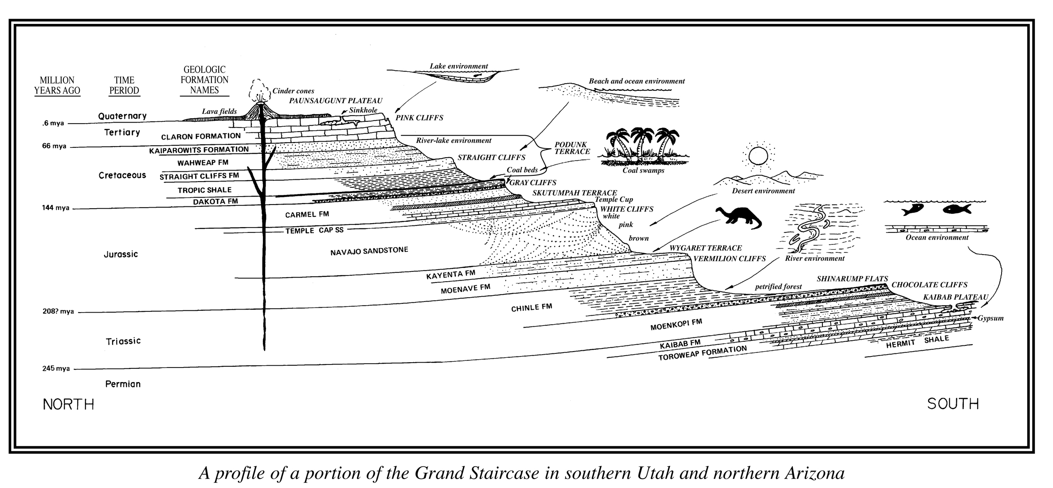
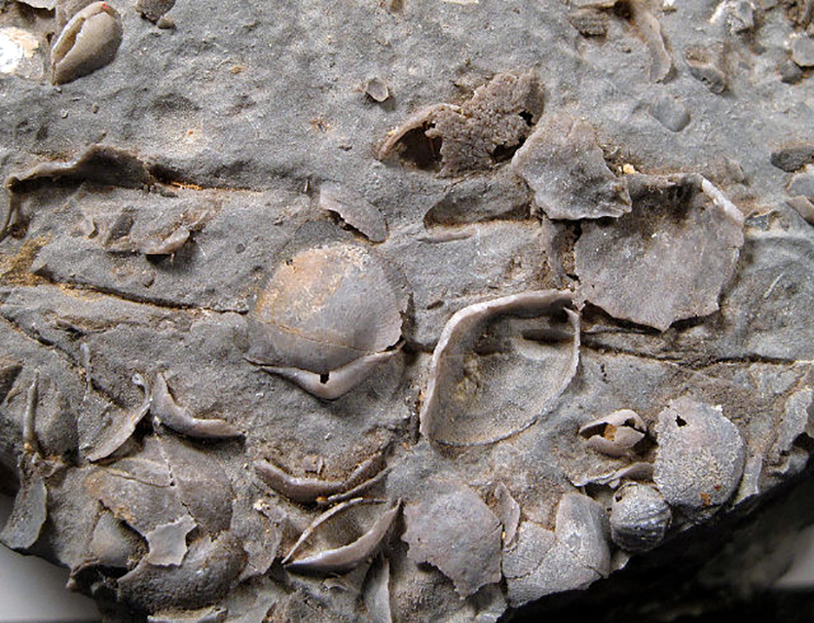
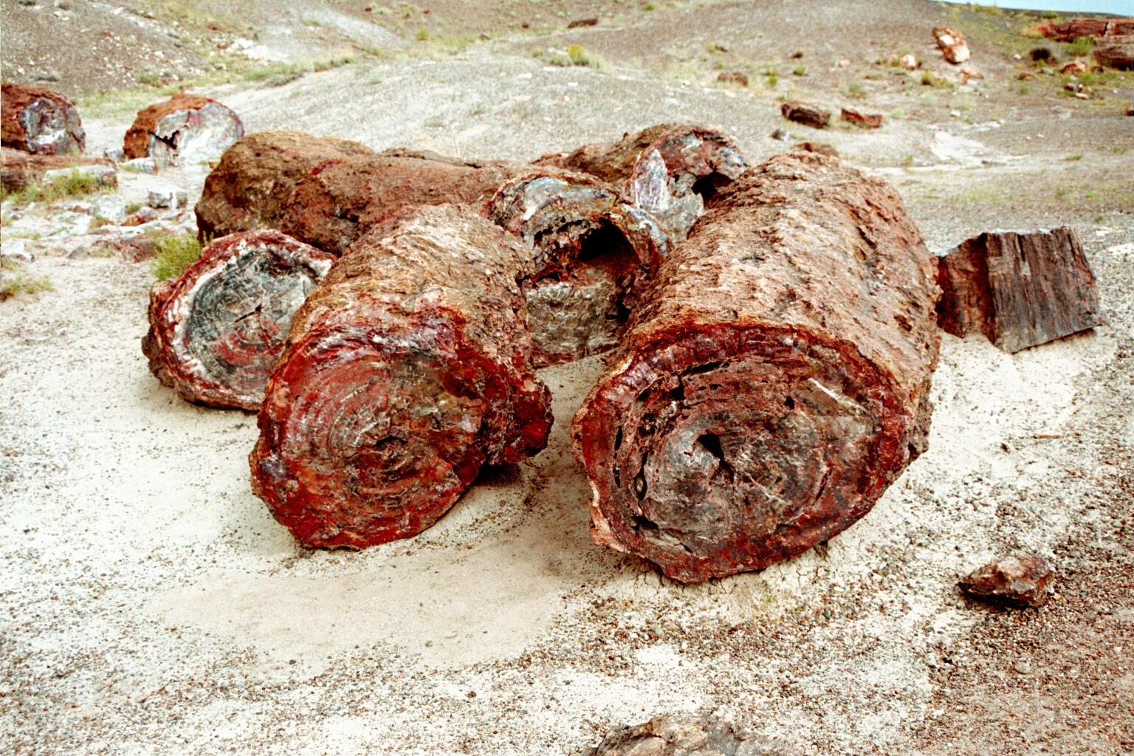
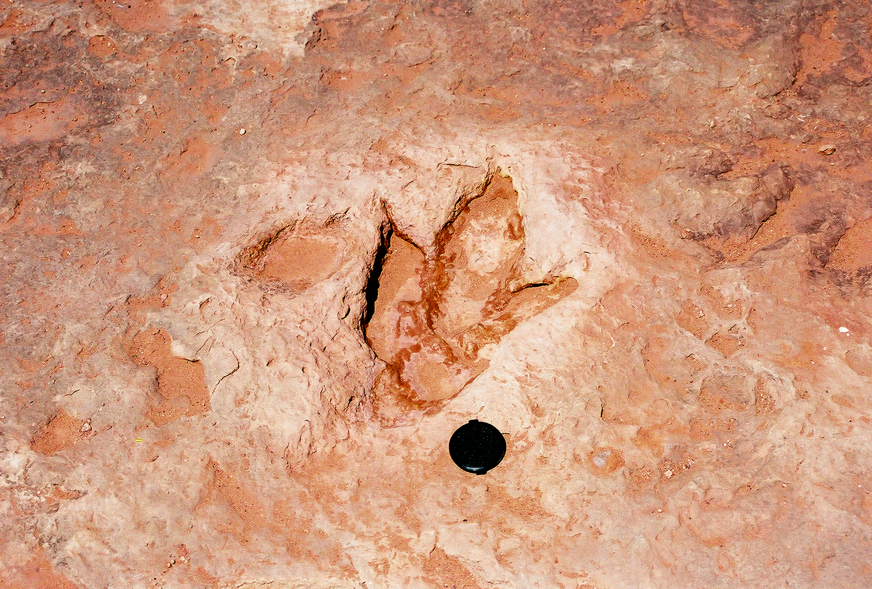
Fossils in the rock layers show that some were formed beneath the sea and others on land.
Utah Geological Survey
Brachiopod shells
Therapod dinosaur footprint
(R. Weller)
Permineralized (petrified) wood

Slide 15
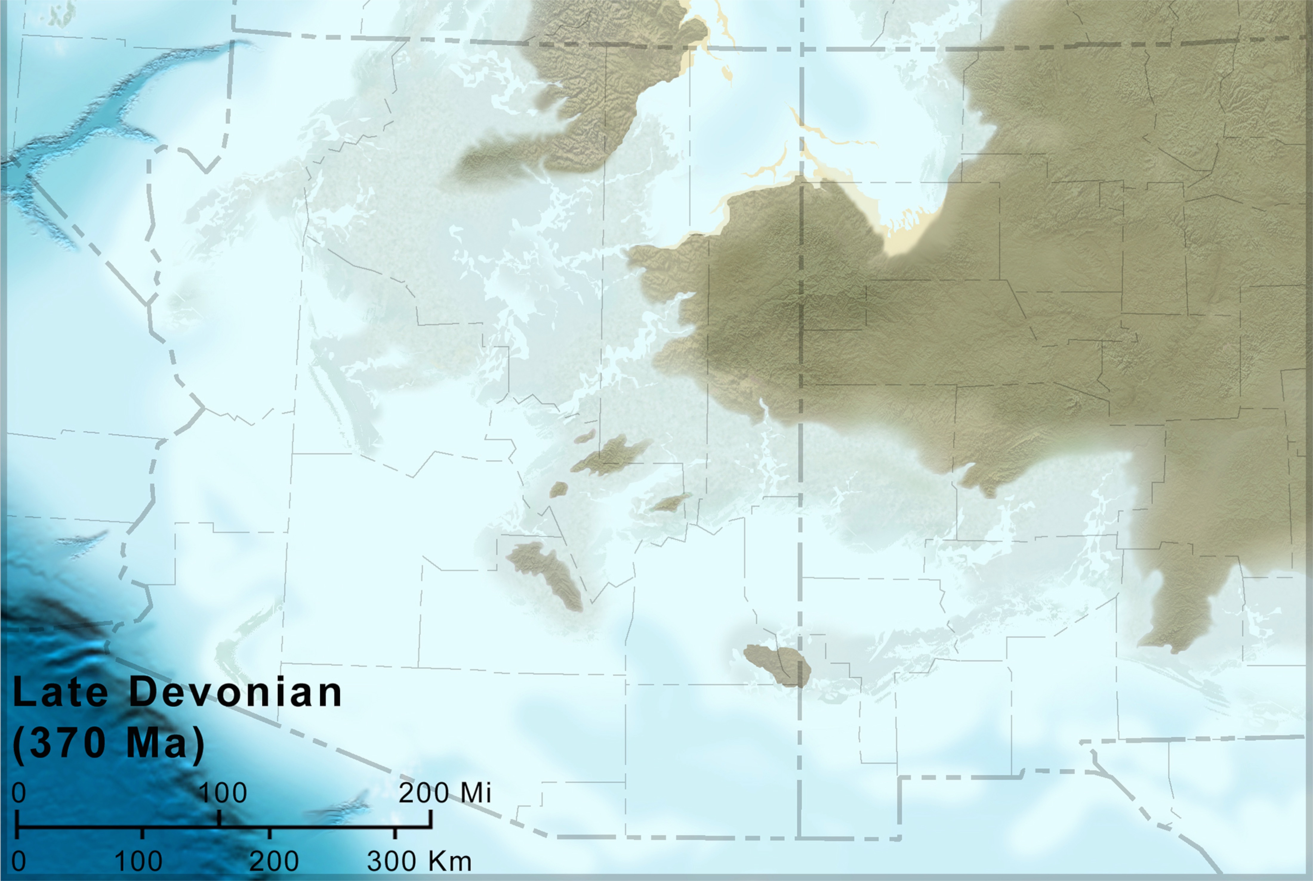
From about 500 to 270 million years ago, the ancient Southwest was low-lying and was periodically flooded by the sea.
Colorado Plateau Geosystems—Blakey (2011)

Slide 16
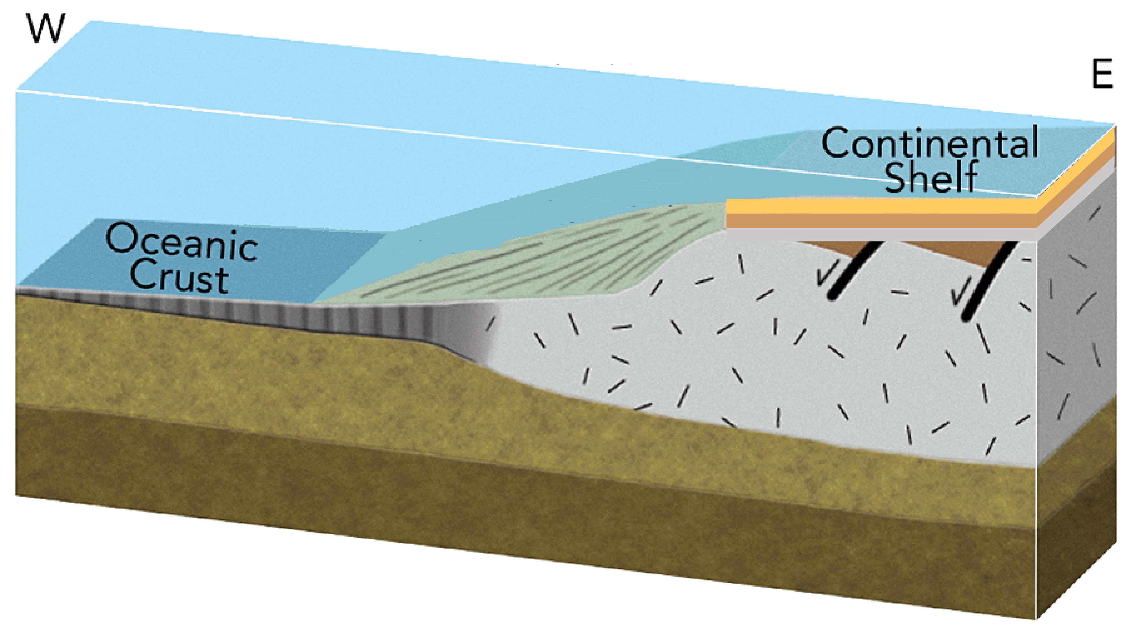
The seas deposited thick layers of lime, mud, and sand—also fossils—on the low-lying continent.
Reynolds, Johnson, Morin, & Carter (2013)

Slide 17
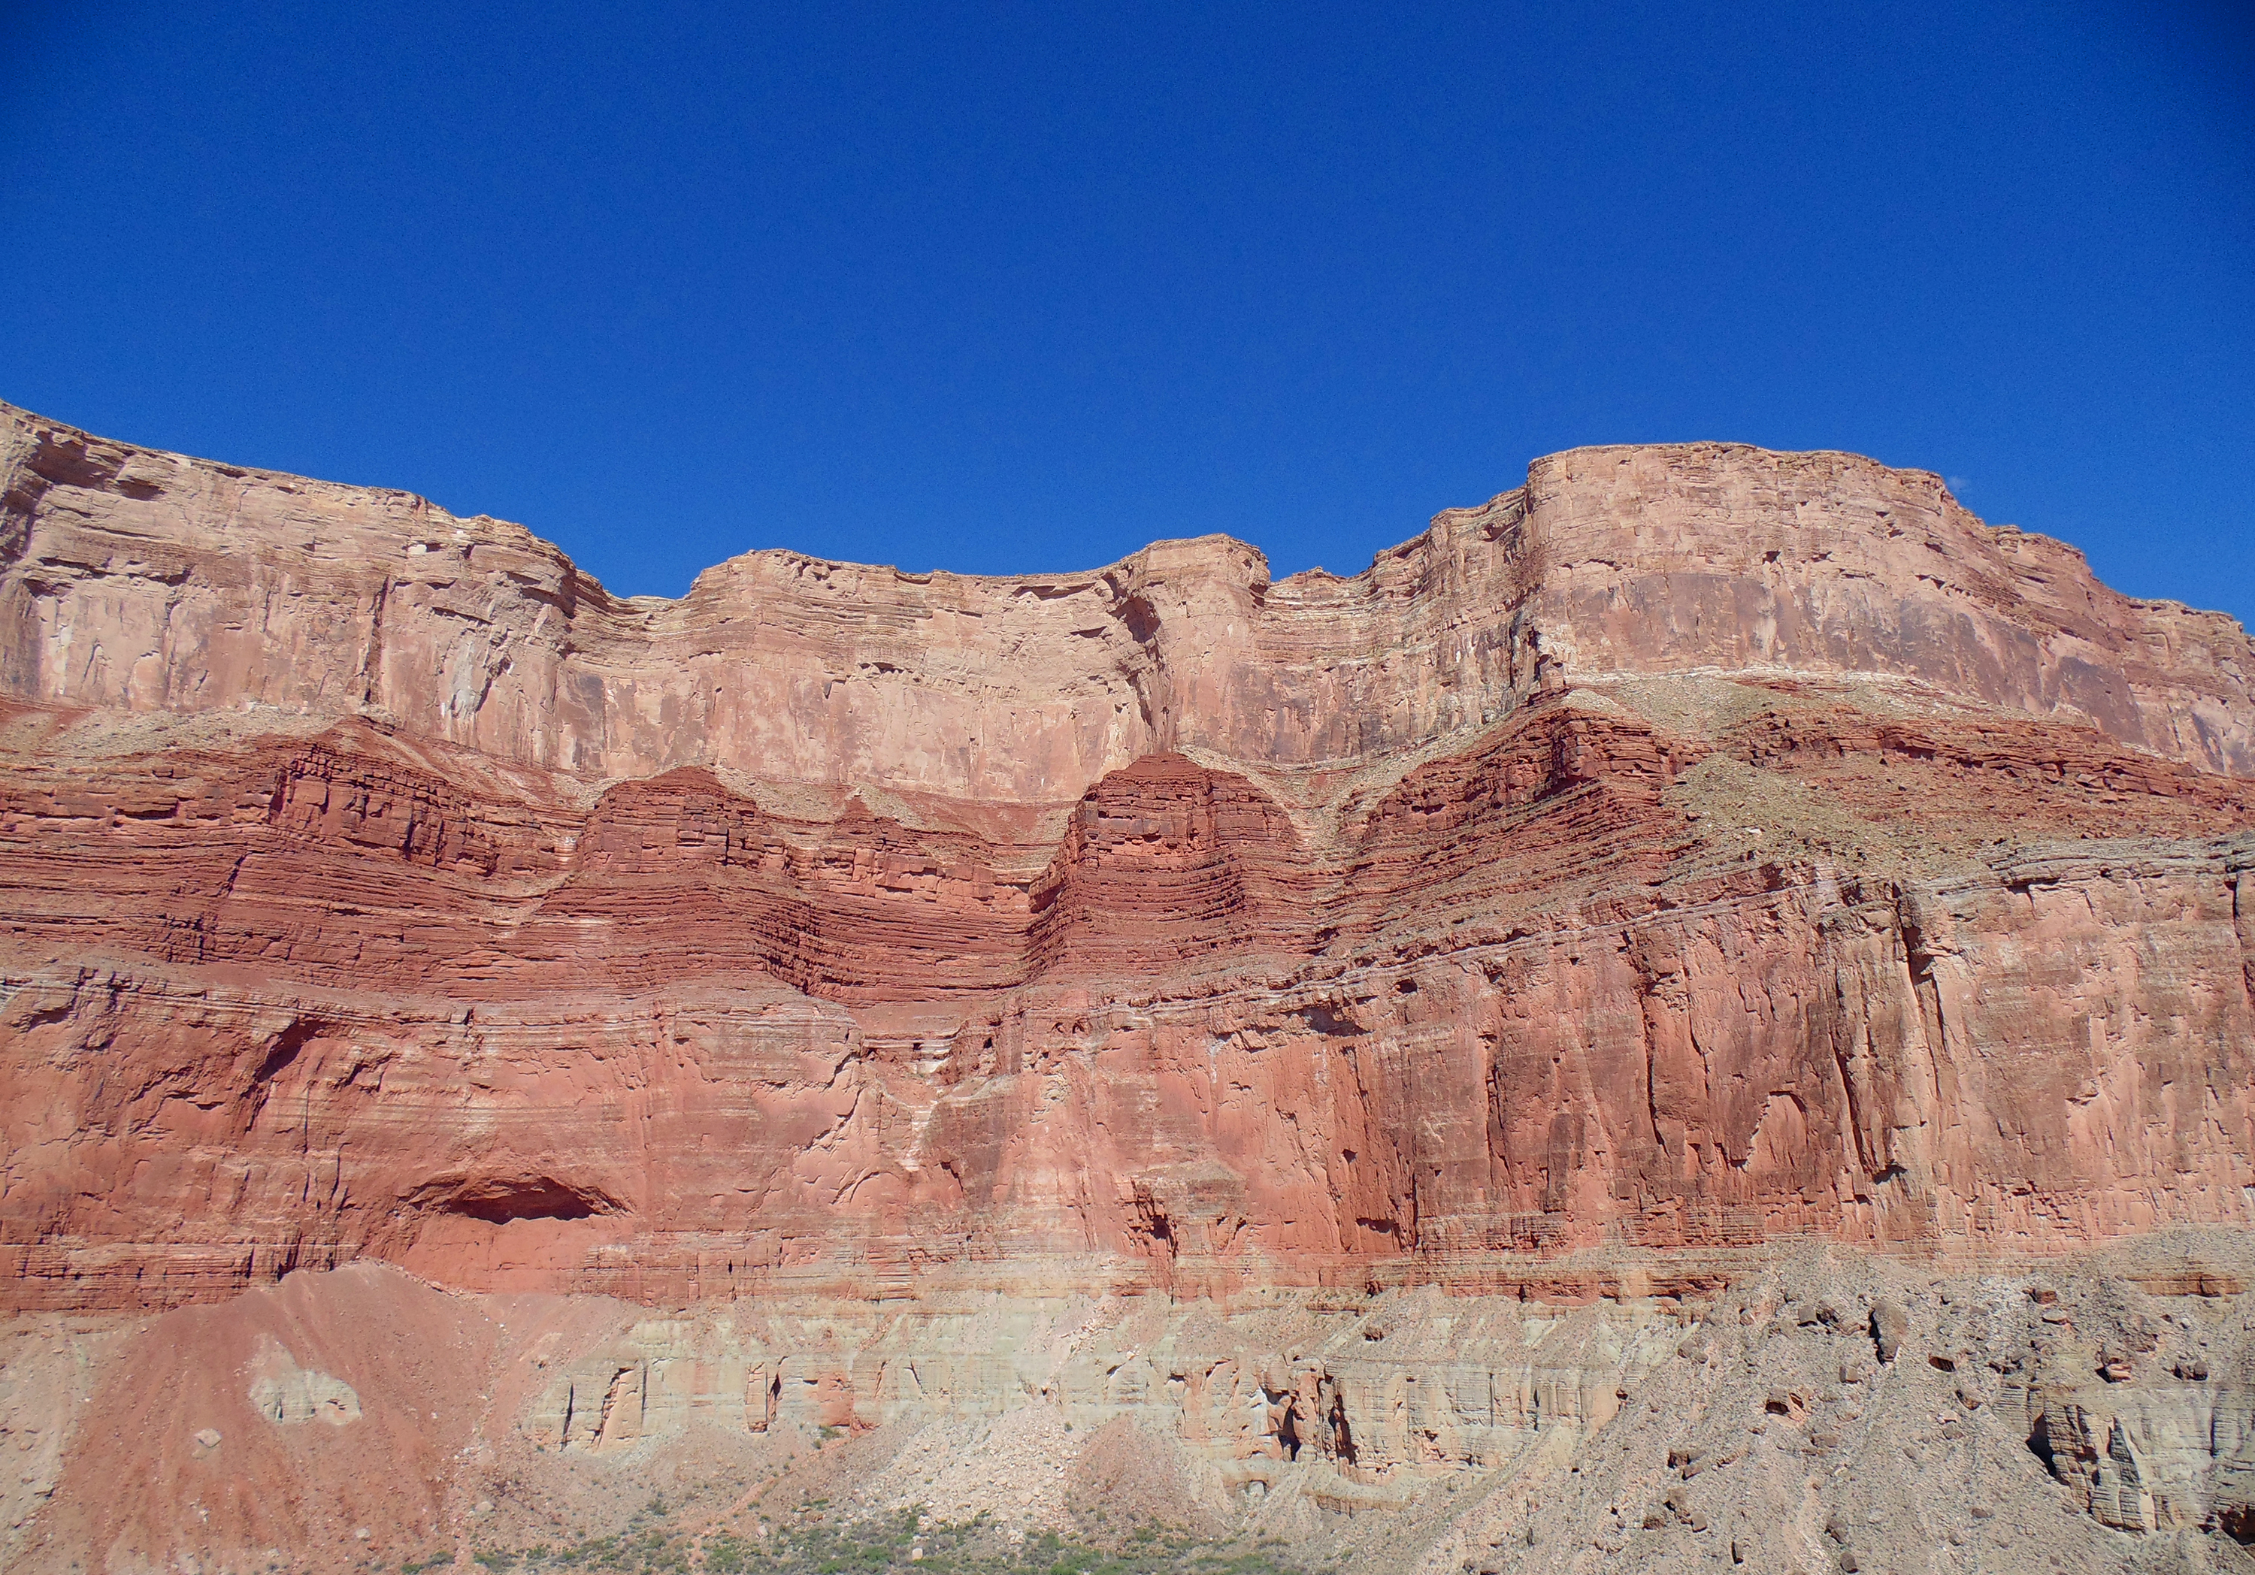
These layers were buried, compressed, and cemented to form great beds of sedimentary rock.
Marble Canyon

Slide 18
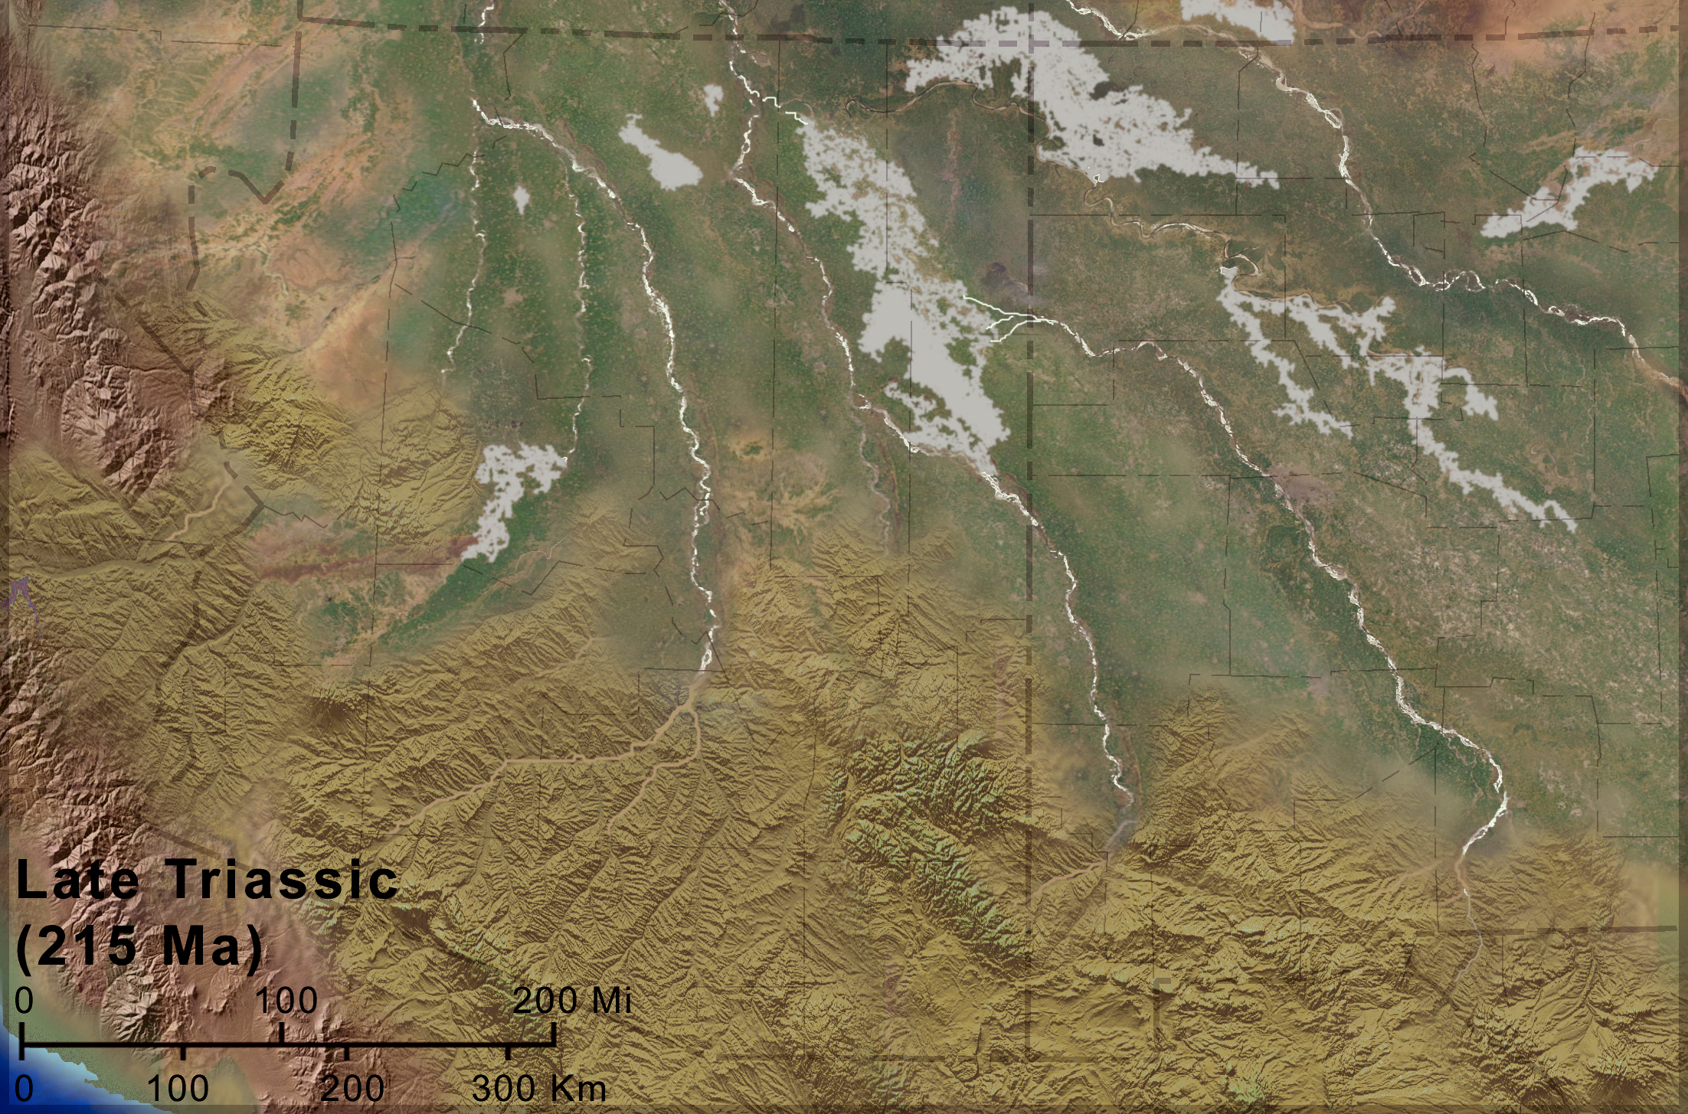
From about 270 to 100 million years ago, mountains blocked the sea, and sand and gravel beds were deposited on land.
Colorado Plateau Geosystems—Blakey (2011)

Slide 19
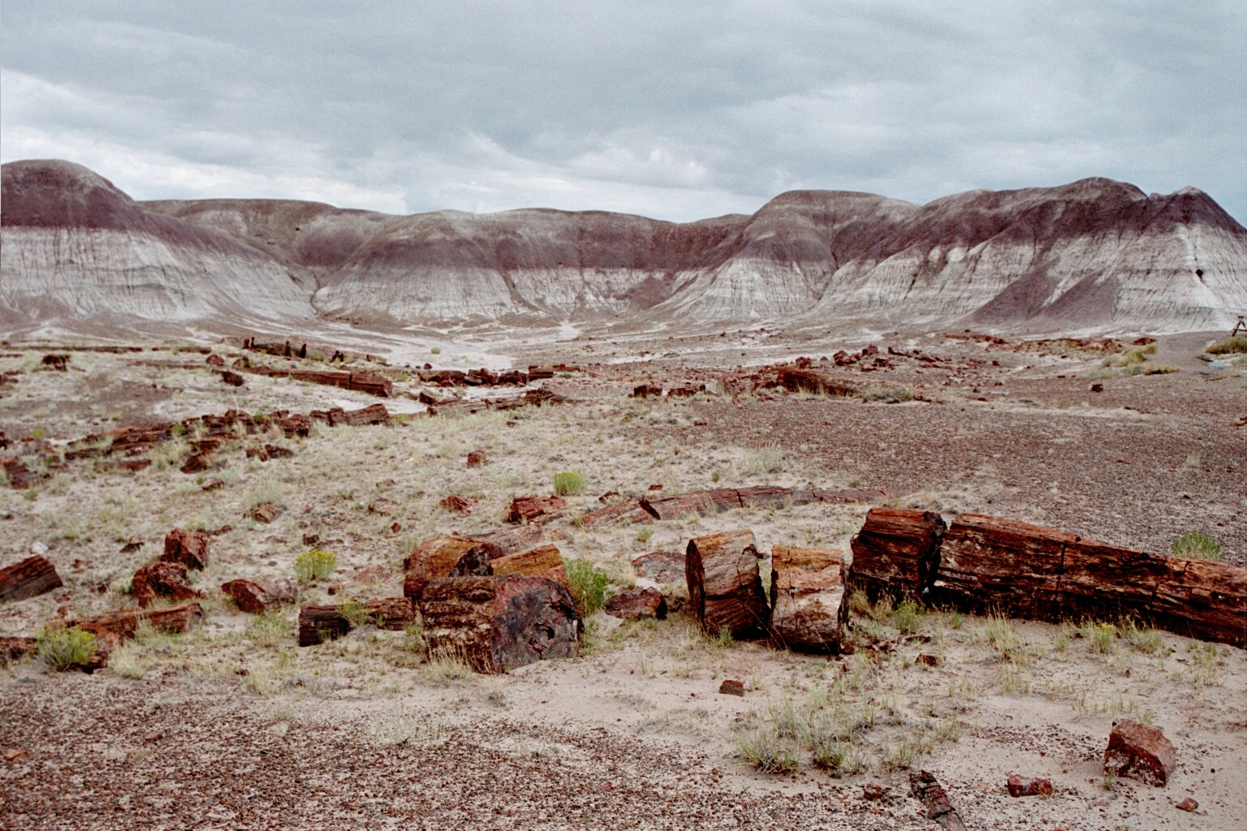
Petrified Forest

Slide 20
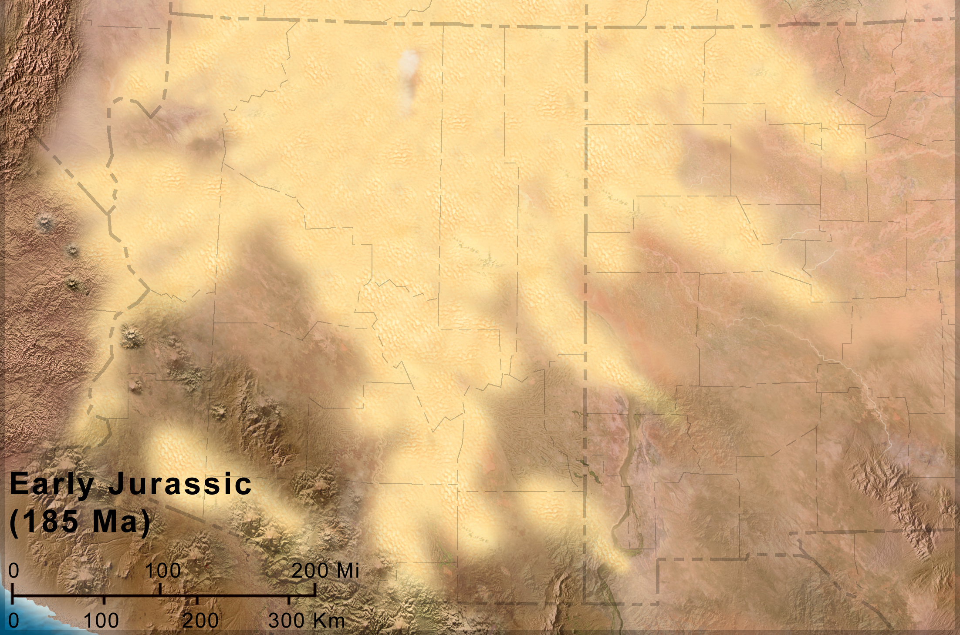
Some of the time, great deserts covered the ancient Southwest, and thick beds of windblown sand were deposited.
Colorado Plateau Geosystems—Blakey (2011)

Slide 21
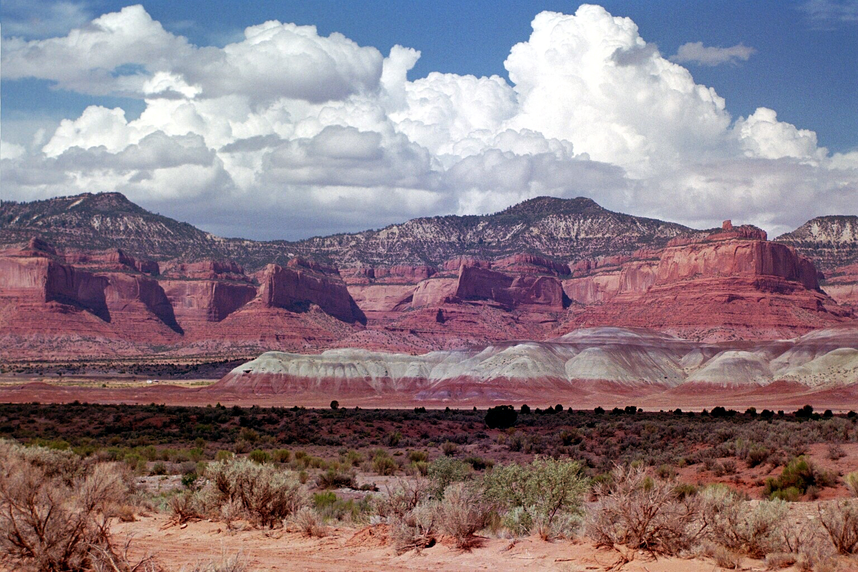
Lukachukai Cliffs

Slide 22
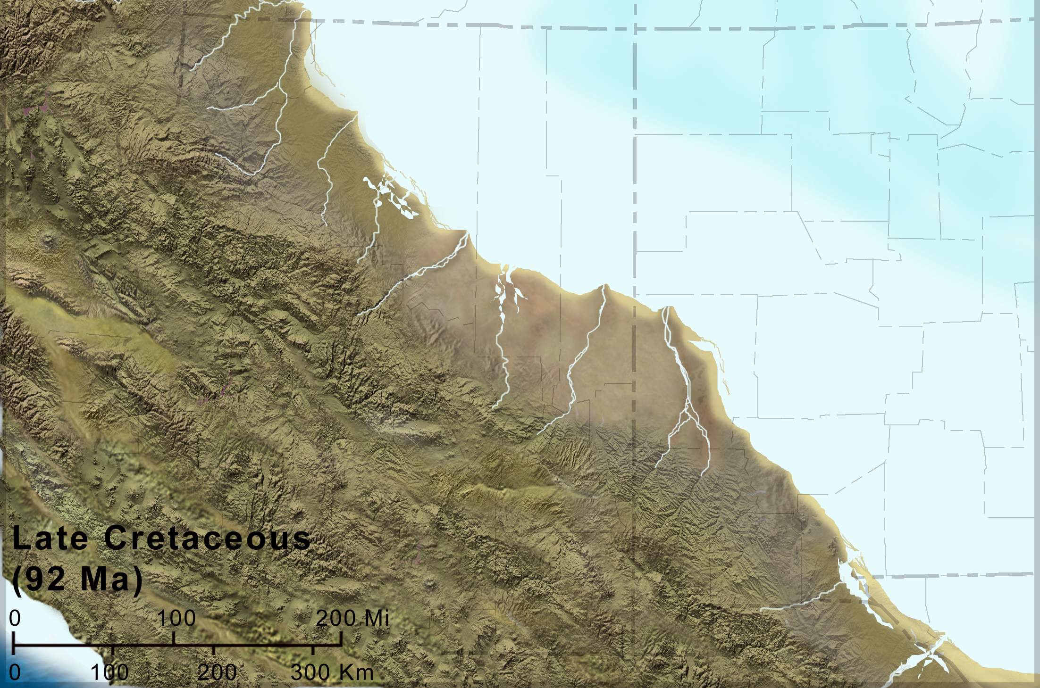
From about 100 to 75 million years ago, seas covered the region again, this time encroaching from the east.
Colorado Plateau Geosystems—Blakey (2011)

Slide 23
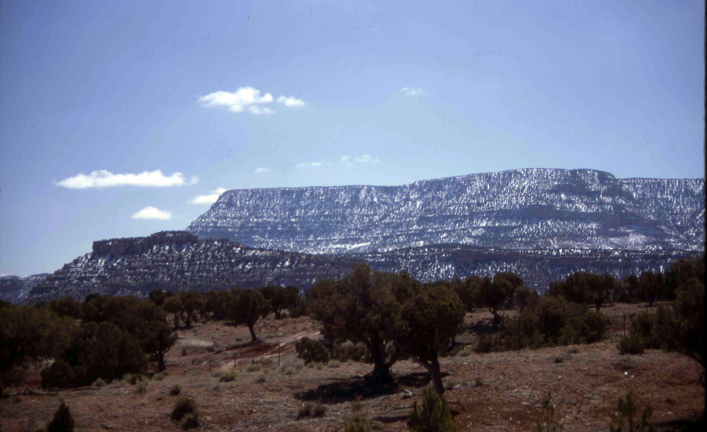
Black Mesa

Slide 24
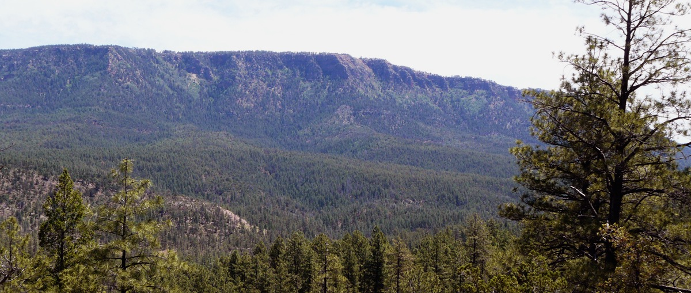
How did the Colorado Plateau rise from sea level to its current high elevation?
The Mogollon Rim: the edge of the present Colorado Plateau

Slide 25
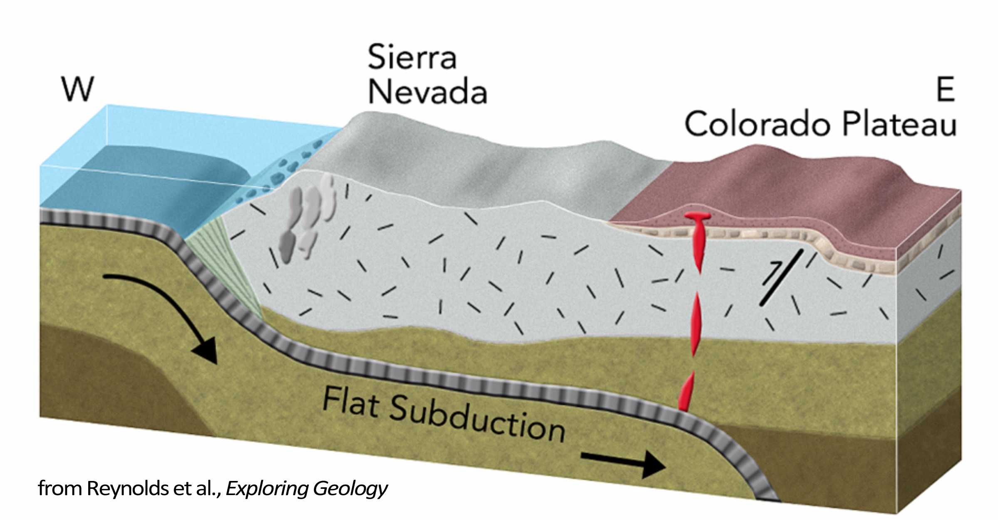
From about 80 to 35 million years ago, the continent overrode the ocean floor, and the future Southwest was heaved high.
CRUST
MANTLE
after Reynolds, Johnson, Morin, & Carter (2013)

Slide 26
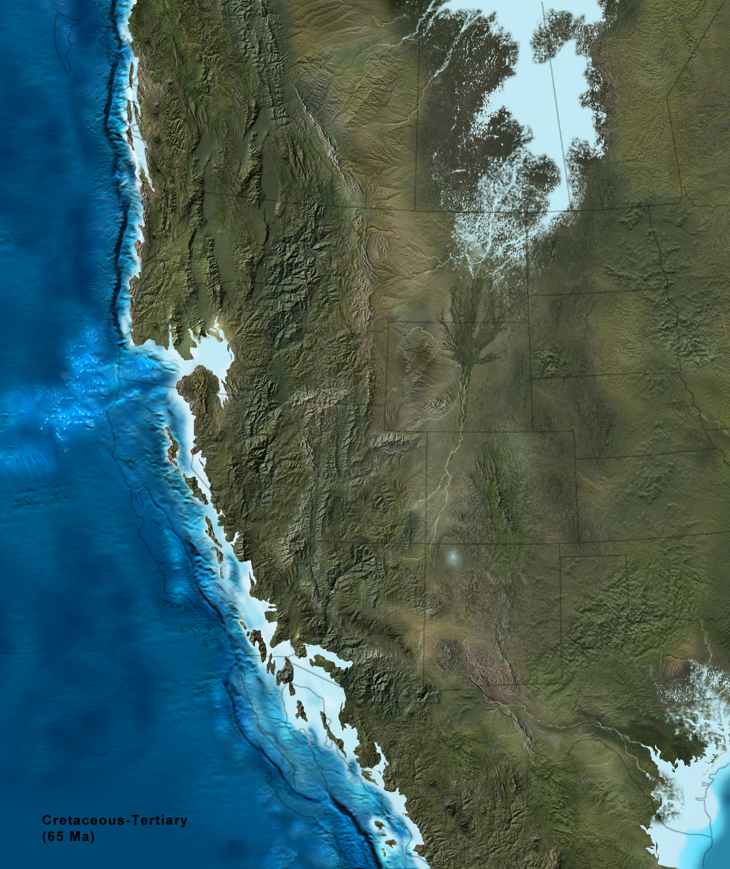
The entire future Southwest region was high in elevation and very rugged during this interval of geologic time.
Colorado Plateau Geosystems—Blakey (2011)

Slide 27
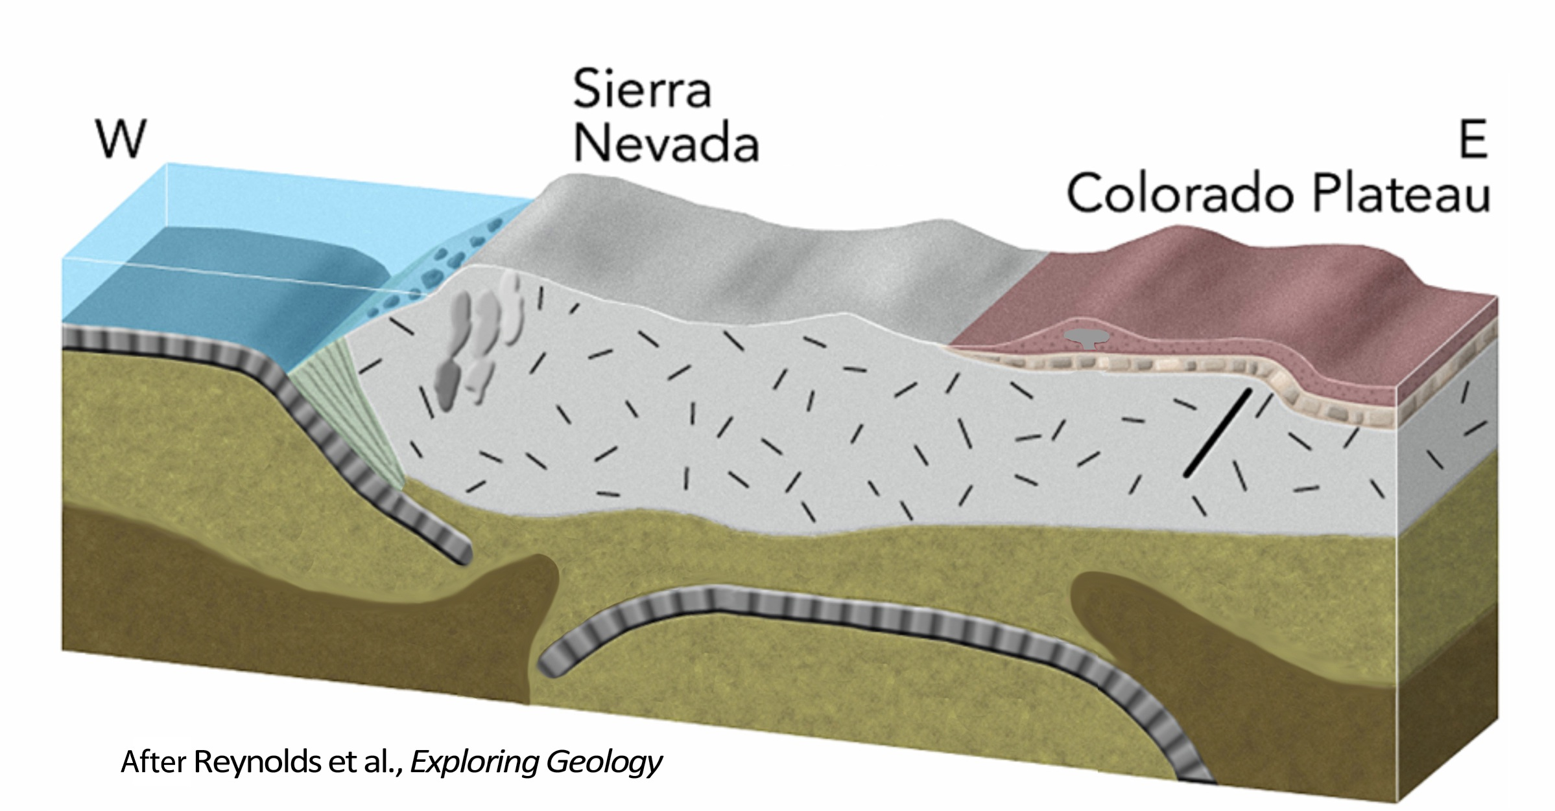
Starting about 35 million years ago the ocean floor fell away and hotter rock welled up to replace it.
Uplift continued!
CRUST
MANTLE
after Reynolds, Johnson, Morin, & Carter (2013)

Slide 28
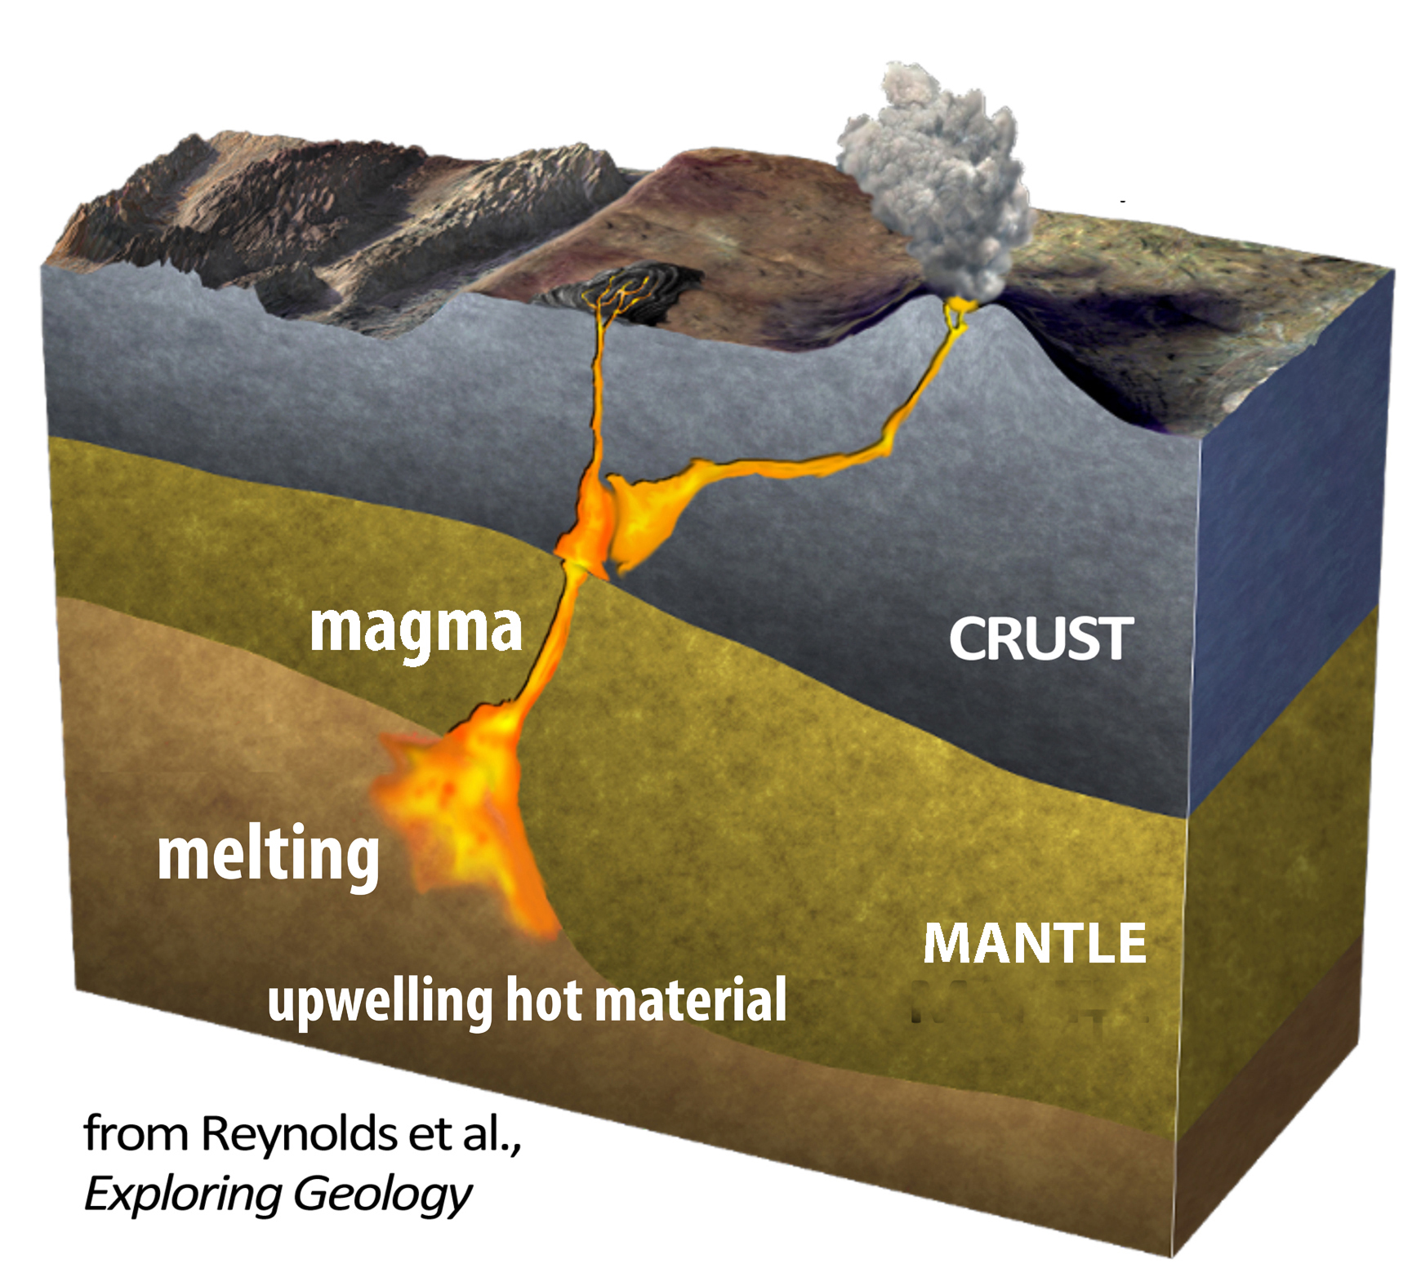
The hot material caused melting and a great “flareup” of volcanoes.

Slide 29
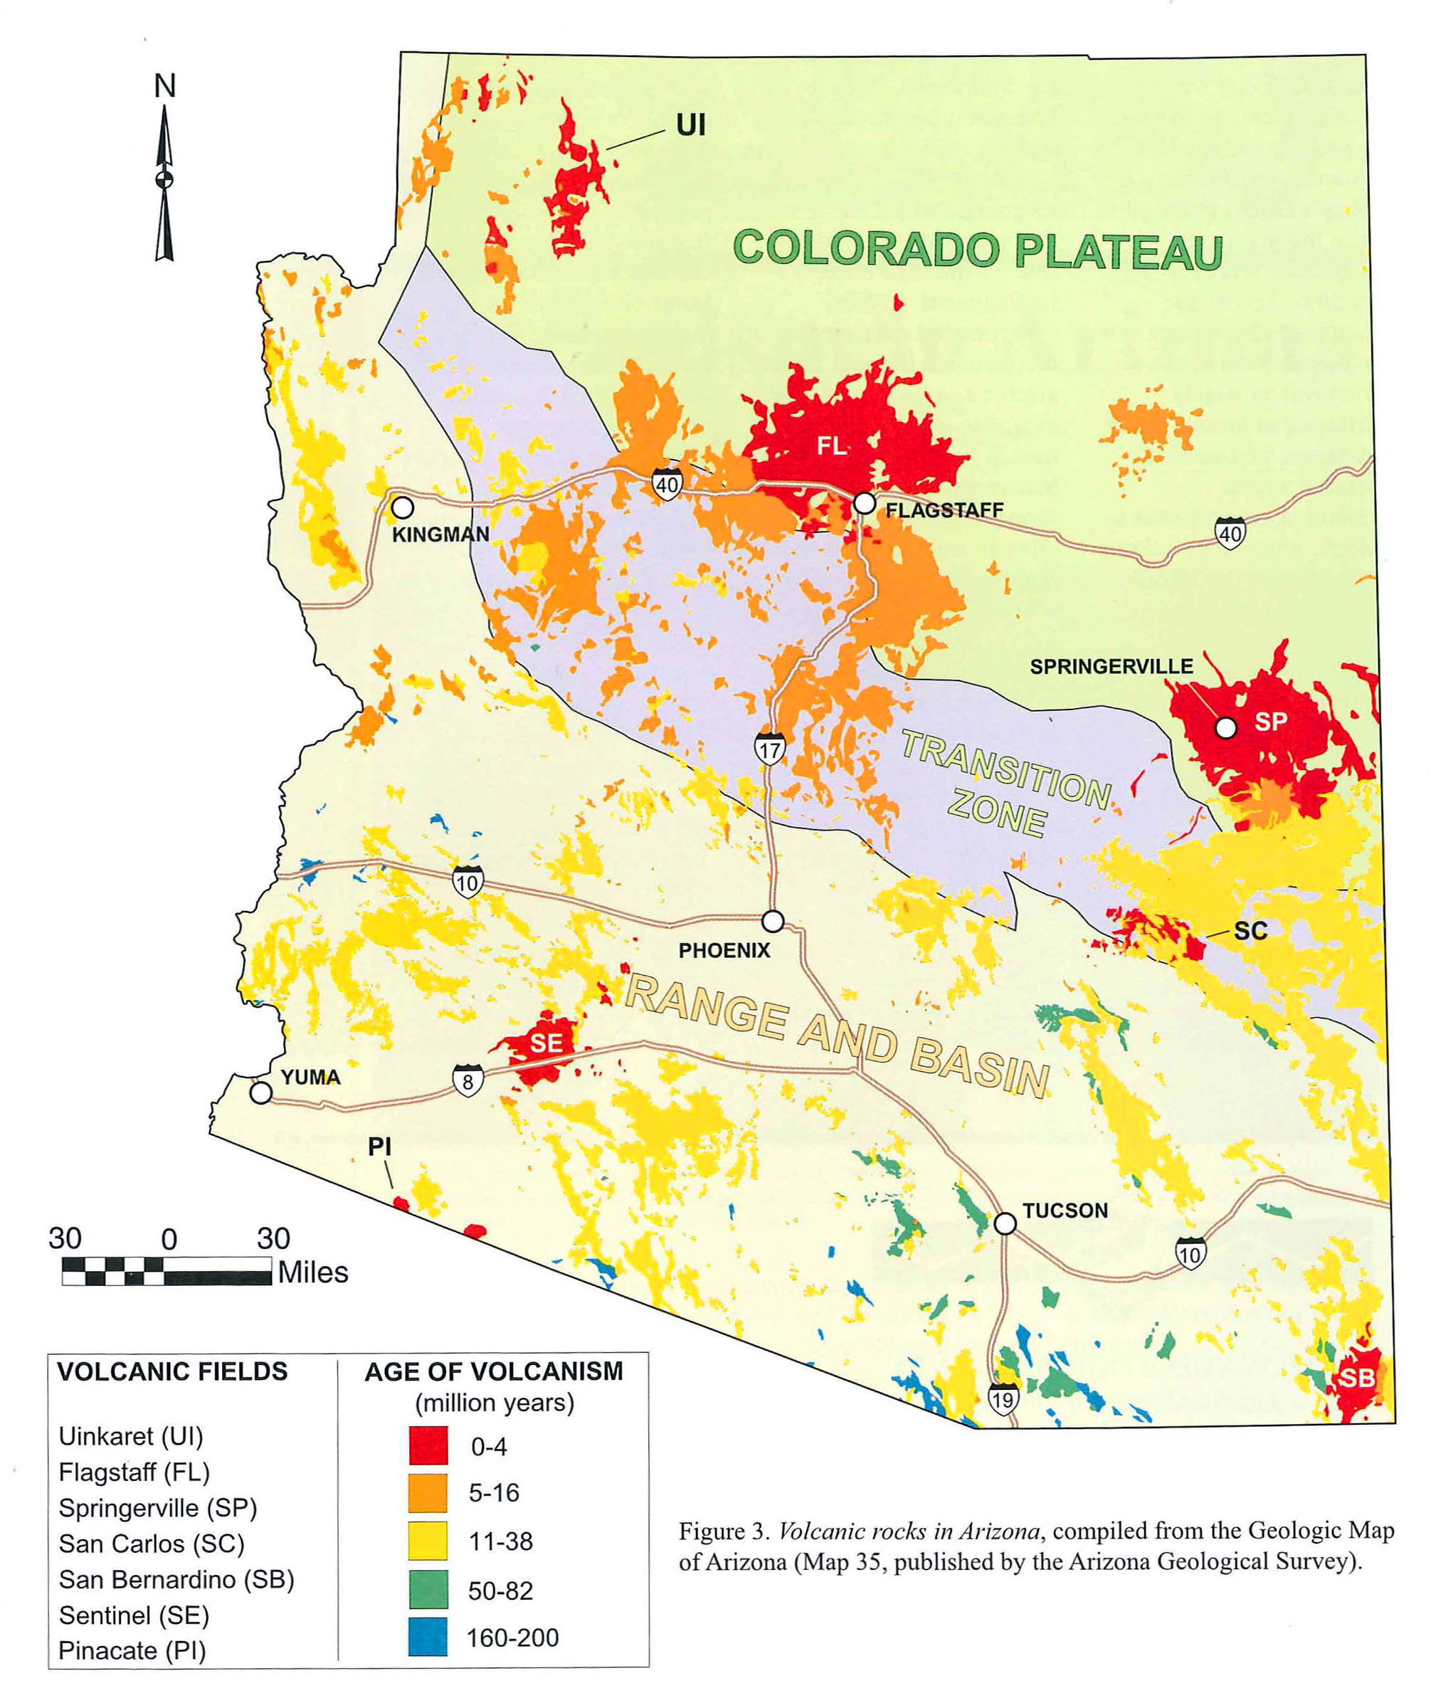
Volcanoes erupted all over Arizona.
Arizona Geological Survey

Slide 30
What accounts for the present low elevations in the Basin and Range?
Northern Basin and Range
Southern
Rocky
Mountains
Colorado
Plateau
(Río Grande Rift)
Great
Plains
Transition Zone
Basin
and
Range
Boundaries
are approximate.
USGS (2010)
Notes:
2 min max
EXPLAIN (< 2 min).
EXPLORE Then prompt students to continue making and noting observations from the next set of slides (exploration of the physiographic provinces of the Southwest).
SOURCE
U.S. Geological Survey (2010). National elevation data set shaded relief of the United States [JPEG]. Retrieved 25 October 2011 from http://eros.usgs.gov/imagegallery/collection.php?type=ned_states#45.

Slide 31
Recall the differences in topography.

Slide 32
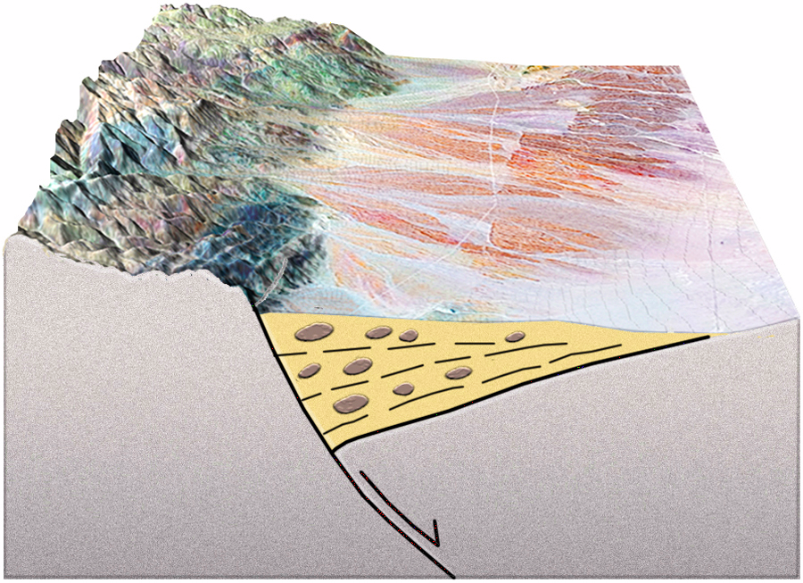
Basin and Range landscapes form on crust that is faulted and downdropped.
Range
Basin
Basins fill with
sand and gravel
eroded from the ranges.
A basin is a block
downdropped
along a fault.
Reynolds, Johnson, Morin, & Carter (2013)
Notes:
2 min max
EXPLAIN (< 2 min).
(May need to emphasize that topography is reversed in image of Abiquiu fault.)
SOURCE
Reynolds, S. J., Johnson, J. K., Morin, P. J., & Carter, C. M. (2013). Exploring geology (3rd ed.). New York: McGraw-Hill.
S. Semken, personal communication.

Slide 33
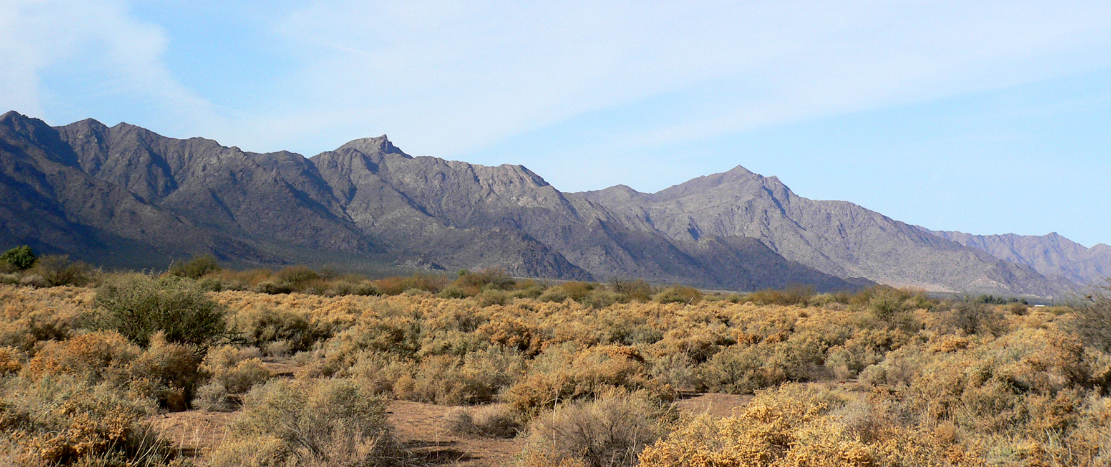
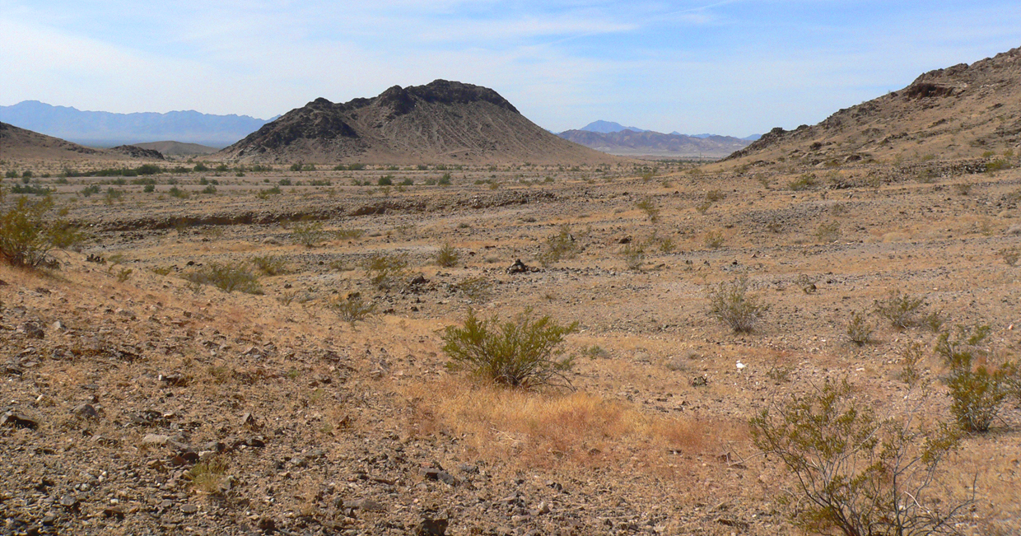
Basin and Range landscapes form on crust that is faulted and downdropped.
Range
Basin
Sierra Estrella
sierra = jagged mountain range
Elevation is low and relief is low to moderate.
Ranges are rocky and rugged.
Desert basins contain sand and gravel
eroded from the ranges.
View from Big Maria Mountains to McCoy Mountains
Notes:
2 min max
EXPLAIN (< 2 min).
SOURCE
S. Semken, personal communication.

Slide 34
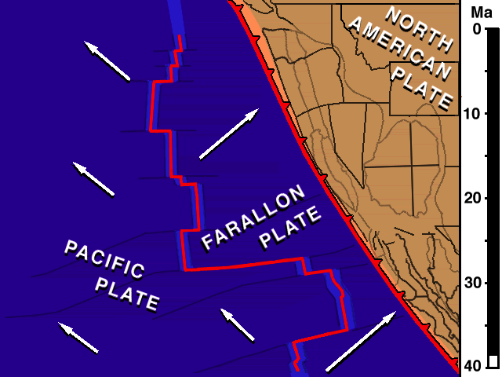
This happens when crust is stretched and thinned by plate-tectonic forces.
Video courtesy of Dr. Tanya Atwater, UC Santa Barbara

Slide 35

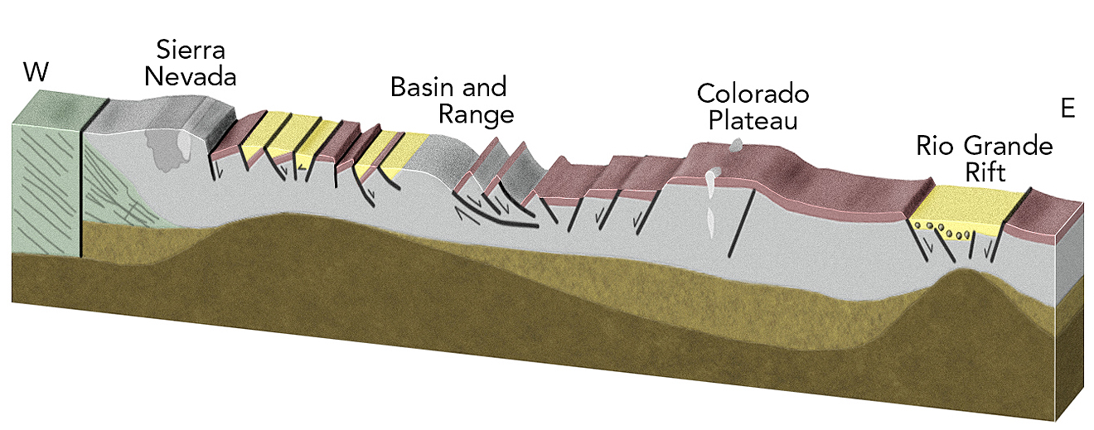
From about 12 to 8 million years ago: Pulled from the south and west, the crust stretched, thinned, and subsided.
Before
Transition
Zone
After

Slide 36
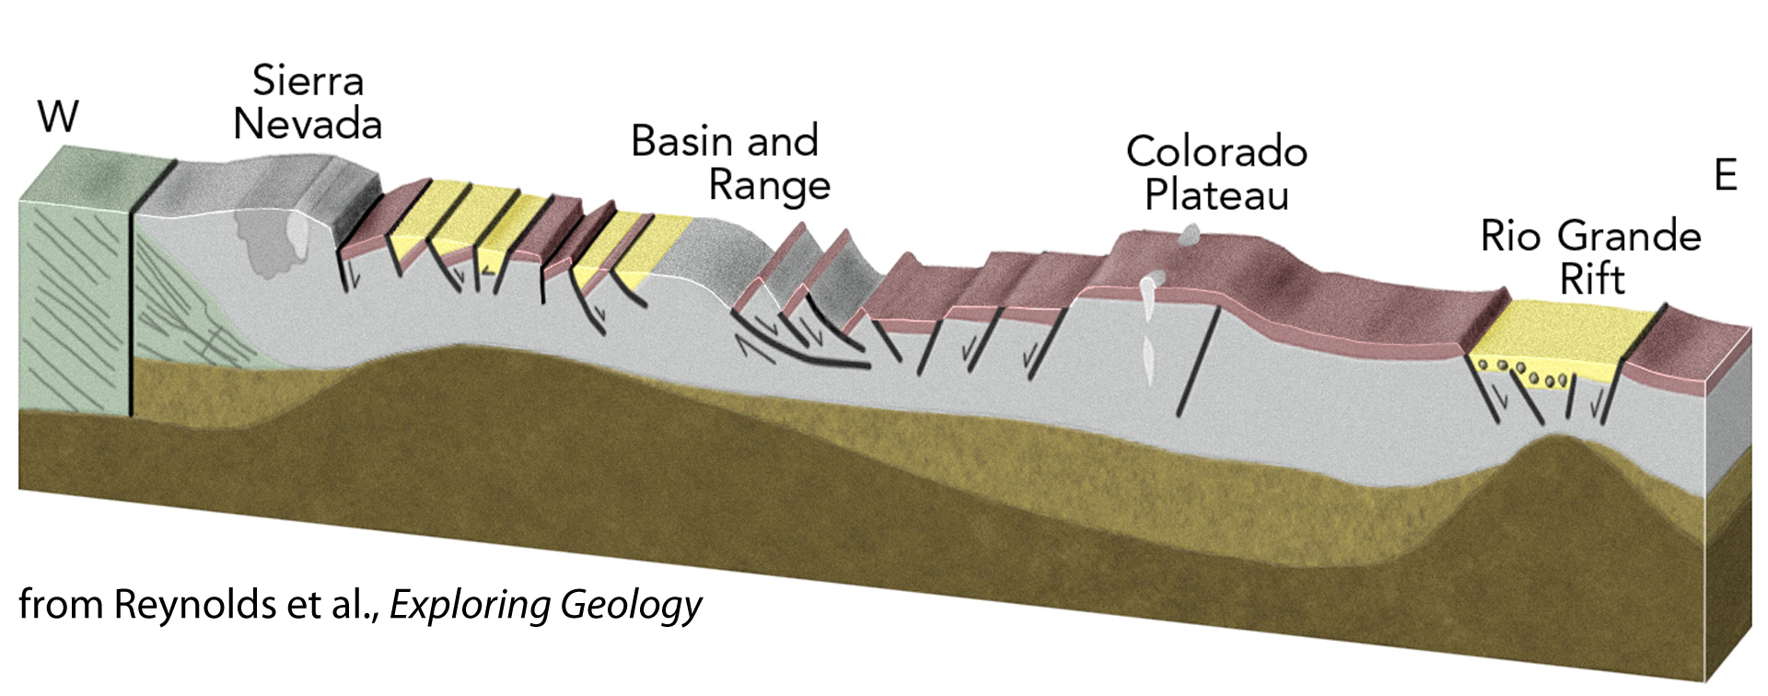
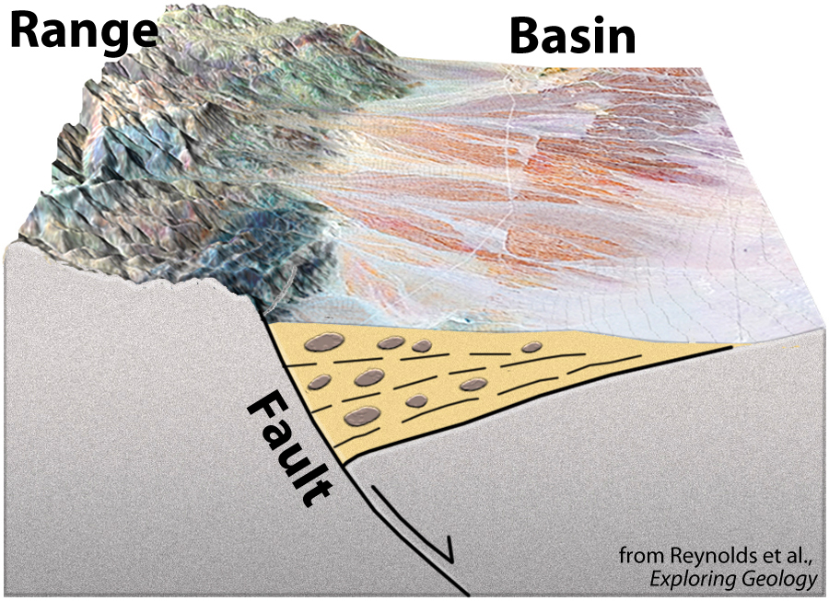
The brittle crust broke into blocks, forming Basin and Range topography.

Slide 37
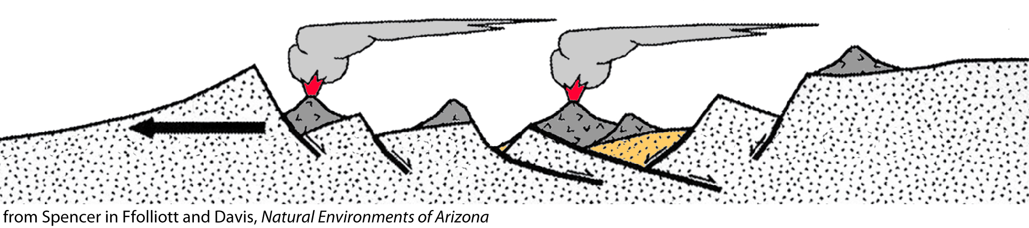
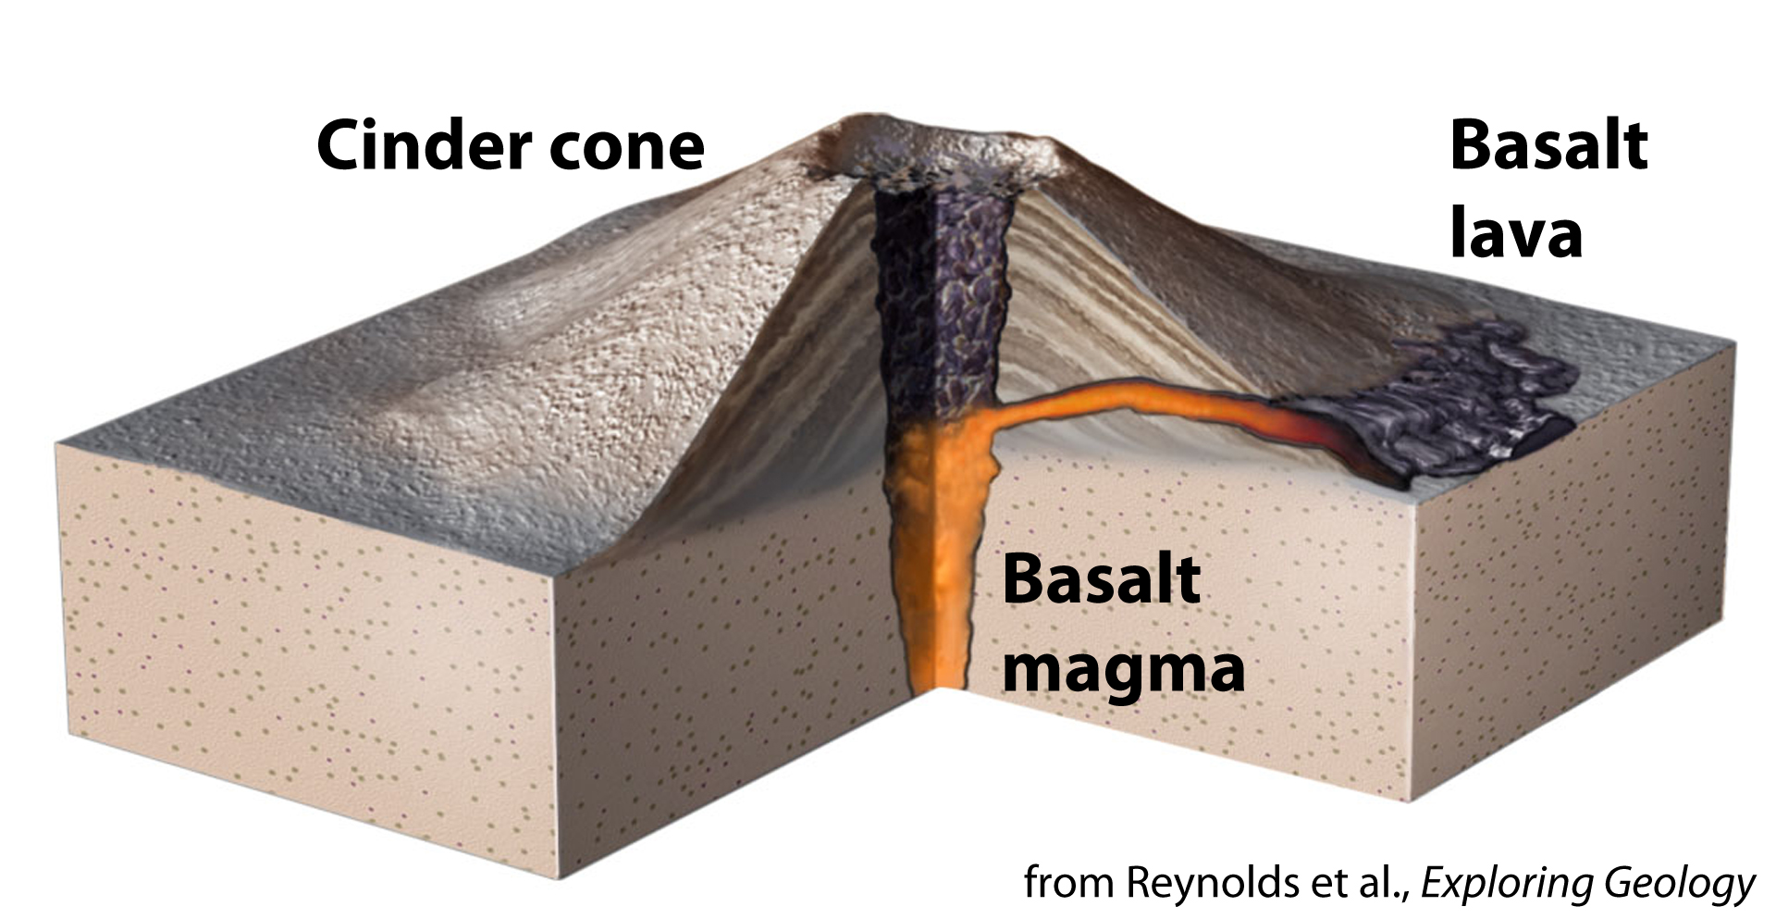
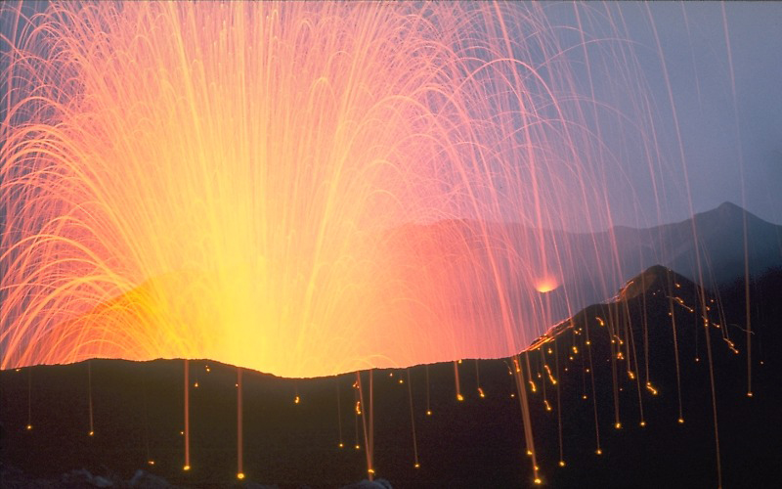
Some smaller volcanoes erupted as the Basin and Range topography developed.
Predominantly
basalt eruptions
Notes:
2 minutes for explanation.
SOURCE
Add here

Slide 38
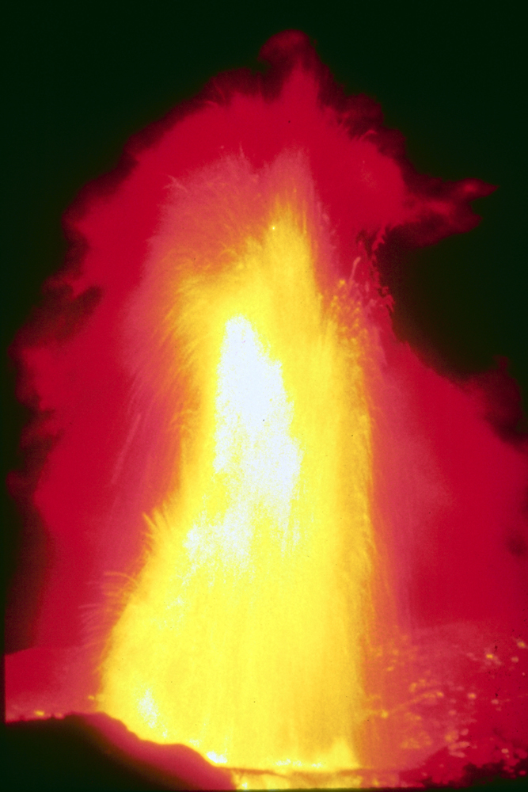
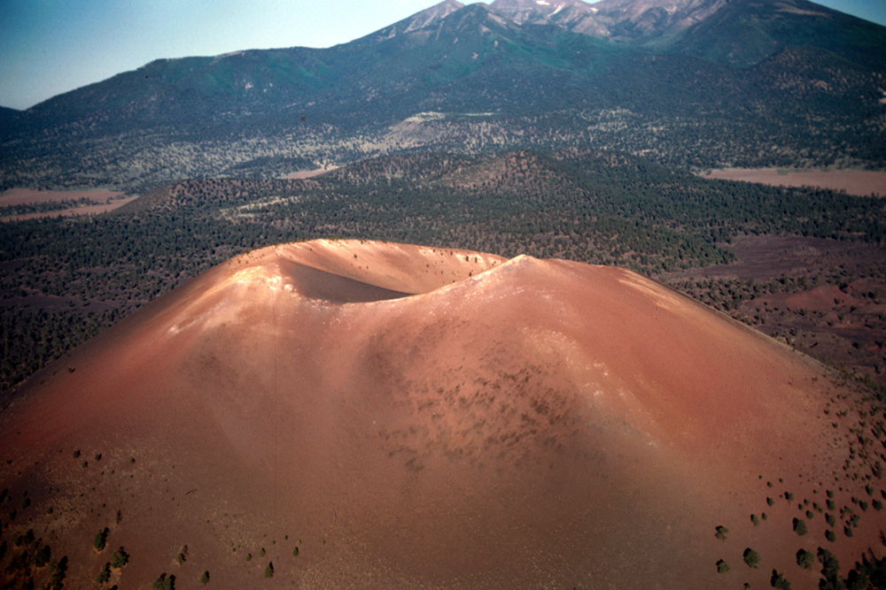
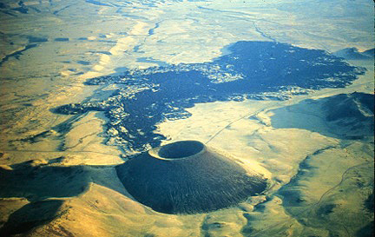
Some volcanoes erupted very recently.
Right inside one of the hills
there was a mass of what looked like
boiling coals pushing upward…
Bursts of sparks
kept shooting into the air
just as from a torch
someone
is running along with…
Spewing forth in every direction,
the molten embers started
running everywhere.
From all appearances,
the flow was heading straight
toward the village of Musangnuvi.
From Earth Fire:
a Hopi story of the
1082 CE Sunset Crater eruption,
Ekkehart Malotki and Michael Lomatuway’ma
Sunset Crater, Arizona (< 1000 ya)
Sunset Crater: erupted in year 1082
SP Crater (erupted 5500 years ago?)
(all photos: U.S. Geological Survey)

Slide 39
Northern Basin and Range
Southern
Rocky
Mountains
Colorado
Plateau
(Río Grande Rift)
Great
Plains
Transition Zone
Basin
and
Range
Boundaries
are approximate.
USGS (2010)
Notes:
2 min max
EXPLAIN (< 2 min).
EXPLORE Then prompt students to continue making and noting observations from the next set of slides (exploration of the physiographic provinces of the Southwest).
SOURCE
U.S. Geological Survey (2010). National elevation data set shaded relief of the United States [JPEG]. Retrieved 25 October 2011 from http://eros.usgs.gov/imagegallery/collection.php?type=ned_states#45.

Slide 40




The Transition Zone is a transitional zone.
Four Peaks
Mazatzal Mountains
Fossil Creek, Verde Valley
Elevation and relief are moderate to high; many slopes are steep.
Upper New River Valley
Landscapes range from desert basins to rugged mountains.
Notes:
2 min max
EXPLAIN (< 2 min).
SOURCES
S. Semken, personal communication.

Slide 41


Modern river systems formed as erosion subdued the landscape.
12 million
years ago
Jungers (2012); figure adapted from Menges & Pearthree (1989)
Less than
8 million
years ago
The Lower
Colorado and
Río Grande
drainages
developed.
Colorado Plateau Geosystems—Blakey (2011)

Slide 42

Modern river systems formed as erosion subdued the landscape.
Virgin
San Juan
Colorado
Little
Colorado
Bill
Williams
Verde
Colorado
Agua
Fria
Salt
Hassa-
yampa
Gila
Gila
San
Pedro

Slide 43

Erosion largely shapes modern Southwest landscapes.
Marshak (2001), Earth: Portrait of a Planet

Slide 44


But occasional earthquakes show us that the Southwest is still tectonically active.
U.S. Geological Survey

Slide 45
Our modern landscape is the result of millions of years of geologic change.
Google Earth

Slide 46
Thank you! ¡Gracias! Ahéhee!
semken.asu.edu
earthscope.org
Google Earth

