Slide 1
Overview of EarthScope 2016
These slides may be used and modified for presentations involving instrumentation, data, science results, and education and outreach incorporating the NSF EarthScope Program

Slide 2
Fair Use Policy:
Fair Use Policy:
These slides are intended for use by EarthScope research scientists, teachers, outreach specialist, and other members of the public.
Please feel free to edit slides and content for your specific use.
We would appreciate it if you would include the following acknowledgement slide in your presentations.

Slide 3
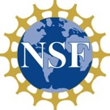








Acknowledgements
EarthScope is a multi-disciplinary project funded by the National Science Foundation (NSF) that is governed by a science plan.
EarthScope facilities are being operated and maintained as a collaborative effort with UNAVCO Inc. and the Incorporated Research Institutions for Seismology (IRIS) with contributions from the U. S. Geological Survey (USGS), National Aeronautics and Space Administration (NASA), and several other national and international organizations. The EarthScope National office is located at the University of Alaska Fairbanks.

Slide 4
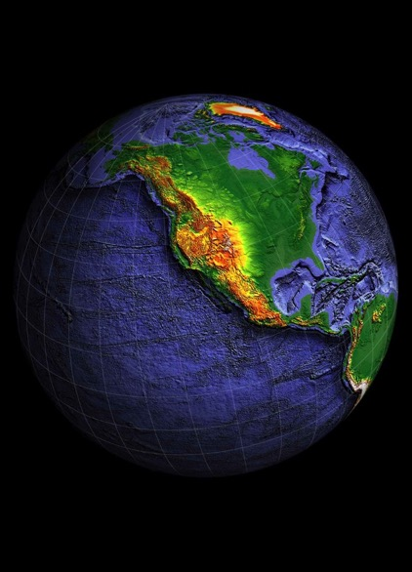
EARTHSCOPE is…
The largest earth science funded project in NSF history
Community driven, free and open data
Named the #1 “Epic Project” by Popular Science in 2011

Slide 5

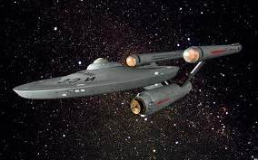
Its 15 year mission (2003-2018) to boldly explore the structure and evolution of the North American continent
http://onceuponageek.com/2009/09/30/star-trek-enterprise-wallpapers/

Slide 6
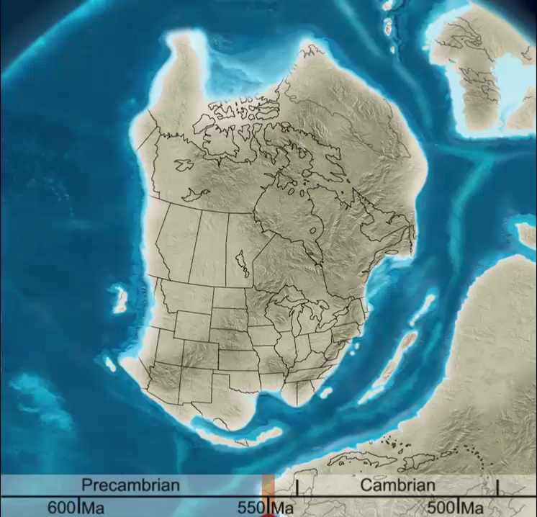
Exploring the Structure and Evolution of the North American Continent:
Measuring the motions and the properties that constrain the processes
Interactive Geology Project, CU Boulder
http://igp.colorado.edu/animations.html
Professor Ron Blakey, Colorado Plateau Geosystems
Notes:
EarthScope is a program of the National Science Foundation (NSF) that deploys thousands of seismic, GPS, and other geophysical instruments to study the structure and evolution of the North American continent and the processes the cause earthquakes and volcanic eruptions. It involves collaboration between scientists, educators, policy makers, and the public to learn about and utilize exciting scientific discoveries as they are being made.
By integrating scientific information derived from its multi-disciplinary observatories, which use a wide variety of geophysical instrumentation, EarthScope's scientists are developing a comprehensive, time-dependent picture of the continent beyond that which any single discipline can achieve. Data obtained from these observatories allows scientist to describe how geological forces shaped North America's landscape and contribute to the public's understanding of our dynamic Earth. EarthScope's use of advanced instrumentation permits us to answer some of the outstanding questions in Earth Sciences by looking deeper, increasing resolution, and integrating diverse measurements and observations. Support for science projects is primarily awarded via a rigorous process of peer review of proposals submitted to the National Science Foundation.

Slide 7
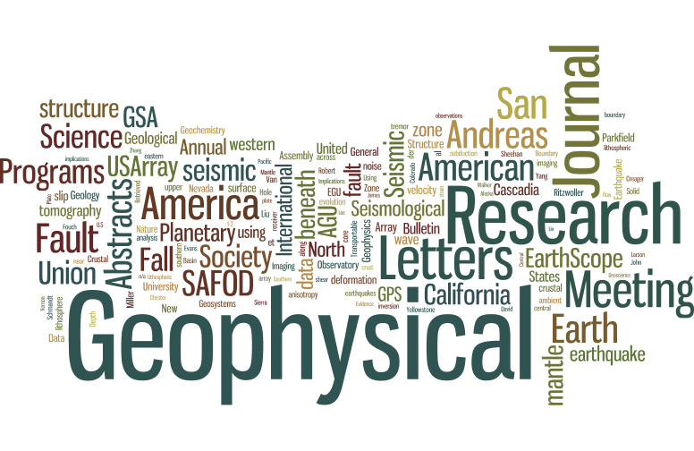
A large multidisciplinary scientific community

Slide 8
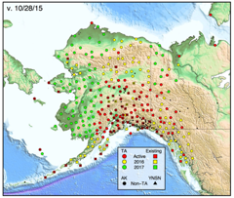
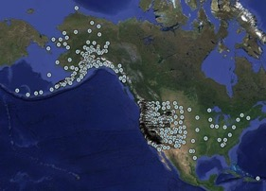
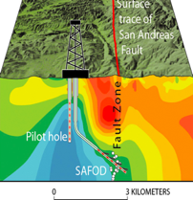
Three Observatories
Plate Boundary Observatory
(PBO)
San Andreas Fault Observatory at Depth
(SAFOD)
US Array Seismic Network
Seismic
MT
GPS/GNSS
Strainmeter
Borehole seismic
Fault Zone Samples
Seismic/EM
SAFOD Core

Slide 9
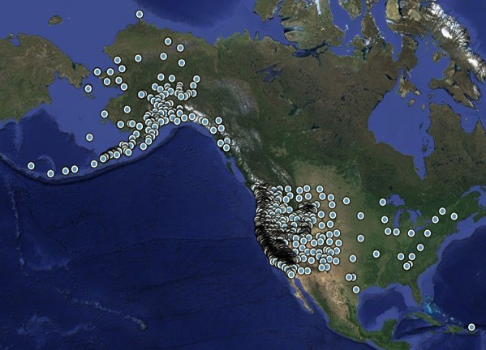
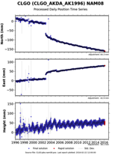
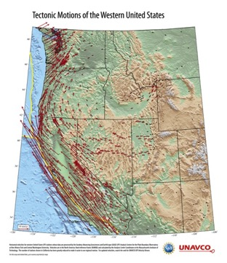
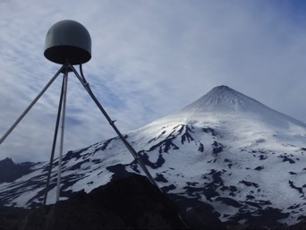
Plate Boundary Observatory (PBO): Geodetic data
Notes:
PBO is a network of more than 1,200 continuous GPS instruments, borehole strainmeters seismometers, and tiltmeters installed primarily throughout the western United States. The objective of PBO is to explore land motions related to movement of the Pacific, Juan de Fuca, and North American tectonic plates. Such motions inform us about earthquakes, volcanoes, tsunamis, and other hazards related to plate tectonics. PBO is also used to remotely measure changes in soil moisture content, snow depth, water content of the troposphere, and ground motions related to changes in the water table.
Complete information is available on the UNAVCO/PBO website.
What you see: map of PBO network
GPS monument in Alaska, next to Shishaldin Volcano, example of a time series (all available online), example of an outreach product (map of tectonic motions).

Slide 10
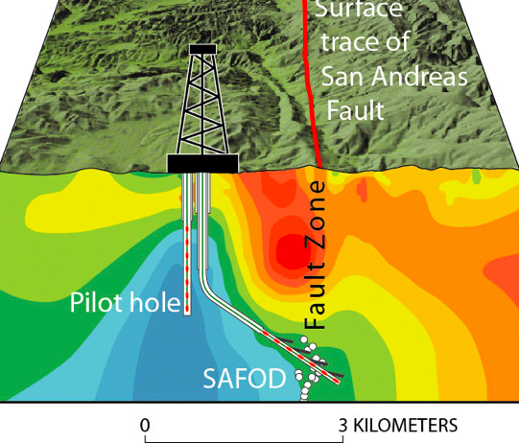
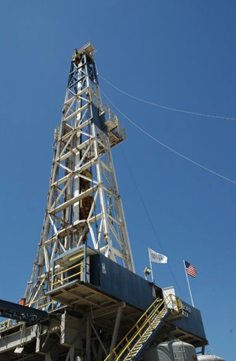
San Andreas Fault Observatory at Depth
(SAFOD)
- Scientific Drilling - 3 km deep borehole - SAFOD core viewer
- Core Samples - Geophysical monitoring
Notes:
The San Andreas Fault Observatory at Depth (SAFOD) was a 3-kilometer deep hole drilled directly into the San Andreas Fault midway between San Francisco and Los Angeles, near Parkfield, CA. Located in an area that has ruptured six times since 1857, the hole provided the first opportunity to observe directly the conditions under which earthquakes occur, to collect rocks and fluids from the fault zone for laboratory study, and to continuously monitor the physical condition within an active earthquake nucleation zone.
The cores were collected from 3 different regions. Each core was cut into approximately 3 foot sections. For sections that the core could easily be removed from the aluminum core barrel, the scanned images include both front and back views. Images of the core are available on the icdp website (http://iodp.tamu.edu/curation/gcr/safod/)
Data holdings from the SAFOD Project can be accessed on the International Continental Scientific Drilling Program (ICDP) and the Northern California Earthquake Data Center (NCEDC) website. The data consist mainly of cutting and mud sample reports, seismic data from borehole seismometers, core boxes, core logging, and lithological reports updated daily. The cores can be interactively viewed in EarthScope SAFOD Core Viewer.

Slide 11
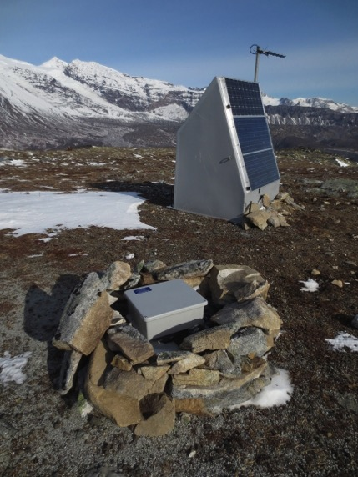
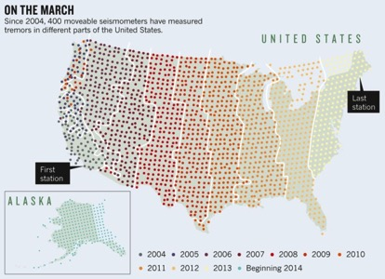
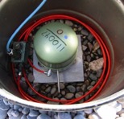
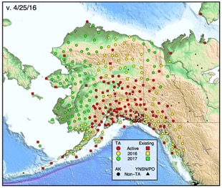
US Array Seismic Network
Notes:
USArray is a 15-year program to place a dense network of permanent and portable seismographs across the continental United States.
It includes 400 Transportable Array (TA) Stations, Each Station occupies a site for 1.5 – 2 years across the country, now installing in Alaska/Yukon
The USArray component of EarthScope is a continental-scale seismic and magnetotelluric observatory designed to provide a foundation for integrated studies of continental lithosphere and deep Earth structure over a wide range of scales. USArray is providing a new insight and new data to address fundamental questions in earthquake physics, volcanic processes, core-mantle interactions, active deformation and tectonics, continental structure and evolution, geodynamics, and crustal fluids (magmatic, hydrothermal, and meteoric).
Information recorded from the network also enable scientists to link structures inherited from earlier stages of continental formation to known and potential geologic hazards (e.g., earthquakes, volcanoes, landslides). The USArray consist of four observatories: Transportable, Flexible and Magnetotelluric Arrays, as well as a Reference Network.
This allows scientists to determine how features seen at Earth’s surface correlate with structural and compositional differences deep within the planet. This information enable scientists to link structures inherited from earlier stages of continental formation to known and potential geologic hazards (e.g., earthquakes, volcanoes, landslides). More information can be found on USArray website (usarray.org)

Slide 12
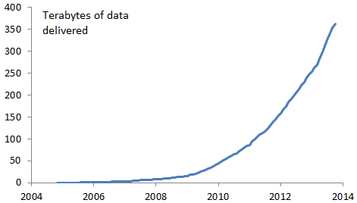
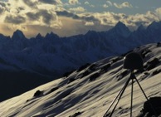
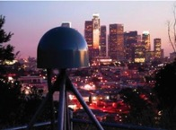
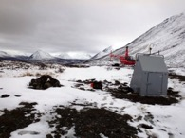
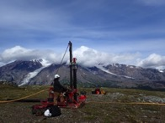
A new way of doing big science: Community governed
Freely available, high precision data can be viewed as the most important legacy of the National Science Foundation's largest investment in solid-Earth Science.
Uncovered unexpected findings . . .
    PBO H20 project
    Tracking hurricanes & tornadoes
    USArray “hears” the Chelyabinsk Meteorite & volcanoes
    Earthquake Early Warning System

Slide 13
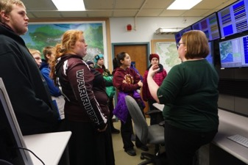
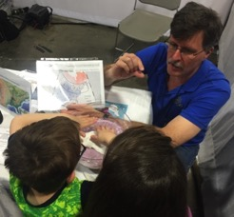
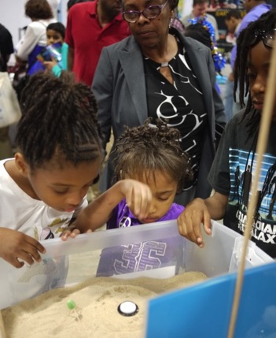
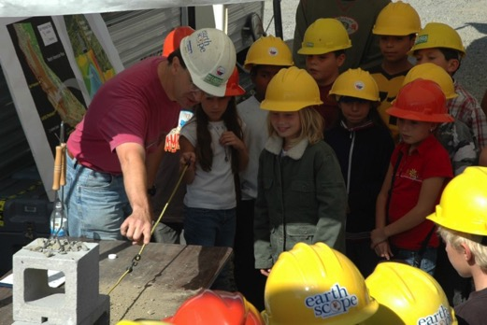
Outreach & Education
Inspire
Educate
Collaborate
Notes:
The expertise, enthusiasm, and findings of the EarthScope community constitute increasingly rich resources for enhancing Earth science education in formal (K-12, college, university) and informal (parks, museums, media) settings. The EarthScope National Office facilitates dissemination of EarthScope science to educators and the public through different venues.

Slide 14
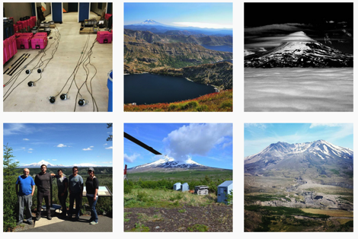
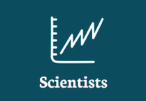

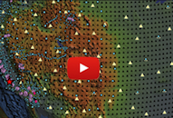
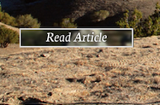





earthscope.org
Online Resources
Online community
#earthscope
#earthscope
@EarthScopeInfo
earthscope

Slide 15
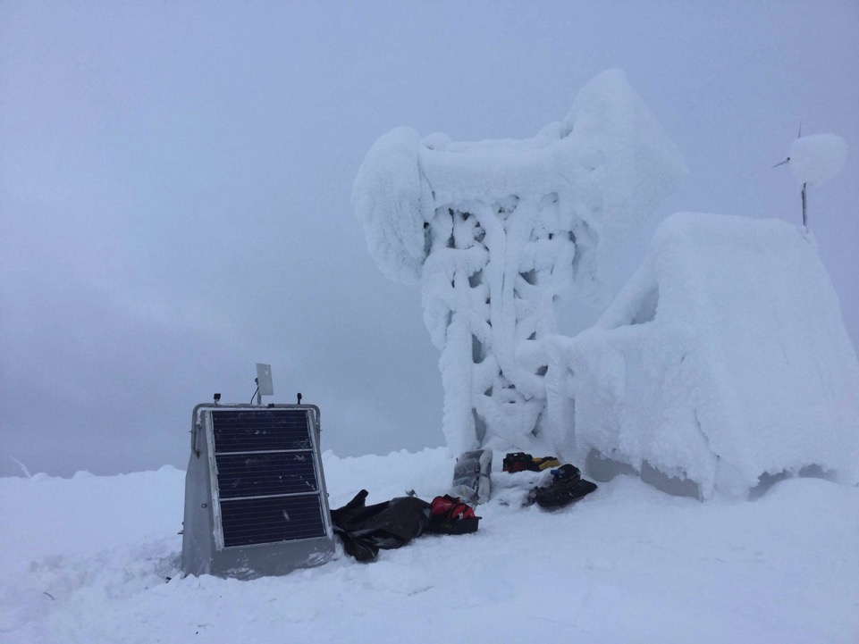
Rotating EarthScope National Office
Oregon State University (2006 – 2011)
Arizona State University (2011 – 2015)
University of Alaska Fairbanks (2015 – 2018)
uaf-earthscope@alaska.edu

