Slide 1
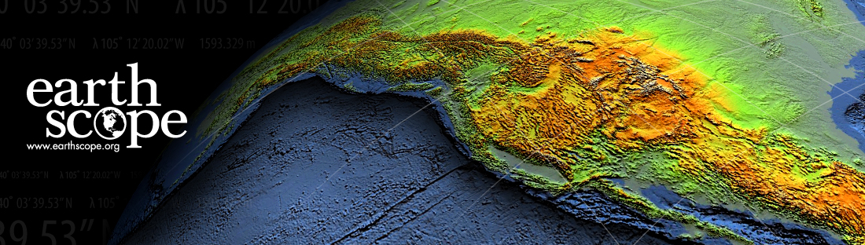


Welcome to the
EarthScope Southwest
Native Science Educators Workshop
The EarthScope Program is funded by the National Science Foundation.

Slide 2
The EarthScope Program an introduction
Steve Semken & Sarah Robinson
EarthScope National Office at Arizona State University
The EarthScope Program is funded by the National Science Foundation.

Slide 3
EarthScope is a 15-year (2003-2018) program of the National Science Foundation (NSF) that deploys thousands of seismic, GPS, and other geophysical instruments to study the structure and evolution of the North American continent and the processes that cause earthquakes and volcanic eruptions.
It involves collaboration among scientists, educators, policy makers, and the public to learn about and make use of geoscientific discoveries as they are being made.
Notes:
Explore structure and evolution of North America, and physical properties that control earthquakes and volcanoes.
Open, freely available data products
Collaborative, interdisciplinary & multi-scale science
Broad community: scientists, educators, public, etc.
Integrated education and outreach

Slide 4
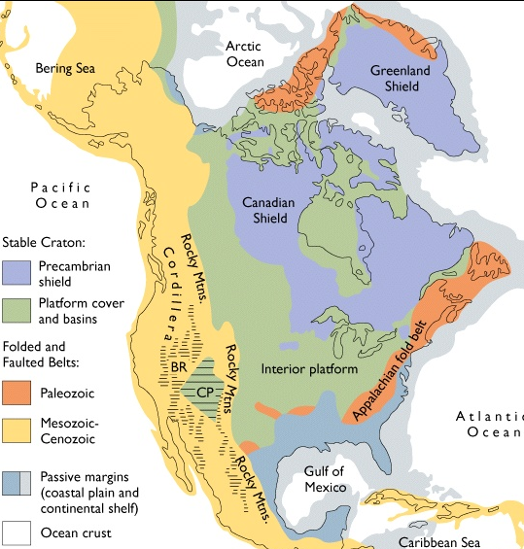
Scientific Targets
Active deformation of the crust
Evolution of North America through geologic time
Deep Earth structure and dynamics
Earthquakes, faults, and rheology
Crustal/mantle fluids and volatiles
Topography & tectonics
Hydro-, cryo-, and atmospheres
(Grotzinger et al.)
Notes:
Explore structure and evolution of North America, and physical properties that control earthquakes and volcanoes.
Open, freely available data products
Collaborative, interdisciplinary & multi-scale science
Broad community: scientists, educators, public, etc.
Integrated education and outreach

Slide 5
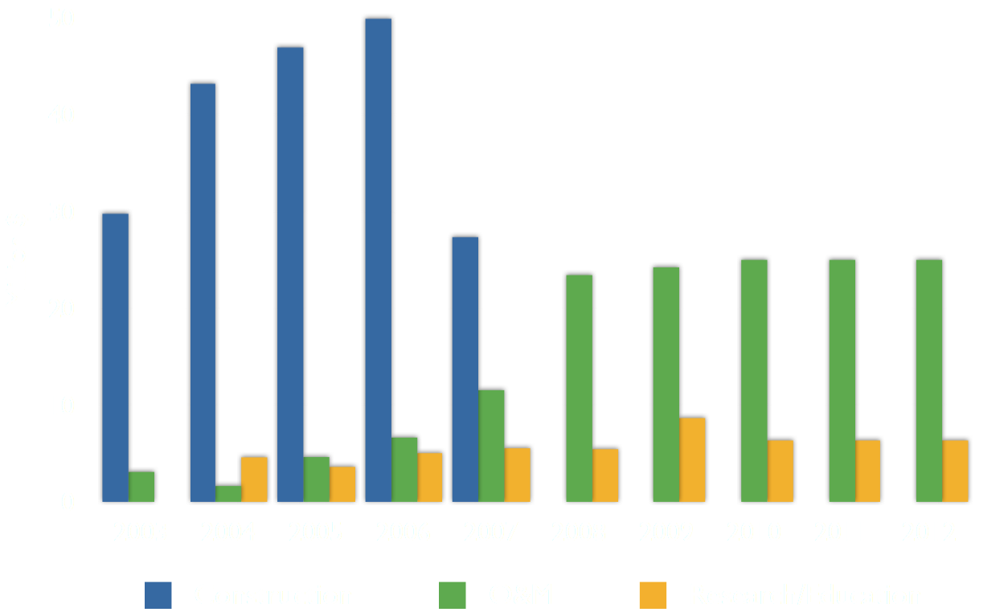
EarthScope Program Budget

Slide 6
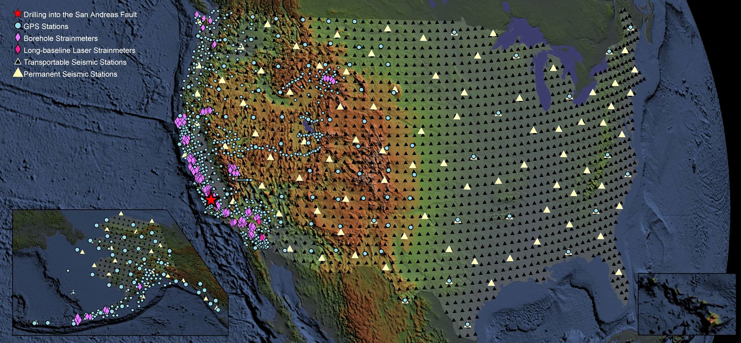
The EarthScope Facility
PBO
Geodetic
Seismic
SAFOD
Samples Seismic/EM
USArray
Seismic
MT
GeoES
Imagery
Geochron

Slide 7
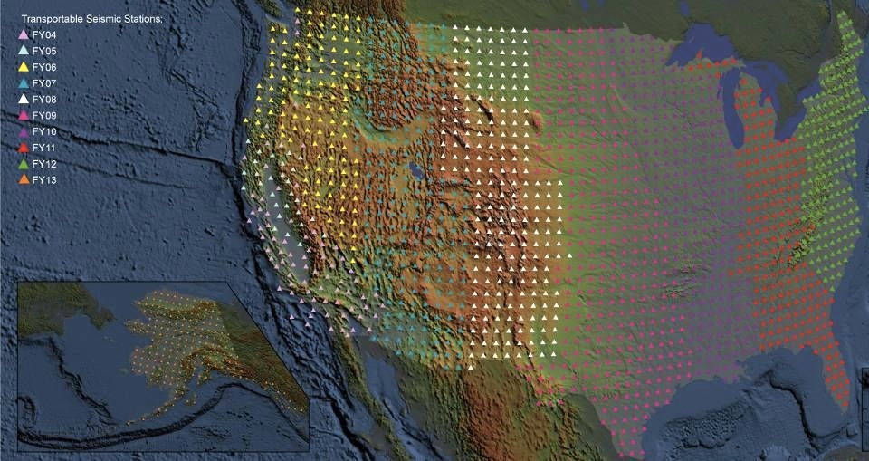
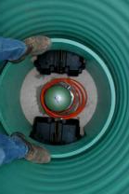
1. U S Array: SEISMIC NETWORK
    Includes 400 Transportable Array (TA) Seismometers
    Each station occupies a site for 1½ to 2 years
    10 years to leap-frog across the lower 48 states
Map courtesy
of IRIS
Operated by IRIS for EarthScope

Slide 8
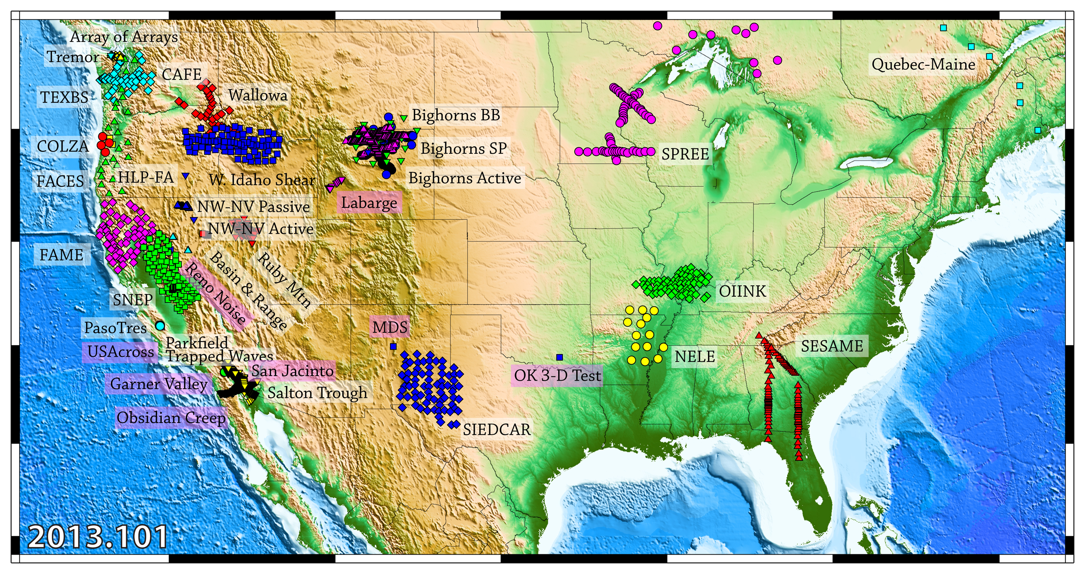
1. U S Array: SEISMIC NETWORK
    also includes the Flexible Array: a pool of 2146 portable seismic instruments deployed for high-density regional seismic experiments within the footprint of the TA
Map
courtesy
of IRIS
Operated by IRIS PASSCAL for EarthScope

Slide 9
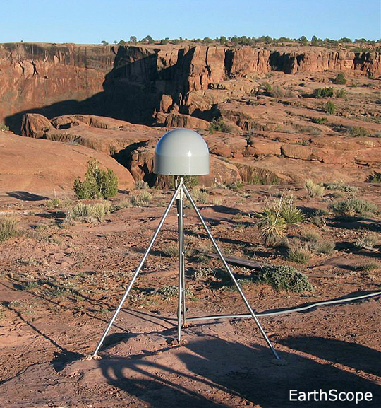
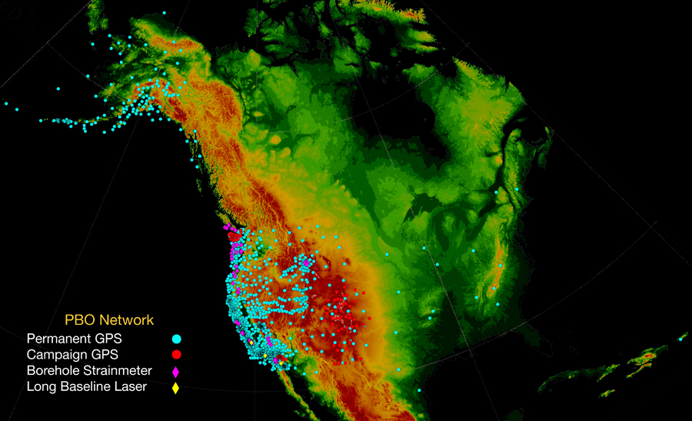
2. Plate Boundary Observatory
(PBO): GPS GEODETIC NETWORK
Operated by UNAVCO
for EarthScope
Map
courtesy
of UNAVCO
Notes:
Presentation notes:
1. Geodetic network divided into "clusters" for ease of deployment
2. Data is held in common
3. Transform cluster looks to measure long-term deformation due to San Andreas - is stress moving to the East?
4. Subduction cluster is being used to investigate Episodic Tremor and Slip - how much deformation is accommodated this way?
5. Extension cluster seeks to explain Basin and Range Paradox
6. Volcanic cluster looks to measure magma chamber inflation
7. Backbone will provide background deformation, including isostatic glacial rebound

Slide 10
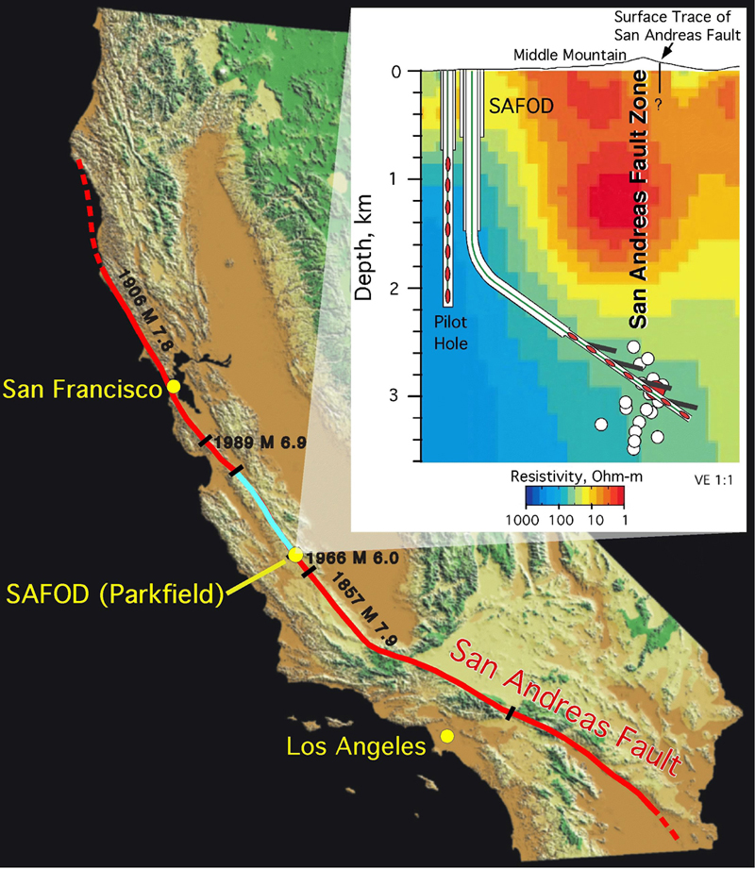
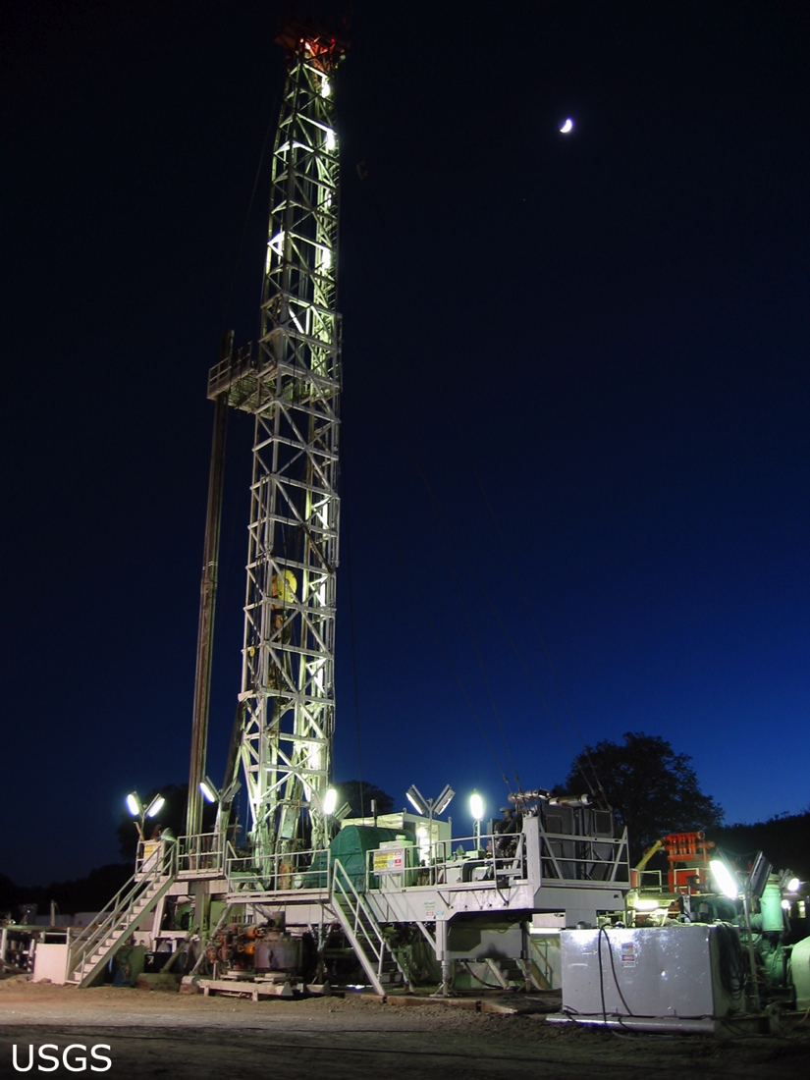

3. San Andreas Fault Observatory at Depth (SAFOD): SCIENTIFIC DRILLING
    4 kilometer (2½ mile) deep hole
    Core samples
    Geophysical monitoring
Managed
by UNAVCO

Slide 11
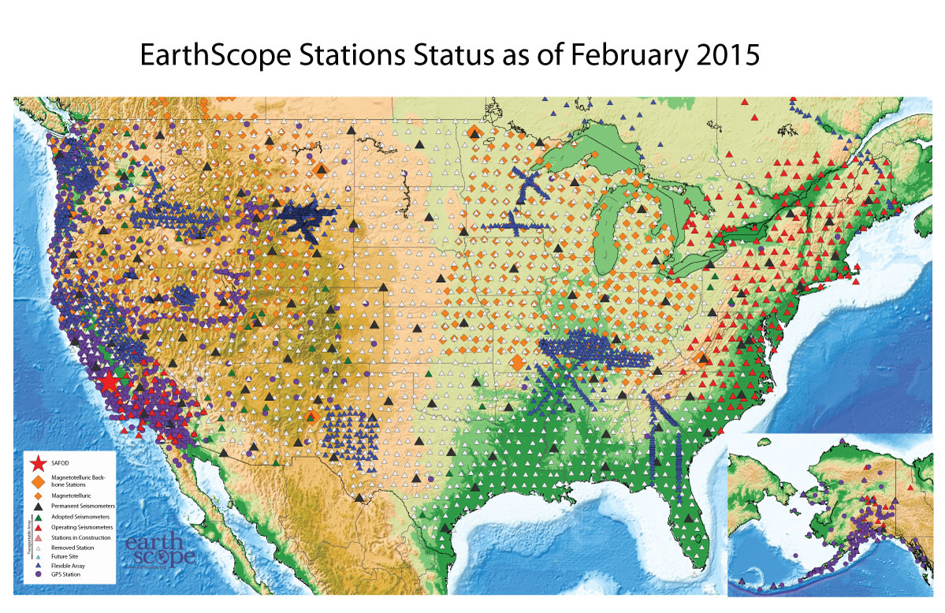
Current Status of EarthScope
http://www.earthscope.org/current_status

Slide 12
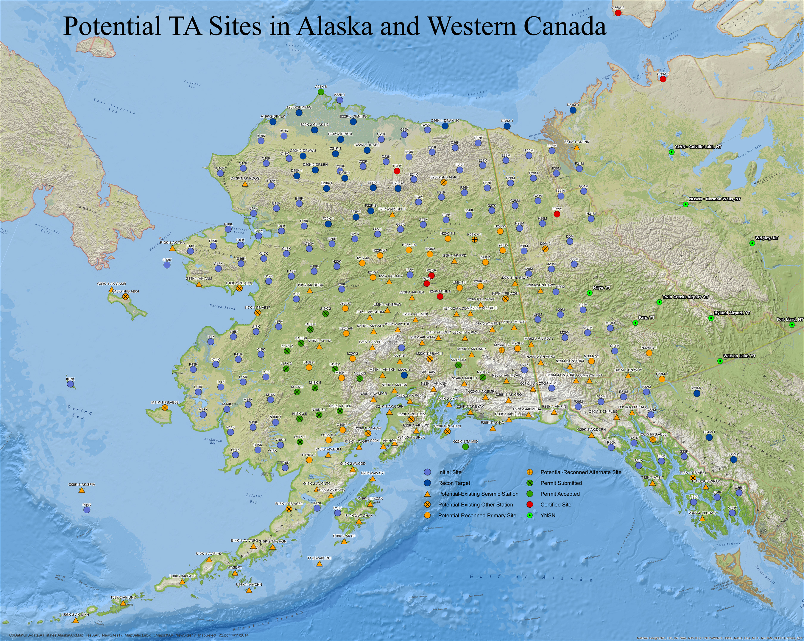
TA in Alaska & W Canada 2014-2018
85-km grid
291 stations, 85 km grid
Map courtesy of IRIS
Notes:
Assuming current plans go forward, next phase of USArray will be focused on Alaska.
Map shows a draft plan of the deployment of TA-AK between 2014 and 2018.

Slide 13
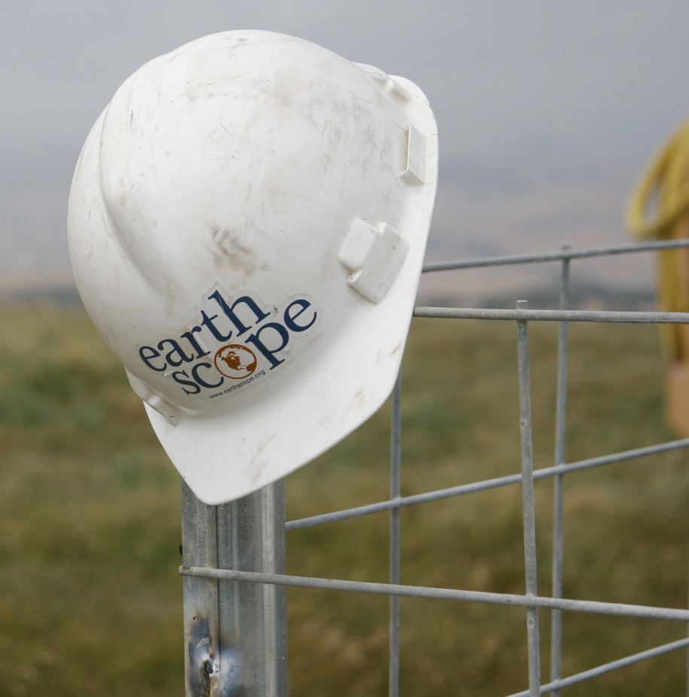

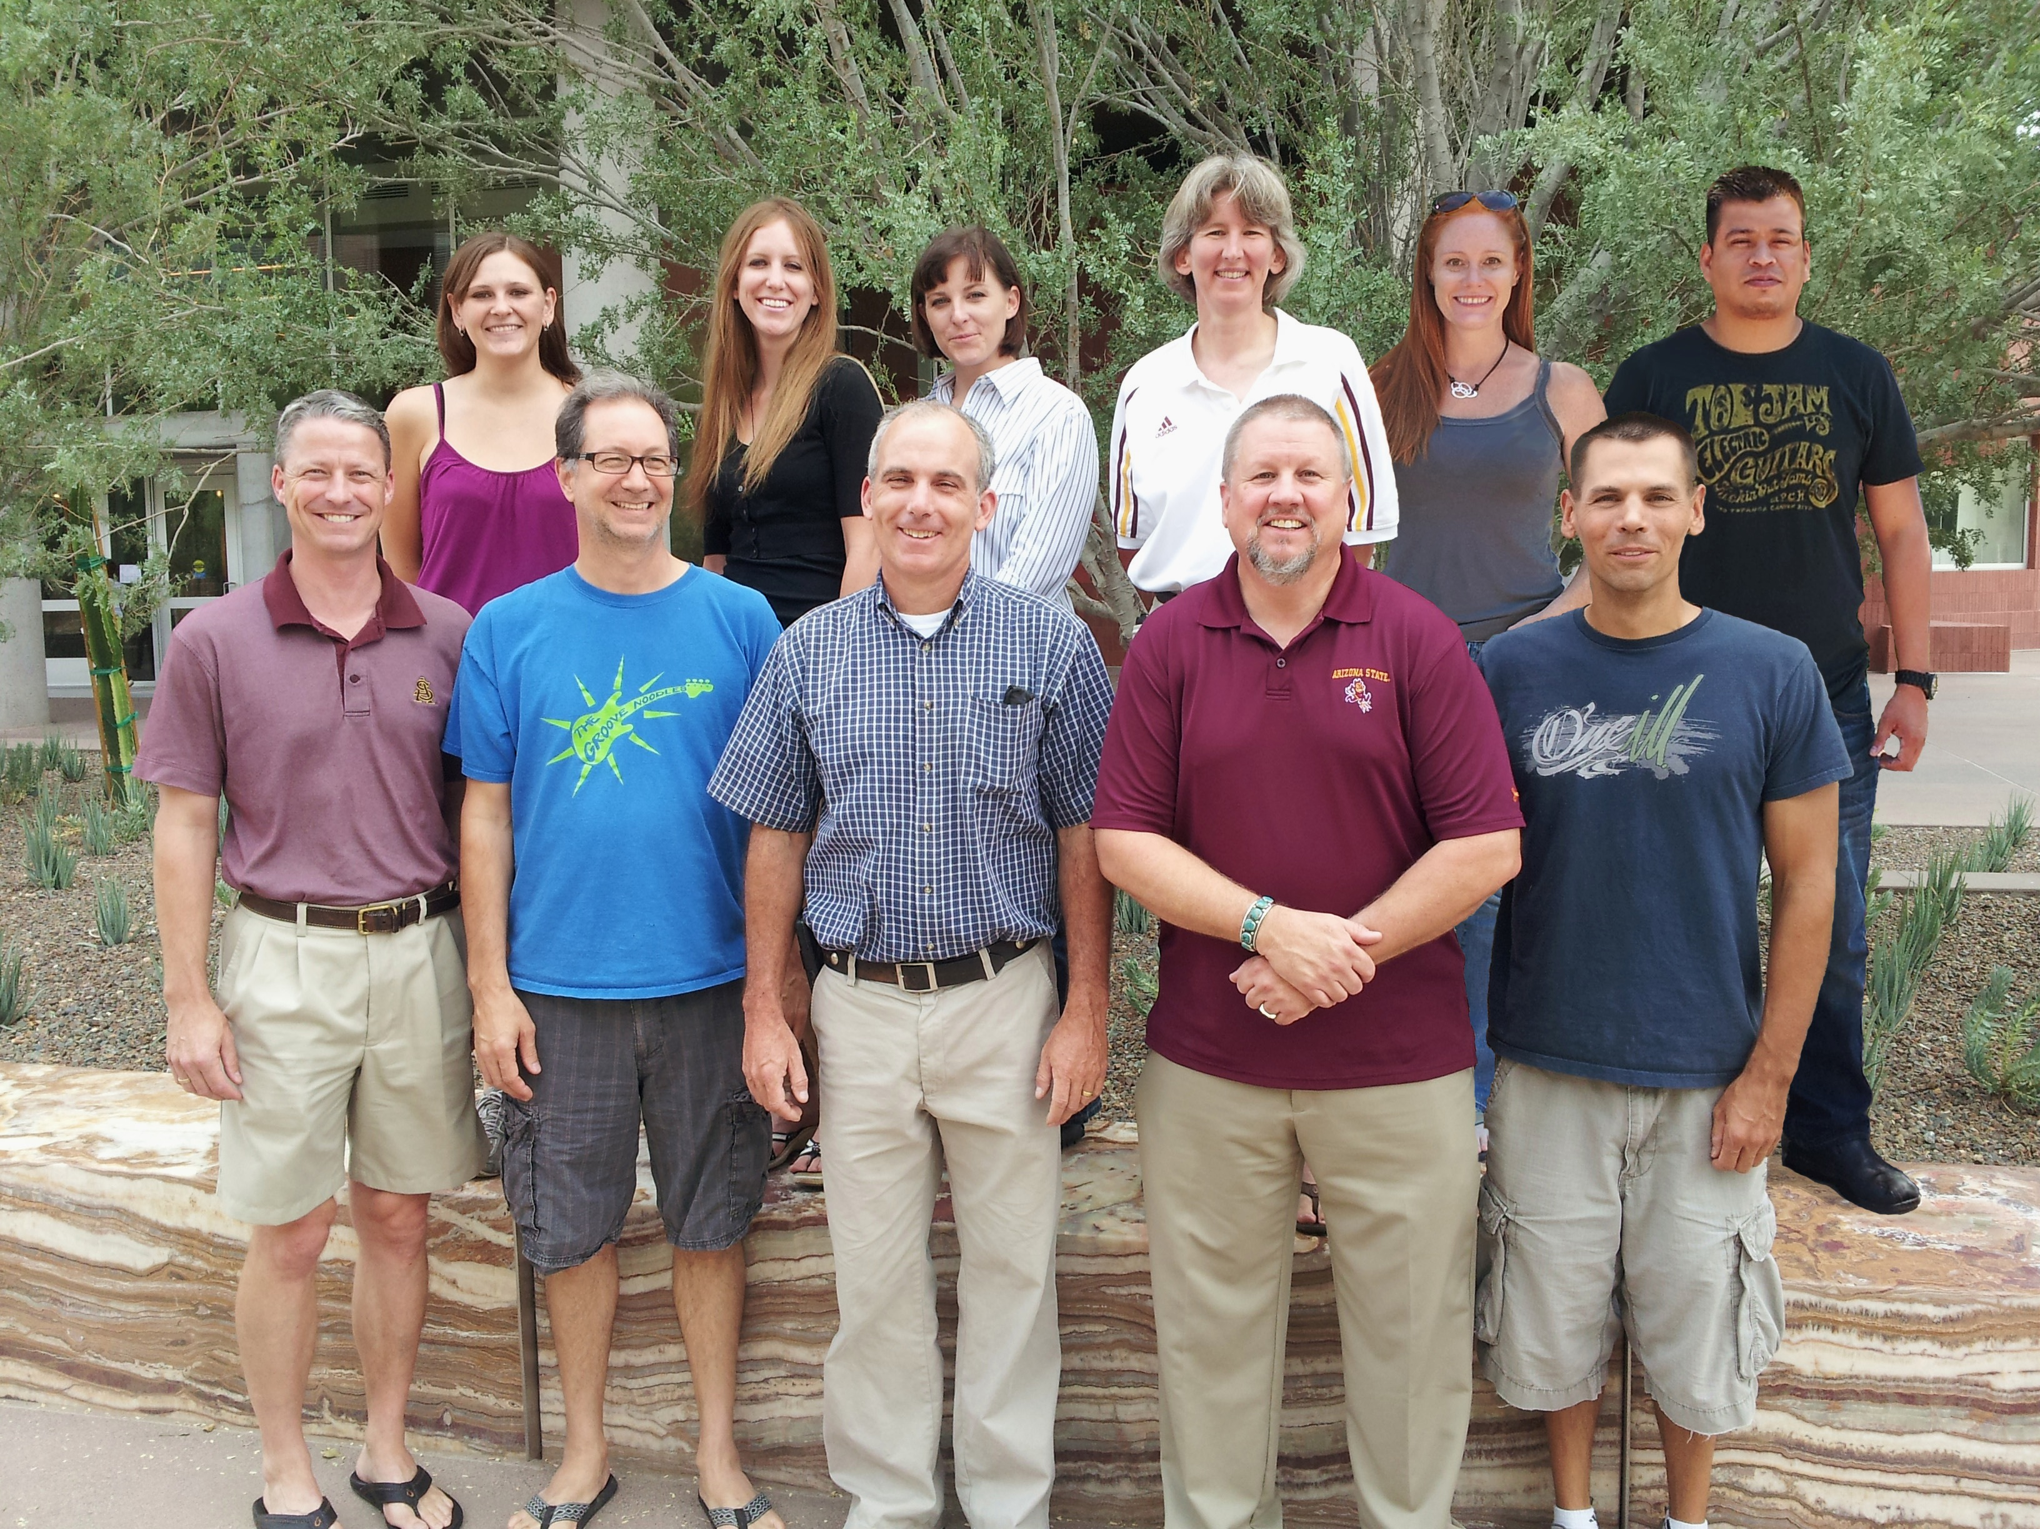
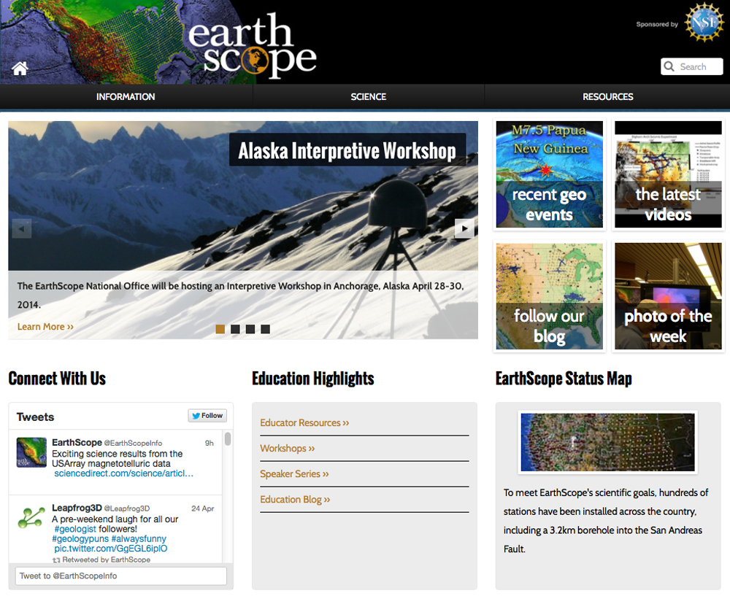

Earthscope
national Office
@ASU 2011-2015
We welcome
your inquiries.
Thank You!
http://www.earthscope.org

