Slide 1
Defining an Earthquake and
Exploring Earthquakes far from Plate Boundaries
Notes:
Learning Objectives:
Students will be able to
Summarize the earthquake process in a short paragraph
Use the Earthquake Machine model to demonstrate the causes of earthquakes, noting the flow of energy through the system
Illustrate the role of models in the process of science in a short description
Abstract
Learning occurs as students collaborate in small groups to investigate the earthquake cycle. This activity emphasizes the role of mechanical models in understanding and testing ideas science.
Teacher Background
Changing the focus of earthquake instruction
Earthquakes are a highly engaging topic for students. The suddenness, and awe-inspiring power of an earthquake, whether experienced directly or via various media outlets, both captures students’ attention and focuses our conceptualization of earthquakes as the impact they can have on society. As a result, students as young as third grade conclude that an earthquake is destruction, injury, and confusion, and the causes are unknown. While the interest is good for learning, such focus on damage and destruction can become an obstacle that limiting learners’ ability to critically and carefully develop an understanding of the actual earthquake and its causes.
Several studies have established that traditional instructional methods for earthquakes are not adequate to allow students to construct coherent explanations about the causes of earthquakes, nor to reduce students’ misconceptions about earthquakes. This activity has been designed to make students’ initial conceptions of earthquakes explicit and then allow them to test these ideas through a hands-on, minds-on exploration of the Earthquake Machine. In this way, students are able to visualize the physical system, including energy inputs and outputs, of a fault system that can lead to earthquakes. The following discussion deemphasizes the damage and destruction that occurs when earthquakes occur near large population centers, and increases the focus on helping students’ construct/expand/replace their own mental models for earthquakes.
Figure 1. The Earthquake Machine is a mechanical model for illustrating the inputs and outputs of the earthquake cycle
The science of the model The simplicity of the Earthquake Machine (Figure 1) allows students to visualize the inputs and outputs of a fault system and explore stick-slip fault behavior. The model’s wooden block and sandpaper base represent an active fault section. Students’ pull on the measuring tape attached to the block is analogous to continuous plate motions away from the boundaries. For example, this represents the downward pull of a subducting slab of lithospheric plate, which is continuously adding tension to the system. The rubber band represents the elastic properties of the surrounding lithosphere, storing potential energy. When the frictional forces between the block and sandpaper are overcome, the block lurches forward with a stick-slip motion. Students get to “experience” an earthquake by seeing the release of energy stored in the rubber band and feeling the propagation of seismic waves from an elastic source. Visualizing the energy released by the slip of the block is further enhanced by the motion of the model building, made of strips of lightweight poster board or manila folder material.
While this model accurately simulates the strain energy that slowly accumulates in rock surrounding a locked fault that is released in a sudden slip event, a process known as the elastic rebound theory, it is ultimately a simplification of a complex Earth system. Such simplifications must be understood to interpret the model accurately. Therefore the relationship between the model and reality should be clearly emphasized to students (Table 1). This is particularly important for high school-aged students, who often think of physical models as copies of reality rather than representations.
The model not only provides a physical perspective on the generation of earthquakes, but it also illustrates the concept of an earthquake’s magnitude, and how this can be calculated based on the physical features of the fault (see inset box). In our model, the length and width (area; A) of the fault section that slips during an event (represented by the dimensions of the block of wood) as well as the rigidity of Earth materials (μ, represented by the elasticity of the rubber band) are constant for every event generated. The only factor that can vary is the displacement (D) or slip of the fault. As a result, there is a direct correlation between the amount of slip of the block and the moment magnitude of the event. While aspects of the mathematical relationship discussed in the inset box may be premature for some students’ experience, all students will physically see this relationship by noting how much the “building” on top of the block moves in relation to the amount the block slips. The further the block slips, the more energy is released, and the more violently the building shakes

Slide 2
Create a description with a partner
?
?
?
?
?
What is an Earthquake?
?
?
?
?
?
?
?
Notes:
Ask participants to individually answer the following question “What is an earthquake?” They will write their answer on 3x5 sticky notes with one idea per note (e.g. sudden release of energy = one note; ground shaking = one note, etc).

Slide 3
Earthquake Machine
Notes:
) Next, have students work in groups of 8-10 students to create a single consensus definition that accounts for everyone’s ideas in the group. This can be efficiently accomplished by creating an affinity diagram. An affinity diagram organizes a large number of ideas into their natural relationships (Ray,1999). Here the first participant reads one of his/her notes and places it on the table top or wall. If other students in the group have a similar idea, their note is read and grouped with the original. Ask the group to name the natural relationship between the ideas and record it with an additional sticky note. These identified natural relationships can be referred to as themes. Continue to call and sort ideas until all sticky notes are posted on flipcharts. Allow sticky notes to be moved as the group refines the natural relationships between their ideas. The group should come to consensus on one definition of an earthquake that includes the entire group’s idea. All group participants record this definition on the student worksheet.
Describe the materials and assembly of Earthquake Machine model. Before communicating what the setup models about earthquakes, demonstrate what happens when you pull slowly on the tape connected to the block on the sandpaper.
NOTE: To use the Earthquake Machine, slowly pull the measuring tape parallel to the surface of the sanding belt. The block should stick in place initially and the rubber band should stretch. When a threshold is reached, block will slip forward as the potential energy stored in the rubber band is suddenly converted to kinetic energy. Once the block stops, the stick slip process begins again.

Slide 4
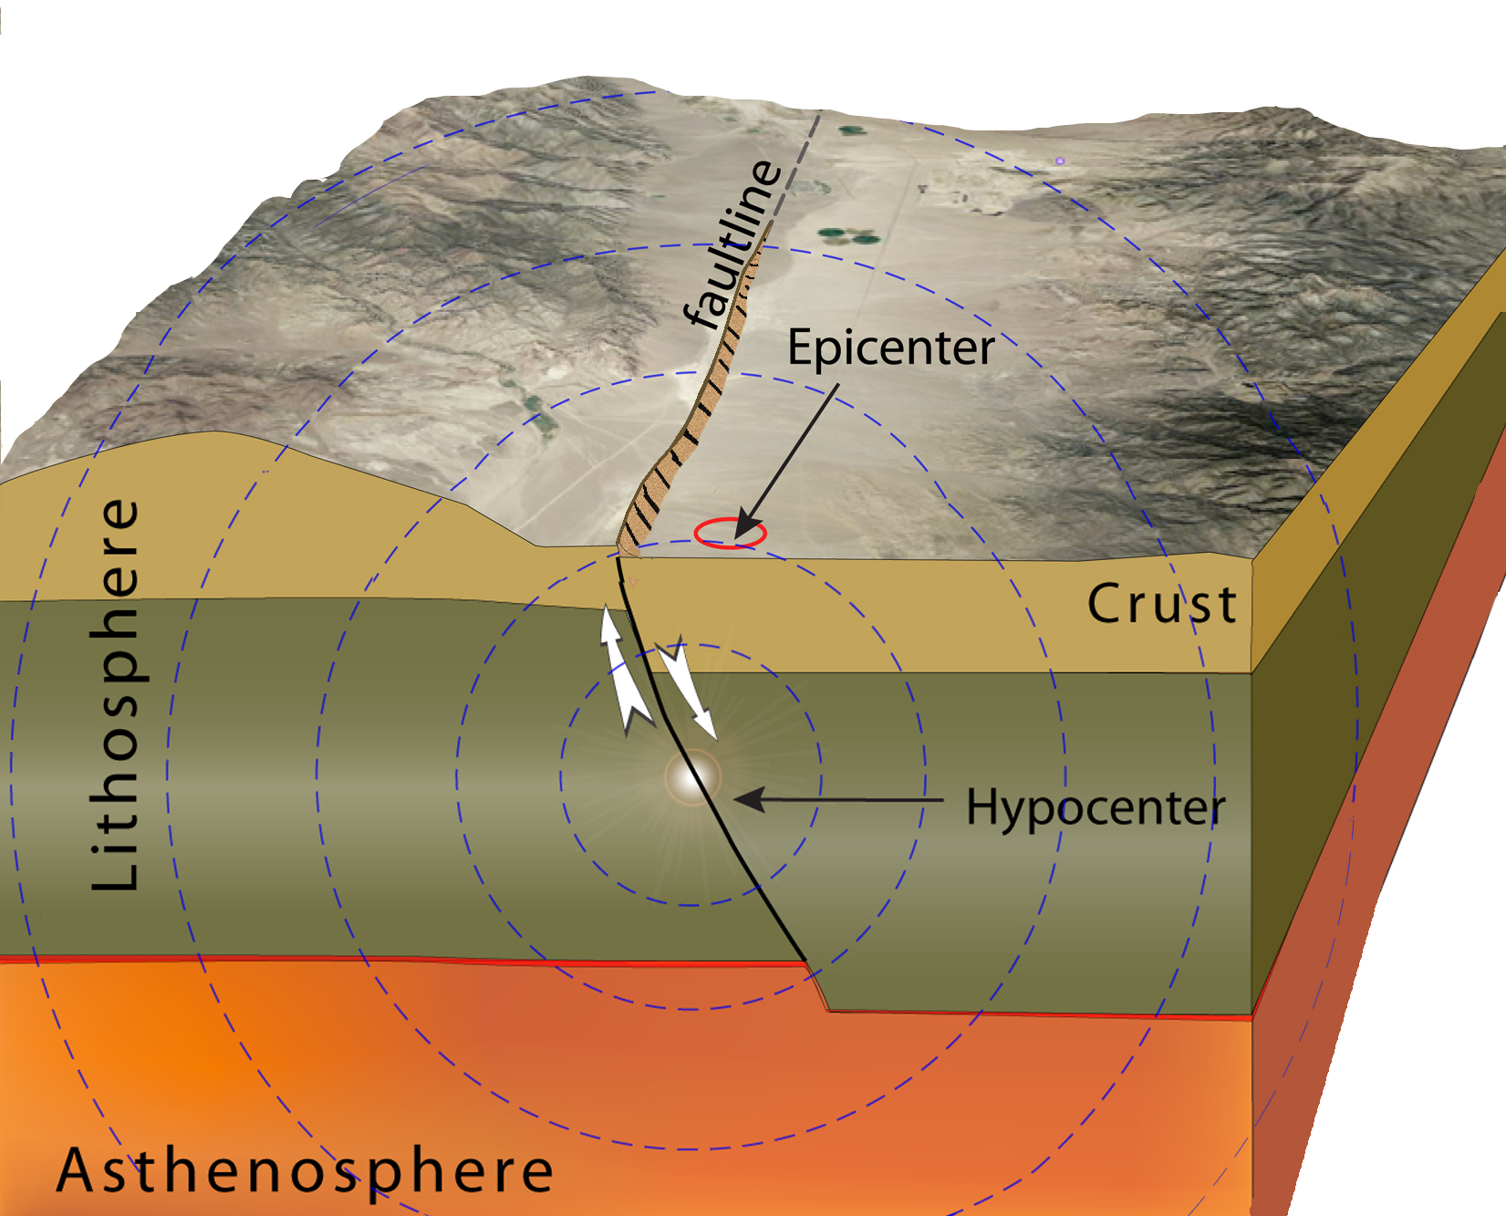
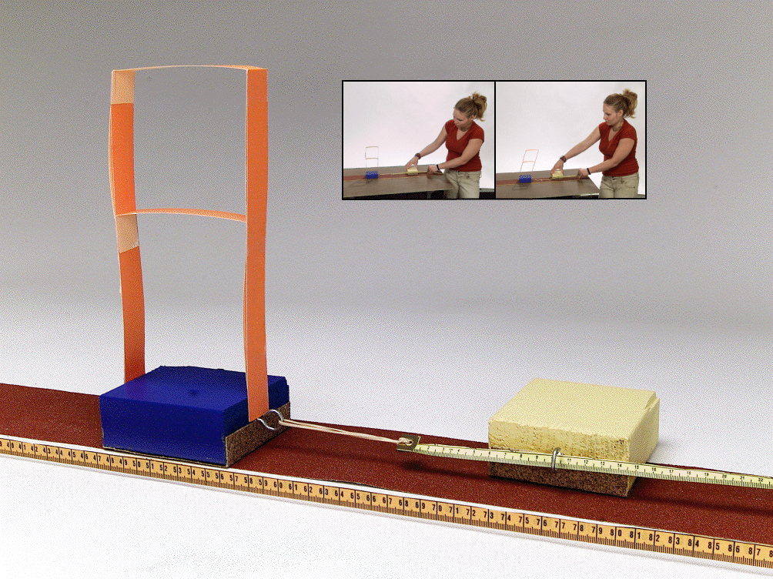
Like and Unlike
An earthquake is the sudden motion of rocks within the Earth as stored elastic energy is released.
Notes:
Refer to teachers notes for a discussion of how the model is like and unlike the Earth.
Emphasize the following two questions in your discussion.
1) How might the model be like a real fault?
ANSWER: The stick-slip behavior of the block is similar to the earthquake cycle where earth materials to store energy elastically over a period of time. When a threshold is reached, the stored energy is suddenly released as an earthquake, which causes seismic waves to propagate outward in all directions .
The sandpaper represents the contact between one plate and another plate
The moving block represents an earthquake
The wood block represents the edge of the plate that is locked
The measuring tape represents the bulk of the plate where plate motion is constant.
The rubber band represents he elastic materials inside the Earth)
Pulling on the measuring tape represents the force causing plate to move
2) How might the model be unlike a real fault?
ANSWER: The materials and the scale, both temporal and physical, are notably different.
In Earth, elastic energy is stored in rocks spanning an area of up to hundreds of kilometers over a period of tens to hundreds of years; the small rubber band takes just seconds to store energy.
The block has fixed dimensions that slip as a single unit while a fault is much larger and more complex. As a result it could slip at any point along the fault; a process that can vary for each earthquake on the fault.
In the model, the boundary between the two plates (or sides of the fault) is parallel to the surface. However, in Earth, plate boundaries (and fault planes) are typically inclined or vertical.
Friction only occurs along the bottom of the wooden block in the model but in a fault, the friction is 3-dimensional and much more complex due to changing pressure and rigidity factors at depth.
Energy in the model comes from our hands. In the Earth the internal heat of the earth drives push of the plates, while gravity drives the downward pull of subducting slabs.
TIP = Create a table to emphasize BOTH like and unlike features. This is essential to avoid generating misconceptions when working with models.
Any benefit in saying something akin to “like the sound waves that radiate away from the sandpaper.”?

Slide 5
Energy in the model comes from you.
Where might this same energy come from in the Earth system?
Think - Pair - Share

Slide 6


Earthquake Machine Properties
Single Tectonic Plate
Top View
B
C
Elastic Properties of
Earth Materials
Bulk of Plate Has Constant Velocity of 1cm/year
Locked Edge of the Plate
Notes:
The sandpaper represents the contact between one plate and another plate
The moving block represents an earthquake
The block of wood/rubber band/measuring tape represents a single tectonic plate
The wood block represents the edge of the plate that is locked
The rubber band represents he elastic materials inside the Earth
Pulling on the measuring tape represents the force causing plate to move

Slide 7
Elastic Rocks
Already talked about rocks being elastic for seismic waves to travel through them
  Small quick motions
How can energy be stored in rocks?
How does energy released relate to earthquake magnitude?
  http://www.iris.edu/hq/programs/education_and_outreach/animations/26

Slide 8
How could you modify the model so that it no longer stored energy?
Based on this (and assuming superhuman powers, perhaps) what would you change about Earth to prevent all future earthquakes?
Notes:
Formative assessment–Ask students how they could modify the model so that it no longer stored energy?
Based on this (and assuming superhuman powers, perhaps) what would you change about Earth to prevent all future earthquakes?
ANSWER:
Option 1: Don’t pull the measuring tape. In Earth, this would be analogous to cooling Earth’s interior thereby removing the driving force on the plates
Option 2: Eliminate the friction between the block and the sandpaper base. In Earth, this would be analogous to removing the locking forces (friction, pressure, etc) at a plate boundary or fault.
Option 3: Remove the rubber band or replace it with string. In Earth, this would be analogous to making rocks and other Earth materials inelastic and unable to store the potential energy for an earthquake

Slide 9
Exploring earthquakes away from a plate boundary
ds.iris.edu/ieb/

Slide 10
Exploring earthquakes away from a plate boundary
Use the Earthquake Browser to look for evidence to answer the question: Do earthquakes occur in Minnesota?
  First look at US as a whole, then zoom into Minnesota
  Look at both the map view, 3D view, and the table list
  What is the biggest event in the catalog?
  Could some or all of the events on the map and in the table be something other than earthquakes?
  Why or why not?

Slide 11
Oklahoma earthquakes
How do the events on the map in Oklahoma compare to the events in Minnesota?
  Look at both the map view and the table list
  Could some or all of the events on the map and in the table be something other than earthquakes?
  Why or why not?
  Now compare the time periods
    1995-01-01 to 2005-01-01
    2005-01-01 to 2015-01-01
  What might explain the difference?

Slide 12
Oklahoma earthquakes
Most recent earthquakes have probably been induced by injection of waste water into deep wells
However most waste water disposal wells don’t cause earthquakes
90% of injected waste water in Oklahoma comes from unconventional wells with a high water/oil ratio
Only 10% comes from disposal of hydrofracking fluids

Slide 13
Seismic hazard in the US

Slide 14
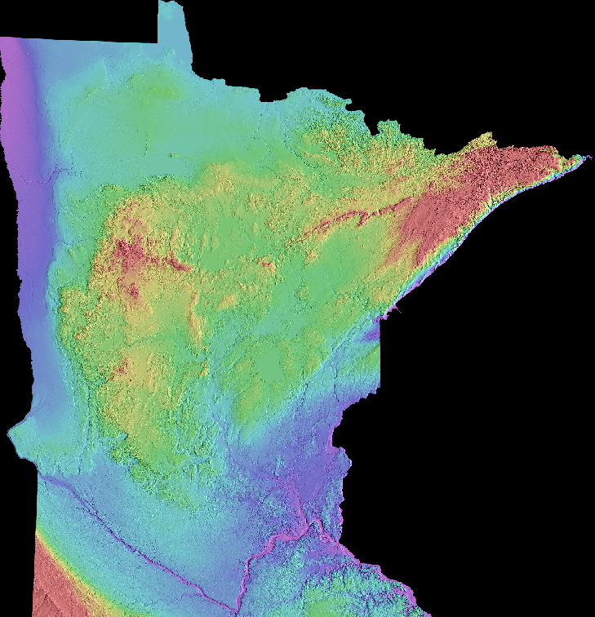
Topography controlling iron deposits

Slide 15
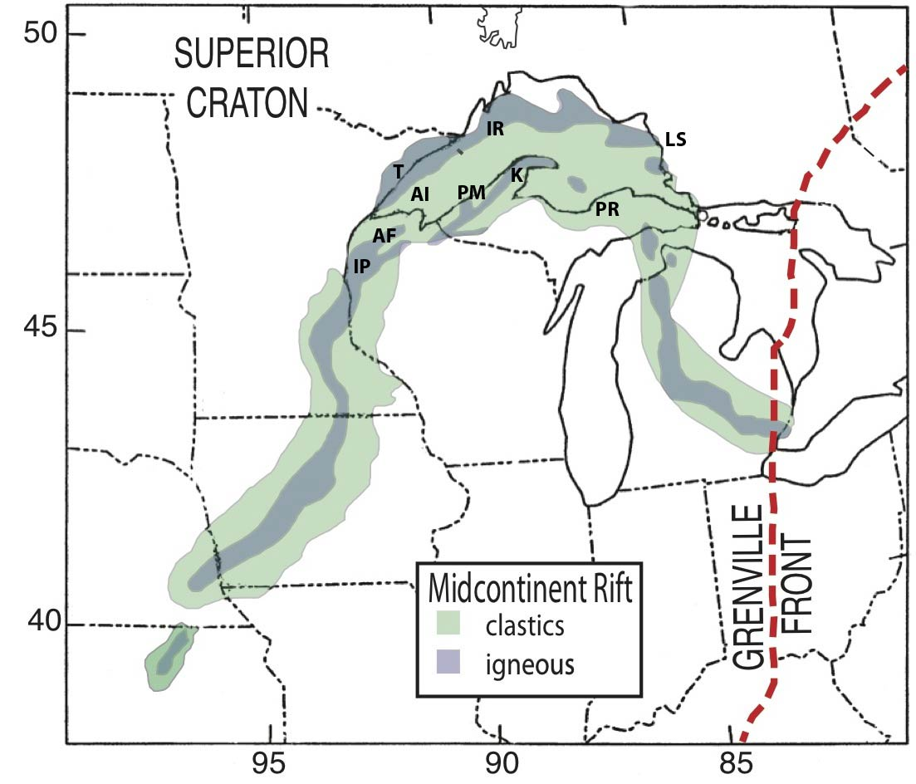
Mid Continent Rift
The Midcontinent Rift System (MCRS), is a 1.1 billion year old 3000 km (1800 mile) long scar along which the North American continent started to tear apart, just as Africa is splitting today along the East African Rift, but for some reason failed to form a new ocean.
The MCRS also provided mineral deposits that shaped the region’s settlement and growth.
Stein et al., 2011

Slide 16
Mid Continent Rift
The Midcontinent Rift System (MCRS) or the Keweenaw Rift is a 1800-mile (3000-kilometer) long belt of igneous (volcanic) and sedimentary rock).
The rift system has two major arms meeting in the Lake Superior region (Hinze et al., 1997; Ojakangas et al., 2001).
One extends southwestward at least as far as Oklahoma, and the other extends southeastward through Michigan to Alabama
Stein et al., 2011

Slide 17
Mid Continent Rift
Despite the rift’s size, most visitors don’t know about it, because these rocks are mostly covered by sediments and sedimentary rocks younger than those of the rift. They appear at the earth’s surface only near Lake Superior.
Stein et al., 2011

Slide 18
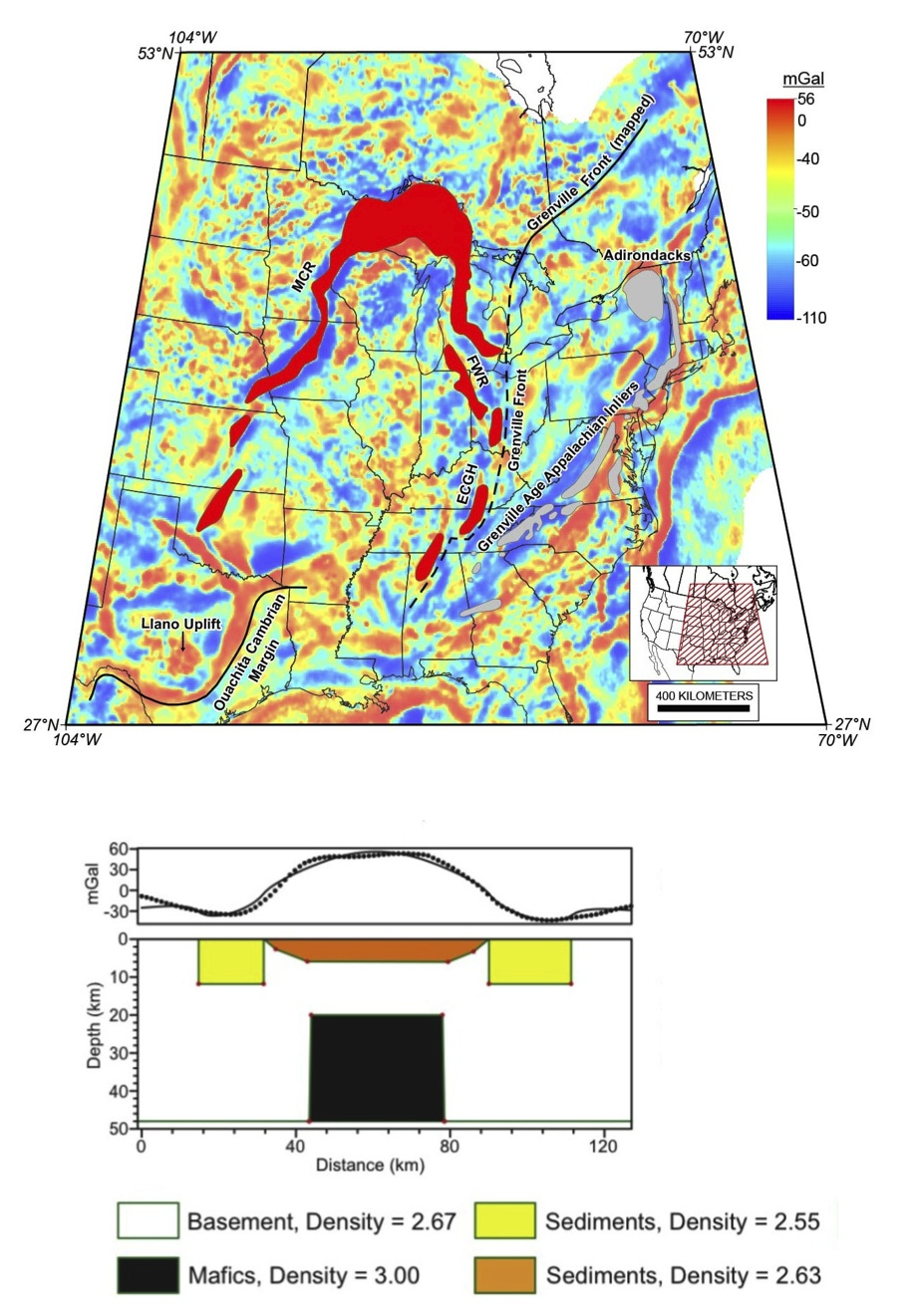
Gravity studies
Geologists combine what they learn from the exposed rocks with clever techniques that “see” the hidden parts of the rift. One technique uses very accurate measurements of gravity and magnetism. The buried volcanic rocks contain lots of iron, and so are denser and more magnetic than the surrounding rocks.
Gravity and magnetic surveys have mapped a huge thickness – up to 15 miles or 25 km - of volcanic rocks, so the entire rift system has about 240,000 cubic miles (a million cubic kilometers) of volcanic rocks. This is 44 times the volume of all the Great Lakes combined!
Stein et al., 2014a
Merino et al., 2013

Slide 19
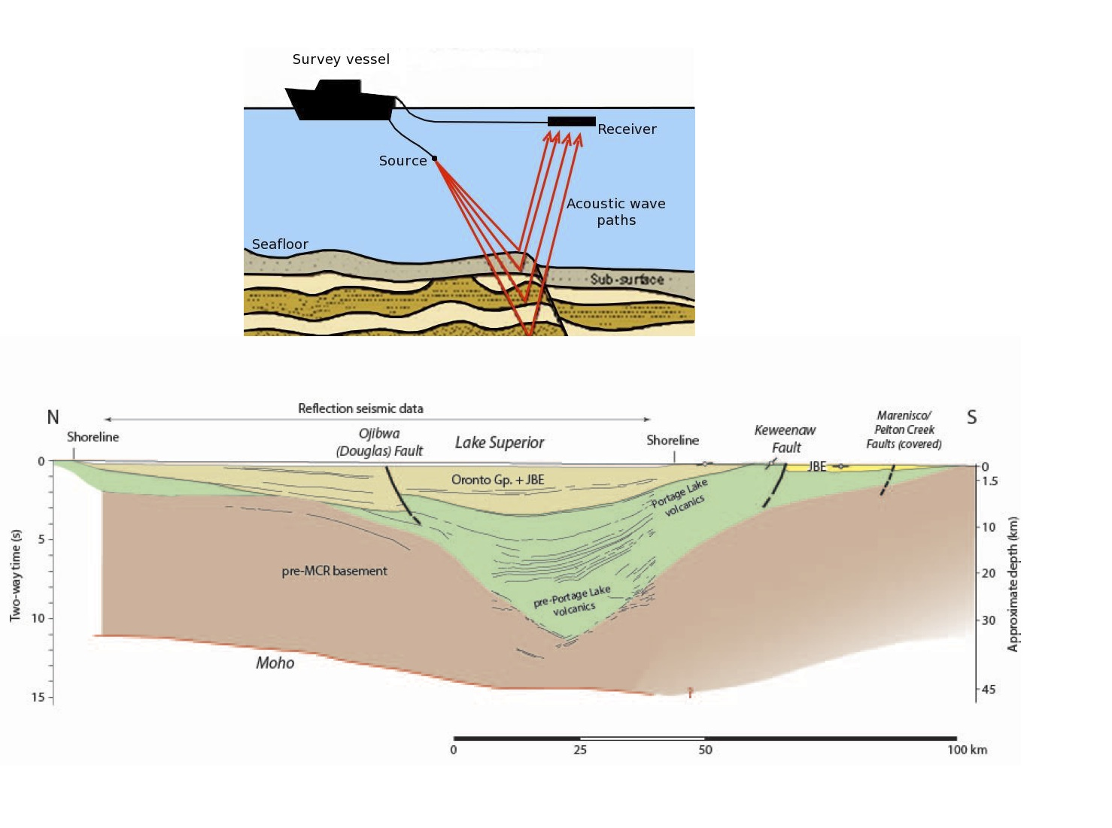
Seismic reflection studies
Univ. of Southhampton
Other methods use seismic waves to “see” at depth. This method, which is also used to find oil and natural gas deposits, is like the way doctors use X-rays. Surveys across Lake Superior used waves generated by a towed sound source that traveled downward, reflected off interfaces at depth between different rocks, and were detected by seismometers. The resulting seismograms were used to generate an image of the rocks at depth.

Slide 20
Geology under Lake Superior from seismic section
A north-south cross section shows a deep depression under Lake Superior filled by layers of volcanic rocks and overlying sediments to a depth of 30 km (18 miles), which is much deeper than Lake Superior’s average depth of about 150 m (500 feet).
This structure is called a syncline, in which the volcanic rocks on the north side – as seen at Isle Royale – dip southward toward the center of the lake, whereas those on the south side – as seen at Porcupine Mountains - dip to the north.
Stein et al., 2014b

