Slide 1
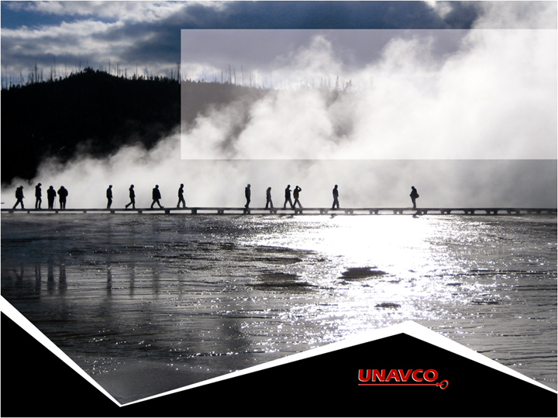
Getting to know EarthScope Plate Boundary Observatory & UNAVCO
Shelley Olds, UNAVCO

Slide 2
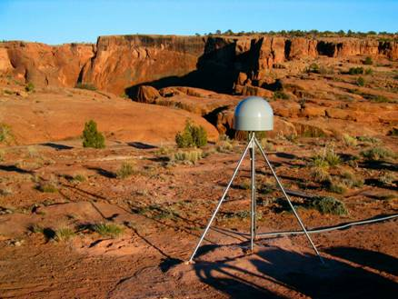
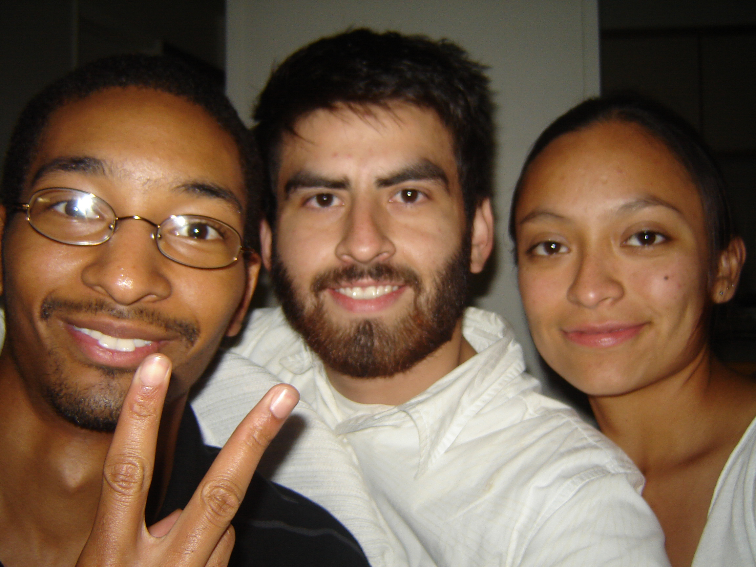
About UNAVCO
NSF and NASA funded
Non-profit
Consortium
Membership-governed
Facilitates geoscience research and education using geodesy
Operates the Nation’s geodesy facility, including the Plate boundary Observatory on behalf of NSF
Broaden the use of UNAVCO data and products by a wide audience of educational and research users

Slide 3
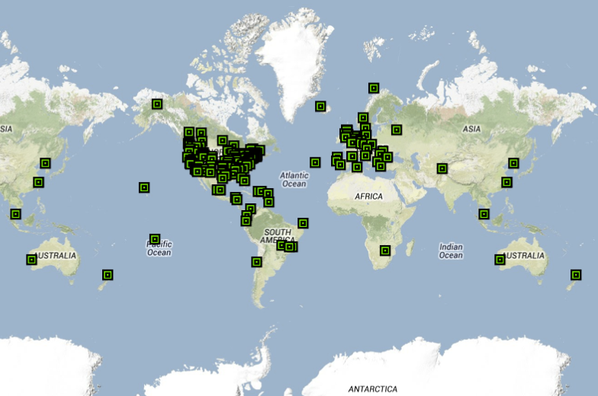
UNAVCO Consortium Members

Slide 4
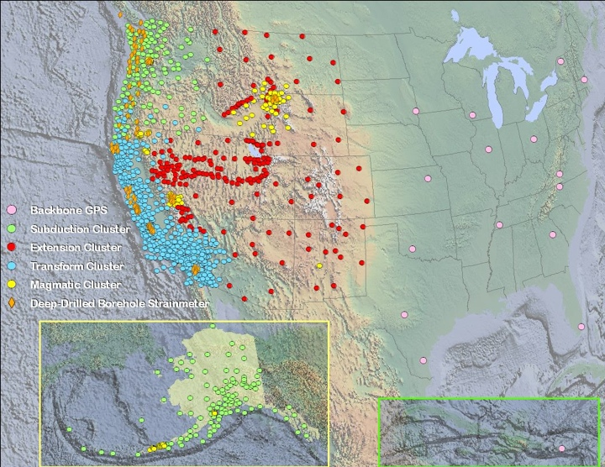
Meet the Plate Boundary Observatory
Geodesy Advancing Geosciences & EarthScope (GAGE)
Continent-scale network
GPS
Borehole strainmeters
Laser strainmeters
LiDAR
Focus:
  Extended plate boundary
Operated by UNAVCO

Slide 5
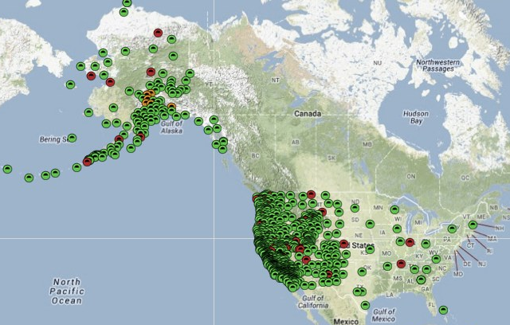
EarthScope PBO GPS Network

Slide 6
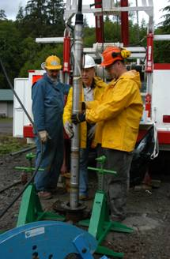
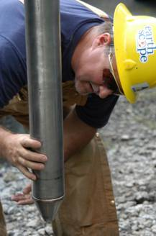
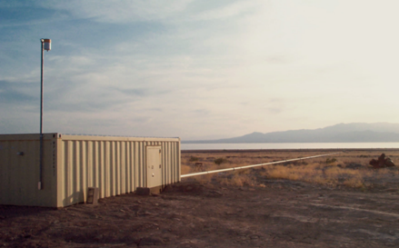
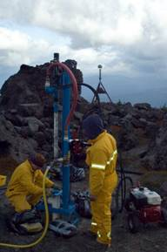
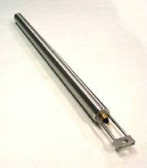
Plate Boundary Observatory Instruments
GPS: 1100 Continuous
74 Borehole Strainmeters
and 78 Borehole Seismometers
5 Laser Strainmeters
26 Shallow Borehole
Tiltmeters
6
Notes:
PBO uses other equipment besides GPS
Tiltmeters common in volcanic settings

Slide 7
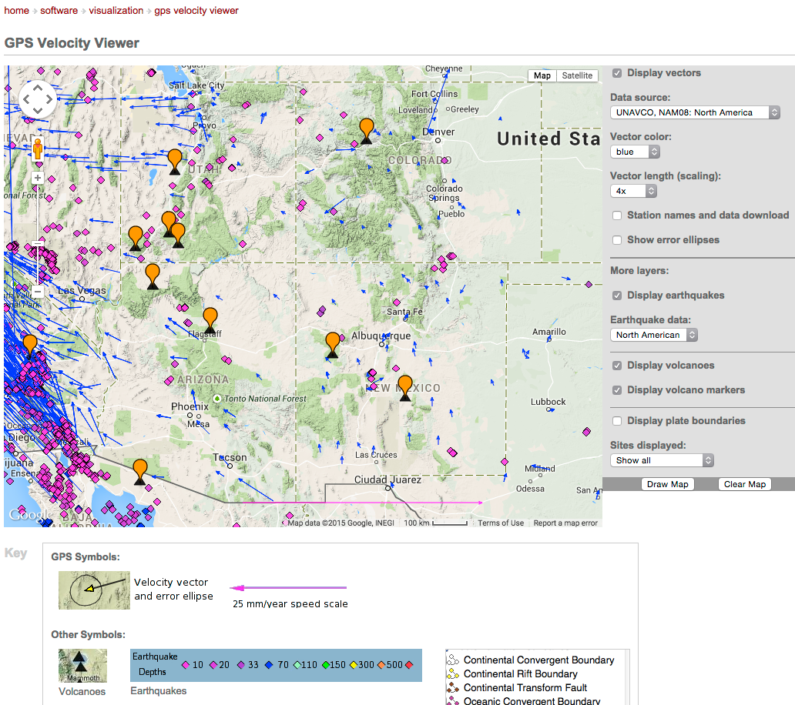
EarthScope in Arizona and New Mexico

Slide 8
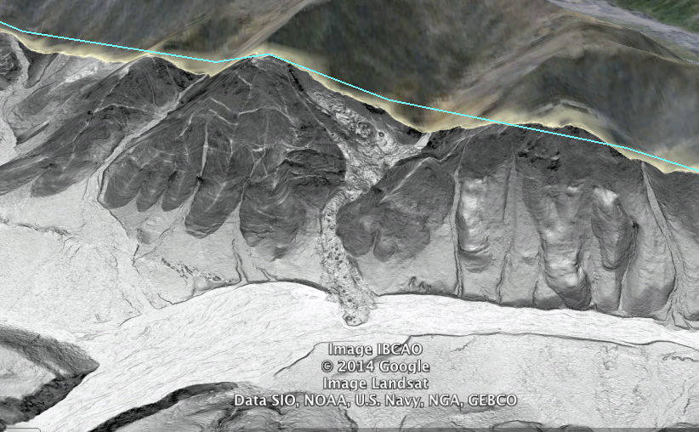
LiDAR – looking below the trees
Open Topography: http://www.opentopography.org/

Slide 9
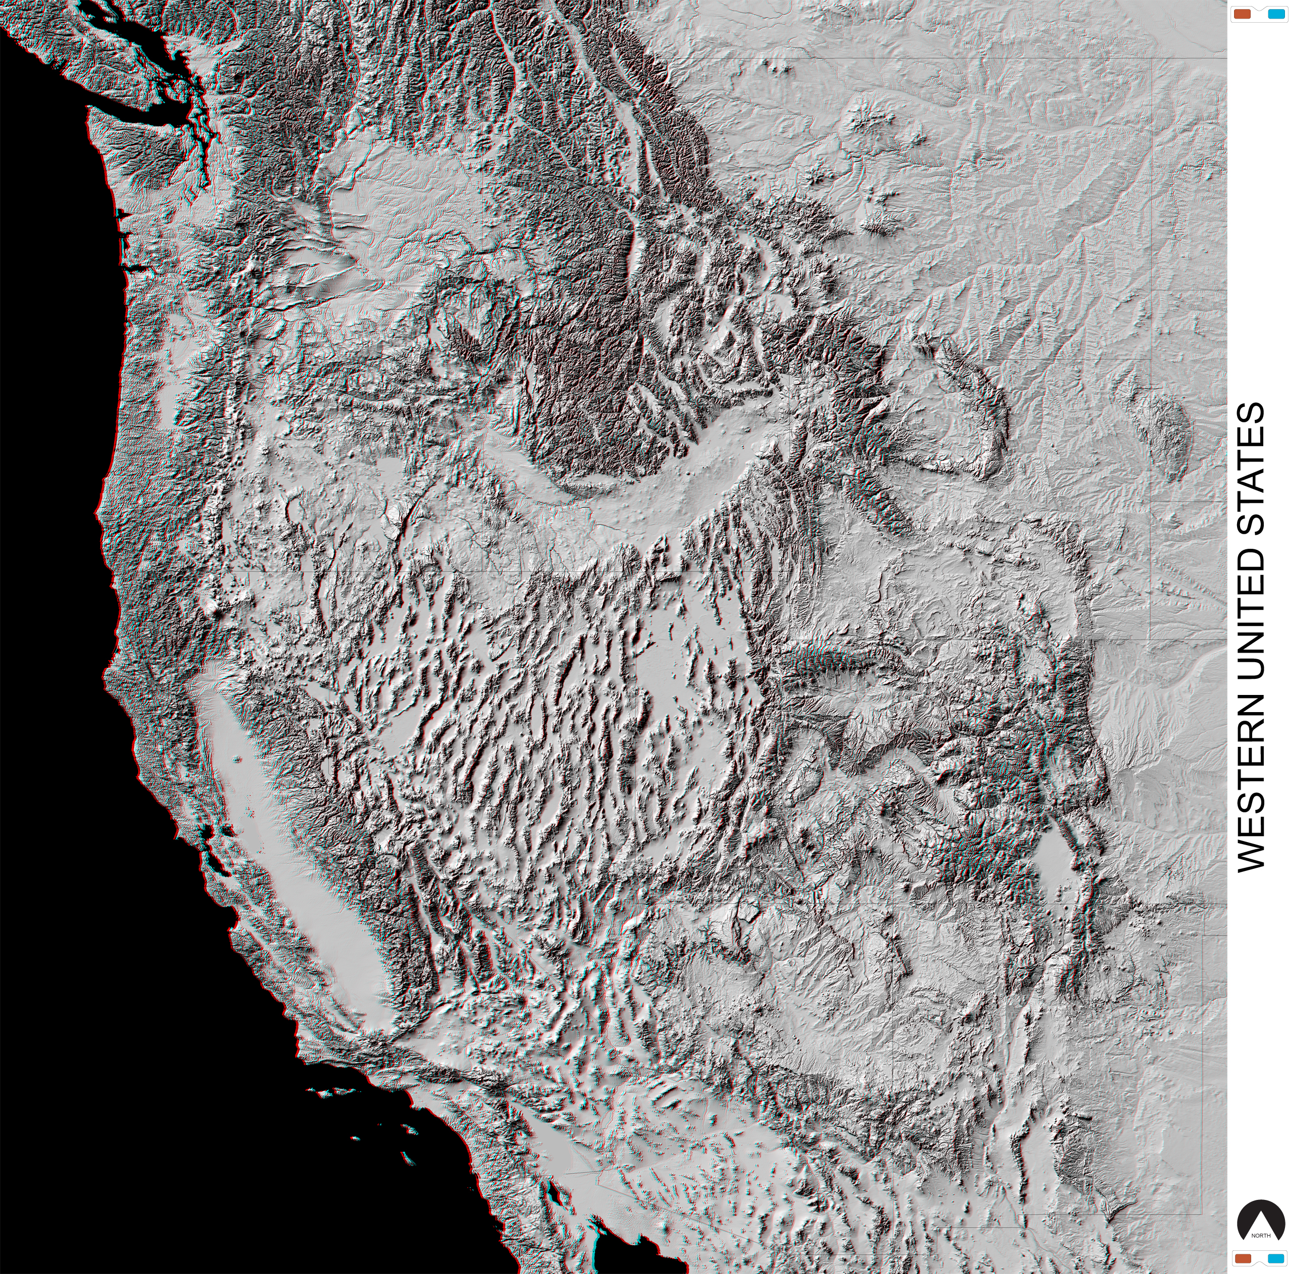
Western US in 3D
Courtesy: Parul Morin, National Center for Earth-surface Dynamics
Data Repository
http://www.nced.umn.edu/Data_Repository.html
[retrieved on 08 March 2015]

Slide 10
Education & Community Engagement
^{Training} Technical short courses, educational workshops, evaluation, new delivery methods
Education Materials Curriculum development (Strain module, GETSI project [NSF-TUES], existing learning materials
Communications Website, outreach materials, social media, conferences
Workforce Development RESESS, RESESS Alumni network, Science Workshop mentoring

Slide 11
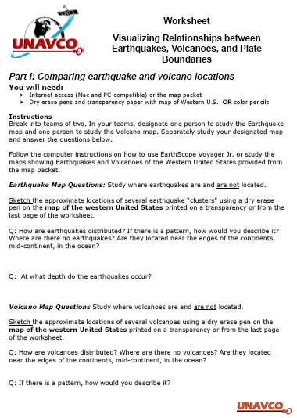
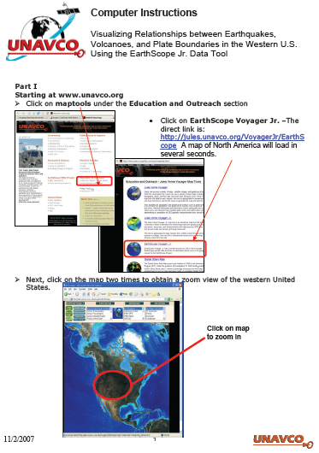
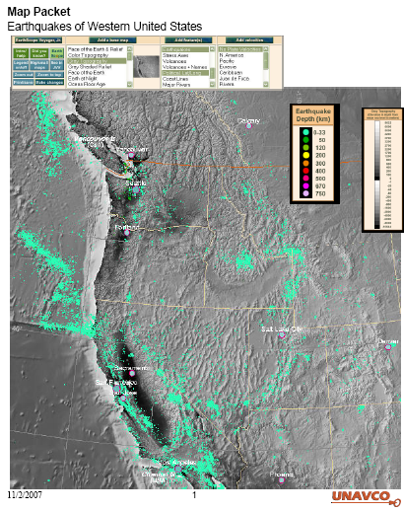
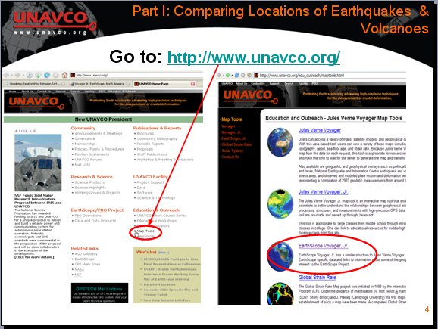
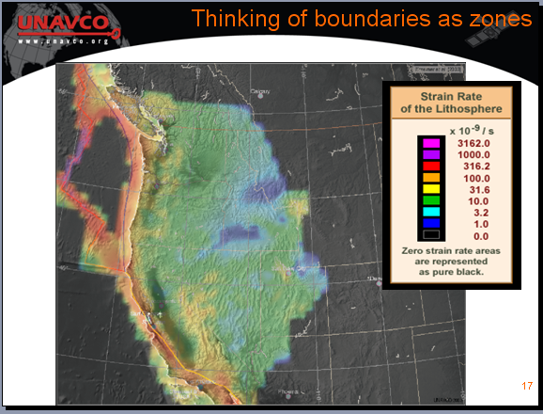
Learning Materials
Tutorials & How to’s
Lessons
Student worksheets
Animations
How to download data
Based on time series inversion algorithms of Lundgren et al. (J. Geophys. Res., 2001) and Berardino et al. (IEEE, 2002).
Notes:
UNAVCO is developing free, place-based, data-rich learning modules for educators and students in introductory Earth science courses at secondary and undergraduate levels.
These modules integrate new scientific discoveries related to crustal deformation and explore applications of GPS, LiDAR, and InSAR techniques to research.
They also provide students with case studies highlighting the process of scientific discovery. This presentation will provide an overview of our current and in-development visualization tools and how they are used in our learning modules.

Slide 12
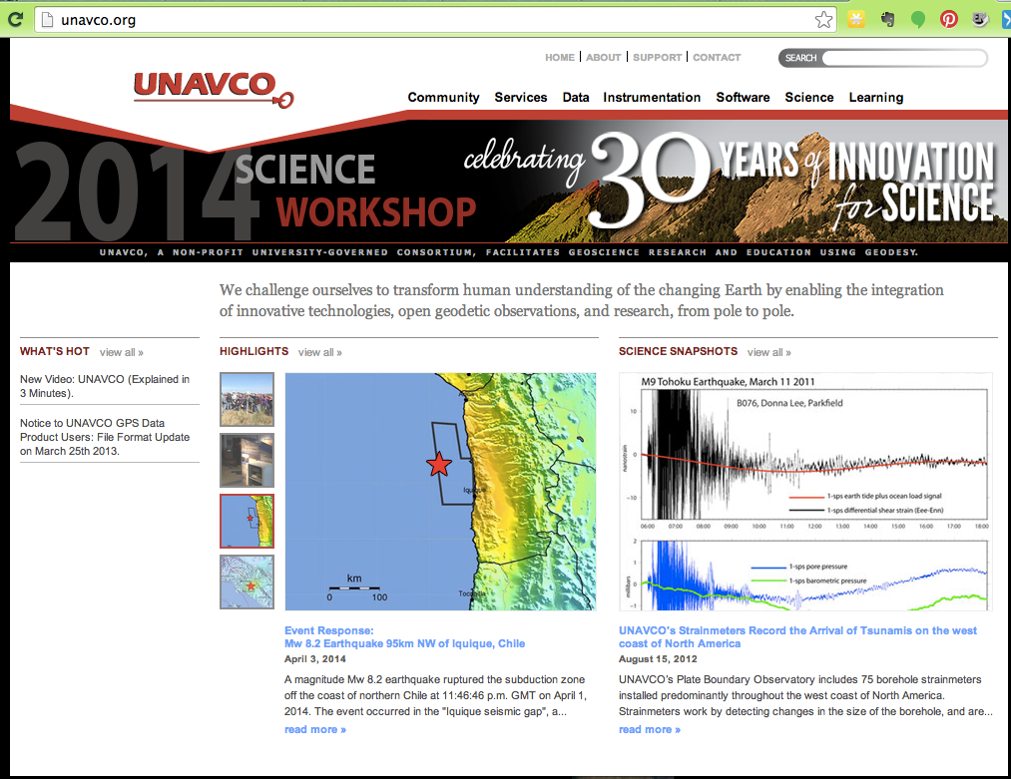
UNAVCO Highlights, and Snapshots reading literacy with science
http://unavco.org/

Slide 13
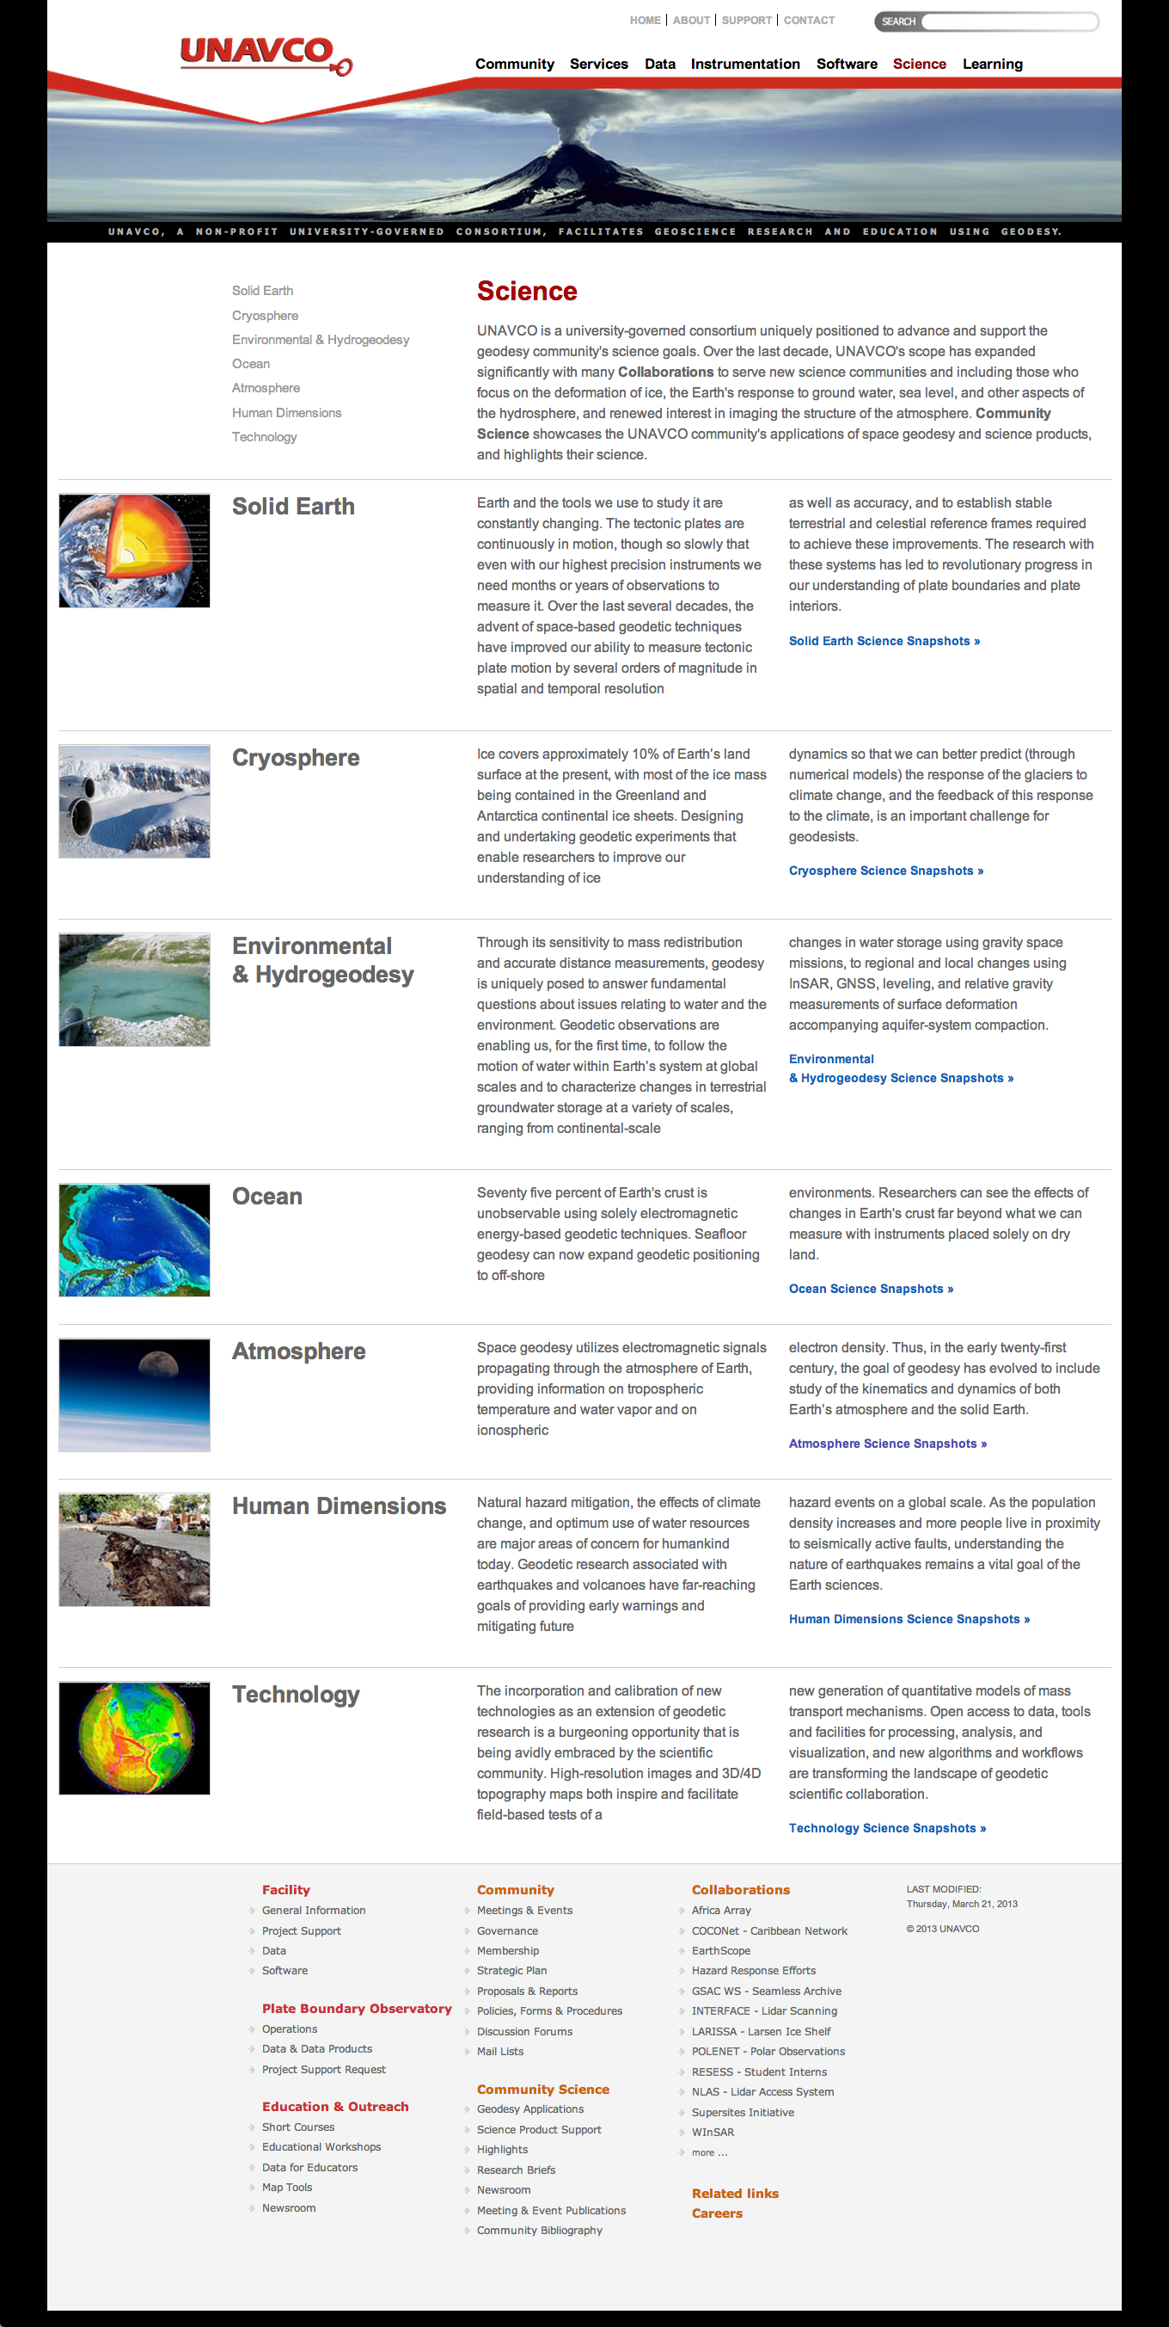
More UNAVCO & PBO Science

Slide 14
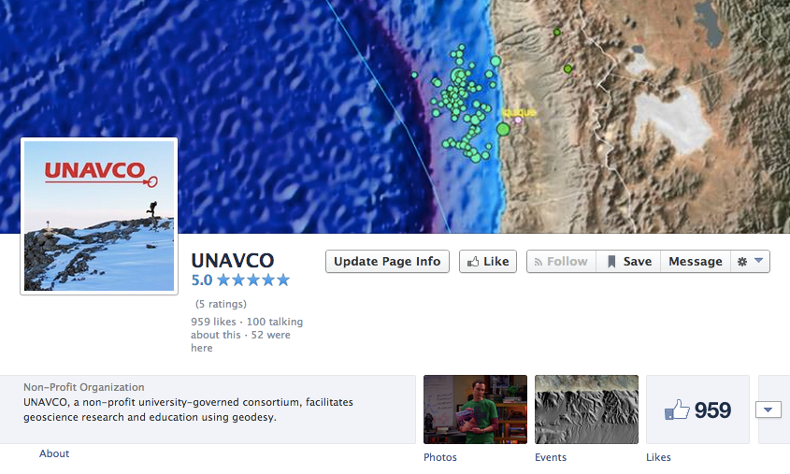
Social Media
Follow UNAVCO on facebook
Facebook Twitter

Slide 15

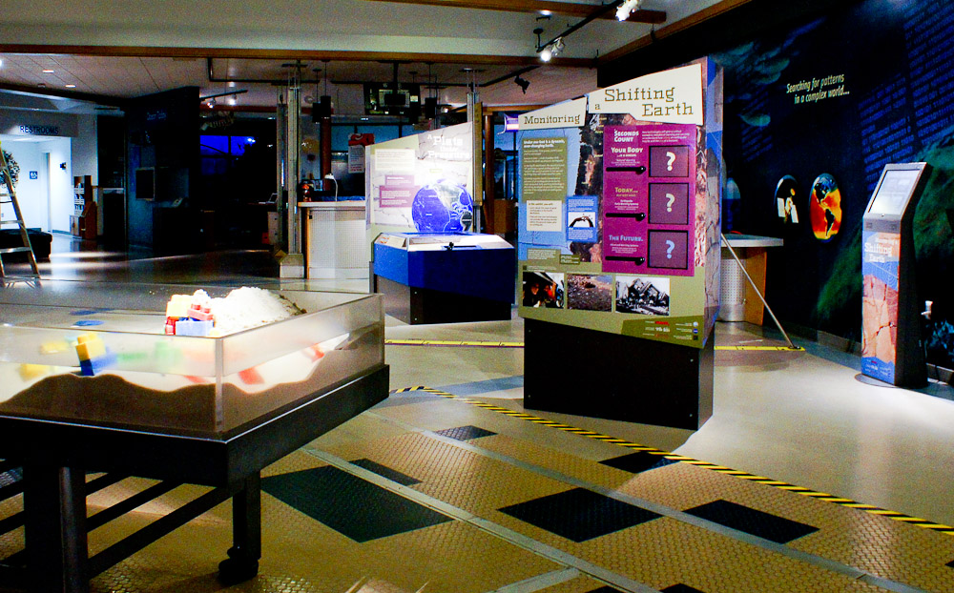
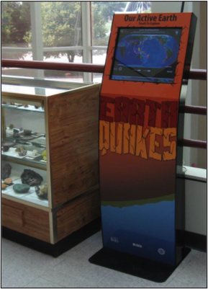
Exhibits

Slide 16
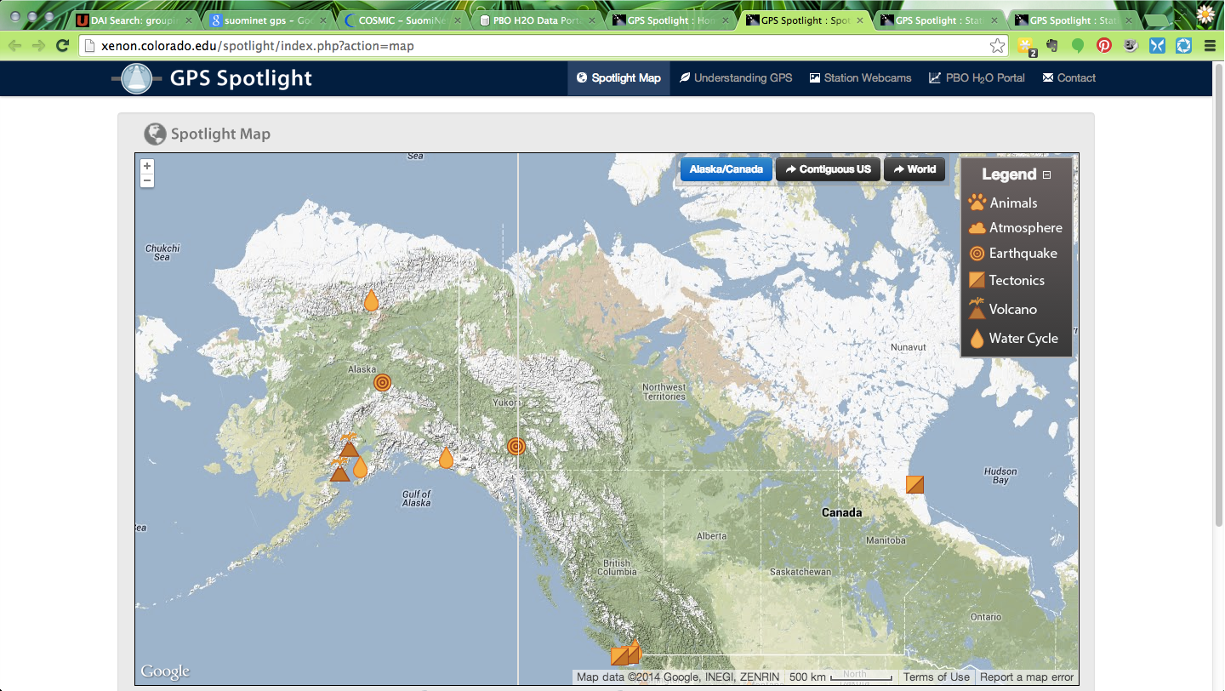
GPS Spotlights
http://xenon.colorado.edu/spotlight/index.php?action=map

Slide 17
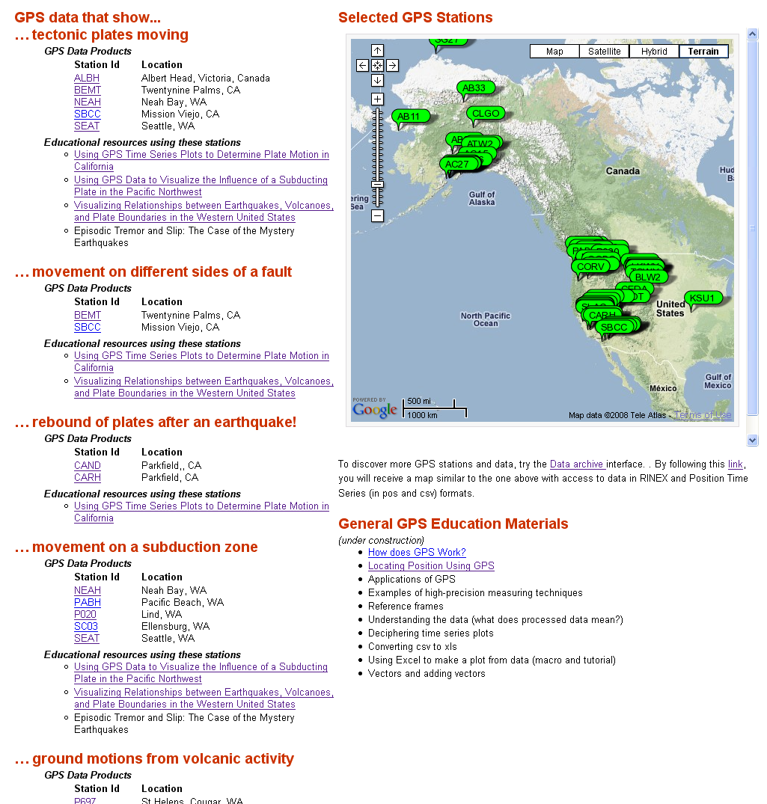
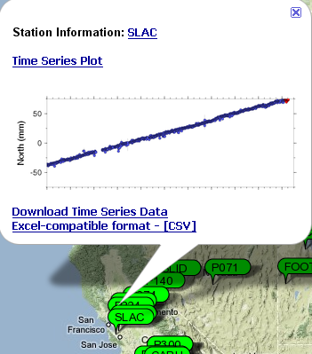
Data for Educators for resources you can use
Visual display of station locations
Interesting data
Full data plot
Quick data preview
Excel readable formats
Associated learning activities
http://www.unavco.org/edu_outreach/data.html
Notes:
Designed with data exploration in mind.
More recently, UNAVCO built the Data for Educators webpage, incorporating an embedded Google Map with GPS locations and providing current GPS time series plots and downloadable data from the Plate Boundary Observatory. To extend and update the datasets available to our community, UNAVCO has been exploring new online and desktop-based technologies such as Google Maps and Google Earth which allow the inclusion of visualizations of more types of datasets, on the fly, while maintaining the self-contained, familiar, and easy to use interface of the JVV map tools.

Slide 18

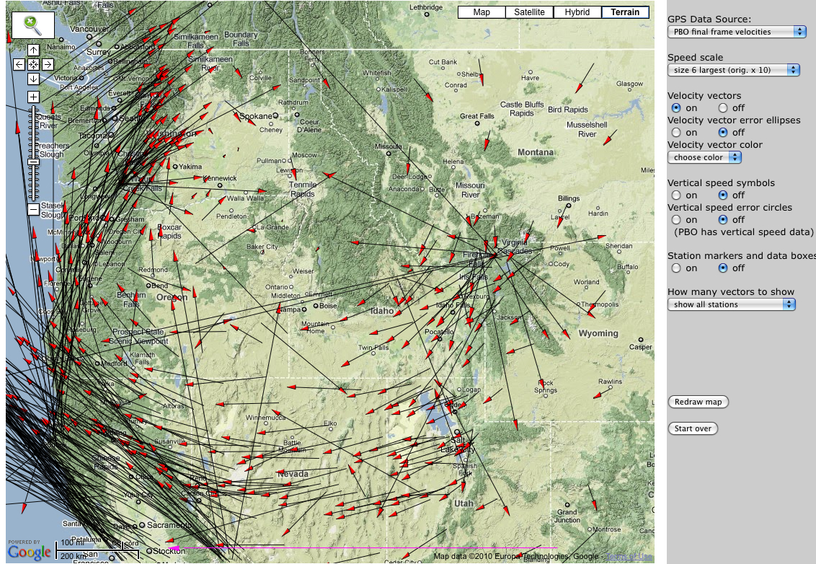
Use Data Tools
25 mm/yr
Data Source: UNAVCO Plate Boundary Observatory: North American Reference Frame
UNAVCO GPS Velocity Viewer
Notes:
Explain again what the vector arrows mean and walk through the map to point out interesting areas.
Explain reference frame …
It is the visual display of GPS, LiDAR, InSAR data, however, that helps make plate tectonics come alive for learners as a process that is happening in the present.

Slide 19
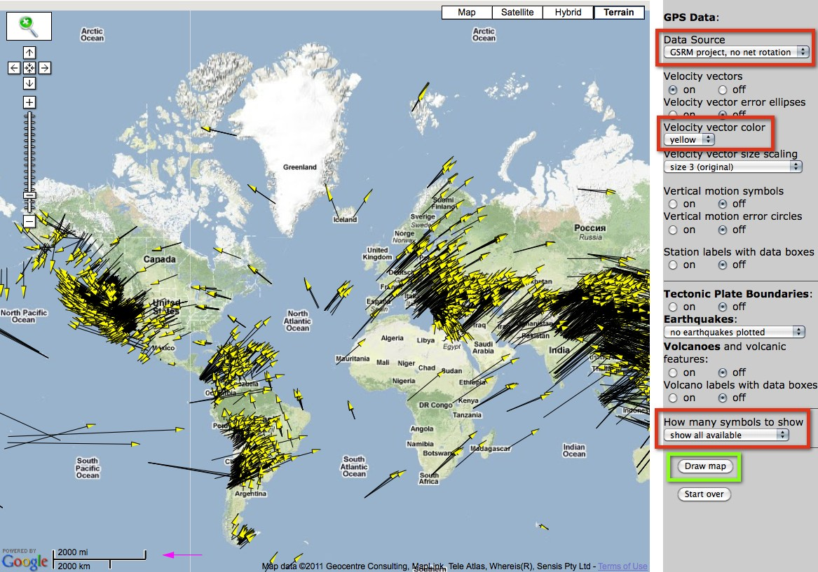
GPS Velocity Viewer
Data source: Global Strain Rate Map Project ; Reference Frame: No Net Rotation
UNAVCO GPS Velocity Viewer:
http://facility.unavco.org/data/maps/GPSVelocityViewer/GPSVelocityViewer.html
Notes:
It is the visual display of GPS, LiDAR, InSAR data, however, that helps make plate tectonics come alive for learners as a process that is happening in the present.
Reference Frame: No Net Rotation – using the velocity viewer

Slide 20
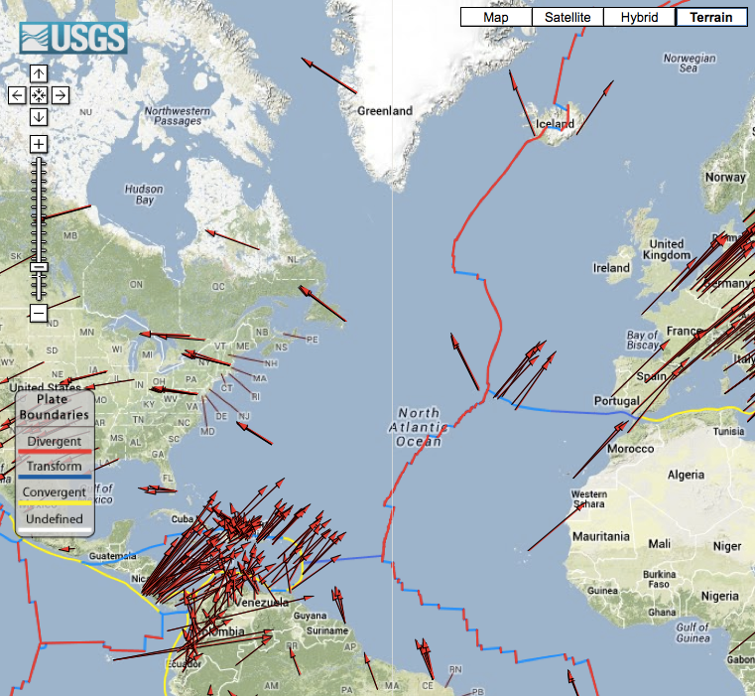
Comparing Plate Movement
GSRM Project GPS Data

Slide 21
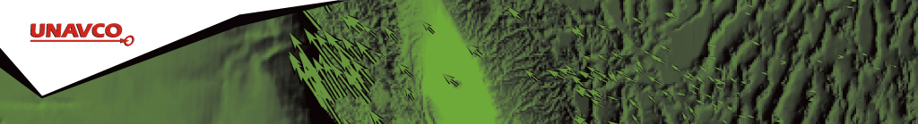
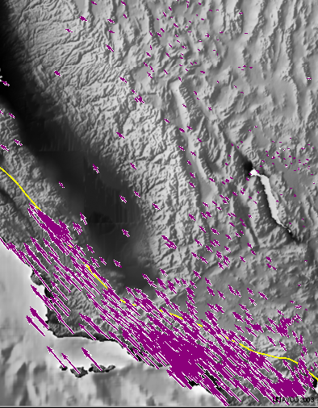
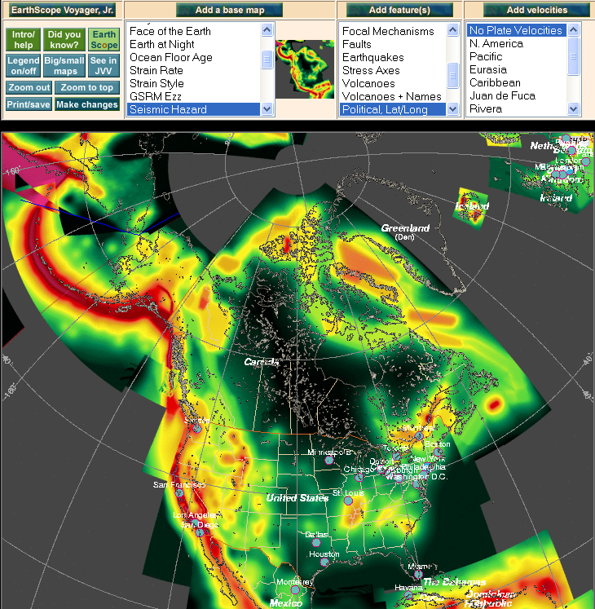
Jules Verne &
EarthScope Voyager Jr.
Seismic Hazard Map
Velocity Vectors
http://www.unavco.org/edu_outreach/maptools.html

Slide 22
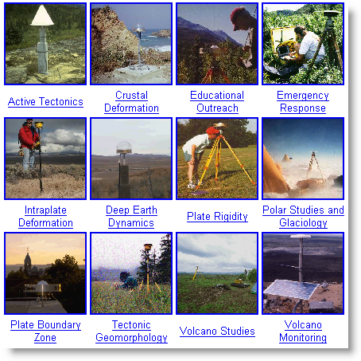
UNAVCO & PBO supported science
Plate movement
Earthquakes
Volcanoes
Glacial movements and isostatic adjustment
Hydrologic changes
Atmospheric – water vapor

Slide 23
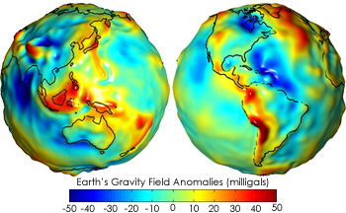
Study & Apply
Geodesy & Measuring Gravity
Geodesy is the science of …
measuring Earth’s
size,
orientation,
And
shape
Gravitational
Field
NASA GRACE
variations of these with time
Map showing variations in the strength of the gravitational force over the surface of the Earth
Blue = less gravity
Red = more gravity
23
Notes:
23
23
Traditional geodetic application is the precise positioning of points on the surface of the Earth.

Slide 24
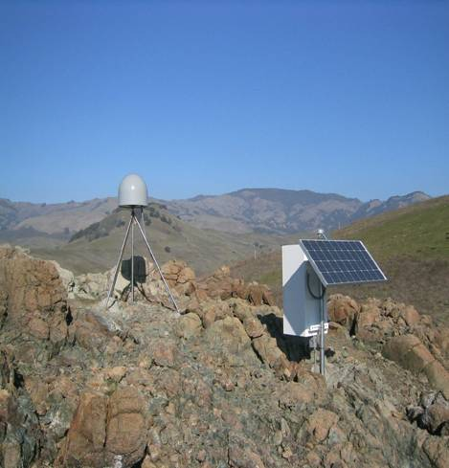
Anatomy of a High-precision
Permanent GPS Station
GPS antenna inside of dome
Monument solidly attached into the ground with braces.
If the ground moves, the station moves.
Solar panel for power
Equipment enclosure
GPS receiver
Power/batteries
Communications/ radio/ modem
Data storage/ memory

Slide 25
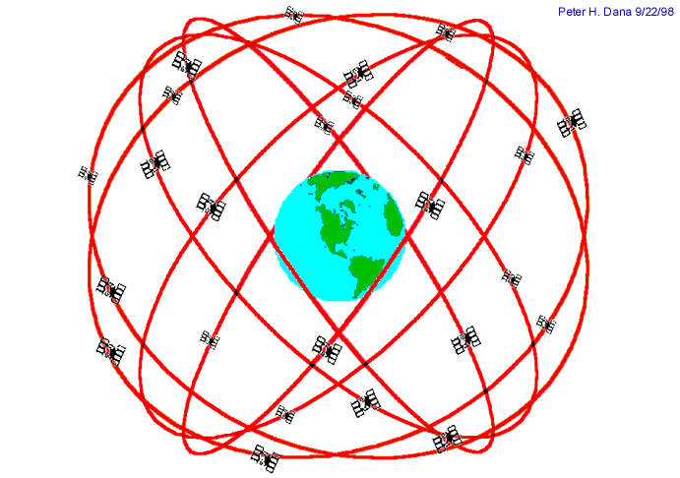

Introduction: GPS Basics
Four satellite signals are needed to locate the receiver in 3D space.
The fourth satellite is also used for time accuracy.
Position can be calculated within to a millimeter.
Needs ground control and time quality
Notes:
Also note that the GPS stations used for scientific work are more precise for many reasons: the unit uses both of the signals coming from the satellites, two the clocks are atomic rather than crystal, (see slide). These stations can measure the change in position of a location with millimeter accuracy.

Slide 26
Demonstration
Pinpoint Location With GPS
How to demonstrate this:
http://www.youtube.com/watch?feature=player_embedded&v=s_CeiMjO5Pc#!

Slide 27
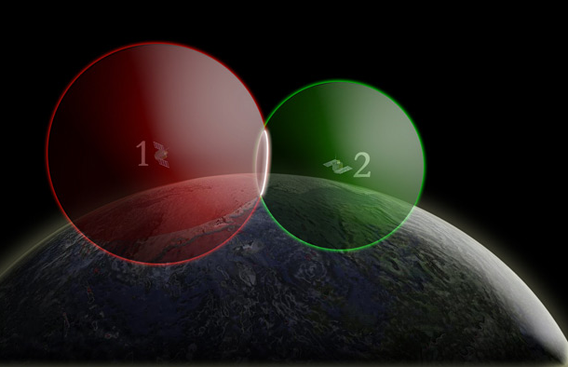
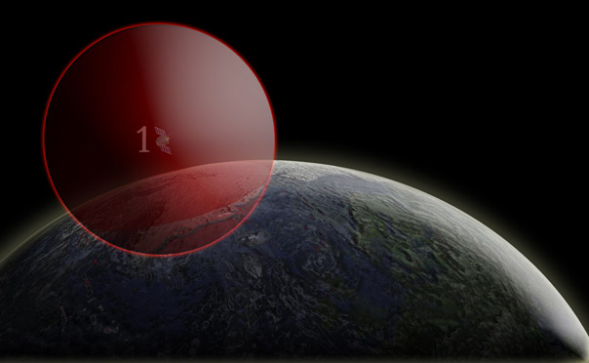
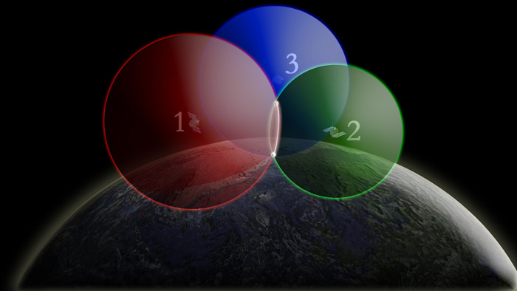
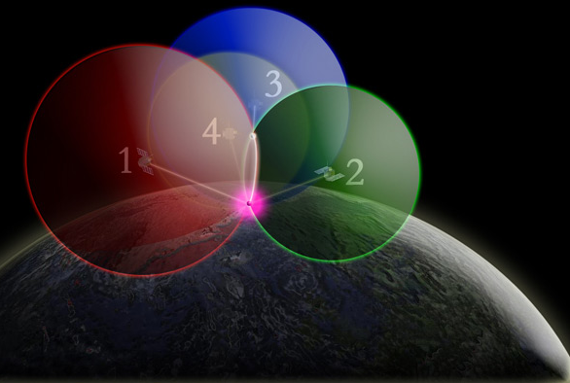
One way to find your location –
4 intersecting spheres
One satellite,
the GPS could be anywhere on the edge of the sphere.
Two satellites, GPS could be on the circle where spheres intersect.
3 satellites:
spheres intersect in 2 places.
4 satellites, spheres intersect in one place.

Slide 28
Thank You!
Contact: Shelley Olds
Education –at- unavco.org
http://www.unavco.org/
Follow UNAVCO on _________
Facebook Twitter

Slide 29
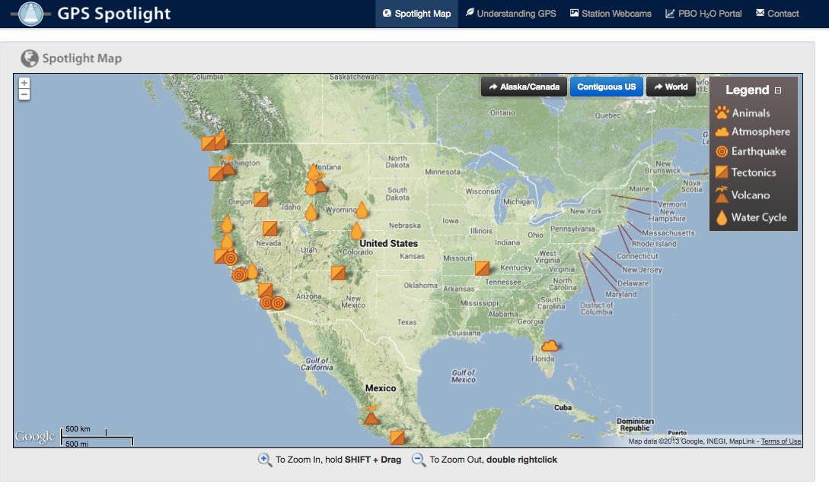
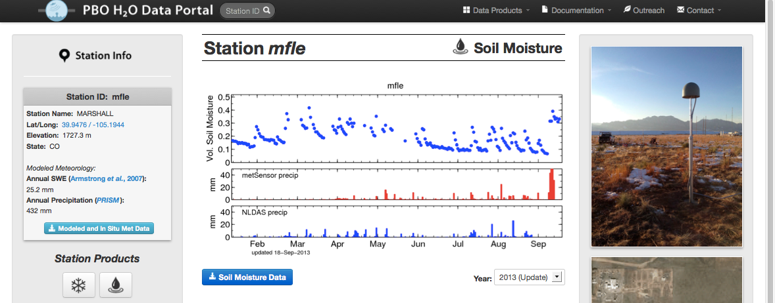
Websites shown during demonstration
Learn more about how GPS works and the science learned through research
GPS Spotlight: http://xenon.colorado.edu/spotlight/index.php
PBO H2O: http://xenon.colorado.edu/portal/index.php

Slide 30
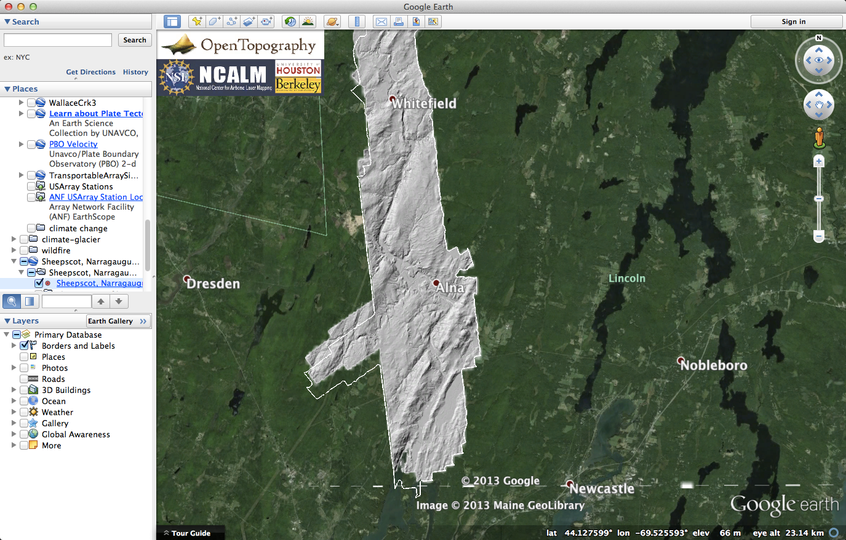
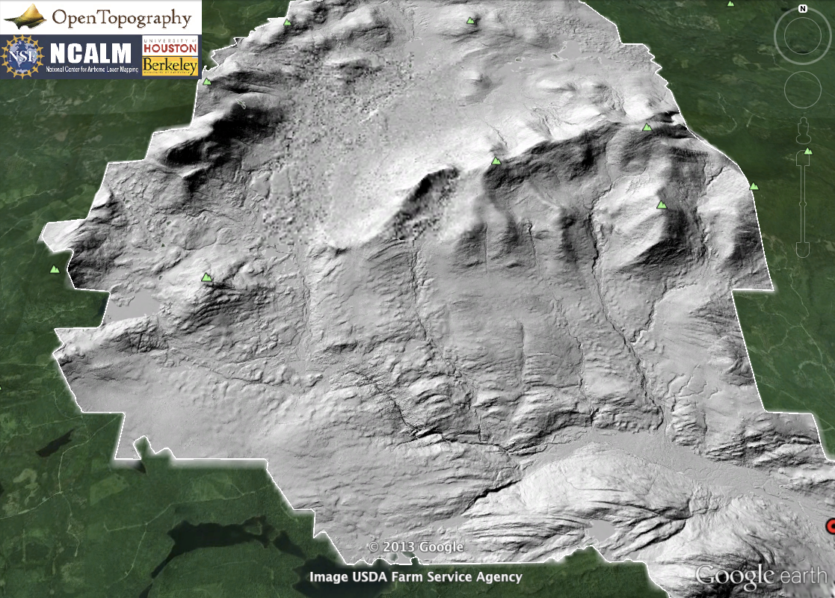
Websites shown during demonstration
See the ground and forests with LiDAR
Many places to get LiDAR!
Open Topography: http://www.opentopography.org/
New York: http://gis.ny.gov/elevation/lidar-coverage.htm
Maine: http://www.maine.gov/megis/projects/lidar.shtml
Vermont: http://vcgi.vermont.gov/warehouse/products/ALL-LDR_MIX_LIDAR_STATE_ALL
New Hampshire: http://www.granit.unh.edu/resourcelibrary/specialtopics/lidar/

Slide 31
About GRACE
http://earthobservatory.nasa.gov/Features/GRACE/page3.php

Slide 32
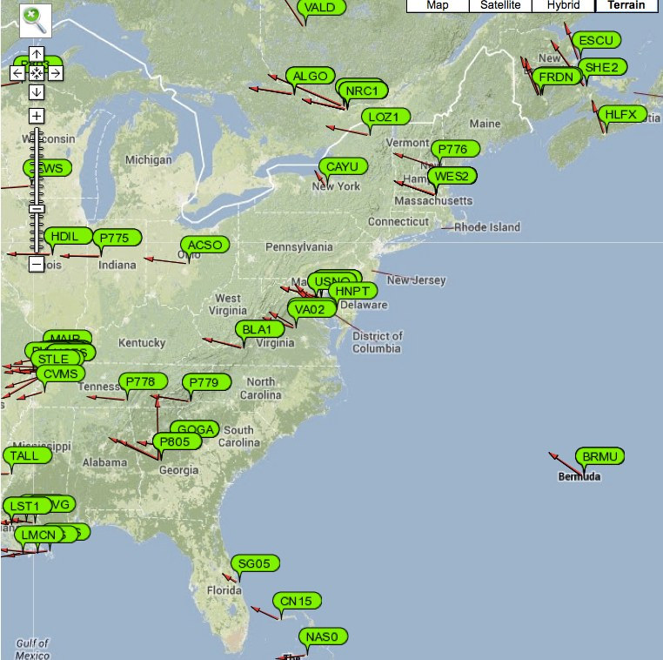
Measuring the Plates Move
UNAVCO Plate Boundary Observatory Data

